Slide 1
IMPACT OF CUSTOMER PREFERENCES ON REVENUE FOR AIRBNB

Slide 2
AGENDA
Objective
Background
Key findings
Recommendations
Appendix:
Data sources
Data model assumptions

Slide 3
OBJECTIVE
Improve business strategies and estimate customer preferences.
Get the insights from pre-Covid period from the data.
Provide early recommendations to various departments on how to tackle for post pandemic changes.

Slide 4
BACKGROUND
Manhattan and Brooklyn contributes around 90% of the revenue collected.
Staten island gets lowest count on reviews with just 1% of the total.
Availability of rooms is the lowest for Brooklyn .

Slide 5
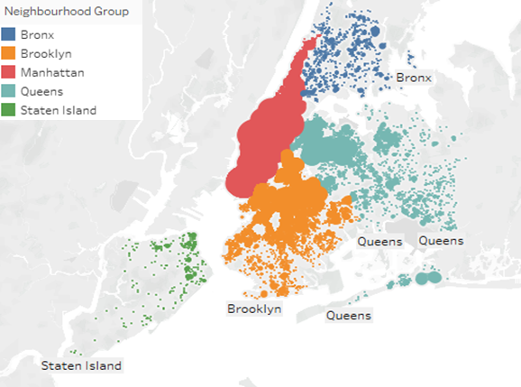
LESSER LISTINGS FROM SMALLER CITIES IS IMPACTING THE OVERALL GROWTH.
The below bubble chart shows listing count area wise:
The top 2 cities(Manhattan and Brooklyn) are contributing 90% as compared to rest.
On an average 142 is charged per night at different listings.
About 72% revenue is from entire home or an apartment followed by private room with 27%.

Slide 6
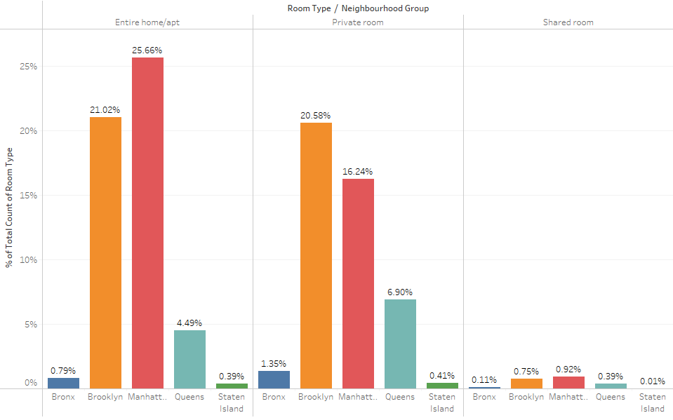
ROOM TYPE CAN HELP YOU TARGET PARTICULAR CUSTOMERS
Manhattan has more listed properties in entire room category at around 26% of the total.
About 83% of the listings are in Manhattan and Brooklyn in Entire home and Private room type.
Shared rooms are very rare in Staten island and Bronx with just 0.12%

Slide 7
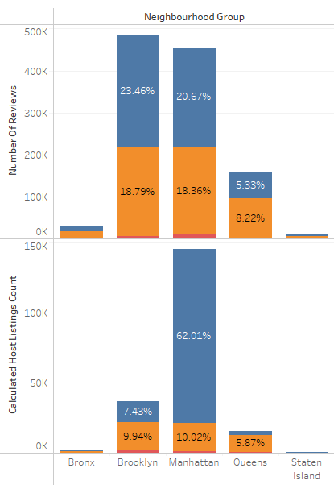
REVIEWS VS HOST LISTINGS
Manhattan has 3% more reviews although having almost 54% less listings count.
The listings count is considerably low in Manhattan by almost 54%.
Manhattan has highest listings count in Entire room category with 62%.

Slide 8
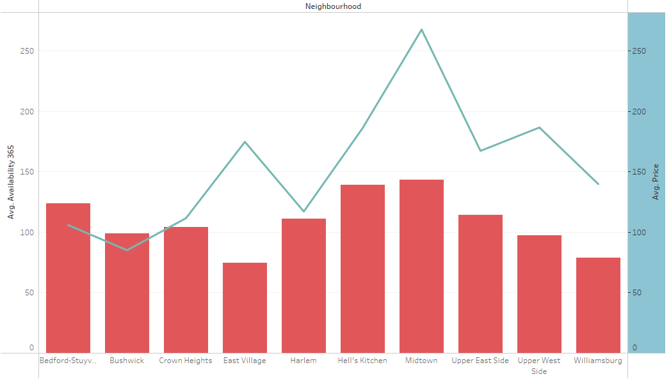
NEIGHBOURHOOD VS AVAILABILITY
The Bedford has the lowest average price despite having a high availability, so customers can be targeted here.
East village availability is low but compared to others prices are high.
Staten island has the lowest average price and availability is high.

Slide 9
AREAS OF IMPROVEMENT
Target more on the small cities.
Increase Availability in Manhattan and Brooklyn.
Reduce the price gap in entire room and private room.

Slide 10
APPENDIX - DATA METHODOLOGY
Tableau was used to get detailed insights along with location.
Used maps, bar and line charts to predict customer preferences
The data set was cleaned for null values, pivot table was used.

Slide 11
APPENDIX - DATA ASSUMPTIONS
There were certain gaps due to missing data
The count of reviews used as popularity matrix.
The latitude and longitude column is clubbed to get a exact location on map.
The 20% of the null values were deleted.

