Slide 1
Anugrah group scam

Slide 2

Group no 6
Avinandita – 1918
Nidhi – 1922
Bipin – 1926
Vishal - 1940

Slide 3

What is the issue ?
Over Rs1,000 Crore at Risk at Anugrah Stockbrokers and Associates?
Anugrah and one of its associates, Teji Mandi Analytics Pvt Limited, ought to have been on the regulator’s radar since they have both been fined in the past.
Unauthorised derivatives advisory service (DAS) through an associate firm called Om Shri Sai Investments (OSSI) since 2017.

Slide 4



Who were the people involved ?
Investors Here is some feedback from investors, whose names have been changed. Arvind Sinha thinks Teji Mandi is a sub-broker of Anugrah and is “running some algo based trading in F&O segment (only options of Nifty and Bank Nifty) across all clients.” He says, “We are not asking for losses to be repaid, but what about the balance that is with the firm?
Om Shri Sai Investments (OSSI)
Teji Mandi Analytics Pvt Limited

Slide 5


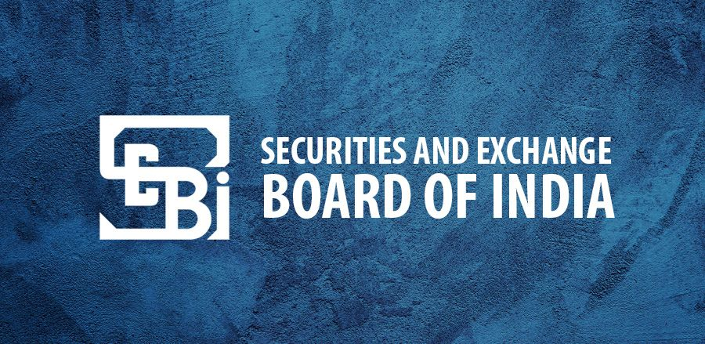
Where was the failure of the system?
One investor had demanded a closure of his trading account and alleges that he has “identified fake contract notes………….
Another investor, using a pseudonym, says that a group of investors has collectively invested over Rs19 crore through the associate of Anugrah (who he does not name but is in all probability it is Teji Mandi Analytics).
Some of them have found stocks missing from their demat accounts.

Slide 6



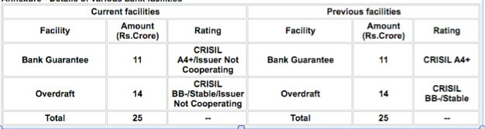

Who were the main accused ?

Slide 7



What preventive measures should be taken that such instances do not happen in future?
Current Stage of the Case
1. Defaulter
2. Interim orders
3. Long Process of Investigations
4. Investors to file claims with the exchange
Preventive Measures
1. New norms on margin pledging
2. Changed focus of Audit
3. Clients need to stay on guard

Slide 8
Thank you
“Money is hard to earn and easy to lose,
Invest your hard earned money wisely”

