Slide 1
Retail Sales Performance Analysis
Exploratory Data Analysis using Python
Tools: Python | Pandas | Matplotlib | Data Cleaning | EDA

Slide 2
Project Objective & Business Questions
Goal:
Analyze retail sales data to understand revenue trends, product performance, sales channels,
geographic performance, and customer acquisition.
Key Questions:
How is revenue changing over time?
Which product categories generate the most revenue?
Which sales channels contribute the most?
Which cities are the strongest performers?
Which customer acquisition channels generate the most revenue?
Does discounting appear to influence revenue?

Slide 3
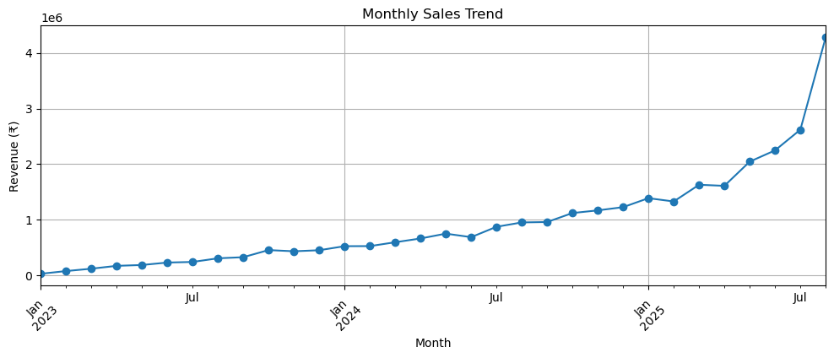
Revenue Shows Positive Growth Over Time
Key Insight
Revenue shows an overall upward trend, with stronger growth toward the later months of the analysis period.
Business Implication
The business appears to be experiencing positive sales momentum and should investigate the factors driving the recent growth.

Slide 4
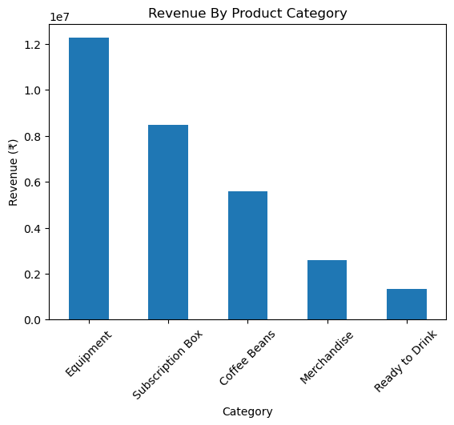
Equipment Leads Revenue Generation
Key Insights:
Equipment is the highest revenue-generating category.
There is a clear gap between Equipment and the lower-performing categories.
Business Implication:
Investigate what drives Equipment's strong performance while identifying opportunities to improve weaker categories.

Slide 5
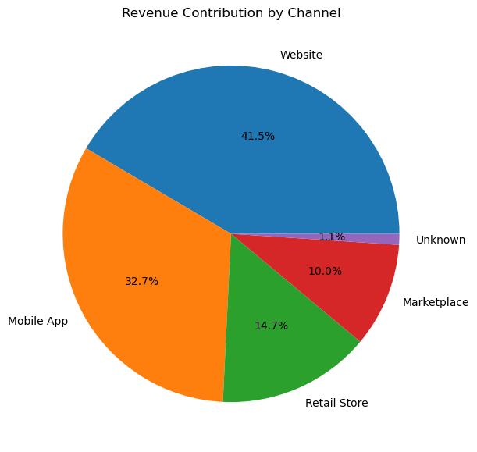
Digital Channels Drive 74% of Revenue
Key Finding:
Website + Mobile App = 74% of total revenue
Business Implication:
Continue optimizing digital customer journeys and investigate opportunities to increase performance in lower-contributing channels.

Slide 6
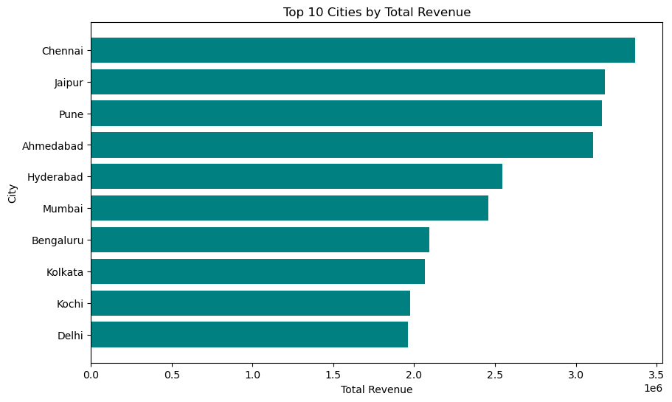
Chennai Leads Revenue Among Analyzed Cities
Key Insights:
Chennai generates the highest revenue among the analyzed cities.
Business Implication:
High-performing cities could be prioritized for expansion, while lower-performing cities can be investigated for growth opportunities.

Slide 7
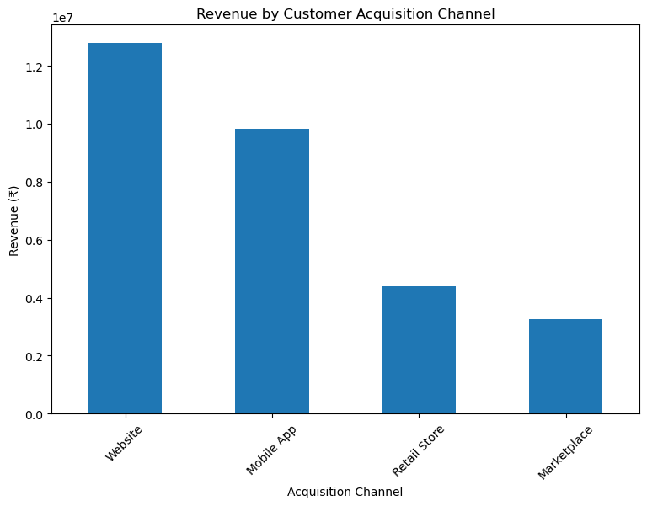
Website Acquisition Generates the Highest Revenue
Key Insights:
Website-acquired customers generate the highest total revenue.
Mobile App acquisition is the second-largest contributor.
Business Implication:
The company should investigate which acquisition campaigns and customer behaviors are driving the strong performance of digital acquisition channels.

Slide 8
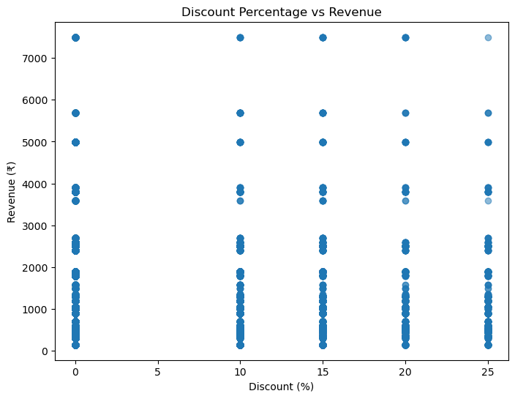
Discounting Does Not Show a Clear Revenue Relationship
Key Insight:
Revenue values are distributed across all discount levels.
No clear upward or downward trend is visible between discount % and revenue.
Business Implication:
Discounting alone may not be a strong driver of revenue. The company should evaluate discounts alongside factors such as product, quantity, customer, and sales channel before changing discount strategy.

Slide 9
Key Findings & Business Recommendations
Key Findings:
01 — Revenue is growing Overall sales show positive momentum over time.
02 — Equipment is the strongest category It generates significantly more revenue than the other categories.
03 — Digital channels dominate Website and Mobile App account for the majority of channel revenue.
04 — Revenue is geographically concentrated A few cities contribute strongly to overall revenue.
05 — Website acquisition performs strongly Website-acquired customers generate the highest total revenue.
Recommendations
→ Invest in high-performing digital channels → Understand the drivers behind Equipment's performance → Develop city-specific strategies → Investigate lower-performing categories and channels → Perform deeper customer-level analysis in future work

