Slide 1
2023 Sept 18
SIT Blockchain
Hackathon
Team Name: SyntaxError
Nikhil Waghmode
Sujal Bagade
Dr. D. Y. Patil Institute of Technology, Pimpri, Pune.
Dr. D. Y. Patil Institute of Technology, Pimpri, Pune.

Slide 2

Blockchain-Based Voting System
PROBLEM STATEMENT 1
Smart Contract Description
This smart contract, created within Remix IDE, constitutes a vital component of a blockchain powered voting system, providing a secure and transparent platform for casting and recording votes. Voters interact with the contract by submitting their unique voter IDs and specifying their chosen party or candidate. The contract meticulously records these selections in an array, establishing an immutable record of voter decisions on the blockchain. Once a vote is committed, it becomes impervious to alteration or manipulation, ensuring the integrity and authenticity of the entire electoral process. This smart contract stands as a fundamental example of how blockchain technology can bolster the trustworthiness of voting systems by guaranteeing the permanence of voter choices and fostering transparency at every step.
2

Slide 3
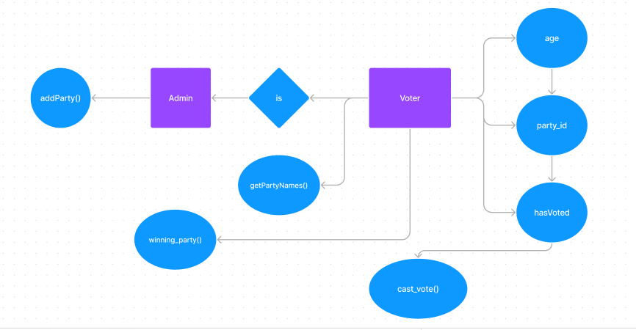
Blockchain-Based Voting System
FLOWCHART

Slide 4
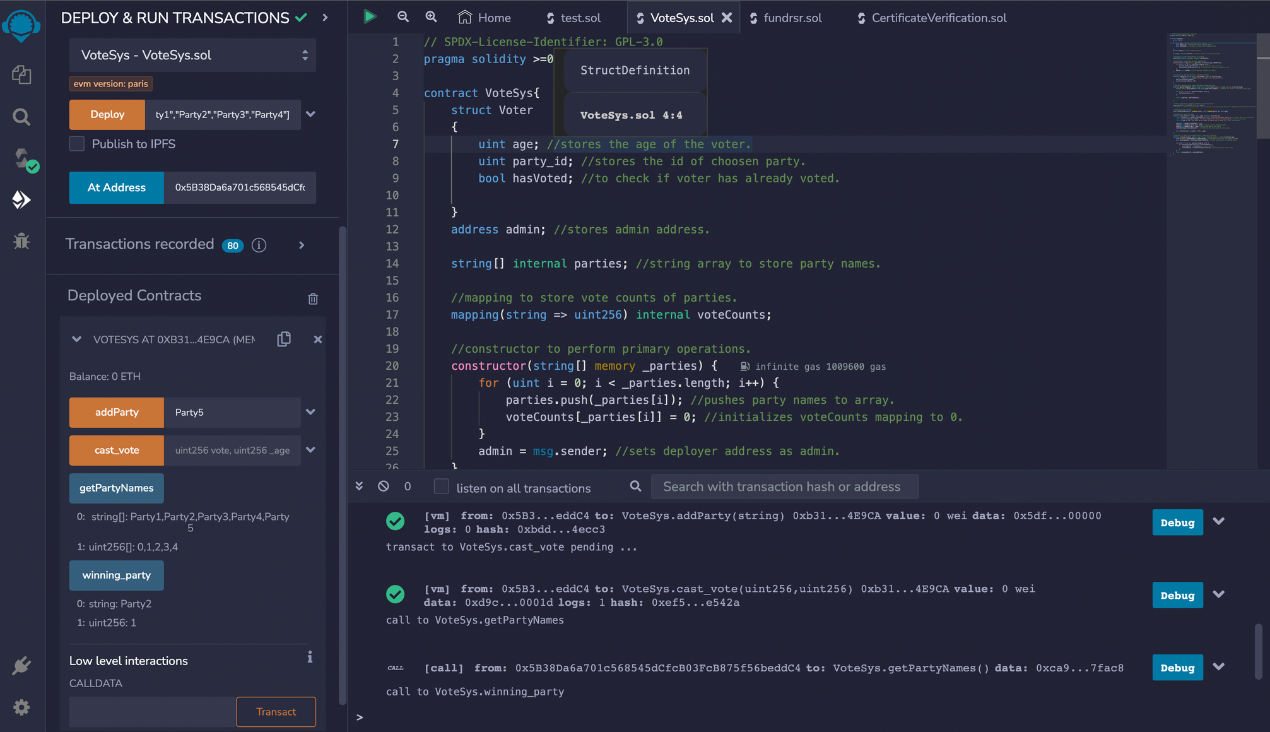
Blockchain-Based Voting System
SCREENSHOT

Slide 5
Blockchain-Based Academic Certificate Verification System
PROBLEM STATEMENT 2
Smart Contract Description
This smart contract, constructed within the Remix IDE, plays a pivotal role in a blockchainpowered academic certificate verification system, addressing the challenges of certificate authenticity. Educational institutions, acting as administrators, employ this contract to issue digital academic certificates to students, including pertinent details such as the student's name, earned degree, and issuance date. The contract registers these certificates securely on the blockchain, ensuring they remain tamper-proof and immutable. Additionally, it offers a mechanism for anyone, be it employers or institutions, to effortlessly verify the legitimacy of these certificates by consulting the blockchain. This smart contract illustrates how blockchain technology enhances transparency, security, and trust in the academic credential verification process.
2

Slide 6
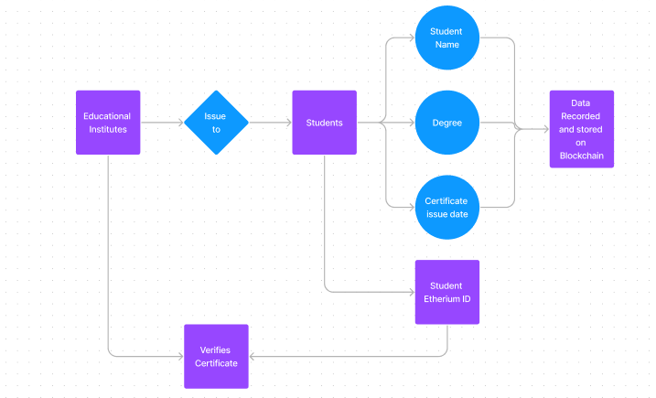
Blockchain-Based Academic Certificate Verification System
FLOWCHART

Slide 7
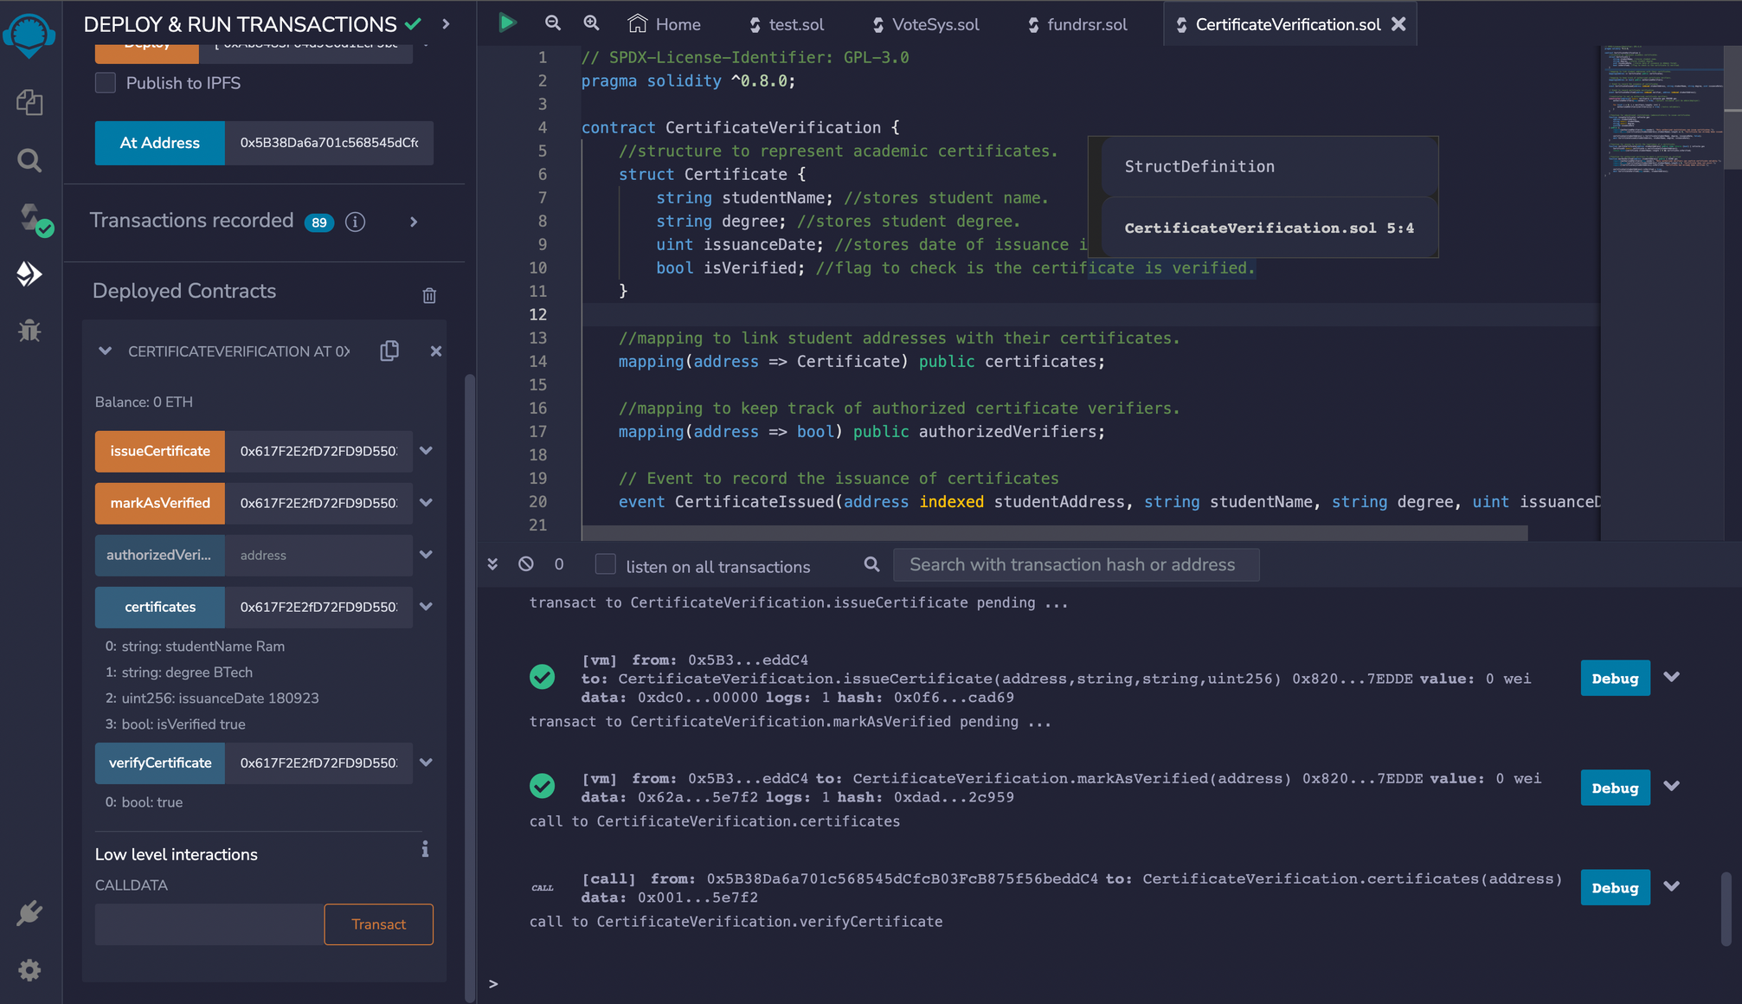
Blockchain-Based Academic Certificate Verification System
SCREENSHOT

Slide 8
Blockchain-Based Digital Art Ownership Tracking System
PROBLEM STATEMENT 3
Smart Contract Description
This smart contract, developed within Remix IDE, forms the core of a blockchain-based system for tracking the ownership and provenance of digital art pieces. It focuses solely on the smart contract's functionality without considering user interfaces. The contract demonstrates how blockchain technology can be applied to securely and transparently manage ownership of digital artworks. It enables artists to register their digital creations on the blockchain, associating each artwork with a unique identifier. Additionally, it facilitates the transfer of ownership from the artist to a collector by updating the blockchain record. The contract further offers a straightforward method for anyone to verify the current owner of a digital art piece by consulting the blockchain, emphasizing the immutability of blockchain records.
2

Slide 9
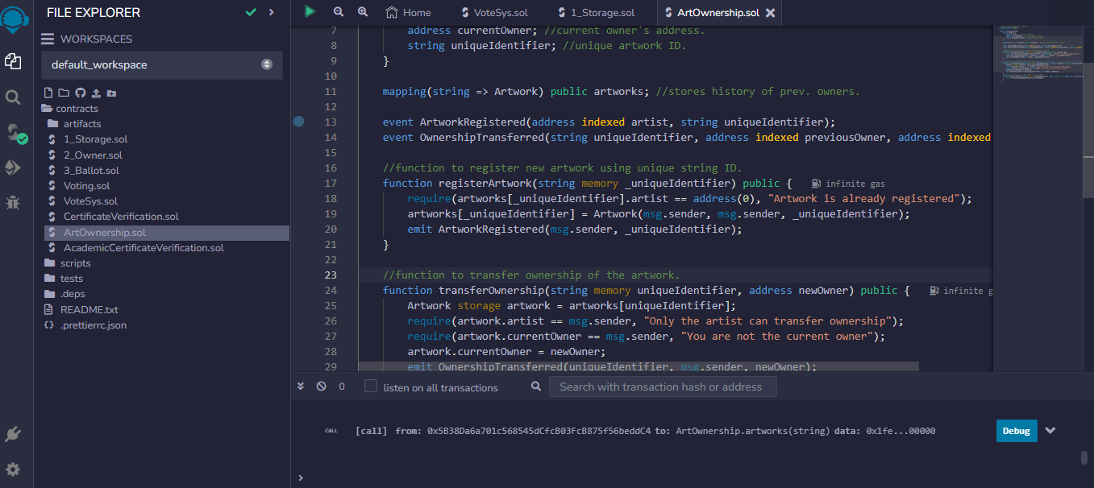
Blockchain-Based Digital Art Ownership Tracking System
SCREENSHOT

Slide 10
Thank you

