Slide 1
Procurix
WCC LAUNCHPAD 30 · TRACK 01: AGENTIC AI
17
agent tools
43B(h)
tax compliance engine
An AI buyer that gets quotes, picks the best supplier, and makes sure small suppliers are paid on time.
Live
reverse auctions
PROBLEM STATEMENT
Buying supplies, and paying small suppliers on time (Section 43B(h), Income Tax Act)
Working
software, not a concept
Nikhil Yadav
github.com/NikhilYadav04/procurement_ai
Notes:
Open with the one-line pitch: you say what you need to buy, the agent emails suppliers, reads quotes, recommends one, and watches the payment deadline. It is working software, code is on GitHub.

Slide 2
Buying is email. Paying late now costs tax
THE PROBLEM
WHAT ONE PURCHASE COSTS TODAY
SECTION 43B(h), INCOME TAX ACT
5 mails
Written one by one, spec pasted in each time
45 days
2 weeks
Waiting, then chasing the ones who stay quiet
Maximum time to pay a Udyam-registered micro or small supplier
15 days
By hand
Every quote retyped into Excel to line them up
If there is no written payment term, which is most SME buying
Not comparable
"Net 30" vs "50% advance", so only price decides
3× bank rate
Interest, compounded monthly, and not deductible
Lost
Why a supplier was chosen leaves with the inbox
Miss it and the deduction moves to the year you pay. Deferred, not forgiven.
Nothing happens on day 46. The firm finds out at audit, ten months later, when nothing can be done.
Notes:
Two problems in one. Buying is manual and unstructured. And since FY 2023-24, paying a micro or small supplier beyond 45 days (15 without a written term) makes that expense non-deductible until paid. There is no alert on day 46.

Slide 3


Built for the one-person procurement team
TARGET USERS
PRIMARY USER
BENEFITS WITHOUT LOGGING IN
The SME buyer
The MSME supplier
₹5 Cr to ₹500 Cr turnover. Construction, manufacturing, facilities, hospitality. Often the founder or a site engineer. No procurement software: Ariba and Coupa are built and priced for enterprises.
Never logs in. Replies by email or opens an auction link. Gets paid on time because the buyer can finally see the deadline.
₹5–500 Cr
20–100
Every week
Email + Excel
turnover range
suppliers, mostly small local firms
repeat buys: steel, furniture, fasteners, safety gear
what they use today
Not for: large enterprises already on a procure-to-pay suite, government tendering, or consumer buying. The wedge is firms with the same legal duty as an enterprise but no system at all.
Notes:
The buyer is the person who IS the procurement department. The supplier never has to adopt anything, which is why this can actually spread.

Slide 4
Why it has to be an agent, not a form
WHY AN AGENT
1
2
3
You don't control the input
It is a chain, not one step
The criteria change every time
Quotes arrive as scans, photos and mail text. Portals make suppliers fill a form first, which is why they never reach Indian SMEs. An agent reads whatever arrives.
One sentence becomes eight steps over days. A revised price or a late reply can show up at any point, so the branches cannot be drawn in advance.
Cheapest is not best. One month delivery decides, the next month payment terms. And always: is this supplier MSME, because that sets the legal deadline.
Defeats: a form
Defeats: a workflow engine
Defeats: a chatbot that only answers
So Procurix reads the mess, plans the chain, and acts on your criteria.
Notes:
Each property rules out a simpler tool. This is the answer to "why not just a form or a chatbot".

Slide 5
One chat box runs the whole buying loop
THE SOLUTION
1 Describe it
2 RFP drafted and sent
3 Quotes read from email
4 Ranked on your weights
5 Award, PO issued
6 Payment clock watched
OR JUST ASK IT
I need 250 workstation desks. Get quotes from Kumar, Rapid and Godrej
"What quotes are waiting on me?"
"Am I at risk on any MSME payments?"
PROCUREX AGENT
"Draft a counter-offer to Godrej"
RFP sent from your Gmail, 3 quotes read. Here is the ranking:
Kumar | ₹31.2 L | Cheapest, but 45 days out
Rapid | ₹33.5 L | 21 days, wants half up front
Godrej | ₹34.8 L | Dearest, longest warranty
"Start a reverse auction for the desks"
"Record the invoice for PO-9005"
"Add these 12 vendors"
You raise the delivery weight, ranking flips to Rapid, you approve, PO is issued
"Generate this month's report"
Notes:
Walk the example: one sentence in, RFP out, PDFs read, ranking back with reasons. Changing the delivery weight reorders the ranking. Every purchase order passes an approval.

Slide 6
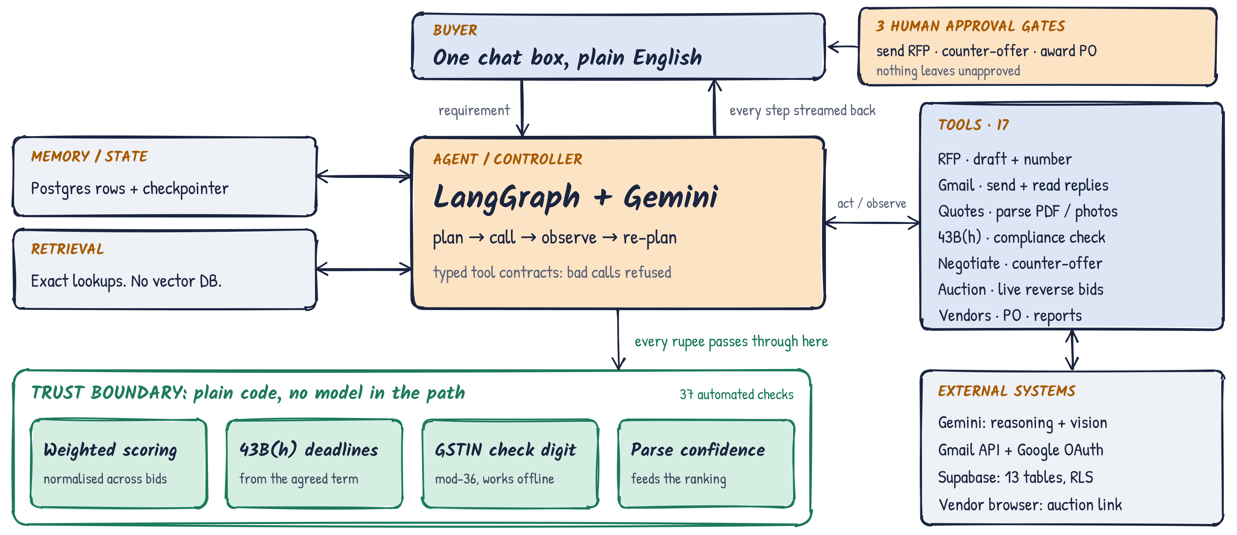
The agent decides. Plain code computes.
SYSTEM ARCHITECTURE
Notes:
Left to right: memory and retrieval feed the agent, the agent calls 17 tools. Anything involving money passes through the green trust boundary, which is plain code with no model in the path. Three human approval gates sit on top.

Slide 7
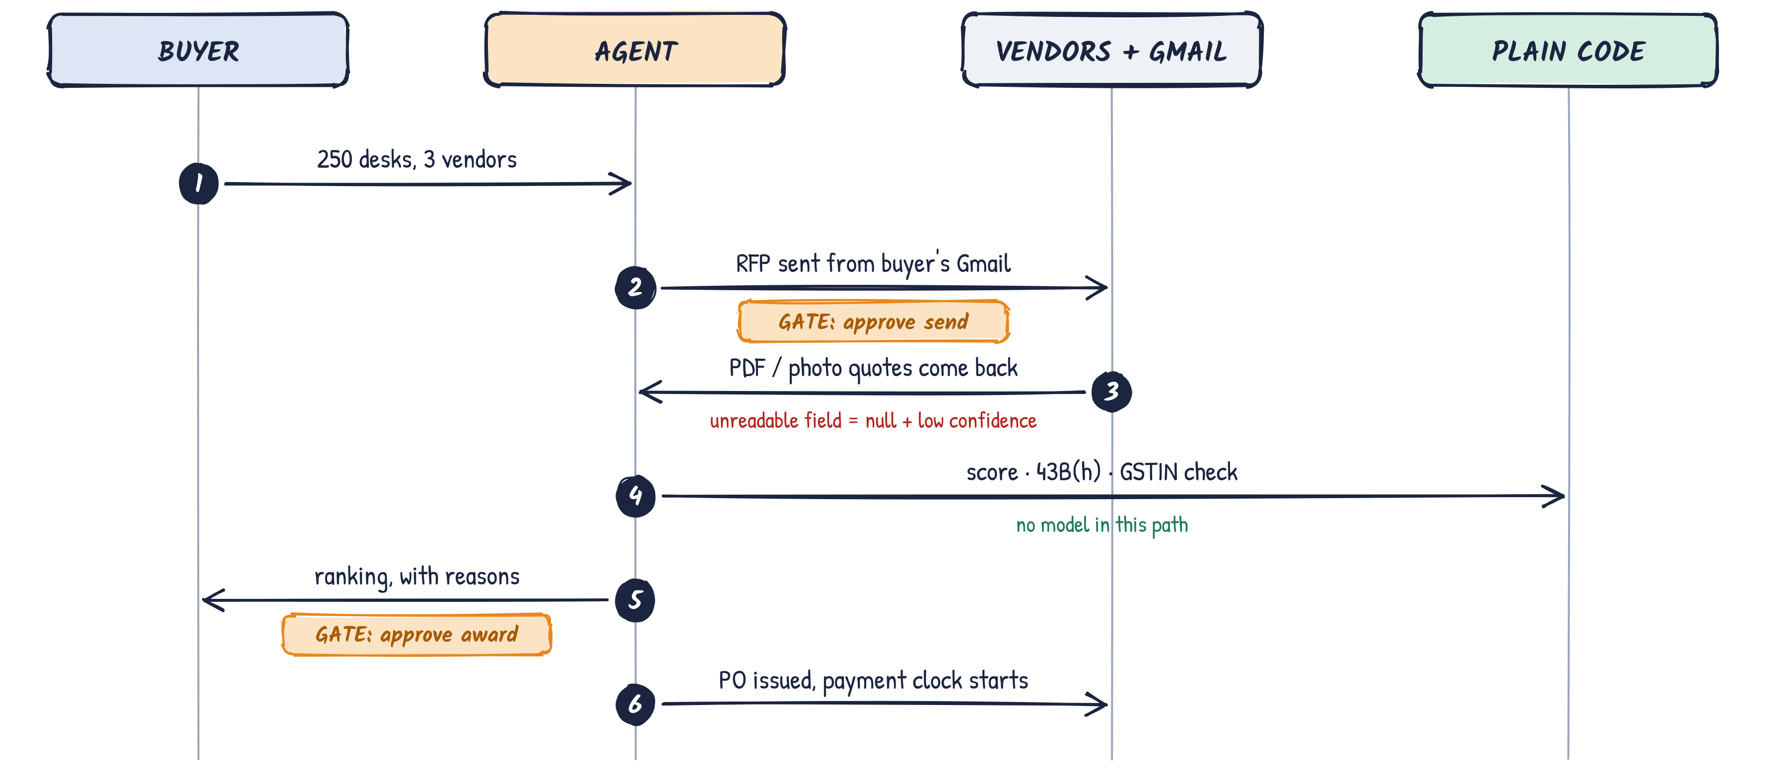
One request, end to end
HOW IT RUNS
Notes:
Six steps. Two approval gates. An unreadable field comes back as null with low confidence, never a guess. Scoring and tax checks never touch the model.

Slide 8






It sends the mail and reads the reply
AGENTIC BEHAVIOUR
PLANNING
DECISION-MAKING
MULTI-STEP
One sentence, one plan
It knows when to stop
Works across days
Resolve vendors, draft, number, send. The plan is rebuilt after every result.
Picks tools and vendors. Pauses for approval before send, negotiate and award.
RFP on Monday, quotes on Thursday. State lives in Postgres, so a restart loses nothing.
TOOL USE
EVALUATION
ADAPTATION
17 tools, typed contracts
Plain code does the maths
It adapts mid-flight
Bad arguments are refused before they reach code. Each result shapes the next step.
Scores, deadlines and GSTIN checks are plain code, backed by 37 automated checks.
Change a weight and the ranking reorders. Late replies rejoin. Unsure fields return null.
Notes:
This is the slide for the rubric: planning, decision-making, multi-step execution, tool use, evaluation, adaptation. Each has one concrete proof point.

Slide 9
Measured on the running system
EXPECTED IMPACT
QUOTE VALUE, ₹ LAKH
THE EXPOSURE NOBODY SEES
₹4.6 L
Extra tax due this year on one unpaid ₹18.40 L invoice to a micro supplier, past its 30-day term. Plus interest at 3× bank rate, compounded.
The fix costs nothing: pay on day 44, not day 46. The value is that somebody knew.
Winning quote vs highest quote on the same requirement.
43B(h) binds every Indian buyer with MSME suppliers from FY 2023-24.
Notes:
Savings come from buying on merit, not first reply. The bigger number is the tax exposure from one late payment. Be ready to say these figures come from test requirements run through the live system.

