Slide 1
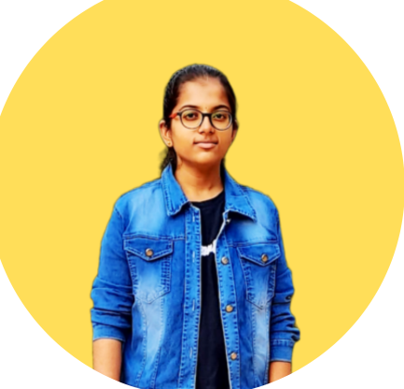
STUDENT DETAILS
Name: BeeReddy Nikhila
Skills Build Email Id: nikhilabeereddy@gmail.com
College Name: Sri Indu College Of Engineering And Technology
College State: Telangana
Internship Domain: Front End Development
Internship Start And End Date: 05-06-2023 To 15-07-2023

Slide 2

PORTFOLIO
PROJECT TITLE

Slide 3
AGENDA
Project Overview
Who are the End Users of this Project?
Value proposition
Customization of my Project
Modelling
Results
Links

Slide 4
Project Overview
This website comprises several sections, including a home section, an about section, a services section, a projects section, and a contact section. The home section serves as an introduction to my work and showcases my skills. In the about section, visitors can find comprehensive information about me and my background. The services section provides an exhaustive list of all the services I offer. For the projects section, I showcase my projects through images, links, and detailed descriptions. To facilitate communication with visitors, the contact section includes a contact form. Additionally, I have added a footer that allows users to connect with me through various social media platforms.
The primary purpose of this website is to showcase my skills and work in a visually appealing manner while ensuring easy navigation for all end-users.

Slide 5

Who are the End Users of this Project?
Portfolios are commonly used across various industries and professions to present one's capabilities and accomplishments in a visually appealing and organized manner.
End Users:
Potential clients
Recruiters and hiring managers
Companies and organizations

Slide 6
For potential clients, a portfolio provides a glimpse into the individual's past projects, highlighting the quality of their work and the solutions they can deliver. It enables clients to make informed decisions when considering engaging the individual's services, as they can assess whether their skills align with the specific requirements of the project.
Recruiters and hiring managers often rely on portfolios to evaluate candidates during the hiring process. By reviewing the individual's portfolio, they can assess the candidate's suitability for a particular job role, understand their strengths and areas of expertise, and gauge their level of experience and professionalism.
For companies and organizations seeking to collaborate with professionals in various fields, portfolios serve as a valuable tool to shortlist potential partners. Companies can evaluate the individual's past work and assess their ability to meet the company's requirements and standards. A compelling portfolio can instill confidence in companies, encouraging them to consider the individual for potential partnerships and collaborations.

Slide 7

Value Proposition
My portfolio addresses the needs of the end users by showcasing my skills, work in visually appealing way that makes it easy for potential clients, recruiters, hiring managers and companies to navigate and learn more about me.
Moreover, the website effectively communicates why they should choose me for their service requirements over other alternatives.
By highlighting my unique value proposition, past accomplishments, and commitment to delivering exceptional results, it establishes a compelling case for selecting me as their preferred choice for services.

Slide 8

CUSTOMIZATION
I have curated a collection of photos, illustrations, and screenshots in my portfolio.

Slide 9
MODELING
Web Languages used:
HTML, CSS and JavaScript
Framework used:
Bootstrap
Other Animation tools:
AOS, animate.style, Bootstrap icons, favicon, Google fonts

Slide 10
RESULT
A screen recorded video is presented in the next page to show result of my project.

Slide 11
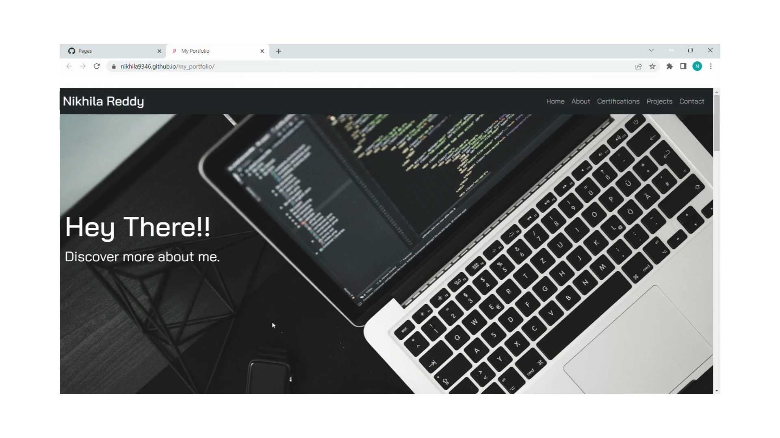

Slide 12

LINKS
GitHub:
https://github.com/Nikhila9346/my_portfolio
Live Site:
https://nikhila9346.github.io/my_portfolio/

Slide 13
THANKYOU

