Slide 1
BAR CODE SCANNER MVP
By,
ASETeam12-
Sai Teja,
Nikhila,
Divya,
Arun

Slide 2

MVP and Viral Coefficient:
A minimum viable product (MVP) is a development technique in which a new product or website is developed with sufficient features to satisfy early adopters. The final, complete set of features is only designed and developed after considering feedback from the product's initial users.
Viral Coefficient is a quantitative measure of virality. Often calculated as the average number of invitations sent by each existing user times the conversion rate of invitation to new user.

Slide 3


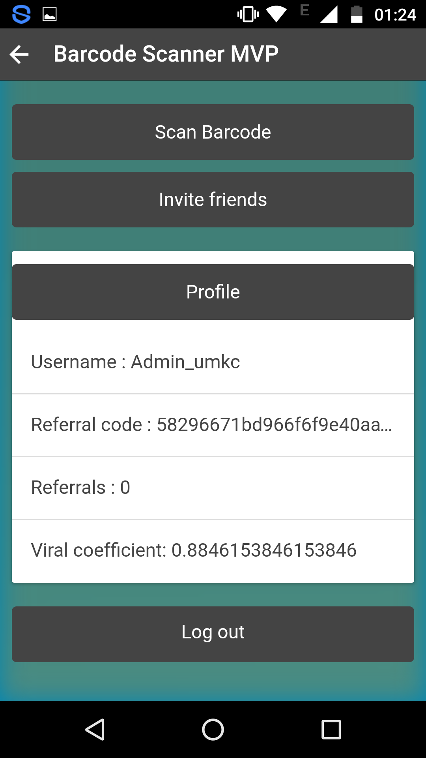

Slide 4




Slide 5

