Slide 1

Bapatla Engineering College: Bapatla – 522102
(Autonomous)
Department of Computer Science and Engineering
EFFICIENT NUMBER PLATE RECOGNITION SYSTEM FOR DETECTING HELMETLESS RIDERS USING DEEP LEARNING MODELS
Presented by
R.Nikhila Sri Mahalakshmi[Y21ACS559]
R.B.V Jahnavi[Y21ACS550] N.Eswar[Y21ACS528]
R.JaganMohan[Y20ACS543]
Batch No - C8
Under the Guidance of
Mr.K.SUMAN,M.Tech
_{Assistant Professor}

Slide 2
Agenda
Problem statement and objectives :
Engineering Knowledge
Analysis:
Existing Methodologies
Literature review
Problem formulation with objectives
Design Methodology
Project Planning and Teamwork
Hardware and Software Requirements

Slide 3
Problem Statement and Objectives
Problem Statement: Many two-wheeler riders violate traffic rules by not wearing helmets, leading to increased road accidents. So we are developing a system that detects helmetless riders and extract their number plates.
Objectives:
This system aims to reduce manual effort in traffic rule enforcement by providing an automated and accurate solution for identifying violations.
By ensuring real-time detection of helmetless riders and capturing their number plates, the project seeks to assist traffic authorities in enforcing laws more effectively.
The ultimate goal is to enhance road safety, encourage helmet compliance, and minimize accidents caused by the negligence of riders.

Slide 4
Engineering Knowledge
The detection of helmetless riders and number plate recognition integrates deep learning models with computer vision techniques to analyze video frame by frame. This ensures accurate and real-time detection, helping automate traffic law enforcement by identifying violators and extracting vehicle number.
Key Technologies:
Deep Learning for Object Detection:We use YOLOv8 (You Only Look Once), a CNN-based object detection model, to detect motorcycles, riders, helmets, and number plates with high accuracy.
Optical Character Recognition :We use Tesseract OCR, a deep learning-based text recognition model, to extract alphanumeric characters from number plates.
Computer Vision for Video Handling :We use OpenCV (cv2) for handling and displaying video frames in Google Colab.

Slide 5
Analysis
Existing Methodologies:
YOLOv3, a real-time object detection algorithm, can be trained to identify objects like people, motorcycles, helmets, and number plates in images or video streams.The real-world scenarios (e.g., varying lighting conditions, different vehicle types, etc.) can pose challenges for YOLOv3's performance .
YOLOv4 is a powerful and efficient object detection model that balances speed and accuracy, making it a popular choice for various real-time applications,but in case of smaller objects, similar objects in close proximity, and varying lighting conditions it doesnot perform well.
YOLOv5 algorithm performs inference on video frames, predicting bounding boxes around detected helmets.It is not effective when there are objects with irregular shapes or sizes, as well as potential for false positives/negatives, and a need for large datasets for optimal

Slide 6
Literature Review
Rajnandani Choubey, Saloni Sharma, Saloni Mourya, Aditya Narayan, Dhruv Bhargav, “Helmet and Number plate detection by using yolo and open cv”,January 2025 International Journal of Engineering Applied Science and Management,ISSN (Online): 2582-6948 Vol. 6 Issue 1.
Priyanshi Tripathia,Pragati Singha,Mantsha Banoa,Komal Sharmaa,Abhishek Shahib,”A Review on Helmet and Number Plate Detection”,International Journal of Research Publication and Reviews, Vol 4, no 5, pp 2473-2484 May 2023.
A. V. Raju and K. N. A. Rao “Efficient License Plate Recognition Using YOLO Object Detectionand Optical Character Recognition” 2021.

Slide 7
Problem Formulation with Objectives
Problem Overview:
Traffic violations, especially riders not wearing helmets, are a major cause of road accidents and fatalities. Manual enforcement of helmet laws is inefficient, time-consuming, and prone to human error. Additionally, tracking and identifying violators is difficult without an automated system. To enhance road safety, a real-time detection system is needed to automatically identify helmetless riders and extract their number plates for enforcement actions.
Problem Definition:
The project aims to develop an automated system that can detect motorcycle riders without helmets in real-time using YOLOv8 and identify the vehicle’s number plate using deep learning and OCR (Optical Character Recognition).Store violation details to assist traffic authorities in enforcing helmet laws.Improve road safety by ensuring effective law enforcement with minimal human intervention.

Slide 8
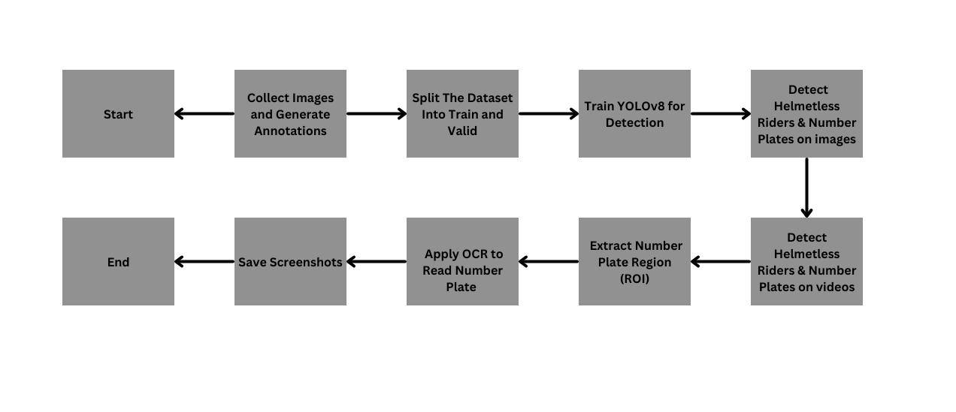
Design Methodology

Slide 9
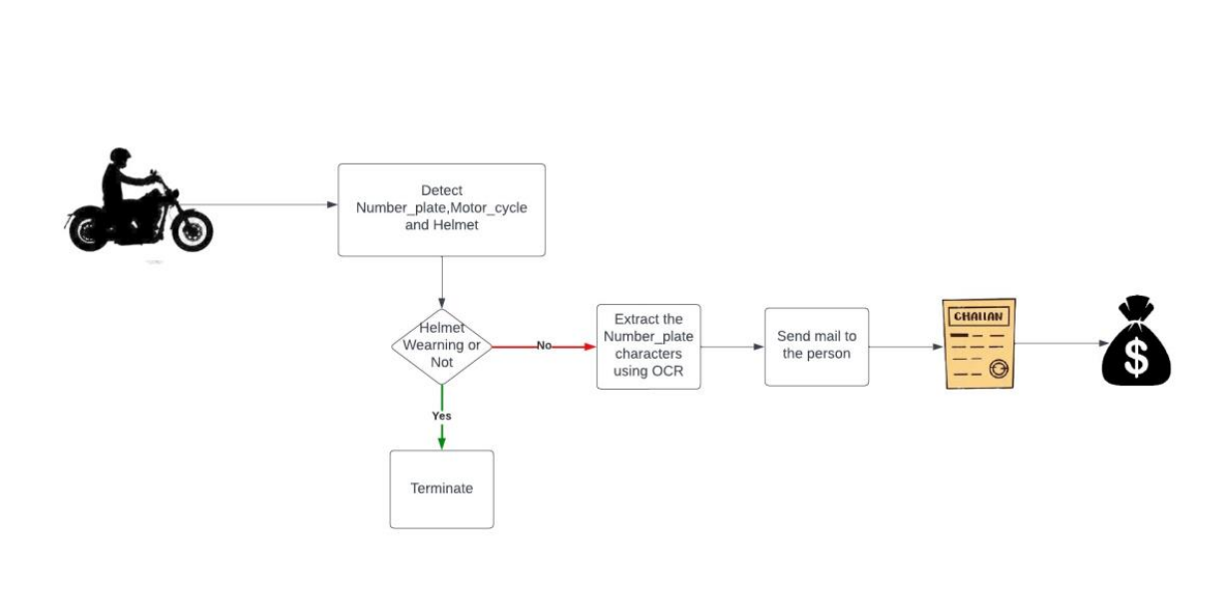
Activity Diagram

Slide 11
Week 4:Initial Training with YOLOv10
- Installed and configured YOLOv10.
- Trained YOLOv10 on the prepared dataset.
Week 5: Evaluation and Decision to Switch to YOLOv8
- After evaluating observed misclassifications
- Decided to switch to YOLOv8 for better performance.
Week 6:Training and Testing YOLOv8 on Images
- Installed and configured YOLOv8.
- Trained YOLOv8 on the prepared dataset and tested the model on images to verify whether it correctly detecting.
Week 7:Testing YOLOv8 on Video
- Provided video input to the trained YOLOv8 model.
- Checked whether it correctly detects riders, helmets, and number plates in real-time.

Slide 12
Planning of Project and Teamwork
Week 1:Research & Planning
- Studied traffic rule violations and helmet detection methods.
- Researched existing helmet and number plate detection techniques.
- Defined problem statement, objectives, and team roles.
Week 2:Exploring & Using Online Datasets
- Researched various open-source datasets for helmet and number plate detection
- Selected public datasets.
Week 3:Creating a Customized Dataset
-Collected images for helmet detection and number plate recognition.
- Manually labeled collected images using MakeSense.ai for:Helmet,rider,numberplate
- Custom dataset created and annotated using MakeSense.ai, but more data was needed

Slide 13
Hardware and Software Requirements
Hardware Requirements:
GPU-enabled System
Storage Device – Atleast 500GB SSD
RAM- 8GB
High-Resolution Camera
Processor –Intel i5/i7 or AMD Ryzen 5/7
Windows 10 or 11,Linux ,Ubuntu
Software Requirements:
Google Colab
OCR Tool – Tesseract OCR

Slide 14
Thank You

