Slide 1

Credit Default Status Prediction
Sai Krishna Nikhil Appasani
git repo URL: https://github.com/Nikhilappasani26/Nikhil-Capstone-Project

Slide 2
Aim and Objectives
The goal of this project is to use machine learning and deep learning to build a smart system that can predict if someone might not pay back a loan (credit default). The system will also help users understand how the prediction was made, using a clear and interactive website. This will make the loan process more accurate, transparent, and efficient for banks and other lenders.
Objectives:
Build a model that can predict if a person will default on a loan, with at least 85% accuracy.
Use deep learning (neural networks) to make the predictions even better.
To Add tools like SHAP to explain why the model made a certain prediction.
To deploy a secure and user-friendly web dashboard where banks or users can check credit risk results.
.

Slide 3
Stake Holders or Target Audience
Banks, credit unions, microfinance institutions
Credit risk analysts & financial data scientists
Regulatory bodies
Customers seeking fair credit assessment

Slide 4
Data Sources
Dataset Source: https://www.kaggle.com/datasets/conorsully1/credit-score
Total Records: 1,000 customers
Total Features: 84 financial attributes
Key Target Variables: Credit score, Default: Binary label (1 ,0)
Current Data Size: 1,000records, 84 features.

Slide 5
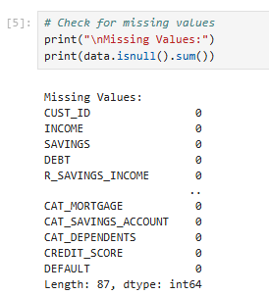
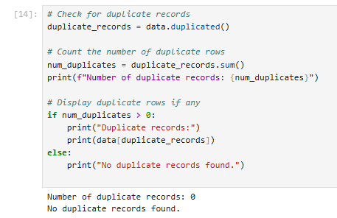
Data Quality and Issues
Missing Values
Duplicate Records
Outliers

Slide 6

Outliers and Inconsistent Formats:
Outliers:
Detected using IQR (Interquartile Range) and capped extreme values for features like Outstanding Debt and Monthly Inhand Salary.
Applied Z-score thresholding on normalized features for outlier detection.
Inconsistent Formats:
Standardized categorical labels .
Converted strings to numerical values using Label Encoding or One-Hot Encoding where needed.
The SelectKBest function is being used for selecting the 10 best features which could be used as an input for training the models

Slide 7
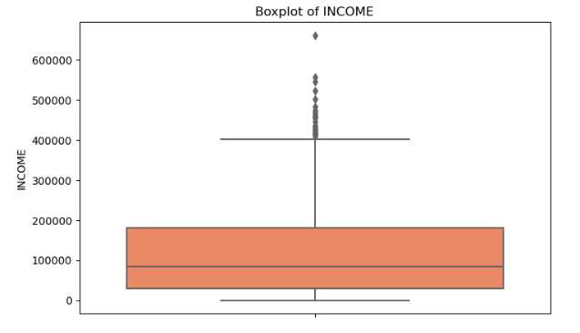
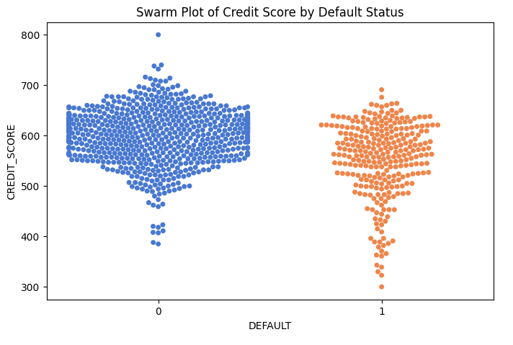
Exploratory Data Analysis (EDA) The interquartile range (IQR) shows the middle 50% of the data which is displayed by, ranges from around 2,000 to 13,000. Many outliers are found above the top whisker, with some values over 50,000, suggesting that expenditure can occasionally be quite high

Slide 8
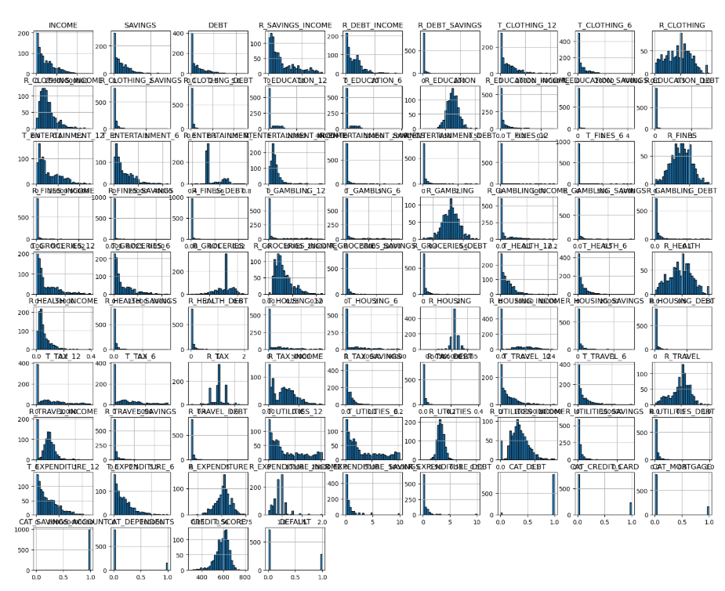
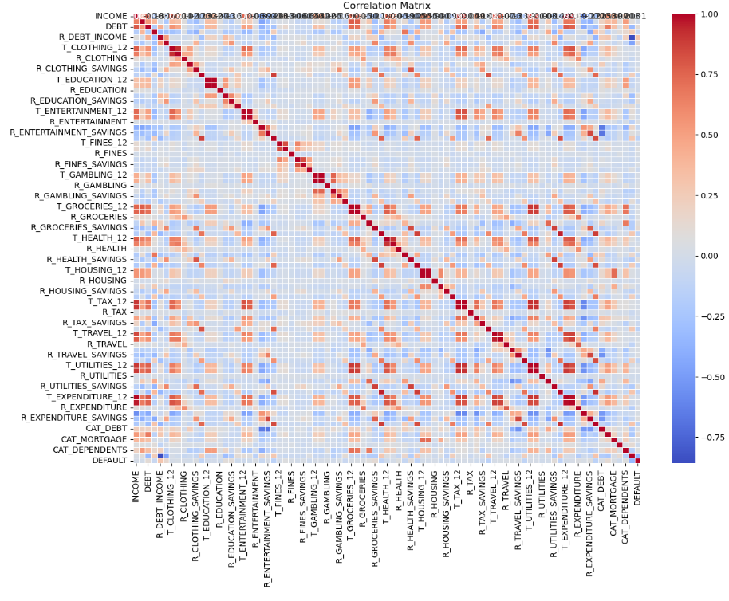
Exploratory Data Analysis (EDA) Using histograms, this plot displays the distribution of numerical characteristics in the credit default dataset. The majority of variables are right-skewed, meaning that most values are concentrated at lower ranges. Understanding data size, skewness, and the necessity of transformation or normalization prior to model training are all aided by this approach.

Slide 9
Modeling / Analysis Techniques
Random Forest:
Ensemble method combining multiple decision trees.
Chosen for its robustness to overfitting, ability to handle non-linear relationships, and interpretability via feature importance.
Neural Network (Baseline):
Built a simple feedforward neural network to capture complex patterns in the data.
Useful for modeling interactions between multiple features.
Fine-Tuned Neural Network:
Performed hyperparameter tuning (e.g., hidden layers, learning rate, activation functions, batch size).
Achieved improved accuracy and generalization compared to baseline models.

Slide 10
Modeling / Analysis Techniques
Evaluation Metrics Used
Accuracy: Overall correctness of the model predictions.
Precision: Proportion of true positives among all predicted positives (important to minimize false positives).
Recall (Sensitivity): Proportion of true positives identified (important to catch actual defaulters).
F1-Score: Harmonic mean of precision and recall—used when classes are imbalanced.
Confusion Matrix: Visual representation of true vs. predicted classes.
ROC-AUC: Measures the model’s ability to distinguish between classes across thresholds.

Slide 11
Results
Random Forest:
Accuracy: 0.7150
Good generalization and stable performance.
Better balance between precision and recall than basic NN.
Basic Neural Network:
Accuracy: 0.7050
Weaker performance on minority class (defaulters).
Needed fine-tuning for improved learning.
Fine-Tuned Neural Network performed best overall:
Accuracy: 0.7450
Strong performance in identifying non-defaulters (class 0) with 98% recall.
Moderate struggle with defaulters (class 1): only 16% recall.

Slide 12
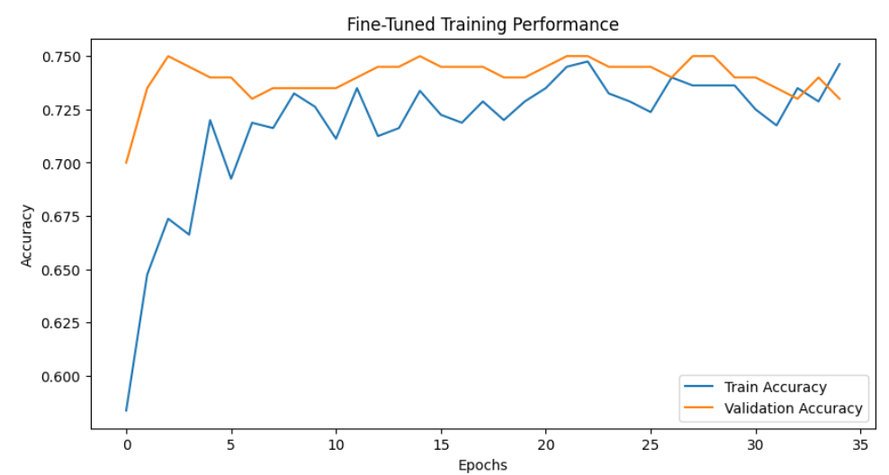
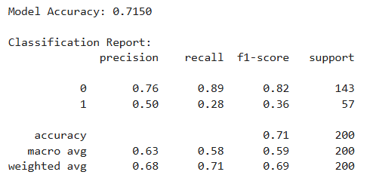
Results
The models are evaluated using the evaluation metrics. It helps in understanding which model has performed well.
It is found that the random forest regression model is giving an accuracy of 71% while that of the fine tunes neural network is 74%.

Slide 13
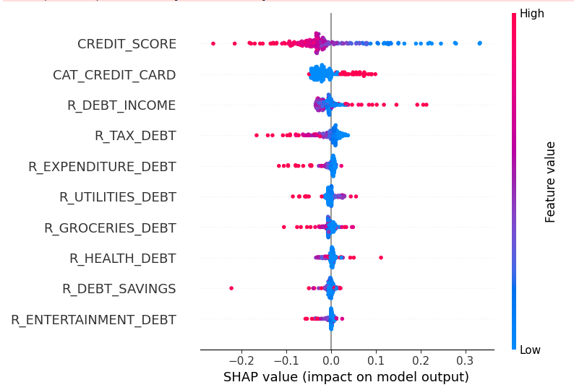
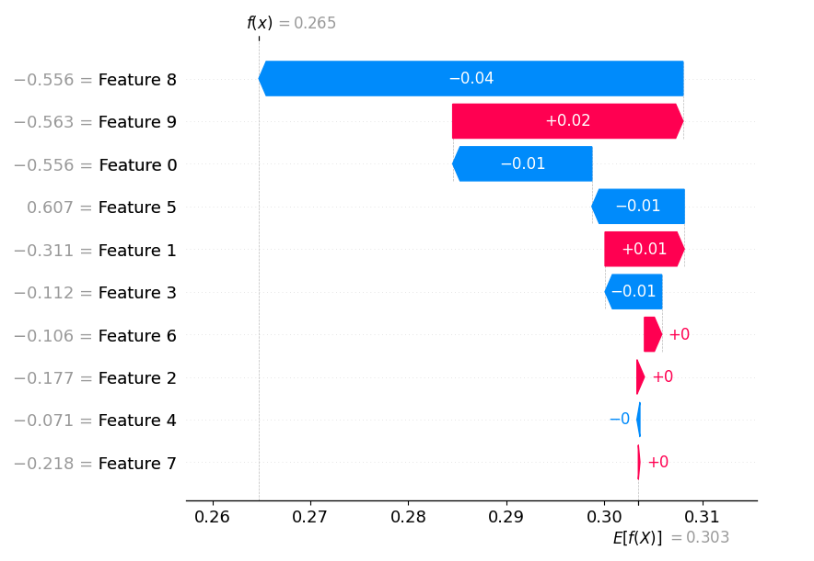
Visualization & Dashboard (if applicable)

Slide 14
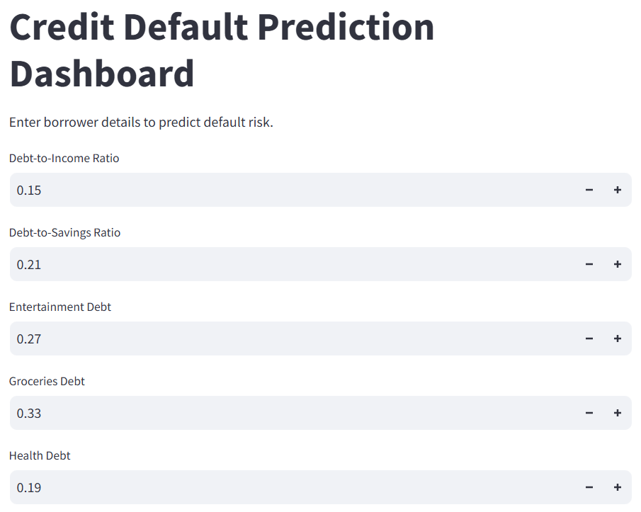
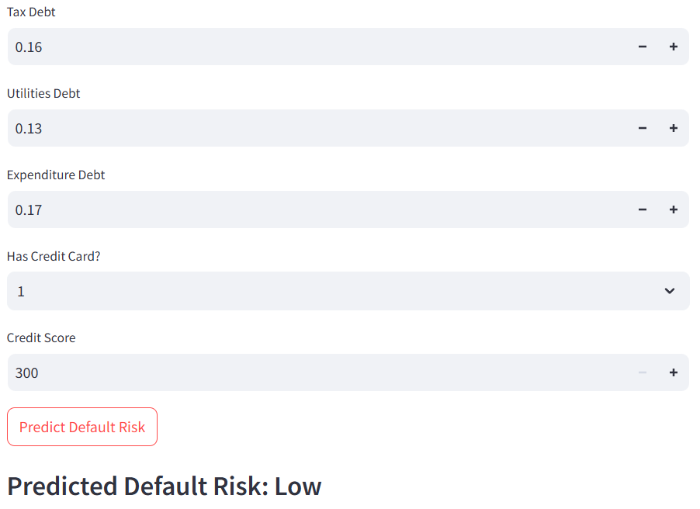
Visualization & Dashboard
A pre-trained Random Forest model is used in this Streamlit-based web application to estimate credit default risk through an interactive dashboard. Key financial indicators that users may add include credit card ownership, credit score, debt-to-income ratio, debt-to-savings ratio, and different sorts of debt (health, grocery, entertainment, etc.).
When the "Predict Default Risk" button is clicked, the application analyses the data and classifies the borrower as having a high or low default risk based on the loaded model

Slide 15
Conclusion & Recommendations
we trained and optimized both conventional machine learning models (such as Random Forest) and deep learning models using a carefully chosen collection of financial and behavioral characteristics.
Fine-Tuned Neural Network achieved the highest accuracy (74.5%) among all models tested.
The predictive model is being implemented with the help of the interactive Streamlit dashboard which helps the model accessible to the real world which helps the stakeholders to put input which would help in quickly assessing the risk. This helps in having a good predictive model which could be appropriately used in the form of a dashboard for observing the credit default.

Slide 16
THANK YOU

