Slide 1
Gender Recognition from Audio Signal

Slide 2
Content
Abstract
Working Process
Block Diagram
Requirements of project
Overview

Slide 3
ABSTRACT
A signal is a physical quantity that changes over time or space and can be represented as zeros and ones. Digital Signal Processing (DSP) uses computers to analyze and manipulate these signals. Speech is a vital form of communication that not only shares information but also provides details about the speaker, such as gender, age, and emotional state.
Gender Recognition (GR) identifies whether the speaker is male or female based on their voice

Slide 4
Working process
Signal Acquisition :- The speech signal is captured from the speaker, which serves as the input to the system. This signal is a physical quantity that varies over time, and in digital form, it is represented by a series of zeros and ones.
Pre-processing :- The captured speech signal undergoes preprocessing to remove noise and enhance its quality. This step ensures that the signal is clean and suitable for analysis
Feature Extraction :- Key features of the speech signal, such as pitch, frequency, and energy, are extracted. These features contain information about the speaker's characteristics, including gender.

Slide 5
continue
Comparison with Database :- The extracted features from the unknown speaker are compared to a database containing known male and female voice samples. The system analyzes the similarities and differences between the unknown voice and the stored voices.
Recognition Decision :- Based on the comparison, the system selects the best matching voice sample from the database. From this match, the system determines whether the speaker is male or female.
Output :- The system outputs the recognition result, indicating the gender of the unknown speaker based on the processed speech signal.

Slide 6
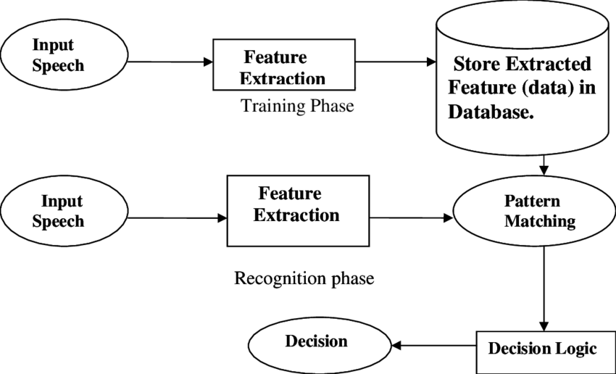
Block Diagram

Slide 7
Requirements for project
Hardware Requirements
Microphone
Computer
Storage
Software Requirements
MATLAB
Signal Processing Toolbox (MATLAB)
Database of Voice Samples

Slide 8
Overview
The Gender Recognition from Speech Signal project aims to identify the gender of a speaker (male or female) by analyzing their speech using Digital Signal Processing (DSP)
By utilizing speech features like pitch and frequency, the system can differentiate between male and female voices

Slide 9
thank you

