Slide 1
AI/NLP Financial Risk Engine
Turning unstructured news and social text into live risk signals, a sentiment-driven index and event-driven stress tests
Sentiment
Event type
Impact 1-10
[Your Full Name] | [Your College Name]
S&P Global & Crisil Campus Hackathon 2026 - Phase III Case Study
Notes:
Introduce yourself, the case study, and the one-line idea: one NLP engine feeding two downstream risk modules.

Slide 2
Problem and approach
The problem
Our approach
Market-moving information arrives as unstructured text: news, tweets, filings
Analysts cannot read it all, so risk signals arrive late or not at all
Banks need machine-readable signals that portfolios and risk models can act on
1
Ingest
News + Twitter/X posts into one stream
2
Understand
Sentiment, event type and impact score per company
3
Act
Feed signals to a rebalancer and a stress tester
Notes:
Business problem in your own words. Stress that the engine is the product and Module A and B prove it is useful.

Slide 3
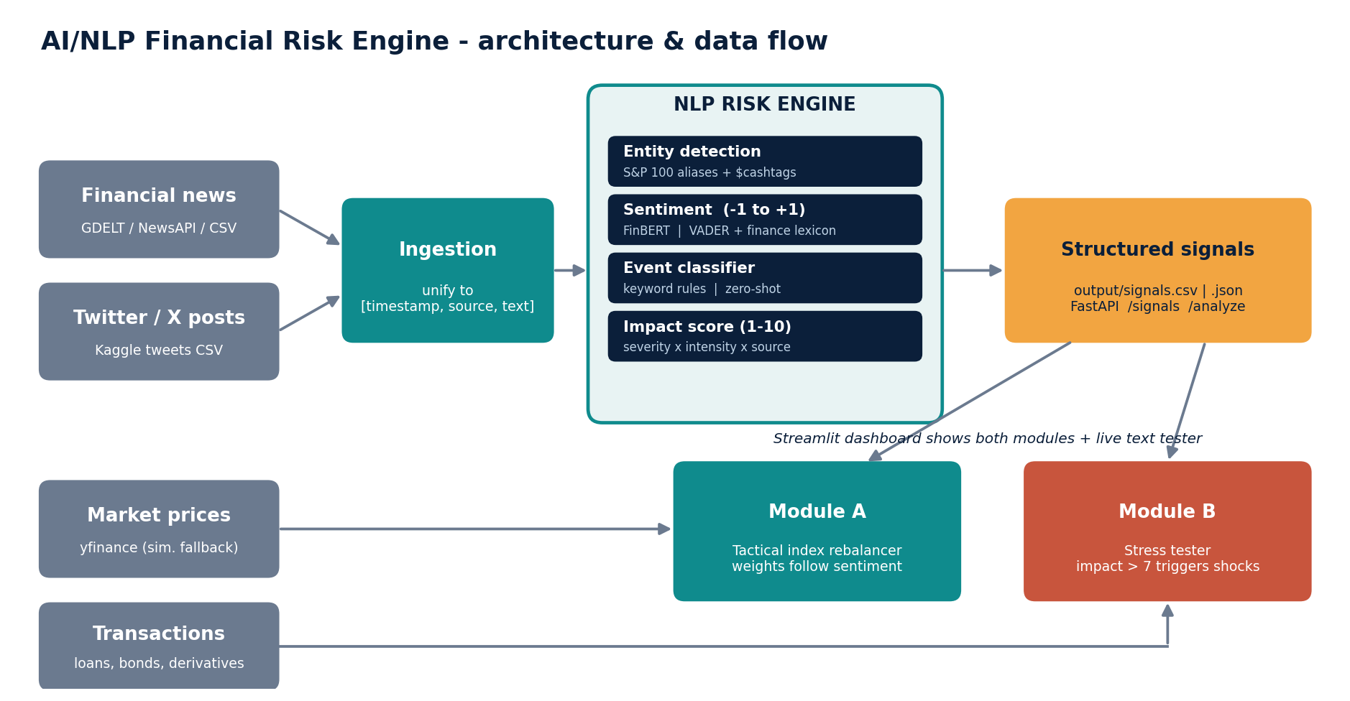
System design and data flow
One engine, many consumers
Signals are plain CSV/JSON plus a FastAPI, so any downstream app can subscribe
Swappable models
FinBERT or VADER for sentiment, rules or zero-shot for events, same output schema
Runs fully offline with sample data; live GDELT and NewsAPI sources are optional.
Notes:
Walk left to right: sources, ingestion, NLP engine, structured signals, then the two modules and dashboard.

Slide 4
Implementation highlights
NLP Risk Engine
Module A: Index rebalancer
Entity detection, sentiment in -1 to +1, 7 event types, impact 1-10 with transparent formula and per-signal drivers
Impact-weighted sentiment, smoothed, nudges weights; capped 2-15% so the index stays diversified
Module B: Stress tester
Engineering
Impact above 7 triggers shocks scaled by severity: equity drop, rate and spread moves, PD uplift, derivative delta
Streamlit dashboard, FastAPI, unit tests, labelled eval set, offline fallbacks for every external dependency
Notes:
Be ready to explain the impact formula: (event base severity + intensity words + 2*abs(sentiment)) * source reliability, clipped to 1-10.

Slide 5
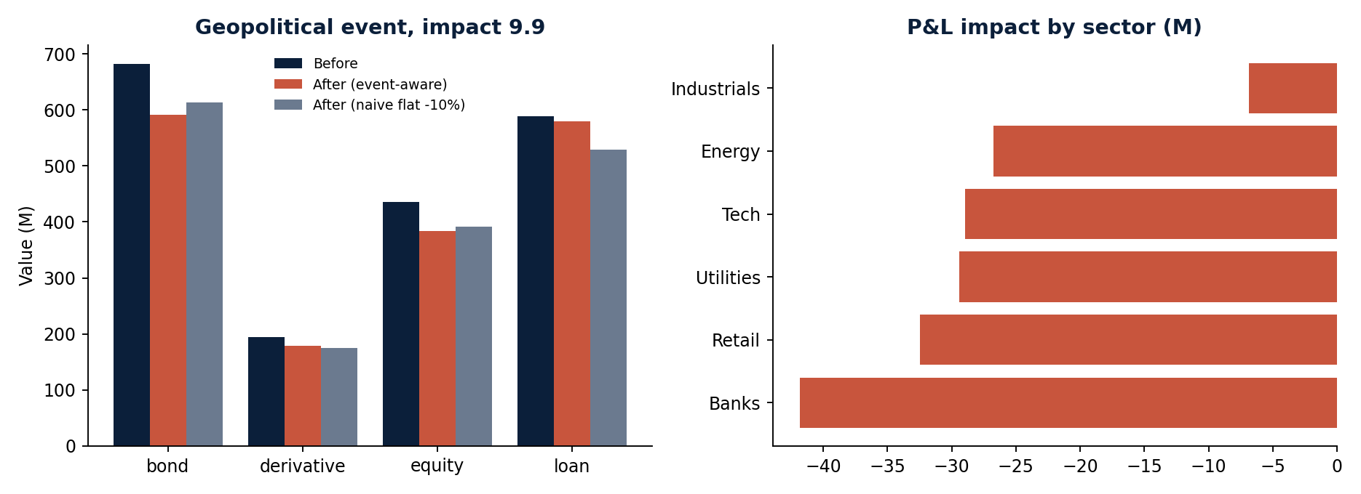
Key results
84
signals from 2 sources
22
high-impact events (score > 7)
-8.76%
Event-aware stress test: 166.3M loss on a 1,899M portfolio, concentrated in bonds (90.6M) and equities (51.7M). A flat -10% shock would say 189.9M and badly overstate the loan loss (8.5M here).
Module A: sentiment moved WMT up 6.4pp and GOOGL down 4.7pp within the 2-15% weight caps.
portfolio value after a Geopolitical shock
Synthetic sample data and simulated prices for the offline demo run; hand-labelled test set is small (n=41), so accuracy is indicative only.
Notes:
Replace or add screenshots of your live dashboard here after the final run on real Kaggle data.

Slide 6
Domain impact
1
Risk and credit teams
Early, quantified warning when a news event threatens exposures, instead of discovering it from price moves
2
Portfolio managers
Systematic, explainable tilts from text sentiment, with weight caps that protect diversification
3
Wholesale banking and treasury
Instant what-if on loans, bonds and derivatives when a geopolitical or credit event hits, by asset class and sector
From reading headlines to a machine-readable risk signal in milliseconds
Notes:
Connect to S&P Global / Crisil: ratings, market intelligence, and risk analytics all depend on timely signal extraction.

Slide 7
Limitations and next steps
Limitations
Next steps
Rule-based events and fallback lexicon miss nuance and sarcasm
Impact score is heuristic, not calibrated to realised market moves
Stress shocks are simplified (duration and PD multipliers)
Small self-labelled evaluation set
Switch on FinBERT and zero-shot events (already supported)
Calibrate impact against historical returns; track the information coefficient
Stream with Kafka and add dedup and source credibility
Historical-scenario and VaR-based stress library
Notes:
Be candid about limits: juries reward it. The backtest hook (src/main.py --backtest) is ready for real prices.

