Slide 1

Birdz
Mobile Application
for Indian Bird Species in Natural Habitats
Birdz

Slide 2
Problem Statement
India is home to over 1,300 species of birds, making manual identification a complex and time-consuming task, especially for students, researchers, and hobbyists without expert knowledge. Existing tools and applications often lack support for Indian biodiversity and offer limited educational resources. There is a clear need for an accessible, AI-powered application solution that simplifies bird species detection and education for users across different platforms.

Slide 3
INTRODUCTION
BirdZ is an AI-powered bird species identification system designed for bird enthusiasts, researchers, and conservationists. It leverages deep learning models to detect and classify Indian bird species through both a mobile application and a web platform. The system offers a user-friendly interface, allowing users to upload or capture bird images for instant recognition and species information. BirdZ bridges the gap between technology and biodiversity by promoting awareness, aiding research, and encouraging environmental conservation through accessible digital tools.

Slide 4
OBJECTIVES
Develop a real-time app for real-time bird detection and classification.
Utilize a custom-built, class-balanced dataset of Indian bird species to train
a deep learning model
Design a clean, intuitive UI/UX that allows users to capture or upload images and instantly view results with bird details.
Integrate backend services for efficient data processing and storage.

Slide 5

Models Used & Deployment Architecture
YOLOv12 – Bird Detection (Detects whether a bird is present in the uploaded image)
Details
Accurately filters non-bird images, reducing unnecessary classification attempts.
Trained on a mix of COCO and custom bird-labeled datasets.
Outputs bounding boxes and confidence scores for bird presence.
Deployment
Hosted on AWS ECS in a Docker container.
Invoked via Node.js backend as an API call from the Flutter app.
Input images temporarily stored on AWS S3 for processing.

Slide 6
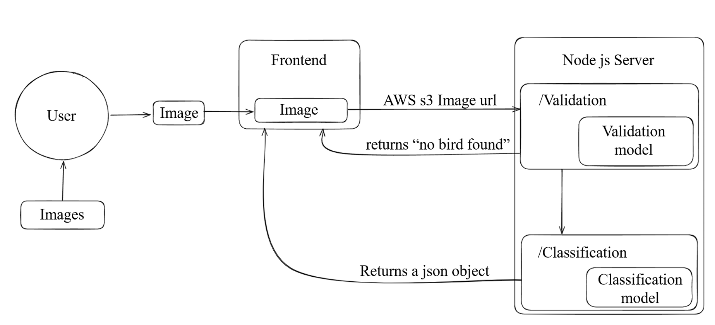
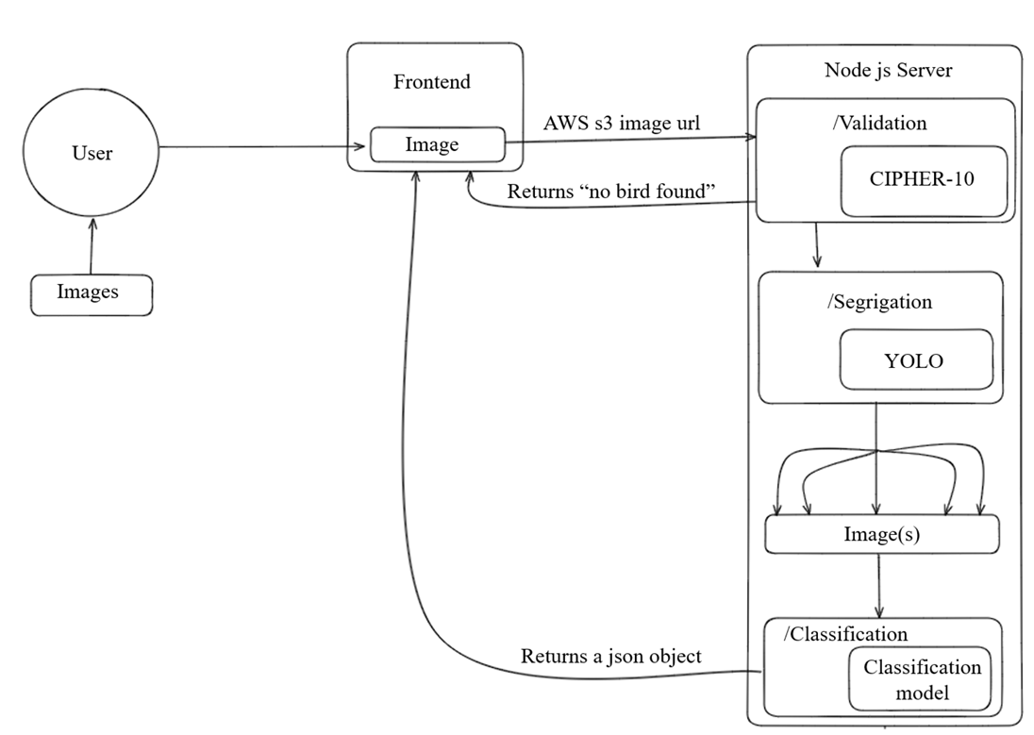


Slide 7
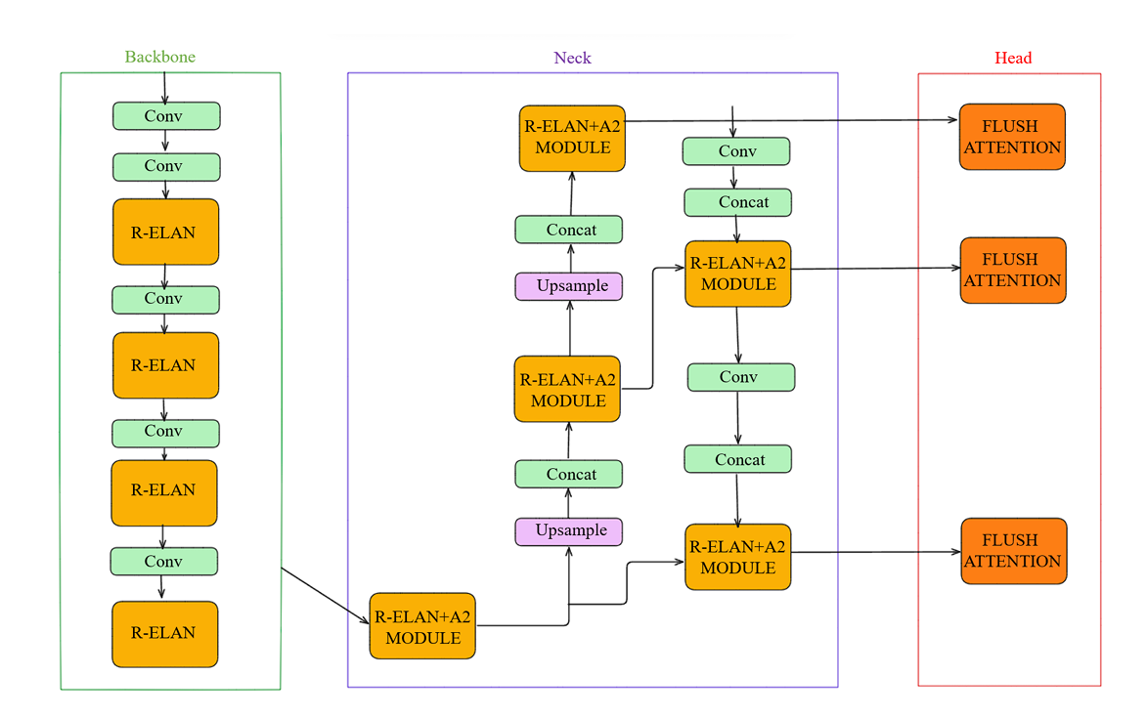
YOLOv12 Architecture

Slide 8
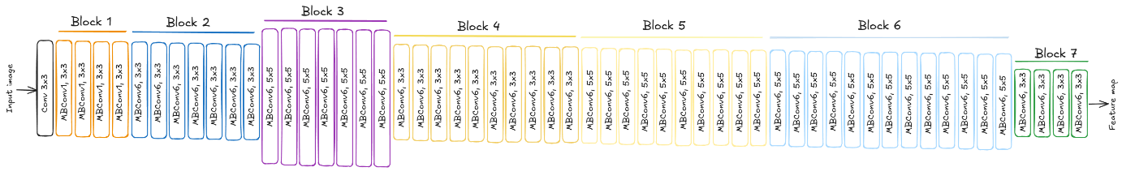
EfficientNet-B7 – Bird Species Classification
(Classifies the species of the bird detected by YOLOv12)
Architecture Overview
EfficientNet B7 serves as the second stage of the two-stage bird identification framework, focused specifically on classifying detected birds into their correct species. As one of the most sophisticated convolutional neural networks, it's designed with compound scaling that optimizes three fundamental dimensions:
Depth Scaling: Increased number of layers to capture complex features of bird species
Width Scaling: Enhanced channel count in each layer to detect minute details in plumage, beak shape, and other distinguishing characteristics
Resolution Scaling: Higher-resolution image processing (224x224 pixels) to recognize intricate patterns and subtle differences between similar species

Slide 9
Performance Metrics for Bird Species Classification
Bird Species | Precision | Recall | F1-Score
AshyCrownedSparrowLark | 0.99 | 0.99 | 0.99
AsianOpenbill | 0.84 | 0.95 | 0.89
Black-headedIbis | 0.97 | 0.99 | 0.98
Crow | 0.94 | 0.9 | 0.92
EurasianCoot | 1 | 0.98 | 0.99
IndianRoller | 0.96 | 0.99 | 0.97
Large-billed Crow | 0.94 | 0.91 | 0.92
LittleCormorant | 0.99 | 0.95 | 0.97
PaddyfieldPipit | 0.95 | 0.99 | 0.97
PaintedStork | 0.97 | 0.93 | 0.95
Red-wattledLapwing | 0.98 | 0.97 | 0.97
Spot-billedPelican | 0.99 | 0.93 | 0.96
White-breastedWaterhen | 1 | 0.98 | 0.99
YellowWattledLapwing | 0.96 | 0.98 | 0.97

Slide 10
Model Performance for 60:40 Train-Test Split
Model Performance for 75:25 Train-Test Split
Model | Accuracy | Precision | Recall | F1 Score
EfficientNetB7 | 97% | 95% | 94% | 95%
ResNet | 95.33% | 94% | 93% | 94%
InceptionV3 | 83% | 83% | 79% | 79%
Model | Accuracy | Precision | Recall | F1 Score
EfficientNetB7 | 98% | 96% | 96% | 96%
ResNet | 96.44% | 96% | 95% | 95%
InceptionV3 | 86% | 83% | 81% | 82%
Model Performance for 80:20 Train-Test Split
Model Performance for 90:10 Train-Test Split
Model | Accuracy | Precision | Recall | F1 Score
EfficientNetB7 | 98% | 96% | 94% | 95%
ResNet | 96.98% | 97% | 96% | 96%
InceptionV3 | 87% | 86% | 84% | 85%
Model | Accuracy | Precision | Recall | F1 Score
EfficientNetB7 | 98% | 97% | 95% | 96%
ResNet | 97% | 96% | 95% | 96%
InceptionV3 | 88% | 88% | 86% | 86%

Slide 11
Methodology – Dataset & Model
Custom Dataset Creation
Created a custom dataset of Indian bird species using images sourced from bird sanctuaries and other publicly available resources, along with personal collections. Manually labeled the images for accurate classification, ensuring class balancing across approximately 14 species to support reliable model training.
Data Preprocessing and Augmentation
Applied image preprocessing (resizing, normalization) and data augmentation (flip, rotate, zoom) to improve model generalization. After augmentation, the dataset was expanded to a total of 6,942 images across 14 species, which were then used to train the final model.
Model Training
Multiple models were experimented with using different training-validation splits, including 60:40, 80:20, 75:25, and 90:10 ratios. Various architectures were tested, including EfficientNetB0, EfficientNetB7, EfficientNetB9, ResNetV2, ResNet50, InceptionV3, MobileNet, and. After extensive testing, EfficientNetB7 with a 75:25 split gave the best classification results for our dataset

Slide 12
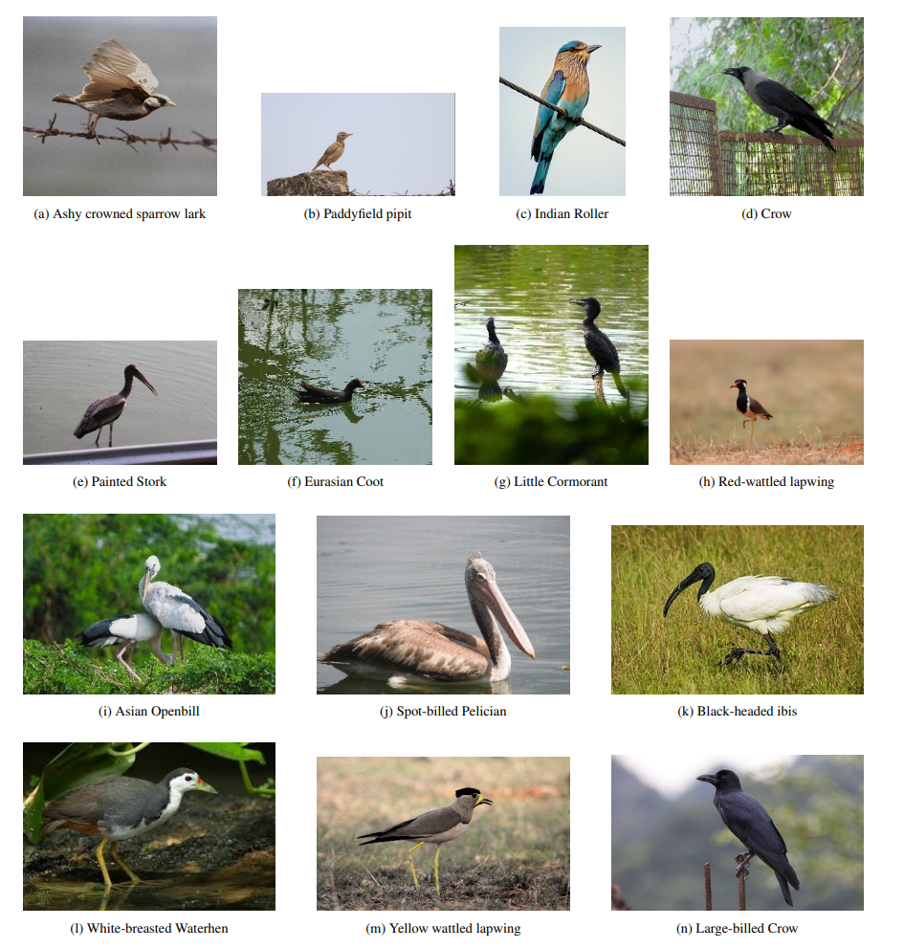
Dataset

Slide 13
Mobile Integration
Flutter Development
The BirdZ mobile app was developed using the Flutter framework, providing cross-platform compatibility for both
Android and iOS. The UI/UX was designed in Figma to ensure an intuitive user experience.
Frontend Implementation
The app includes Home and Search screens for easy navigation, allowing users to interact with the app smoothly.
Backend Logic
The backend was implemented using Node.js, handling the application’s logic and communication with the machine
learning models.
Bird Detection
Integrated YOLOv12 for bird detection, allowing the app to verify if the input image contains a bird before performing
species classification.
Classification Model
The EfficientNet B7 model was used for bird species classification, delivering high accuracy while being
computationally efficient for mobile use.
Cloud Hosting & Scalability
Images and models were hosted on AWS S3, and the backend and machine learning models were containerized
using Docker and deployed on AWS ECS for scalable, efficient processing.

Slide 14
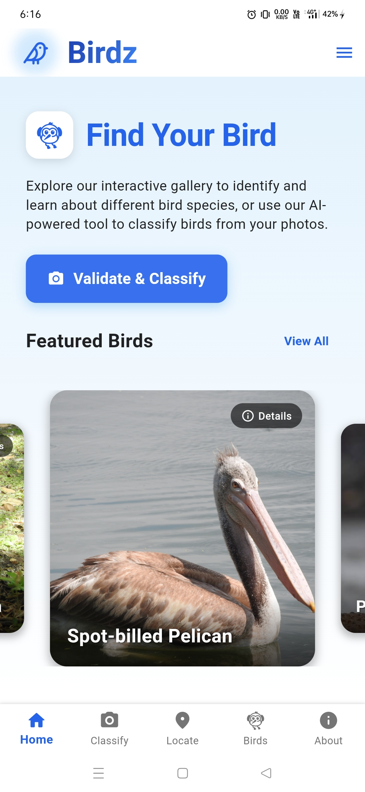
Features Implemented

Slide 15
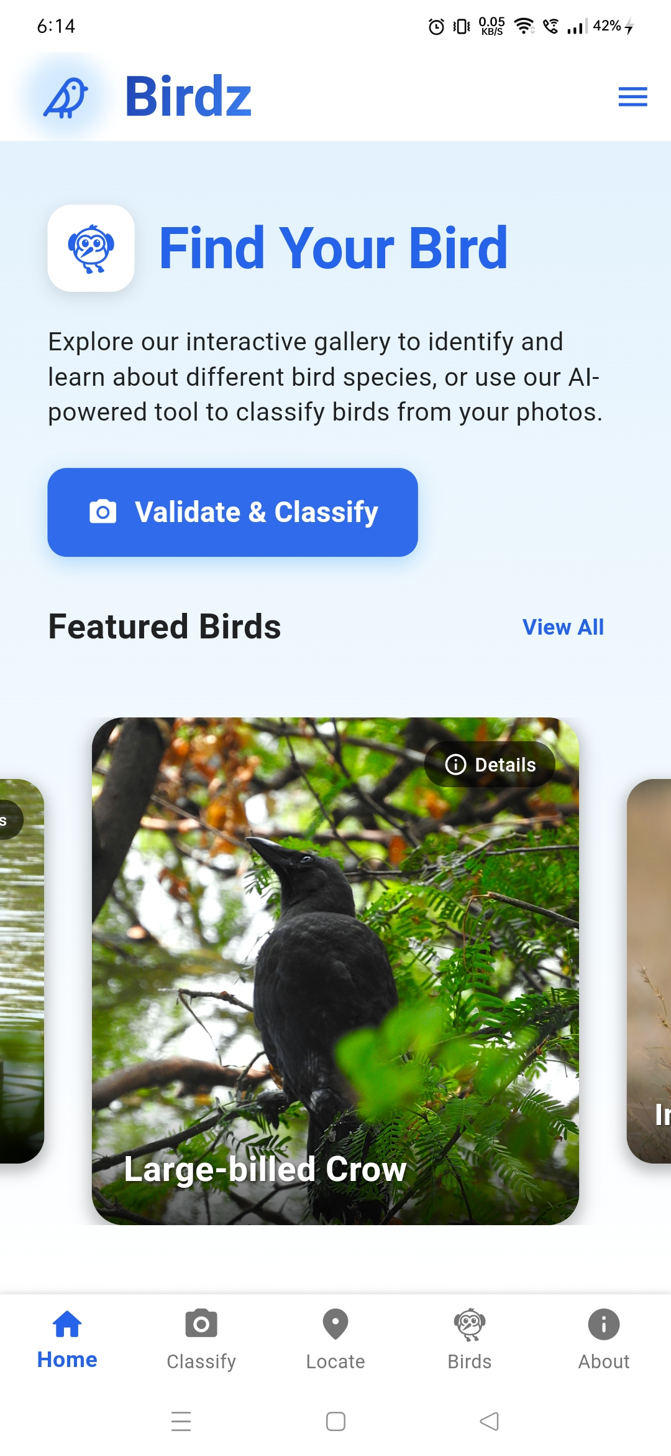
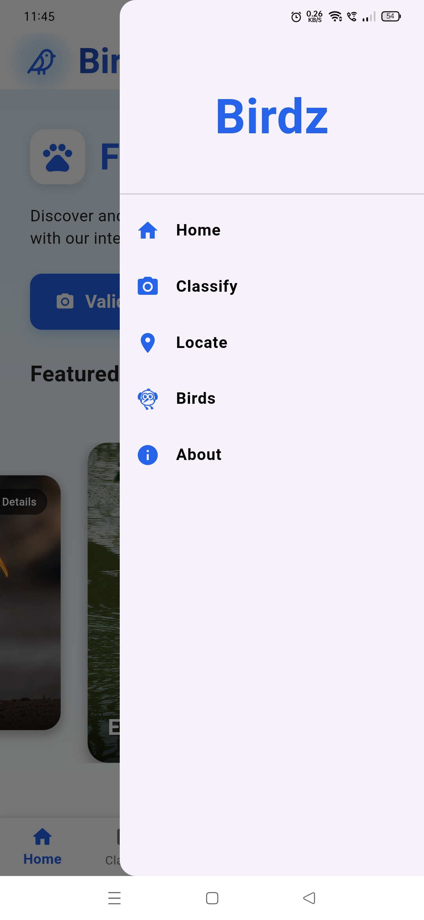

Home Page
App drawer

Slide 16

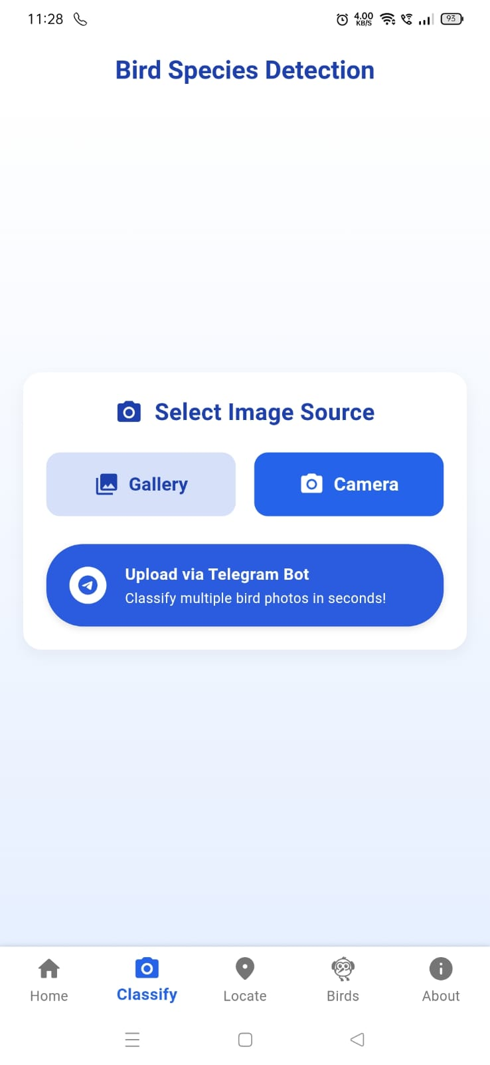
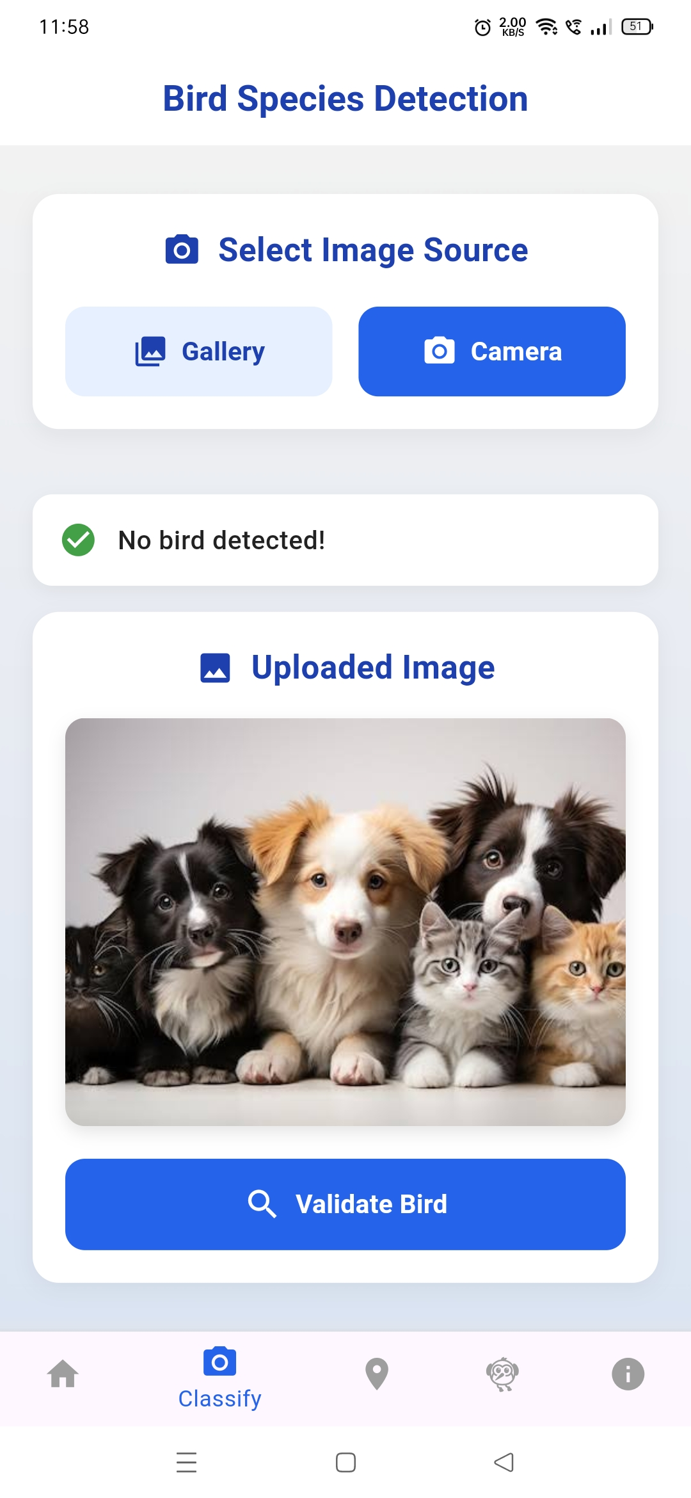
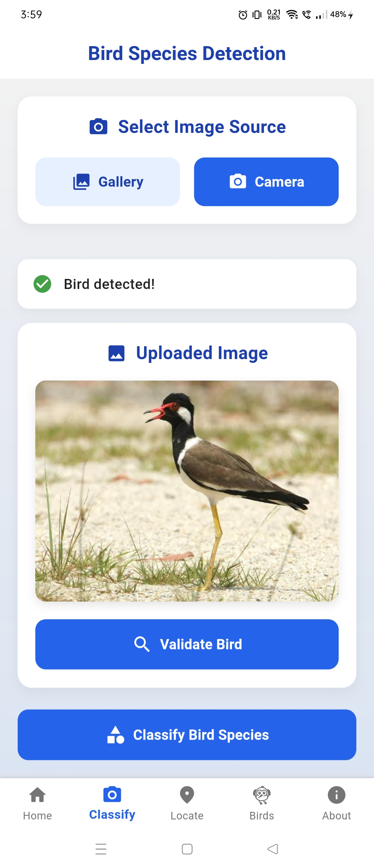
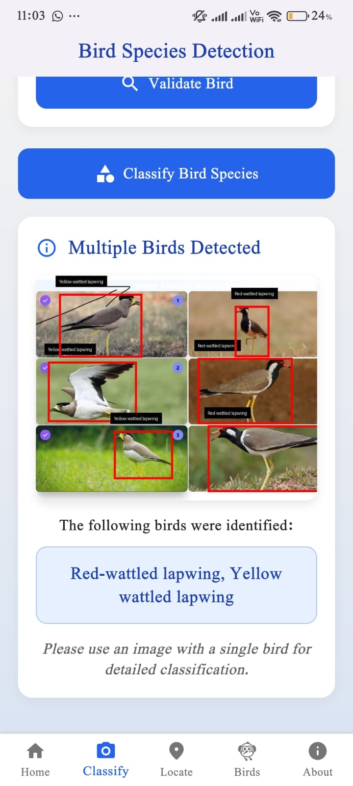
Classification Page Features
Upon image upload (from camera or gallery), the app uses the YOLOv12 model to first verify whether the image contains a bird.
If no bird is detected, the app notifies the user immediately
If a bird is detected, the user can proceed by clicking "Classify” for classification.
Telegram Bot
Users can use this bot to upload batches of
bird images and receive classifications at scale
perfect for enthusiasts or conservation projects

Slide 17
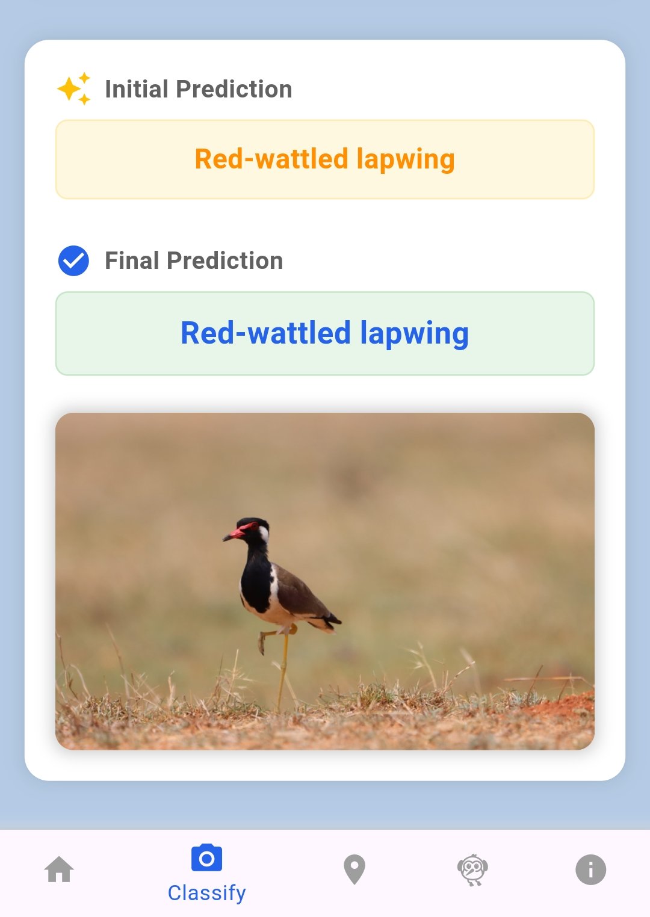
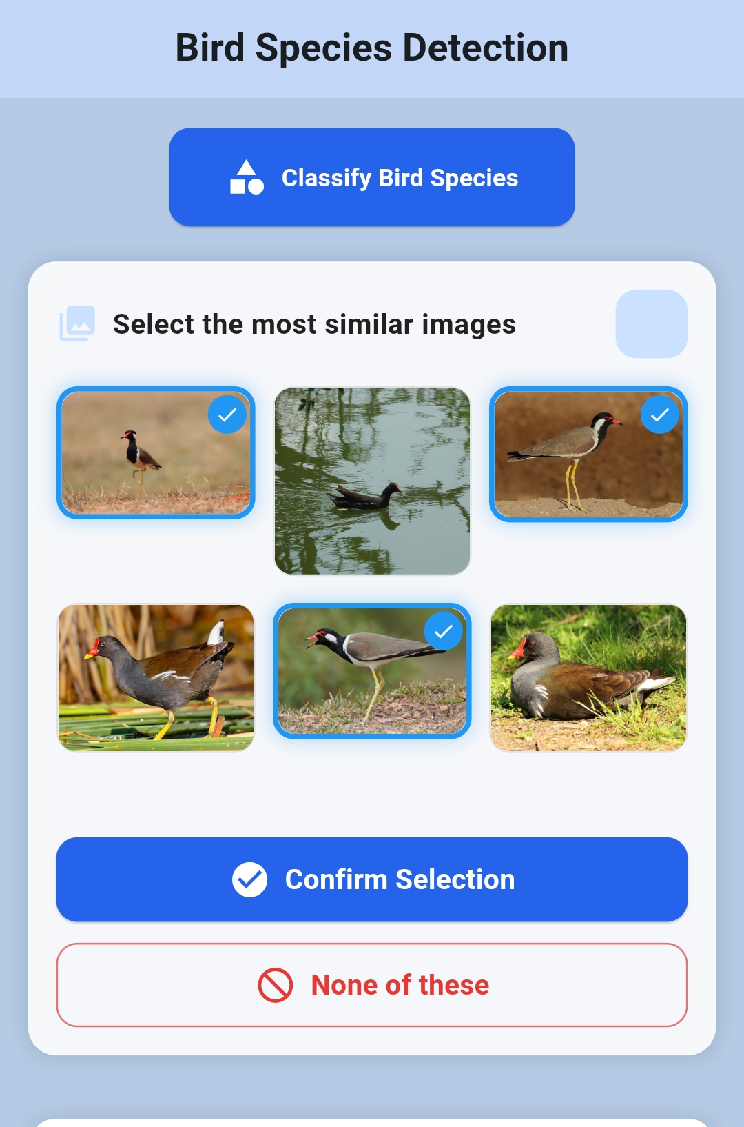
Similarity Matching
The app performs a similarity search using features extracted by the EfficientNetB7 model.
A list/grid of similar bird images is displayed, based on visual similarity scores
The user is prompted to select three images from the list that closely resemble the uploaded bird.
This step helps refine the classification by incorporating human perception of similarity.
Based on the user's selection, the app displays:
✅ Initial Prediction: Based on the selected similar birds.
✅ Final Prediction: The confirmed species name and an image for clarity.

Slide 18
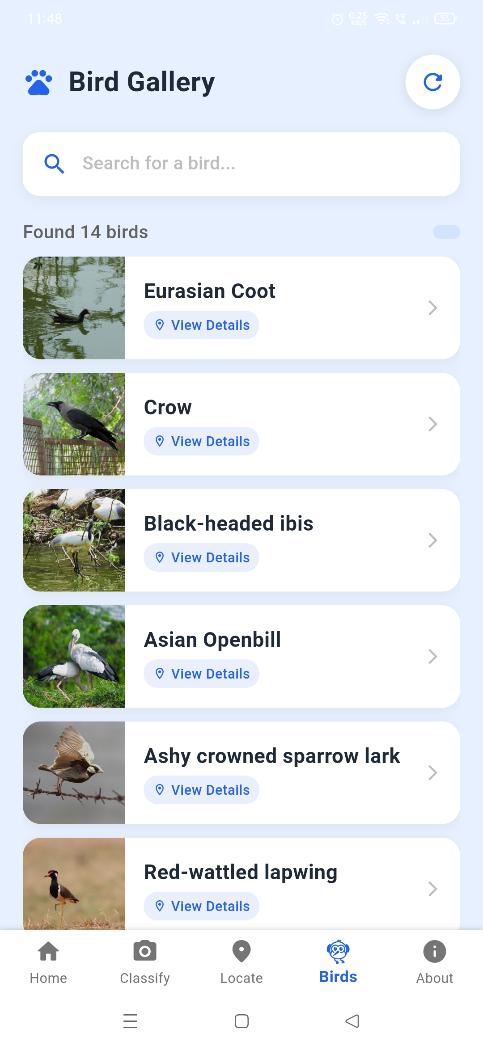
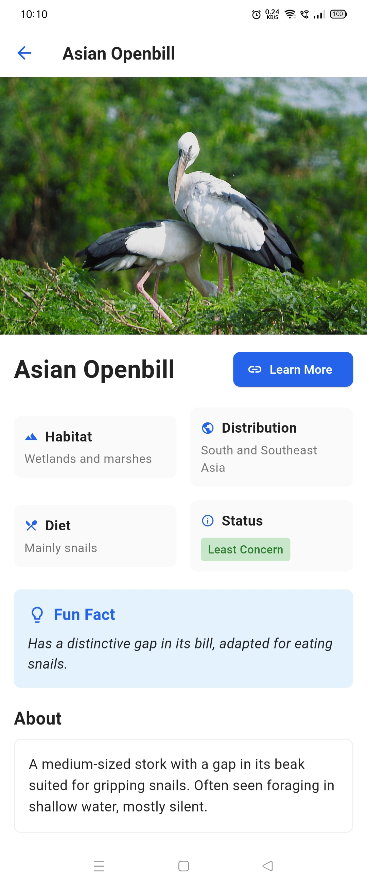
Bird Gallery Page Features
This page acts as a rich interactive gallery of Indian bird species curated in the app.
The user can scroll through all the bird entries and tap on any bird card to learn more. Once a bird is selected, we can see Bird Common Name
Habitat & Region Info, A representative image, Interesting facts or notes about the bird
When the user clicks “learn more”, they’re taken directly to that bird’s Wikipedia page, so they can dive deeper into its behavior, diet, distribution, and more — all from a trusted knowledge source.

Slide 19
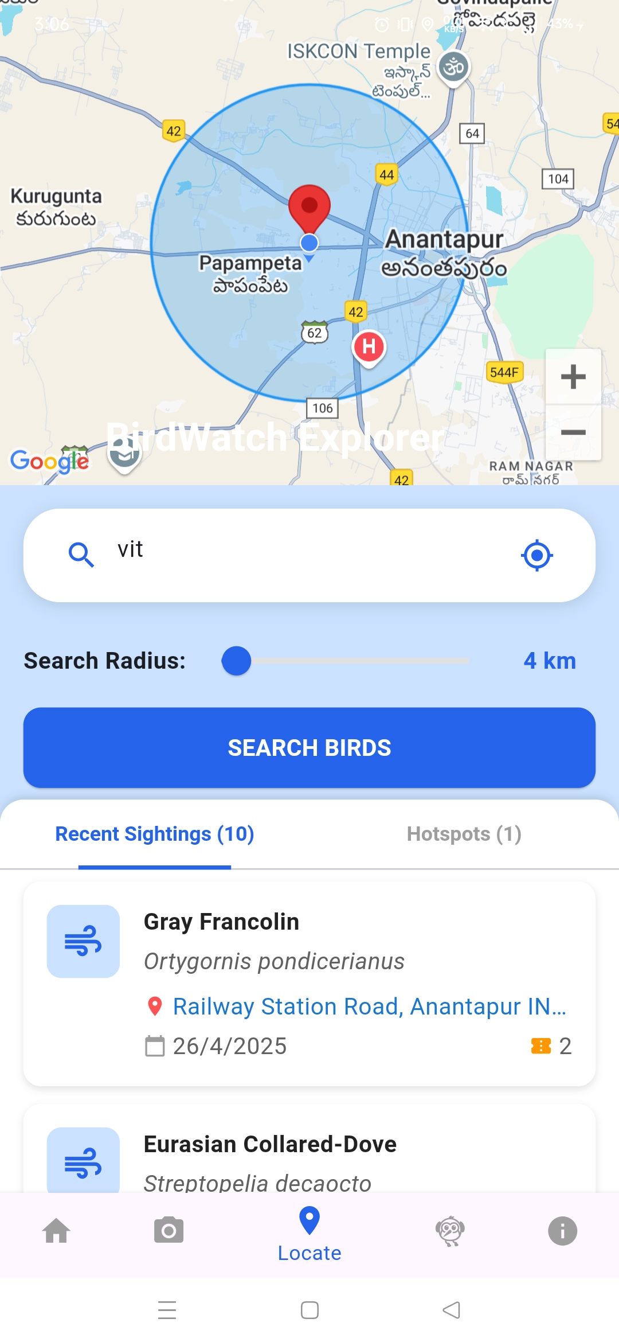
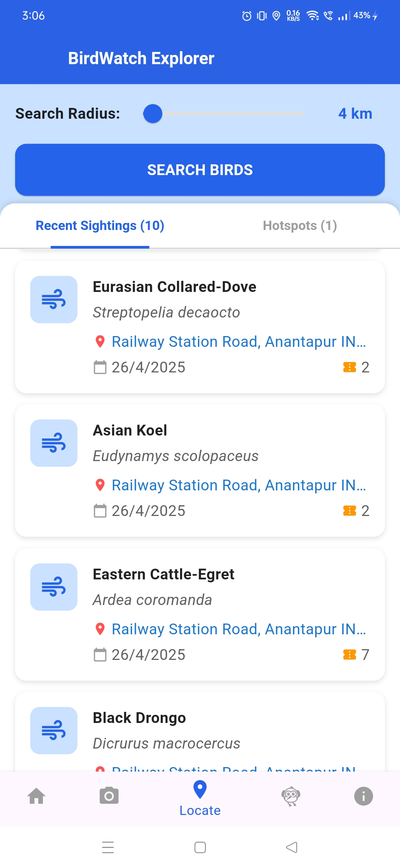
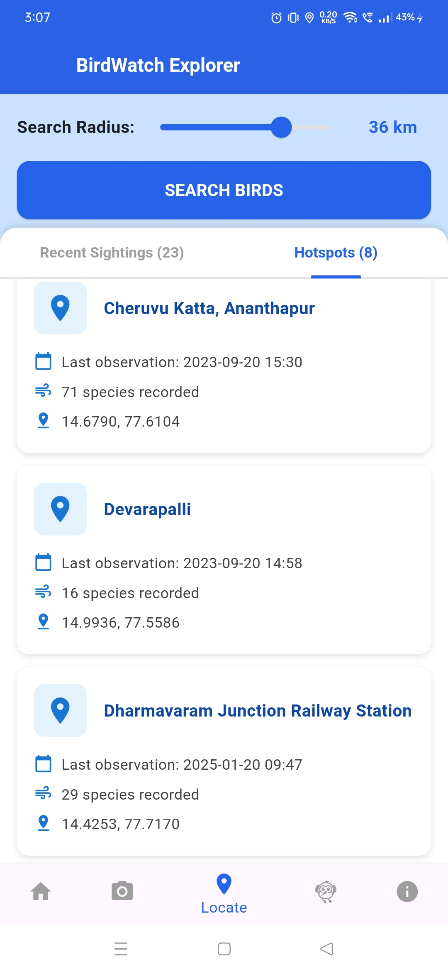

📍 Location Page – Real-Time Bird Sightings Nearby
This page connects users to real-world birdwatching activity by using their current location.
Using the eBird API, we fetch:
✅ Recent sightings of birds spotted around the user’s area.
🗺️ Birding hotspots based on radius input (e.g., 5–50 km).
This turns the app into a field guide — helping users discover what species are nearby right now and encouraging outdoor exploration. Whether you're in a park, sanctuary, or even your backyard, this page gives real-time information about birds spotted near your current location.

Slide 20
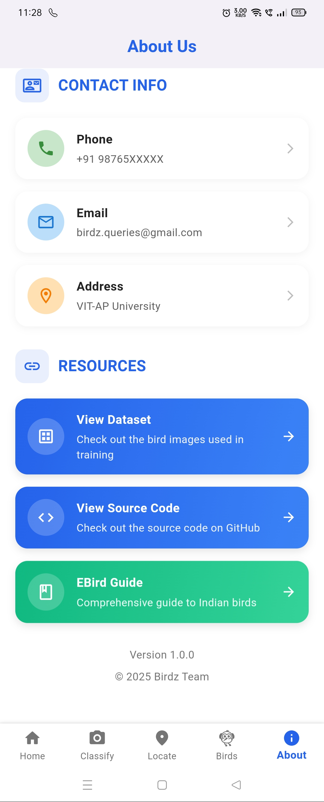
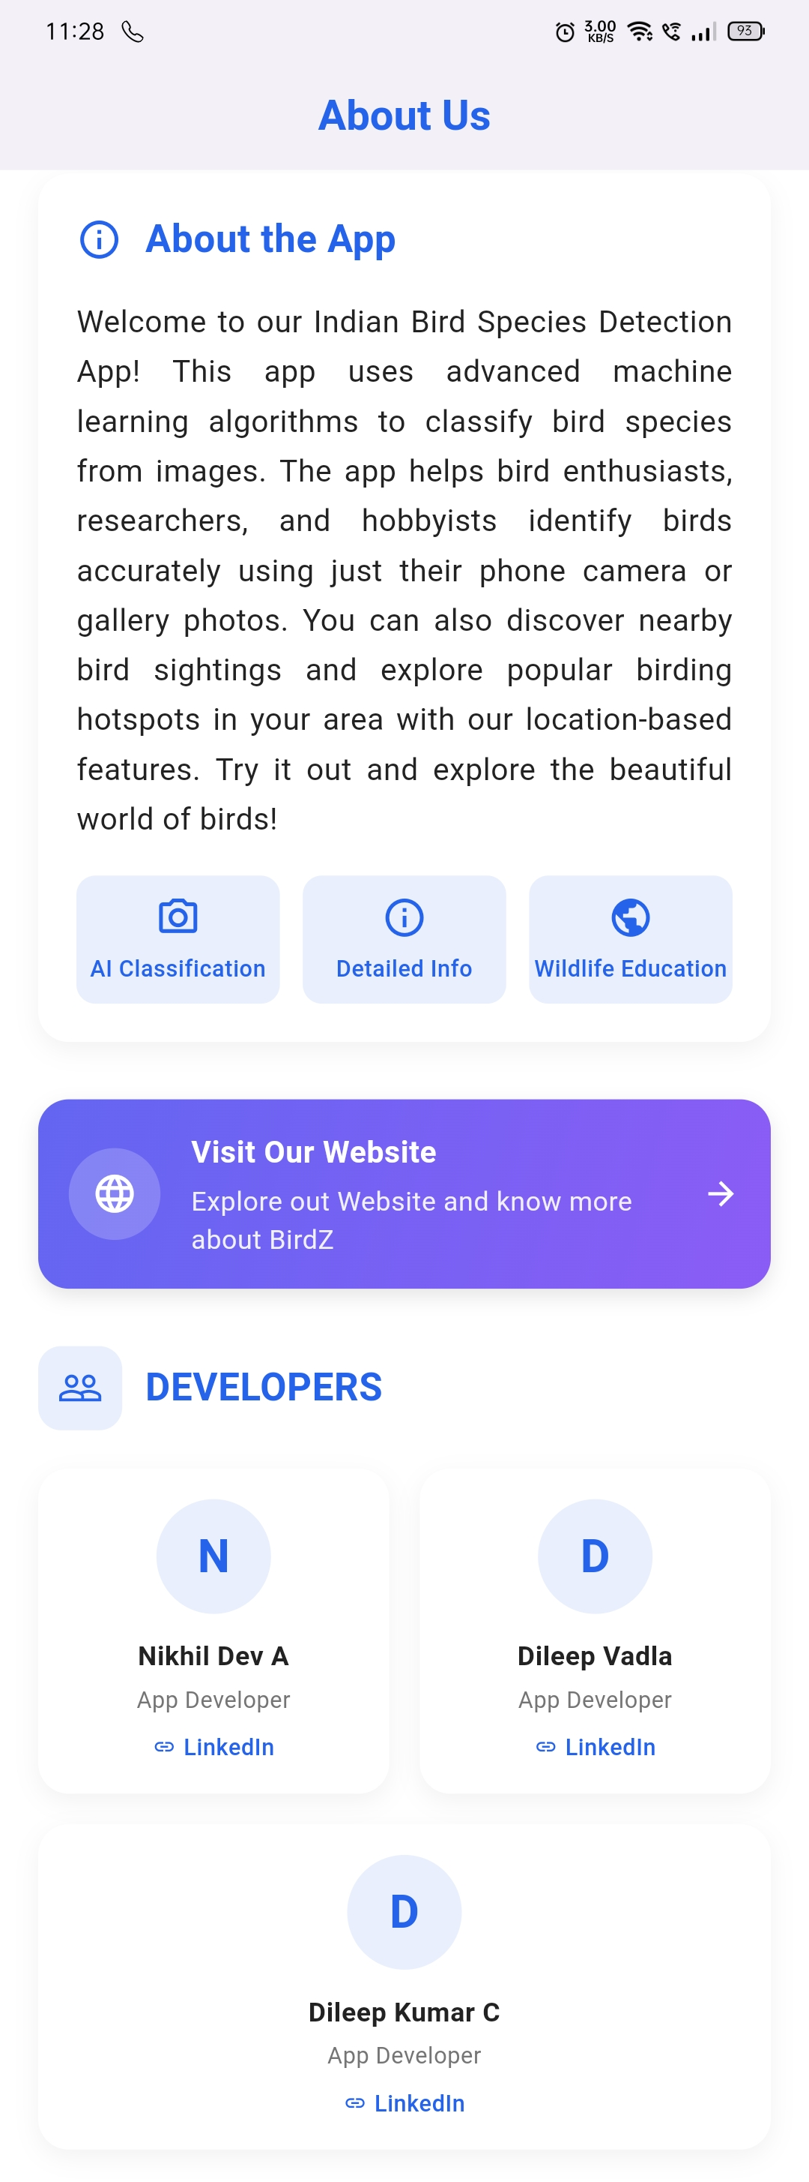
About Us Page – Get to Know the Team & Tools
The "About Us" page provides users with:
A short introduction to the BirdZ app,
its purpose, and its development journey.
Contact details
including an email for questions, suggestions, or support.
And for researchers, or anyone who needs to classify multiple bird images in bulk, we provide access to our Telegram Bot.
Telegram Bot
Users can use this bot to upload batches of
bird images and receive classifications at scale
perfect for enthusiasts or conservation projects.

Slide 21
CONCLUSION
The BirdZ mobile application successfully integrates deep learning, cloud infrastructure, and mobile development to provide an intelligent and user-friendly platform for Indian bird species identification. By leveraging a custom-curated and augmented dataset, powerful models like EfficientNet B7 for classification and YOLOv8 for validation, and deploying via scalable AWS services, the app delivers fast, accurate, and With a Flutter-based UI and seamless image input through camera or gallery, BirdZ helps users identify bird species easily while encouraging interest in India’s diverse birdlife. The project demonstrates the effective synergy of AI and mobile technology in creating impactful, real-world solutions.

Slide 22
Thank You

