Slide 1
Multi-Cancer Gene Expression Analysis
TCGA-style dataset — summaries, DE, clustering, ML

Slide 2
Dataset Summary
Samples: 9263, Genes: 716
Top cancer types by N: BRCA, UCEC, KIRC, LUAD, LGG
Top 5 variable genes: UBB, HIST1H1C, UBC, PFN1, DAXX

Slide 3
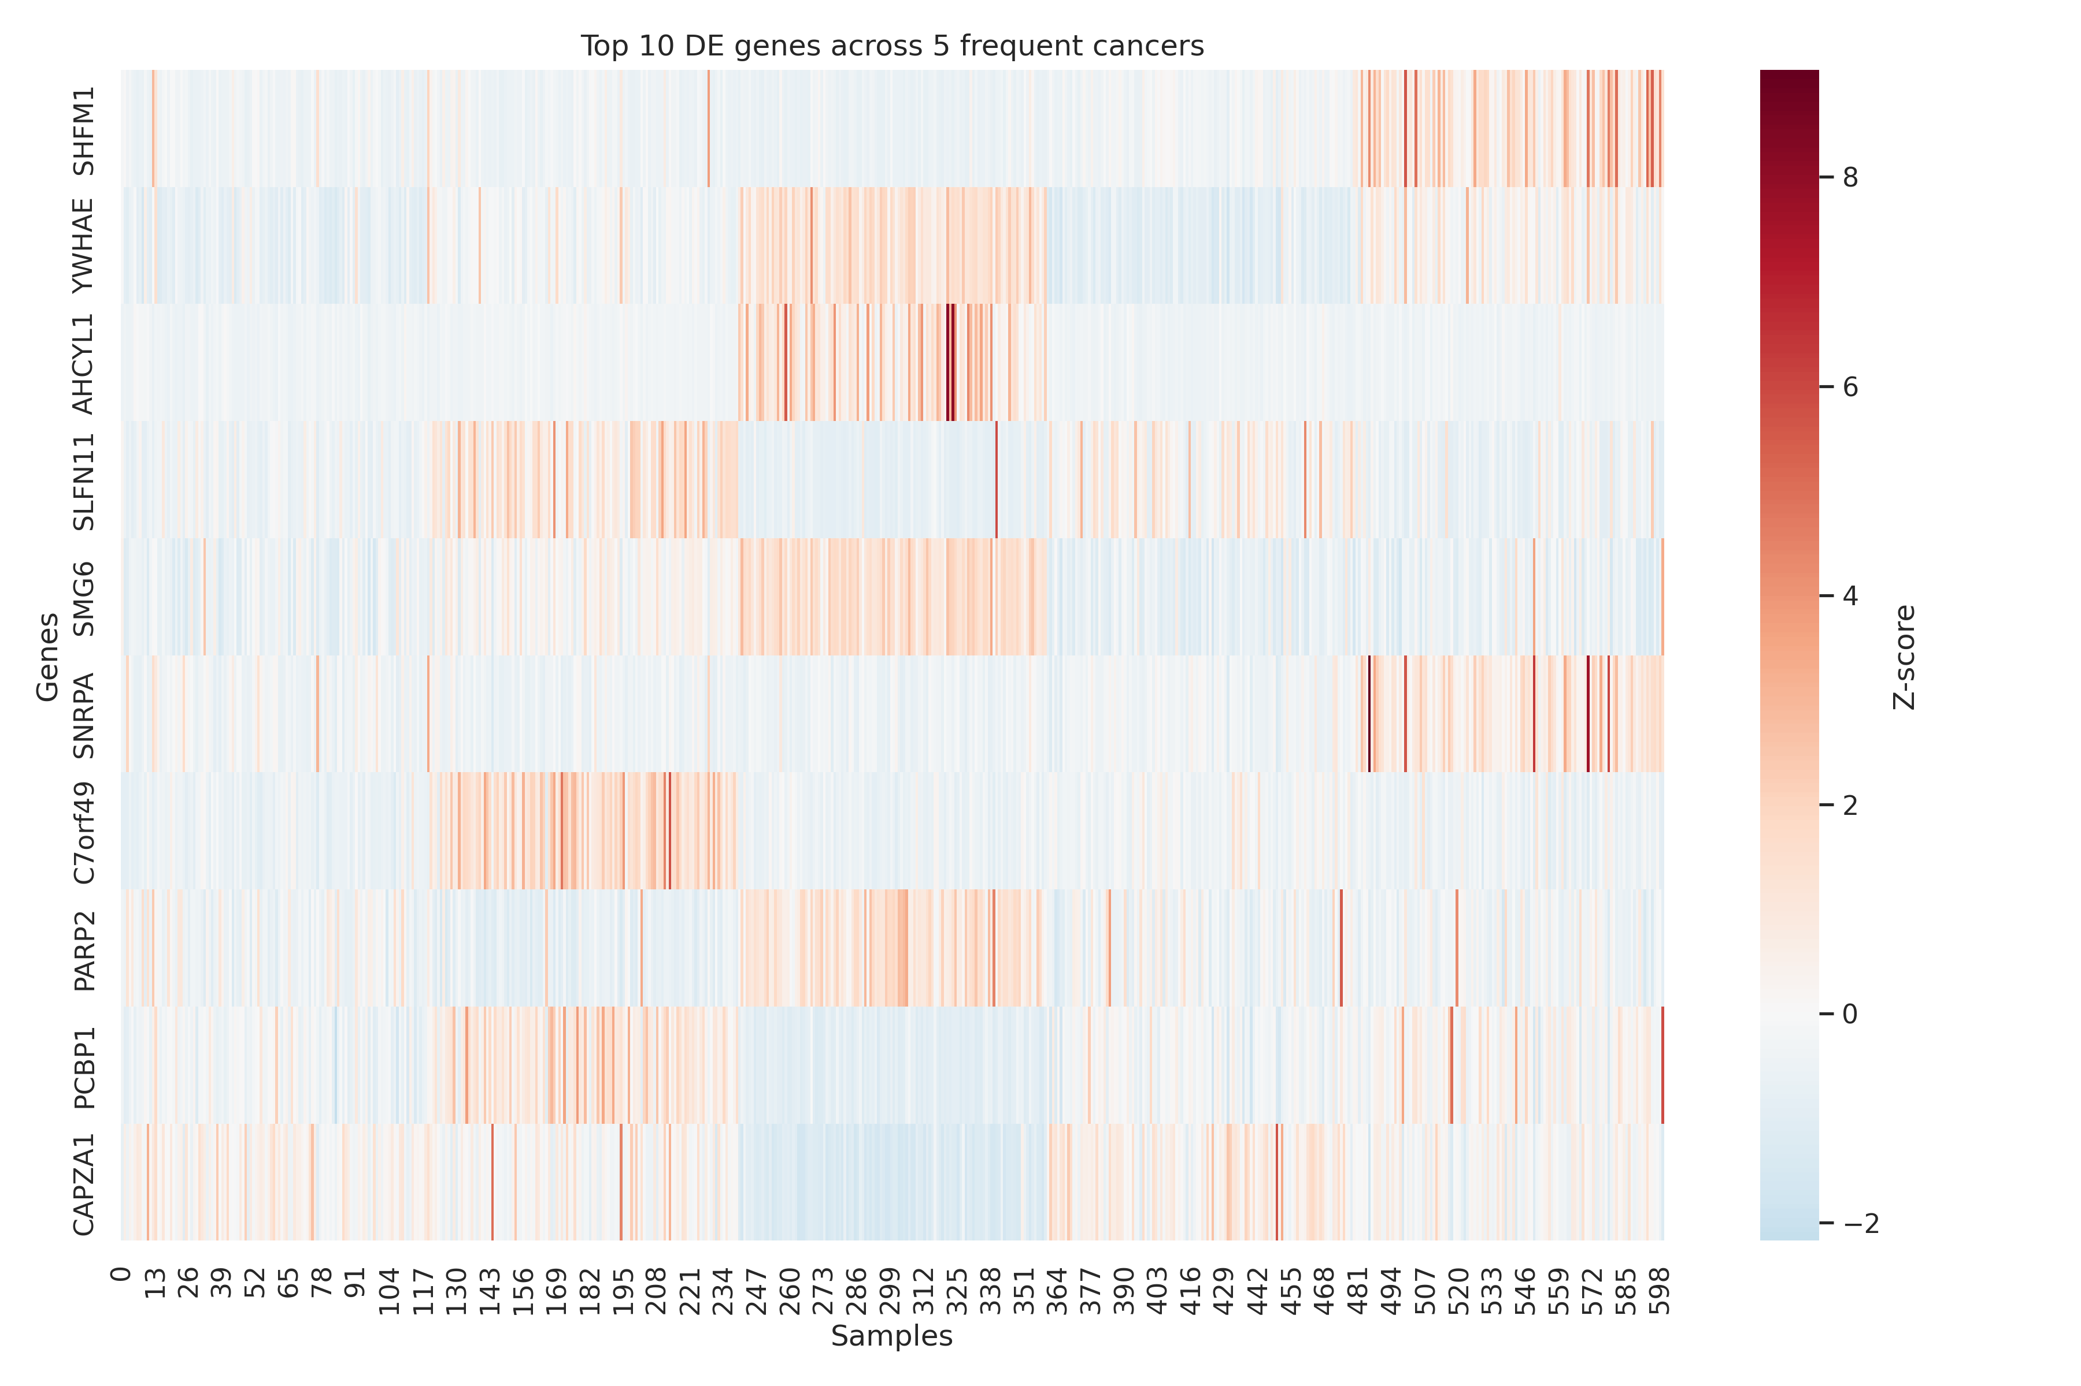
Differential Expression Heatmap
Top 10 DE genes (ANOVA) across 5 most frequent cancers

Slide 4
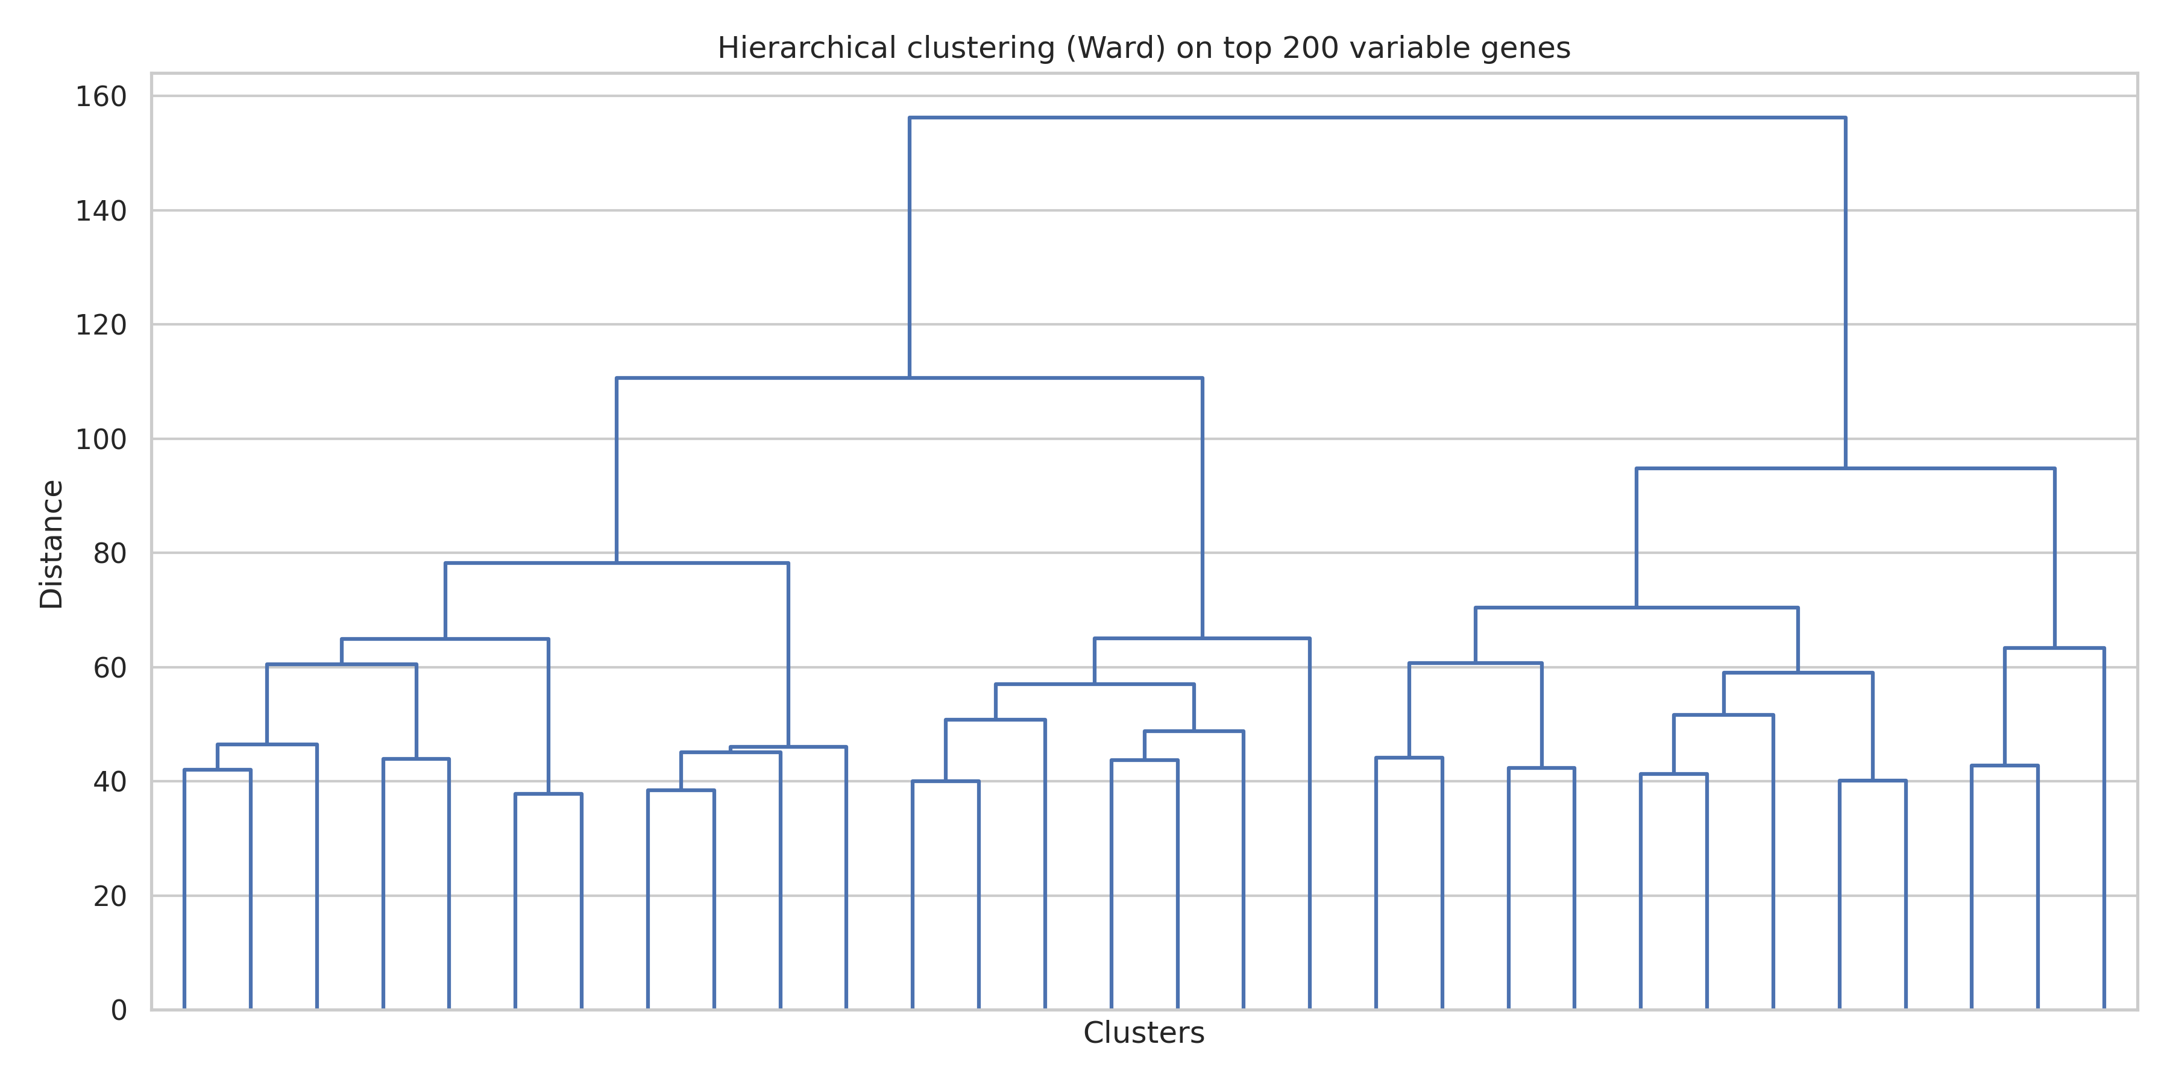
Hierarchical Clustering
Ward linkage on top 200 variable genes

Slide 5
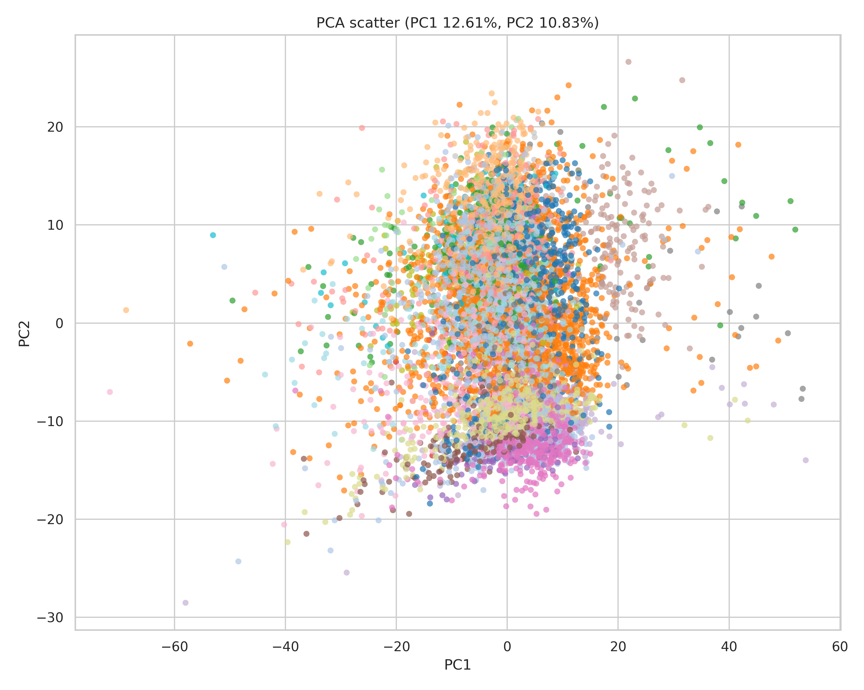
PCA (PC1 vs PC2)
Explained variance: PC1 12.61%, PC2 10.83%

Slide 6
Model Performance
Best model: Ensemble(RandomForest+RandomForest)
Accuracy: 0.895
Full report: outputs/model_report.csv; CV: outputs/model_search_results.csv
Top genes: SOX9, RASSF7, IDH1, PIAS3, CCNA1, SNAI2, CCND1, CCND2, NCAPD3, CCNE1

Slide 7
Biomarkers for BRCA (LogReg)
Top positive-weight genes: ESR1, RUNX1, RAD21, SETMAR, LEO1, PIAS4, PPP6C, GRB2
Full coefficients: outputs/logreg_coefs_BRCA.csv

Slide 8
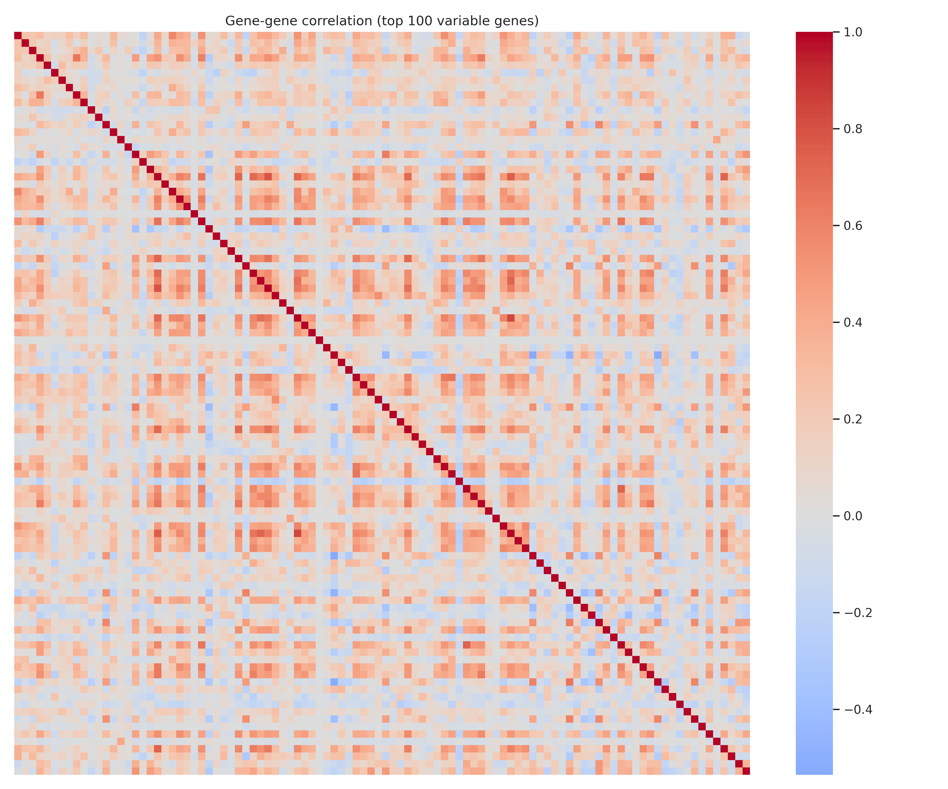
Gene-Gene Co-expression
Pearson correlation among top 100 variable genes

