Slide 1
Simple RISC processor
Our Project group consists of :
Kancharla Nikhilesh Bhagavan-(20114043)
Kudikala Rishikesh-(20114046)
Madamanchi ashok Chowdary-(20114052)
Mallamgari Nithin Reddy-(20114053)
Kyamaji vedanth Vardhan-(20114048)
Baddam Venkat praneeth reddy-(20114020)
Murthati mahi babu-(20114058)
Macharla sri Vardhan-(20114051)

Slide 2
INDEX
1.Problem Statement(3)
2.Assumptions to be noted(4)
3.Stages of working of SimpleRisc(5)
4.Instruction and Address format(6-9)
5.Assembler code(10-11)
6. Instruction Fetch(12)
7.Operand Fetch(13-15)
8.Registerfile(16-19)
9.Register writeback(20)
10.Execution unit(21-25)
11.Memory Access(26-27)
12.DataPath(28)
13.Control Unit(29-32)
14.Example(33-35)

Slide 3

Problem Statement
Designing a 32-bit Simple Risc processor which executes instructions from an instruction set(23 instructions) that are simple and having simple addressing modes. We also designed an Assembler using java which interprets assembly language instructions and convert into machine instructions.

Slide 4
Some of the assumptions and points to be noted:
The instruction set architecture we employed in this processor is RISC.
Our desired processor performs arithmetic, logical, bitwise, load, store, move operations.
We will use register for ALU architecture which are general-purpose registers which store only integer values as discussed earlier.
We also limited the number of registers to 16 and which store a 32-bit integer each.
We assume that the processor implements in Big-Endian Representation and has Van-Neuman view of memory.
We are assuming to have 4 bytes in an address of memory we are using i.e. each instruction of 32-bits is stored in a single address.

Slide 5
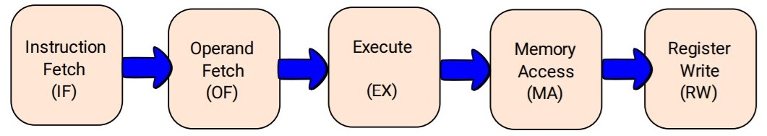
The different stage of working of a RISC processor that we implemented.

Slide 6
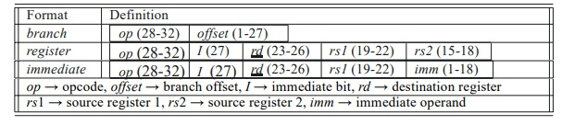
Instructions and Address Format
Address Format:

Slide 7
The length of Address word in this processor is 32-bit in which 5-bits are occupied by opcode as we are having 23 instructions in total.
The contents of immediate values are embedded in instruction only rather than storing it in separate space.
We use 2-bits of space for modifier as some instructions need them and 1-bit for a Boolean value which depicts whether we are dealing with immediate values or not.
And 4-bits for each register as we are having 16 registers in total.
For an instruction the number of registers vary from 1-3 depending on type of instruction.

Slide 8
Opcodes for the instructions
add 00000
sub 00001
mul 00010
div 00011
mod 00100
cmp 00101
and 00110
or 00111
not 01000
mov 01001
lsl 01010
lsr 01011
asr 01100
nop 01101
ld 01110
st 01111
beq 10000
bgt 10001
b 10010
call 10011
ret 10100
xor 10101
xnor 10110

Slide 9
Instruction Format(23 instructions)
add rd, rs1, (rs2/imm)
sub rd, rs1, (rs2/imm)
mul rd, rs1, (rs2/imm)
div rd, rs1, (rs2/imm)
mod rd, rs1, (rs2/imm)
cmp rs1, (rs2/imm)
and rd, rs1, (rs2/imm)
or rd, rs1, (rs2/imm)
not rd, (rs2/imm)
mov rd, (rs2/imm)
lsl rd, rs1, (rs2/imm)
lsr rd, rs1, (rs2/imm)
asr rd, rs1, (rs2/imm)
nop
ld rd, imm[rs1]
st rd, imm[rs1]
beq offset
bgt offset
b offset
call offset
Ret
xor rd, rs1, (rs2/imm)
xnor rd, rs1, (rs2/imm)

Slide 10
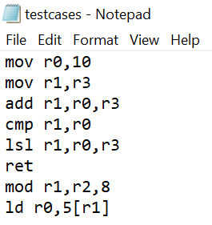
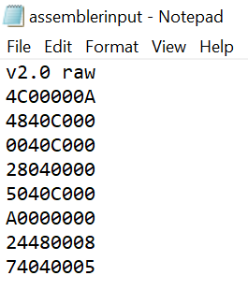
Assembler Code
Assembler code converts the low-level language in assembly program into a hexadecimal instruction which is used by the risc processor to process the instructions.
The assembly code takes the instructions in the test case file as input and then writes a new file named assembler input with all the hexadecimal instructions corresponding to the testcase instructions. The below diagrams show the input and the corresponding hexadecimal code.
This diagram shows the testcase format This diagram shows the assembly output

Slide 11
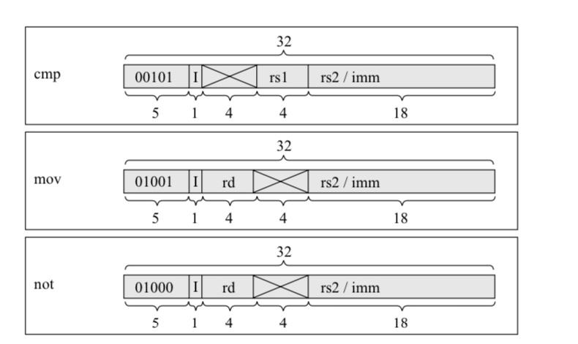
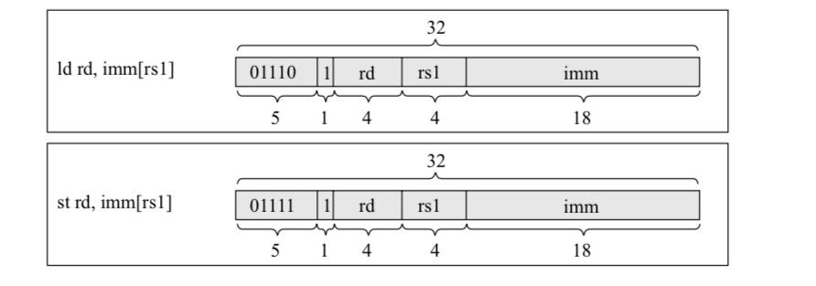
Various Type of instruction formats

Slide 12
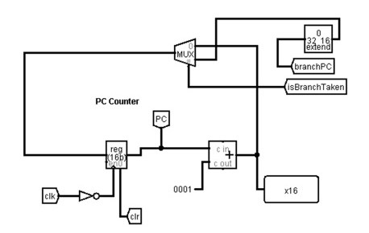
Instruction fetch
Instruction fetch unit fetches the instruction from the instruction memory which is currently stored in the PC and computes the address of the next Instruction.
At the end of the fetch operation, the PC points to the next operation which is to be read at the next cycle.

Slide 13
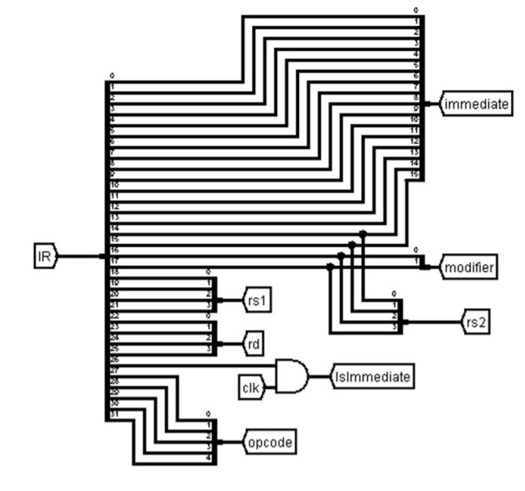
Operand fetch
The important functionalities of OF are:
Calculating the value of the immediate operand taking in the account of modifiers and the branch target by encoding the offset embedded in the instruction.
Also, it decides which registers are involved in the given instruction.

Slide 14
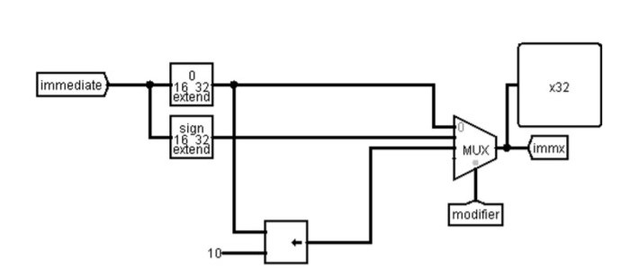
Immediate Calculation
The least significant 18 bits from the instruction are separated using splitter. In this 18 bits, the 18th and 17th bits are the modifiers bits, with the help of the multiplexer and the modifier bits we extract the 32-bit format of the immediate.

Slide 15
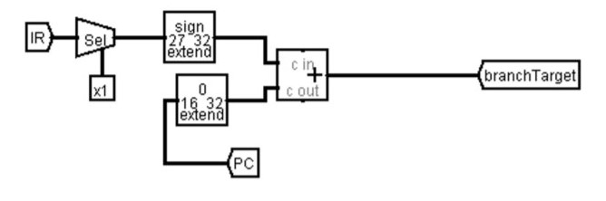
Branch taken:
For branch target, first we need to extract the offset(1 to 27 bits) from the instruction using splitter and extend its sign to make it 32-bit number.
As we use PC-relative addressing mode, we must add PC to this 32-bit offset to get the branch target.

Slide 16
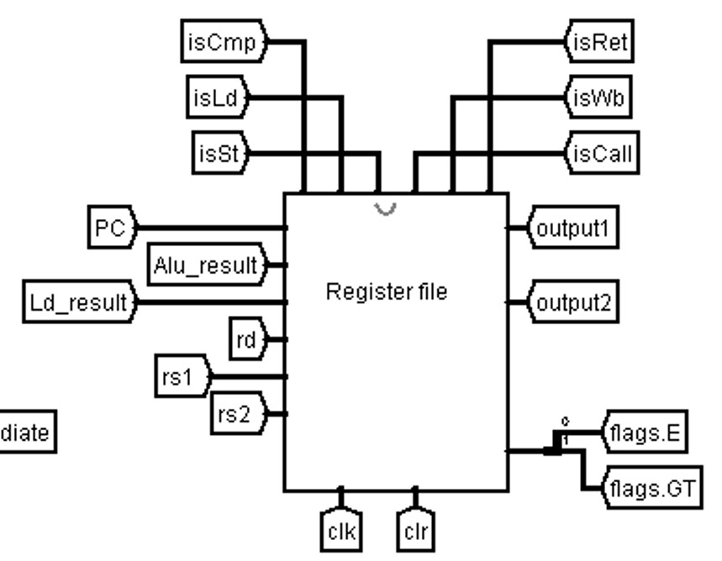
Register File

Slide 17
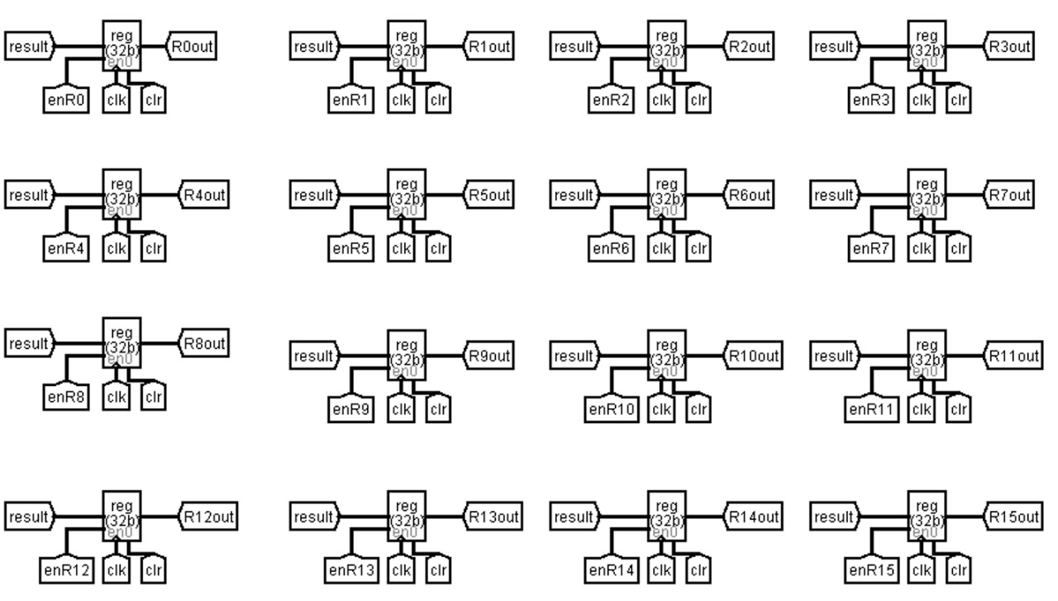
Registers
We designed the processor consisting of registers which only store integer values.
These are the 16 registers we use for this processor.
R15 is the return address register.

Slide 18
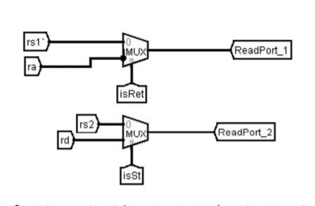
Register file read.
The register file has two read ports.
For MUX-1:
The two inputs are rs1 or ra(for ret inst.)
For MUX-2:
The two inputs are either rs2 or rd(for store inst.)
It gives the read port addresses as the output.

Slide 19
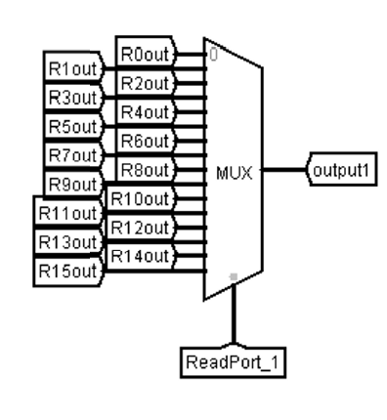
Register file read.
Here, the multiplexer takes address from the ReadPort_1 and gives the output1 which is stored in the register that is to be read.
Similarly, it takes the ReadPort_2 address and gives the output 2 which will further be used for the execution.

Slide 20
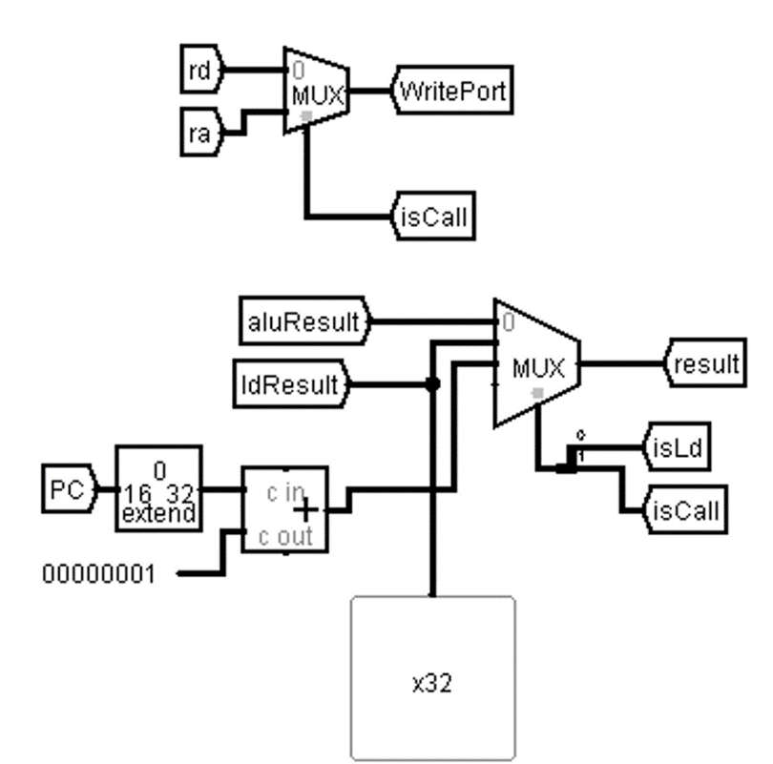
REGISTER WRITEBACK UNIT
In this step, we will write back the calculated values back to the register file. That calculated value can be ALU result or output of load instruction or the return address in the case of call instruction.
We have three inputs for the multiplexer i.e., aluResult, ldResult and return address and the output is result which will be stored into the suitable register.
Here we use the control signals isLd and isCall as selection bits for the multiplexer.

Slide 21
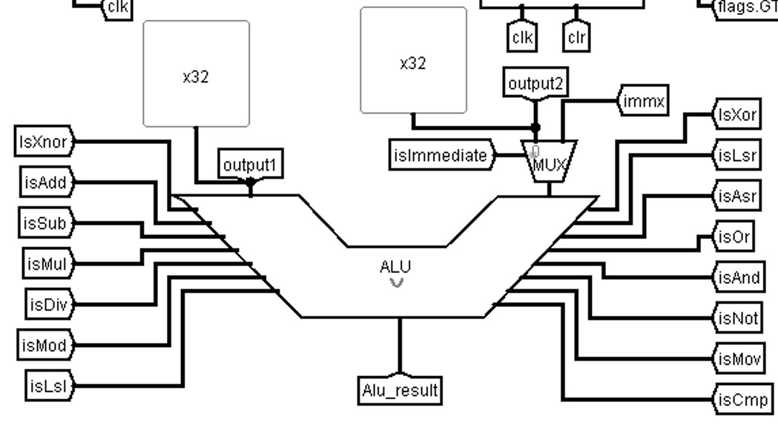
EXECUTION UNIT

Slide 22
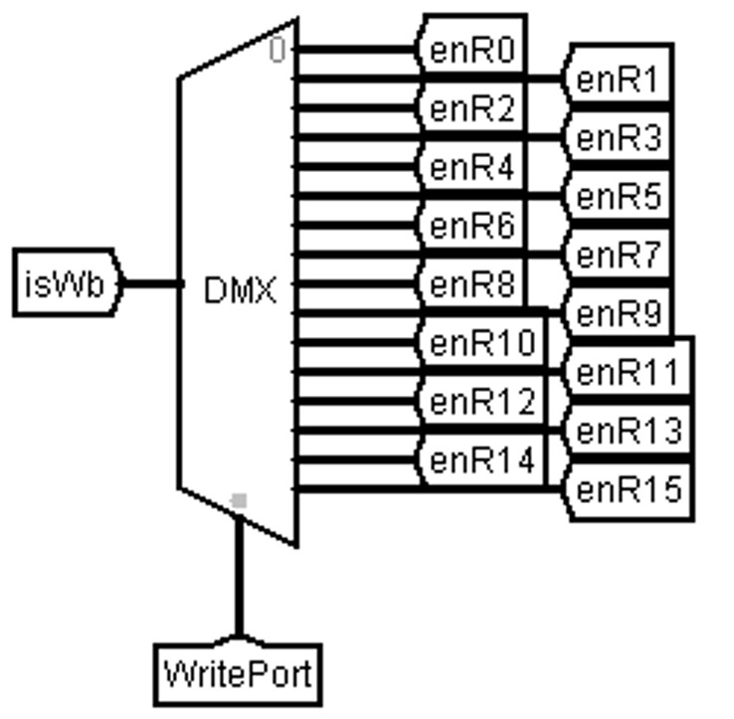
Using this demultiplexer we choose the register to be enabled for
writing back the result.

Slide 23
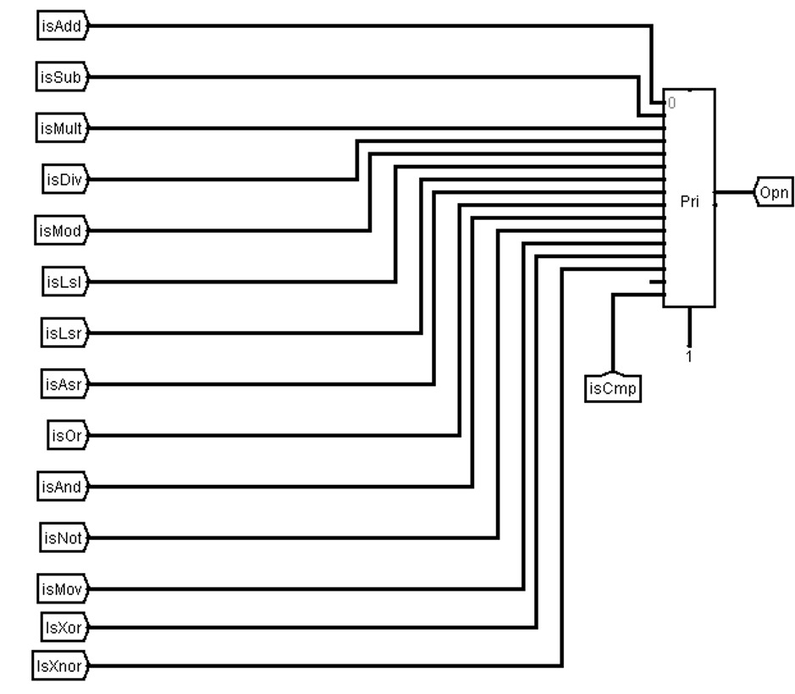
ALU
Based on the control signals generated, we choose from different arithmetic operations like addition, subtraction, etc. by encoding the operation into opn tunnel.

Slide 24
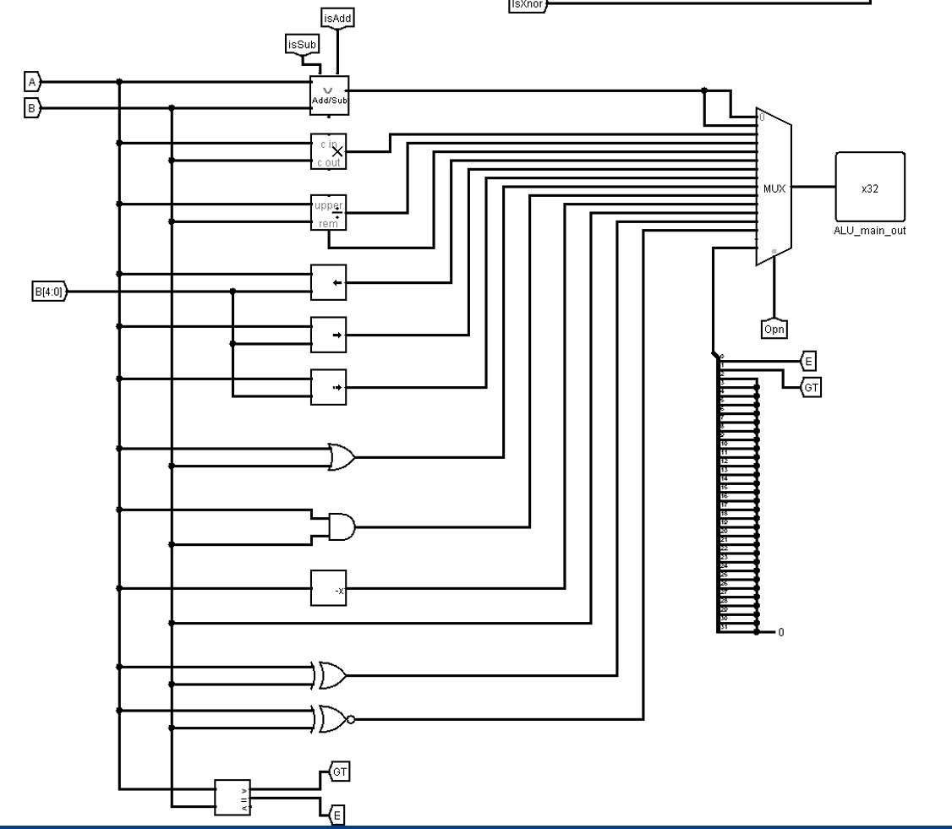
Execution of operations
We perform several operations using adder/subtractor, multiplier, divider, comparator and shift operations, etc.
We choose the main output of the ALU from among the outputs of these operations using a multiplexer which has opn as select input and generate it as ALU result.

Slide 25
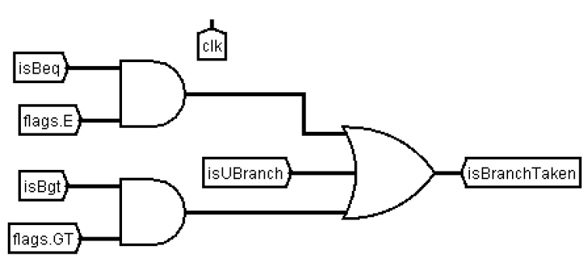
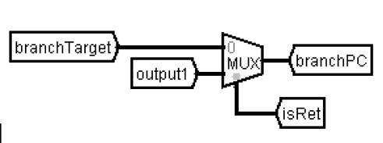
BRANCH UNIT
IsBranchTaken takes the value 1 when isBeq/isBgt operation is applicable and required comparisons satisfy or isUBranch is taken.
BranchPC chooses branchTarget in case of ret instruction.
This branchPC is loaded into PC when isBranchTaken is 1.

Slide 26
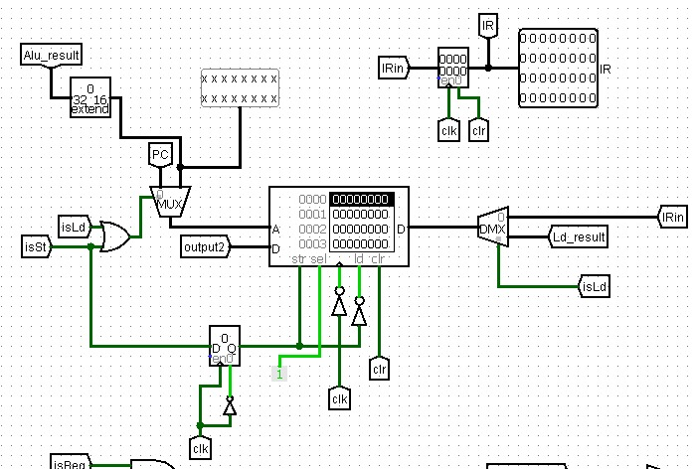
MEMORY ACCESS

Slide 27
RAM
This part of the circuit is memory (RAM).
It is used to store instructions that have been loaded into it after the assembly code converts assembly language to hexadecimal instruction code.
We fetch the instructions from this unit and load them into the Instruction register (IR).
We also use this unit to store and load data. As you can see, there is a multiplexer which selects the Alu_result input instead of PC which is for instruction fetch, when there is a load or store instruction.
Alu_result is basically the address into/from which the data is being stored/loaded. Output 2 is generally the data from the register (which has the data that we need to store in the memory).

Slide 28
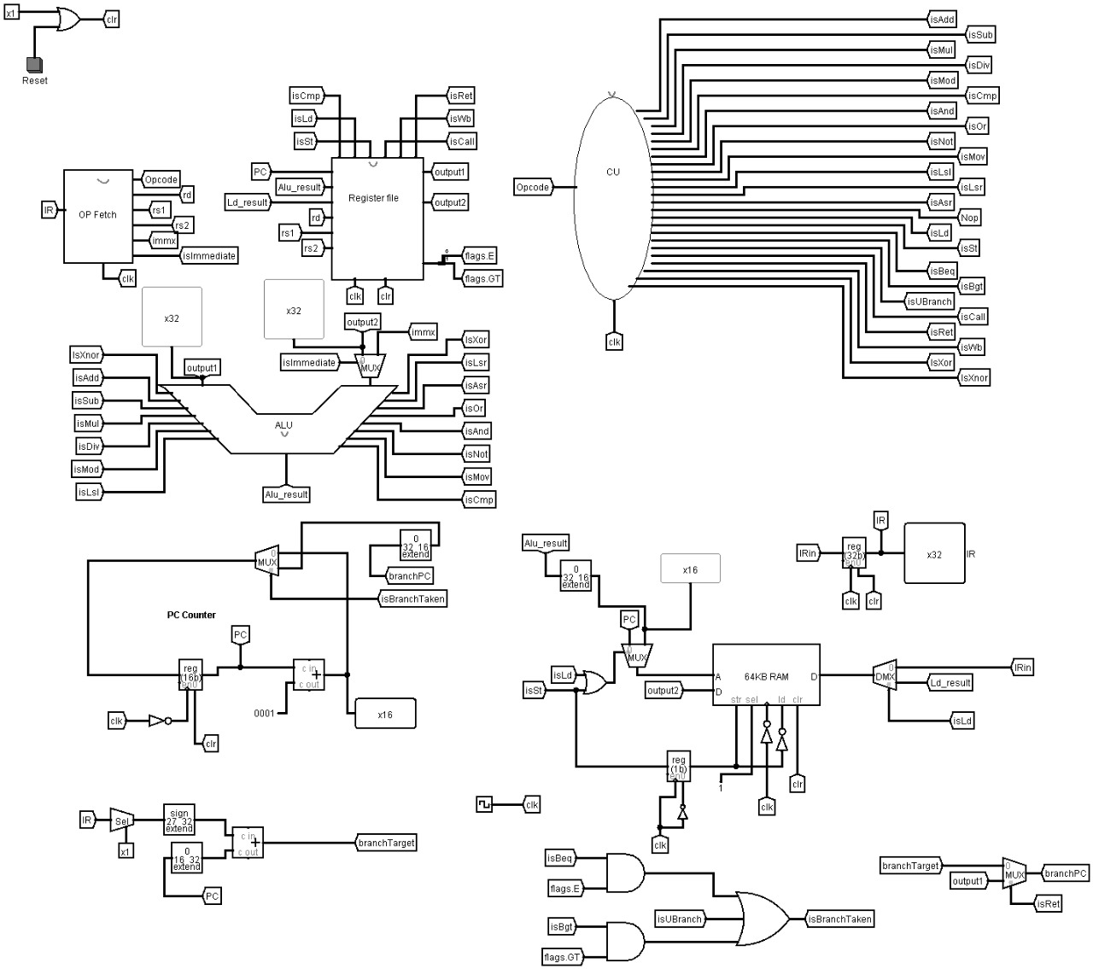
DATA PATH – Combining all the five stages.

Slide 29
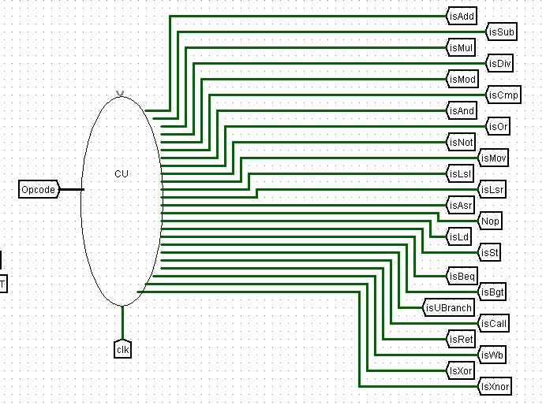
CONTROL UNIT
The control unit (CU) is a component of a computer's central processing unit (CPU) that directs the operation of the processor.
It takes in the “Opcode” as input and gives out control signals which are further used in different stages like register write/read, execution and operand fetch unit.

Slide 30
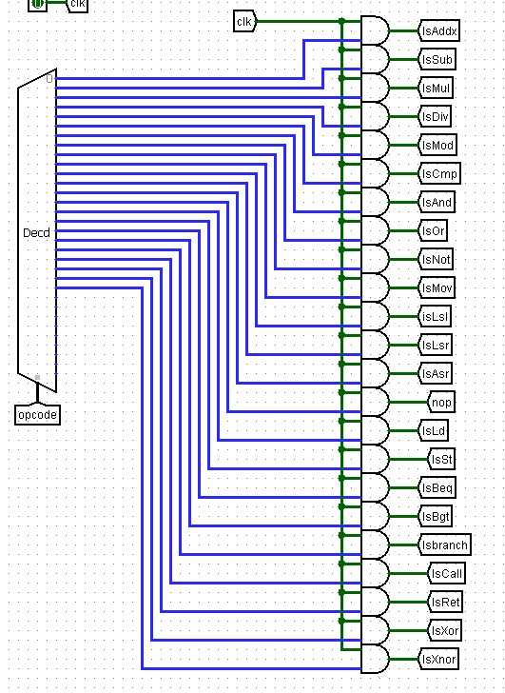
Opcode passed as selection bits for the above decoder which performs the action of identifying which output should 1.
If the opcode is 00000, the value of signal IsAddx is made 1.
If the opcode is 00001, then the value of signal IsSub is assigned 1. Similarly, the remaining signals are also assigned based on the value of opcode.

Slide 31
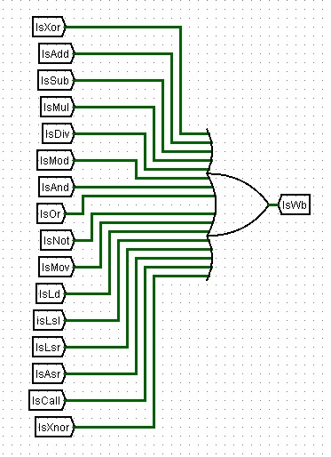
IsWb signal is activated, when one of the given inputs :
IsAdd IsSub, IsMul, IsDiv, IsMod IsAnd, IsOr, IsNot, IsMov, IsLd, IsLsl, IsLsr, IsAsr, IsCall, isXor, isXnor is activated.
This is to send the signal to writeback the result into the register after one of these operation.

Slide 32
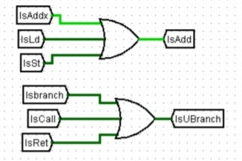
IsAdd is activated whenever one of the IsAddx, IsLd, IsSt signals are active as the add operation in ALU is used for adding memory address too.
Ex: ld r2, 4[r0]
Here, ALU calculates memory address as [r0+4] and the value in that memory address is loaded into register r2.
Similarly, IsUBranch is activated whenever one of the Isbranch, IsCall , IsRet is 1. We have again used nor gates to implement this logic.

Slide 33
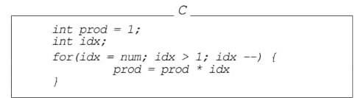
An example: Calculate factorial of 5
Assembly language
High level language
mov r0, 5
mov r1,1
mov r2,r0
.loop
mul r1,r1,r2
sub r2,r2,1
cmp r2,1
bgt .loop

Slide 34
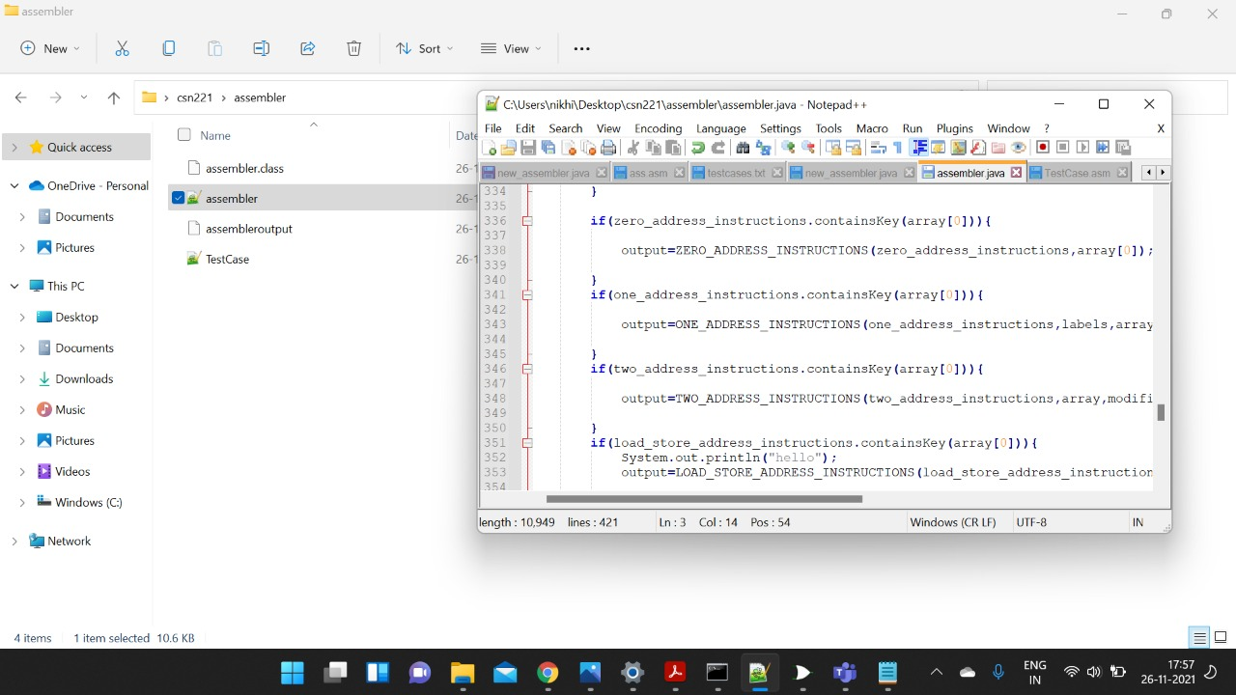
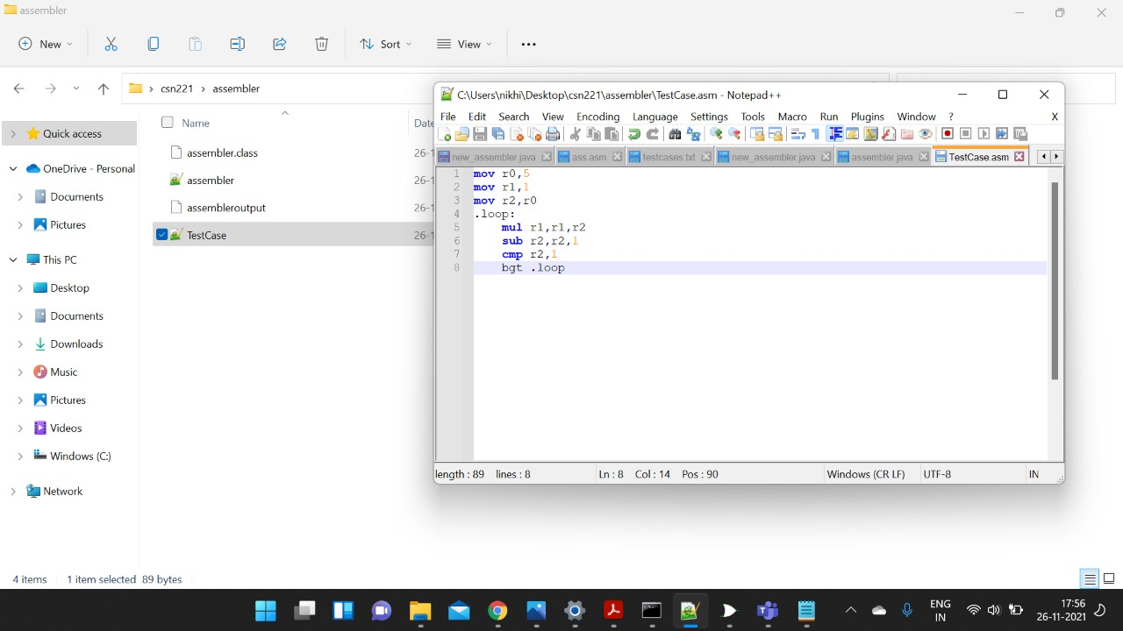
Assembler when run converts assembly language into hexadecimal instructions which are loaded into the memory
Assembler code
Testcase assembly program

Slide 35
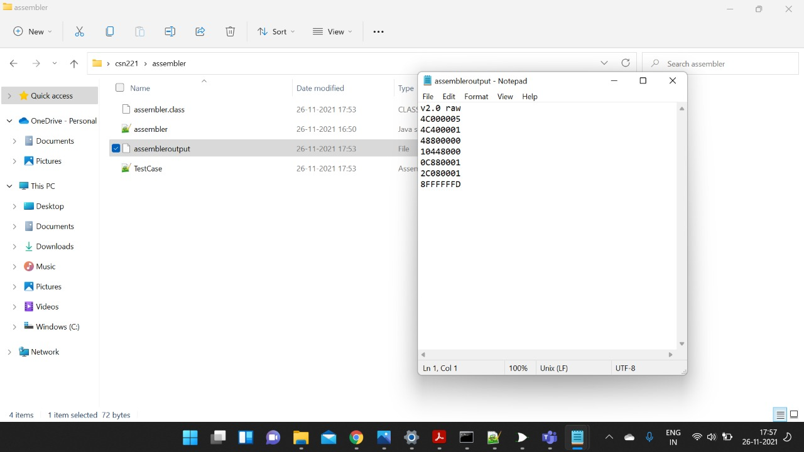
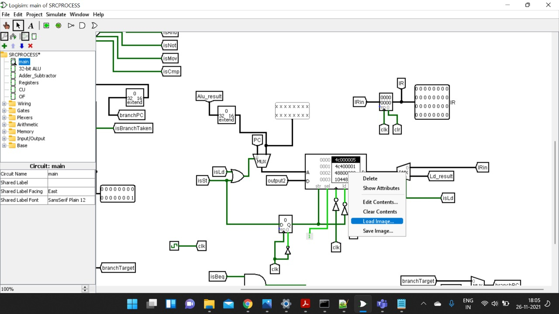
Assembler output file
Instructions loaded into the memory
Now let's see the simulation of this program in Logisim…

