Slide 1
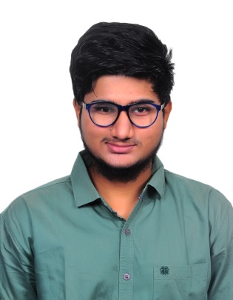

Nikhileswara Sri Venkat Muraharirao
Analyst/Software Engineer
Bachelor of Technology,
Electronics and Communication Engineering : 2018-22
Azure Fundamentals AZ-900 Certification
Skills
muraharirao-nikhileswara.sri-venkat@capgemini.com
C# | Basics, OOPS, Exception Handling ,Arrays ,Collection and Generics, Delegates and Events, File Io and Serialization.
.NET Framework | Architecture which includes CTS,CLS,FCL,BCL and CLR.
Ado.net | Basics Architecture
Database | SQL
Tools | GIT,POSTMAN
UI Technology | HTML5 ,CSS & Angular
Add On Skills | Communication Skills, Team Management
+91 8978965137
A4
Full Stack Developer
Understanding of RDBMS concepts using SQL Server.
Practical understanding of C# and SQL concepts using Visual Studio and SQL Server
Hands on experience in developing applications using .NET Framework, ADO.NET Core
Understanding of HTML5 , CSS and Angular Cli
Certified in Azure Fundamentals & completed AZ-900 certification.
Completed case study on Flight Booking System which is a Web based System. It is an efficient system which allows passengers’ to book their flight on their own. The application provides them user-friendly functionalities .The main objective of Fight Booking System is to act as a bridge between passenger and the airways by allowing the customer(passenger) to book the flight ticket from anywhere to anywhere around the world.
Technologies used:
ANGULAR
ASP.NET CORE
Microsoft SQL Server
Video Link : Click
GitHub-Link : https://github.com/NikhileshNikky
https://github.com/sdsameer07

