Slide 1
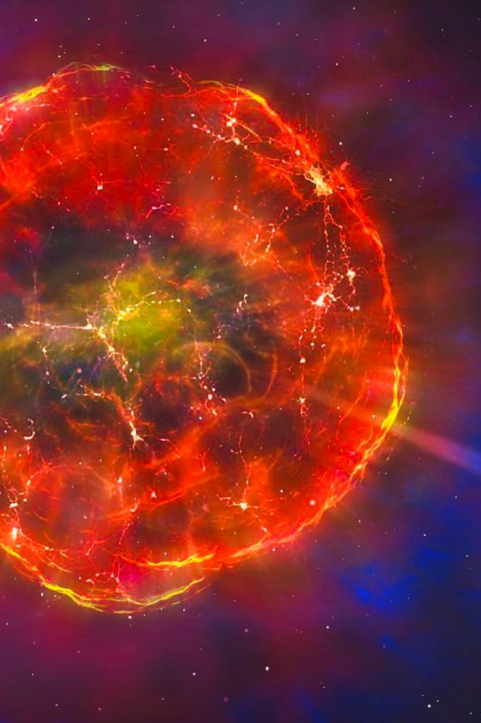


Supernovae: A Journey into the Heart of the Stars
Supernovae are the explosive dying stages of some of the most massive stars in the universe. In this presentation, we'll explore the fascinating science behind these cosmic events.
by Nikhileswar reddy Pochimireddy

Slide 2

What Causes a Supernova?
Core Collapse
Supernovae occur when a star's core runs out of fuel and can no longer support itself against gravity. The core collapses, causing a shockwave that blows off the star's outer layers into space.
Triggered Explosion
In some cases, a supernova can also be triggered by the sudden ignition of nuclear fusion in the star's outer layers, producing a runaway reaction that blows the star apart.

Slide 3

The Math of Supernovae
1
Pre-Supernova
Our understanding of supernovae relies on complex mathematical models that incorporate everything from nuclear reactions to fluid dynamics. Before a star explodes, we can use these models to predict what kind of supernova it will produce.
2
During the Explosion
During the supernova itself, the equations of physics become even more challenging. Scientists study the light, neutrinos, and other particles emitted by the explosion to better understand how the star died and what it was made of.
3
Aftermath
Finally, we use simulations to model the aftermath of supernovae, including the formation of neutron stars and black holes, the spreading of heavy elements through interstellar space, and the impact of supernovae on their surrounding galaxies.

Slide 4
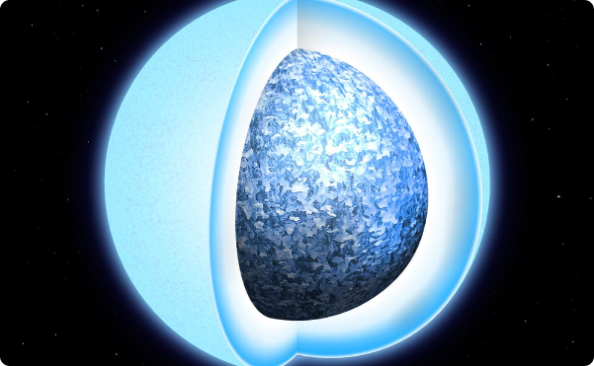
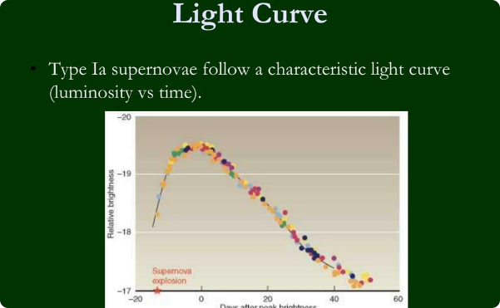
Type Ia Supernovae: Cosmic Explosions as Standard Candles
Binary Systems
Standard Candles
Type Ia supernovae occur in binary star systems where one star is a white dwarf and the other is a companion star. When the white dwarf accretes enough material from its companion, it can ignite carbon fusion and explode.
Type Ia supernovae are particularly useful for measuring the distances to faraway galaxies because they all have a similar brightness, or luminosity, that can be used to create a "standard candle" that astronomers can use to gauge distance.

Slide 5
Type II Supernovae: The Death of Massive Stars
1
Progenitor Stars
Type II supernovae are the most common type of supernova and occur in massive stars that have run out of nuclear fuel. These stars fuse progressively heavier elements in their cores until they reach iron, at which point they collapse.
2
Core Collapse
When the core of a massive star collapses, it creates a shockwave that propagates outward, blowing off the star's outer layers into space. The explosion can outshine entire galaxies and leave behind a neutron star or black hole.
3
Heavy Elements
Type II supernovae are also responsible for creating the heaviest elements in the universe, including gold, platinum, and uranium. These elements are then dispersed throughout space, eventually becoming part of new stars and planets.

Slide 6
The Role of Supernovae in Galactic Evolution
Formation of Black Holes
Chemical Enrichment
Cosmic Ray Production
Supernovae are the primary mechanism for forming black holes, the most mysterious objects in the universe. They also provide astronomers with unique opportunities to observe black holes and study the extreme physics that governs their behavior.
Supernovae are also key players in the evolution of galaxies. When they explode, they release heavy elements like carbon, nitrogen, and oxygen into interstellar space, enriching the material from which new stars and planets form.
Finally, supernovae are one of the primary sources of cosmic rays, high-energy particles that constantly rain down on Earth from deep space. Studying these particles can tell us about the most energetic processes in the universe.

Slide 7
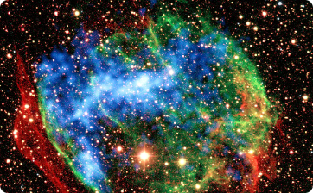
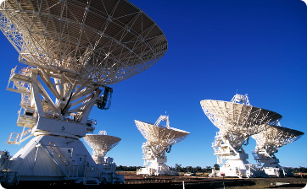
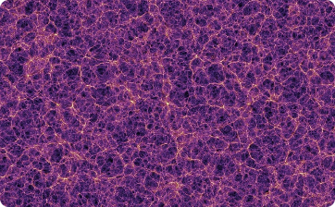
Wrapping Up: How Studying Supernovae Helps Us Understand the Universe
Cosmic "Fossils"
The Future of Supernova Science
Awe-Inspiring Scale
Supernova remnants, the glowing gas clouds that mark the aftermath of supernovae, are like cosmic "fossils" that provide a window into the life and death of stars. By studying them, we can learn about everything from the birth of the first stars to the ultimate fate of the universe.
Finally, studying supernovae can help us appreciate the incredible scale and beauty of the universe. These explosions are among the most powerful events in the cosmos, and they remind us of our place in a vast and mysterious universe that is waiting to be discovered.
In the coming decades, astronomers will use powerful new telescopes and observatories to study supernovae in even greater detail. They hope to solve some of the biggest mysteries in astrophysics, from the nature of dark energy to the origins of life itself.

