Slide 1
Thinker’s Thinking about Amzn Web Service
Database Storage, analysis and Visualization using AWS. Jason Xu
Jake Lacombe
Nikhil Gupta
Keerthi Korivi

Slide 2
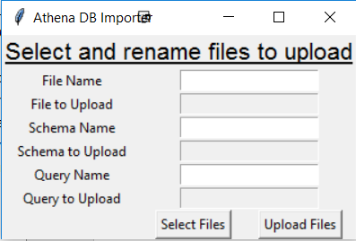
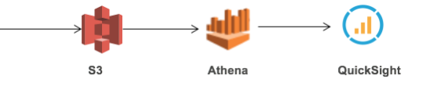
Project Model
The objective of our project is to build a data pipeline which helps in extracting insights from the data with faster turnaround time.

Slide 3
Problem with existing services
Managing Databases is Painful and Difficult. (example - Database corruption)
SQL Databases do not Work Well at Scale.
Hadoop is Difficult to Deploy and Manage.
Data Warehouses are Costly, Complex, and Slow.
Commercial Databases are Punitive and Expensive.
We believe AWS not only provides for reduced costs but also enables better, secure and scalable workflow and better infrastructure capabilities for the companies.

Slide 4
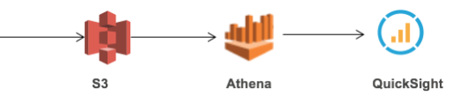
Amazon S3
Amazon Simple Storage Service (Amazon S3)
Makes it simple and practical to collect, store, and analyze data - regardless of format – all at massive scale.

Slide 5
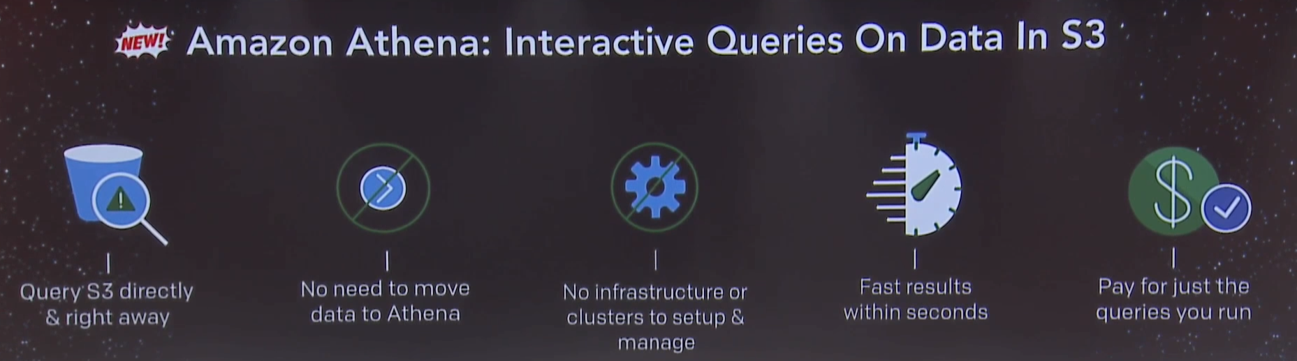
AWS Athena

Slide 6
Amazon Athena is an interactive query service .
Athena is ideal for quick, ad-hoc querying but it can also handle complex analysis.
Athena queries data directly in Amazon S3. There are no additional storage charges beyond S3.
Athena is server less, so there is no infrastructure to manage, and you pay only for the queries that you run.
Amazon Athena automatically executes queries in parallel, so most results come back within seconds.

Slide 7
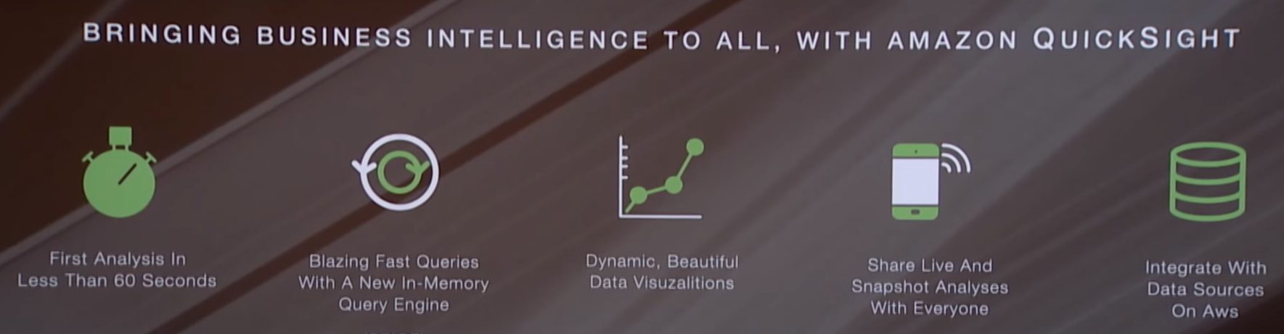
AWS QuickSight
Release date - November 15, 2016 3:00 PM GMT
You’ve got the data and you’ve got the questions. Now you want the insights!

Slide 8
Amazon QuickSight is a fast business analytics service to build visualizations, perform ad hoc analysis, and quickly get business insights from your data.
Fast Calculation
Low Cost - 1/10th the cost of on-premises solutions from the old guard.
Ease of Use - As you select tables and fields, it recommends the most appropriate types of graphs and other visualizations
Effortless Scale - provides fast analytics and visualization while scaling to handle to hundreds of thousands of users and terabytes of data per organization.

Slide 9
DEMO

Slide 10
Demo & Enhancements
The Athena to Quicksight manual interaction can be automated
Dynamic schema generation

