Slide 1
Secure Data Hiding in Image Using Steganography
CAPSTONE PROJECT
Presented By:
Student Name : Kuchana Nikhil
College Name & Department : SR University, CSE

Slide 2
OUTLINE
Problem Statement
Technology used
Wow factor
End users
Result
Conclusion
Git-hub Link
Future scope

Slide 3
Problem Statement
With growing digital communication, sensitive data protection is crucial. Traditional encryption methods are visible, and therefore steganography can be an alternative. The project integrates image steganography with password protection and encryption to securely hide messages in images for confidentiality and to prevent unauthorized access. The utility enables users to embed and recover encrypted messages using Least Significant Bit (LSB) encoding, which adds more security to information.

Slide 4
Technology used
Programming Language : Python
GUI Framework : Tkinter (for user interface)
Libraries :
Pillow (PIL) – For image processing
Stegano (LSB) – For hiding and retrieving messages in images
Cryptography (Fernet) – For encrypting and decrypting messages
Bcrypt – For password hashing and verification
Development Environment : VS Code, IDLE (Python)
Operating System Compatibility : Windows, Linux, and macOS
File Formats Supported : PNG, JPG (for steganography)

Slide 5
Wow factors
Dual -Layer Protection: Layers steganography and encryption to offer greater data security.
Hidden Message Storage: Used Least Significant Bit (LSB) encoding to store encrypted text inside images without visual alteration.
Password Authentication: Used Bcrypt hashing for secure authentication before the reveal of the hidden message.
Friendly GUI: Made with Tkinter, a user-friendly graphical user interface for easy encryption and decryption.
Cross -Platform Support: Works functionally compatible on Windows, Linux, and macOS operating systems and JPG as well as PNG file types-compatible.
Click and Download: Allows for people to instantly download the secured image with the click of a button, whereby it can then be shared at ease safely.

Slide 6
End users
Researchers & Students – Find and experiment with steganography, cryptography, and security principles.
Privacy - Conscious Users – Hide personal messages, passwords, or confidential information from unwanted access.
Journalists & Whistleblowers – Securely hide confidential data in images so that it cannot be traced.
Intelligence Agencies & Law Enforcement – Hide confidential information and send secure, encrypted messages.

Slide 7
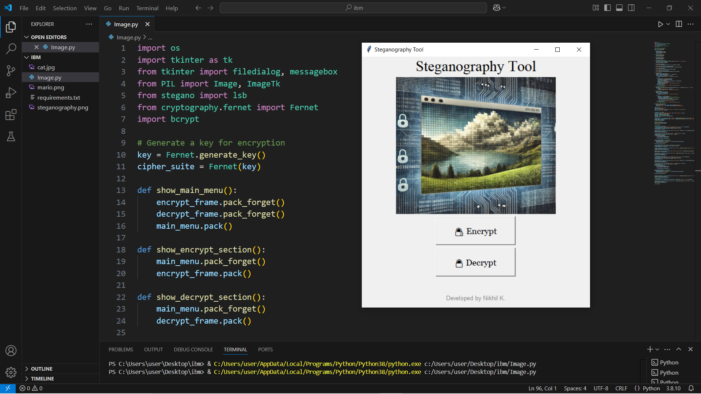
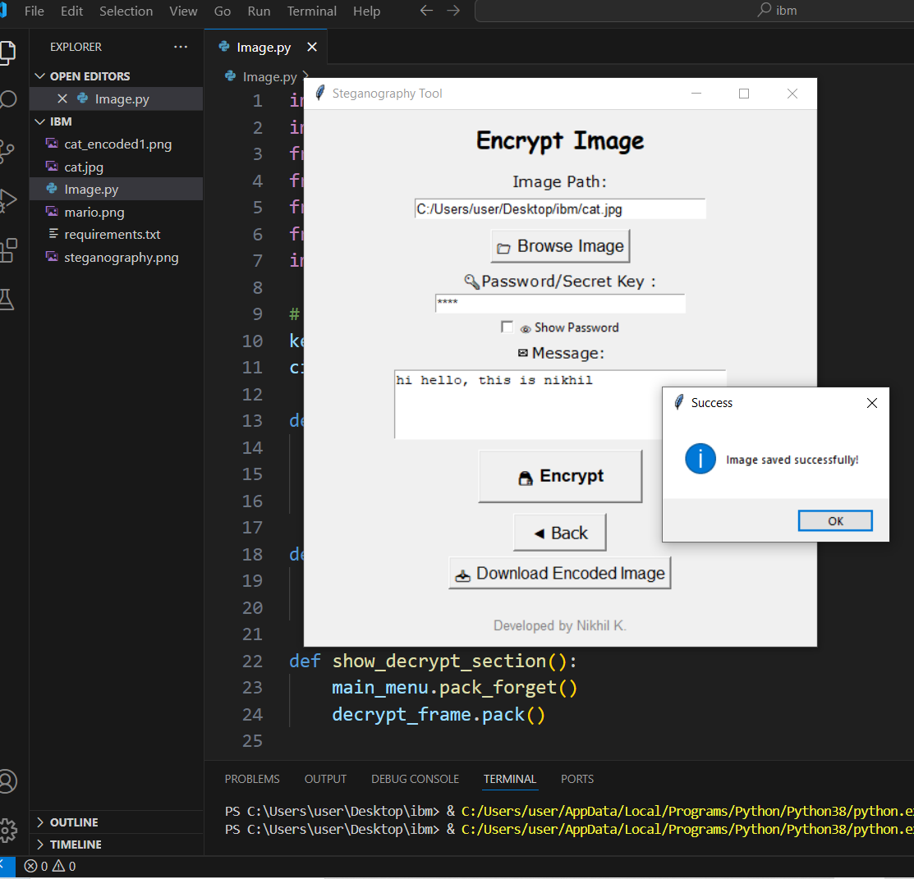
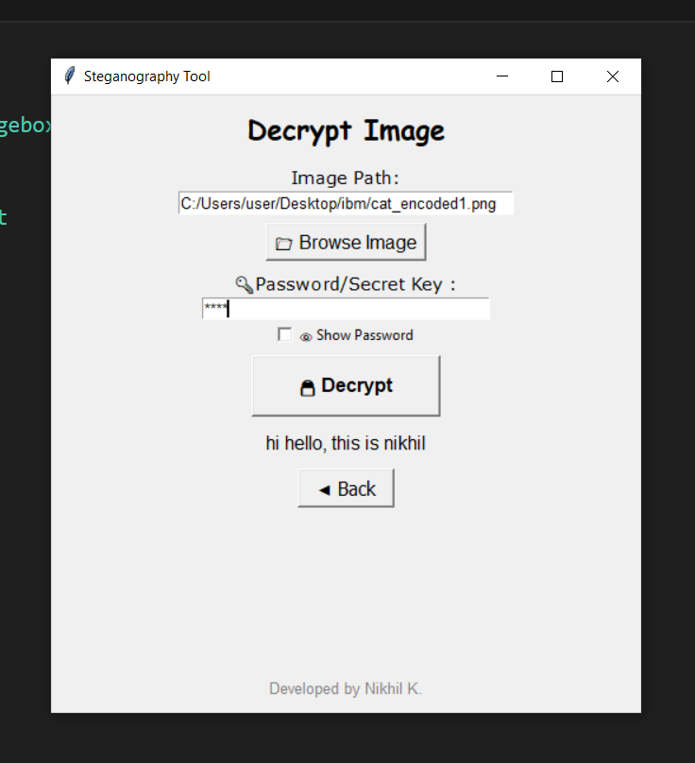
Results

Slide 8
Conclusion
This project serves the need for secure and hidden communication well by integrating steganography and encryption into a user-friendly application. With the utilization of LSB image encoding and secure encryption techniques, the project ensures that sensitive messages can be hidden securely in images without being found out. Password protection and cross-platform compatibility features make it a reliable solution for individuals and businesses seeking enhanced data security.
In short, this device provides a simple but effective method of securely concealing and retrieving messages and is thus a vital tool to add to cybersecurity, privacy protection, and secure data transfer.

Slide 9
GitHub Link
GitHub Repository : https://github.com/Nikhilhello/AICT_CS_Internship
Deployed Application : https://steganographytool-nikhil.streamlit.app/

Slide 10
Future scope(optional)
Improved Encryption Methods – Employ safer encryption methods like AES-256 for enhanced protection.
Support for Multi-File Formats – Extend steganography to include text, audio, and video formats.
Cloud Storage Facility – Support secure cloud storage and retrieval of encrypted images.
Mobile App Creation – Create Android/iOS apps for secure messaging on the go.
Resistance to AI-based Steganalysis – Improve resistance to detection using AI-based steganalysis methods.
Multi-Level Security – Add multi-factor authentication (MFA) for greater security before decryption.

Slide 11
THANK YOU

