Slide 1
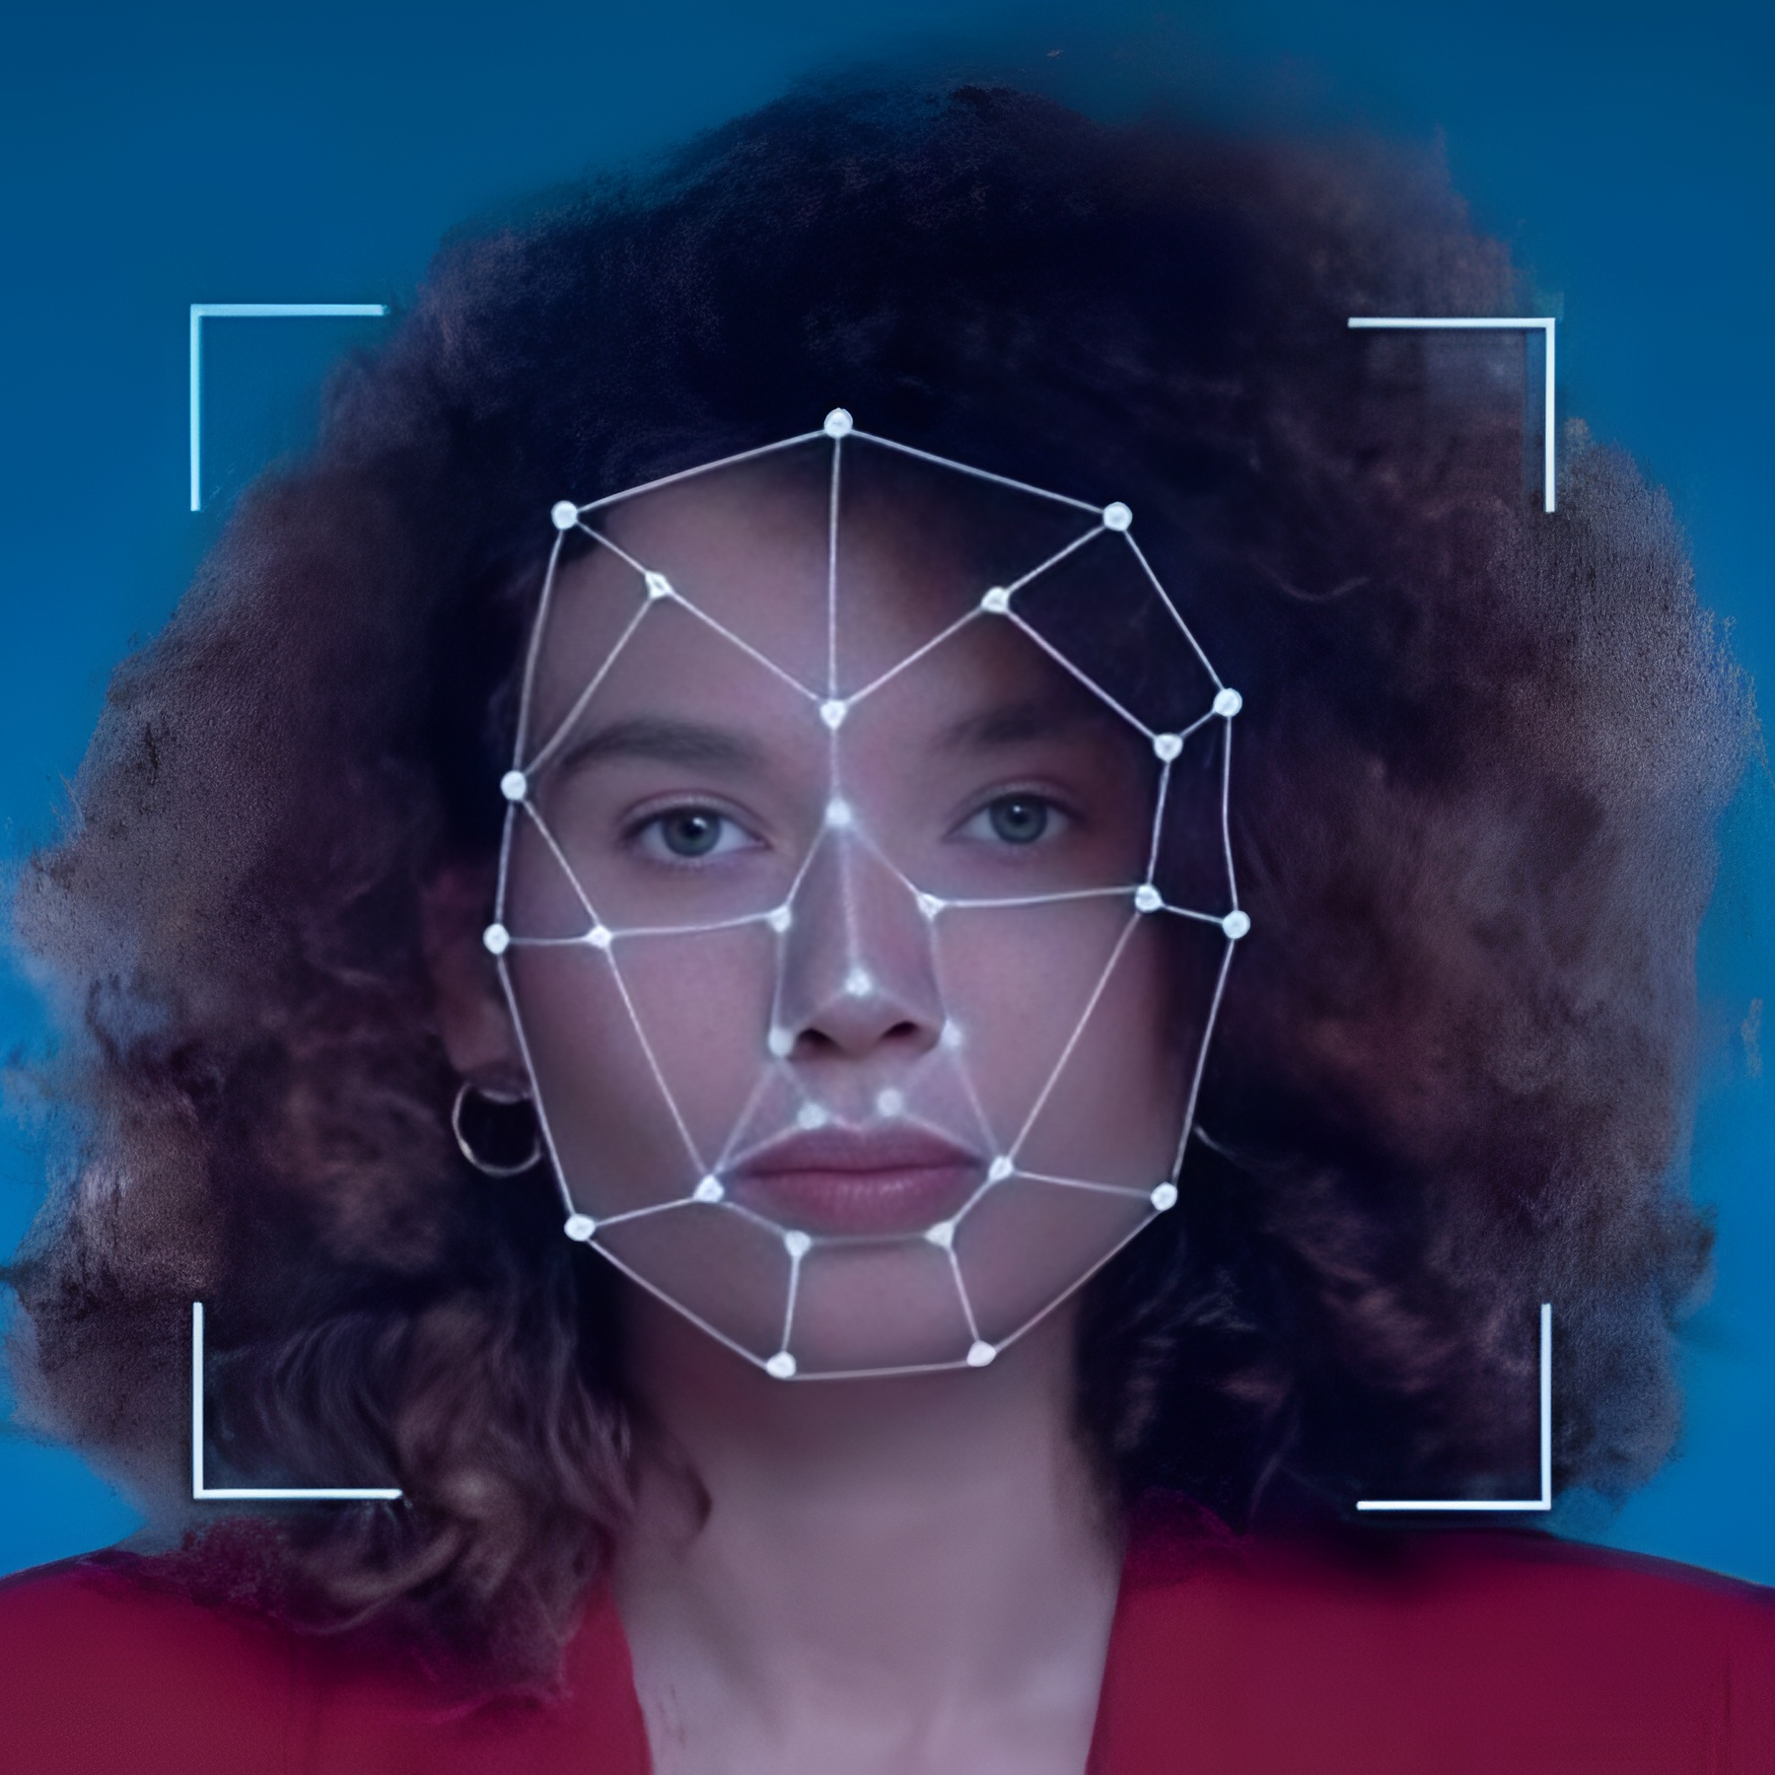
Deepfake Detection and Attribution
Team:
2303A51L99 J. Sri Varsha
2303A51LA0 K. Sindhu
2303A51LA7 B. Jayanth
2303A51LA9 G. Mahendra
2303A51LB0 K. Nikhil
Project Guide: Dr. Ramesh Babu A

Slide 2
Introduction
Deepfakes have become a major challenge in these digital times.
They manipulate audio, images, and video content using deep learning.
This project aims to design a unified system for the detection and attribution of synthetic content across multiple modalities.
The solution integrates deep learning models built on PyTorch, CNNs, and XceptionNet architectures.

Slide 3
Literature Review
S.No | Author & Year | Title | Key Contribution | Difference in Our Work
1 | Rössler et al., 2019 | FaceForensics++: Learning to Detect Manipulated Facial Images | Created a large-scale benchmark dataset and evaluated Xception-based deepfake detectors on facial manipulations. | Our system extends beyond image-level detection to multi-modal (audio, image, video) deepfake detection with attribution.
2 | Chollet, 2017 | Xception: Deep Learning with Depthwise Separable Convolutions | Introduced the Xception architecture enabling deeper, efficient CNNs for image classification tasks. | We used and enhanced XceptionNet with attention mechanisms for higher accuracy and better feature representation.
3 | Dolhansky et al., 2020 | The DeepFake Detection Challenge (DFDC) Dataset | Provided a large and diverse benchmark dataset for evaluating video-based deepfake detection methods. | We trained our Legacy Xception model on FaceForensics++ and custom datasets, achieving 90% validation accuracy.
4 | Zhang et al., 2022 | A Survey on Deepfake Audio Detection: Challenges and Progress | Reviewed deepfake audio detection approaches using mel-spectrograms and CNNs. | We developed a custom CNN for audio spectrogram classification, achieving 98.25% accuracy in distinguishing real and synthetic voices.

Slide 4
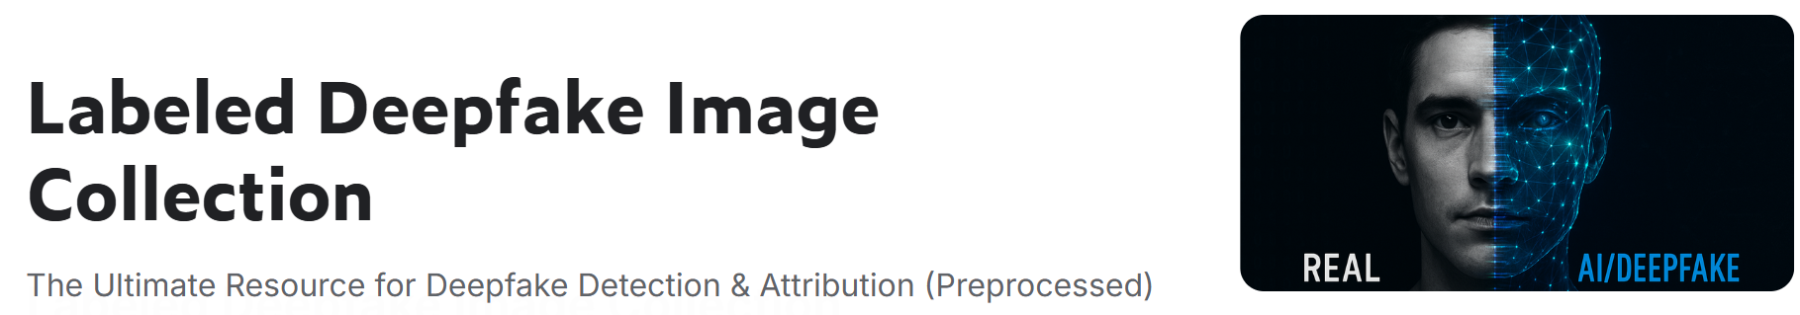
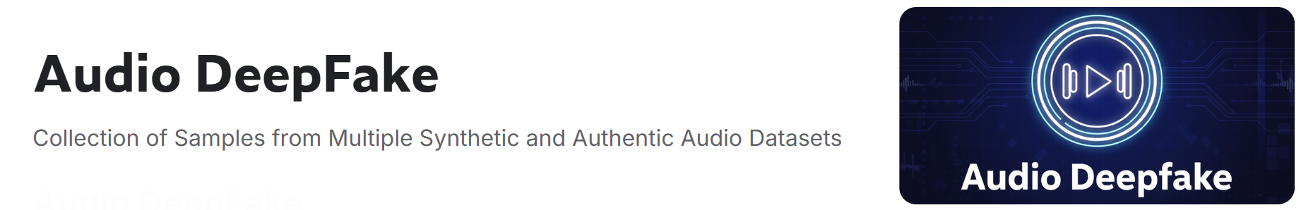

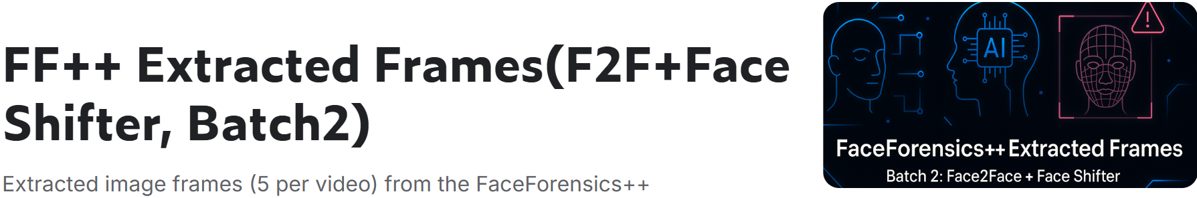
Datasets Used
Audio Dataset
Image Dataset
Video Dataset

Slide 5
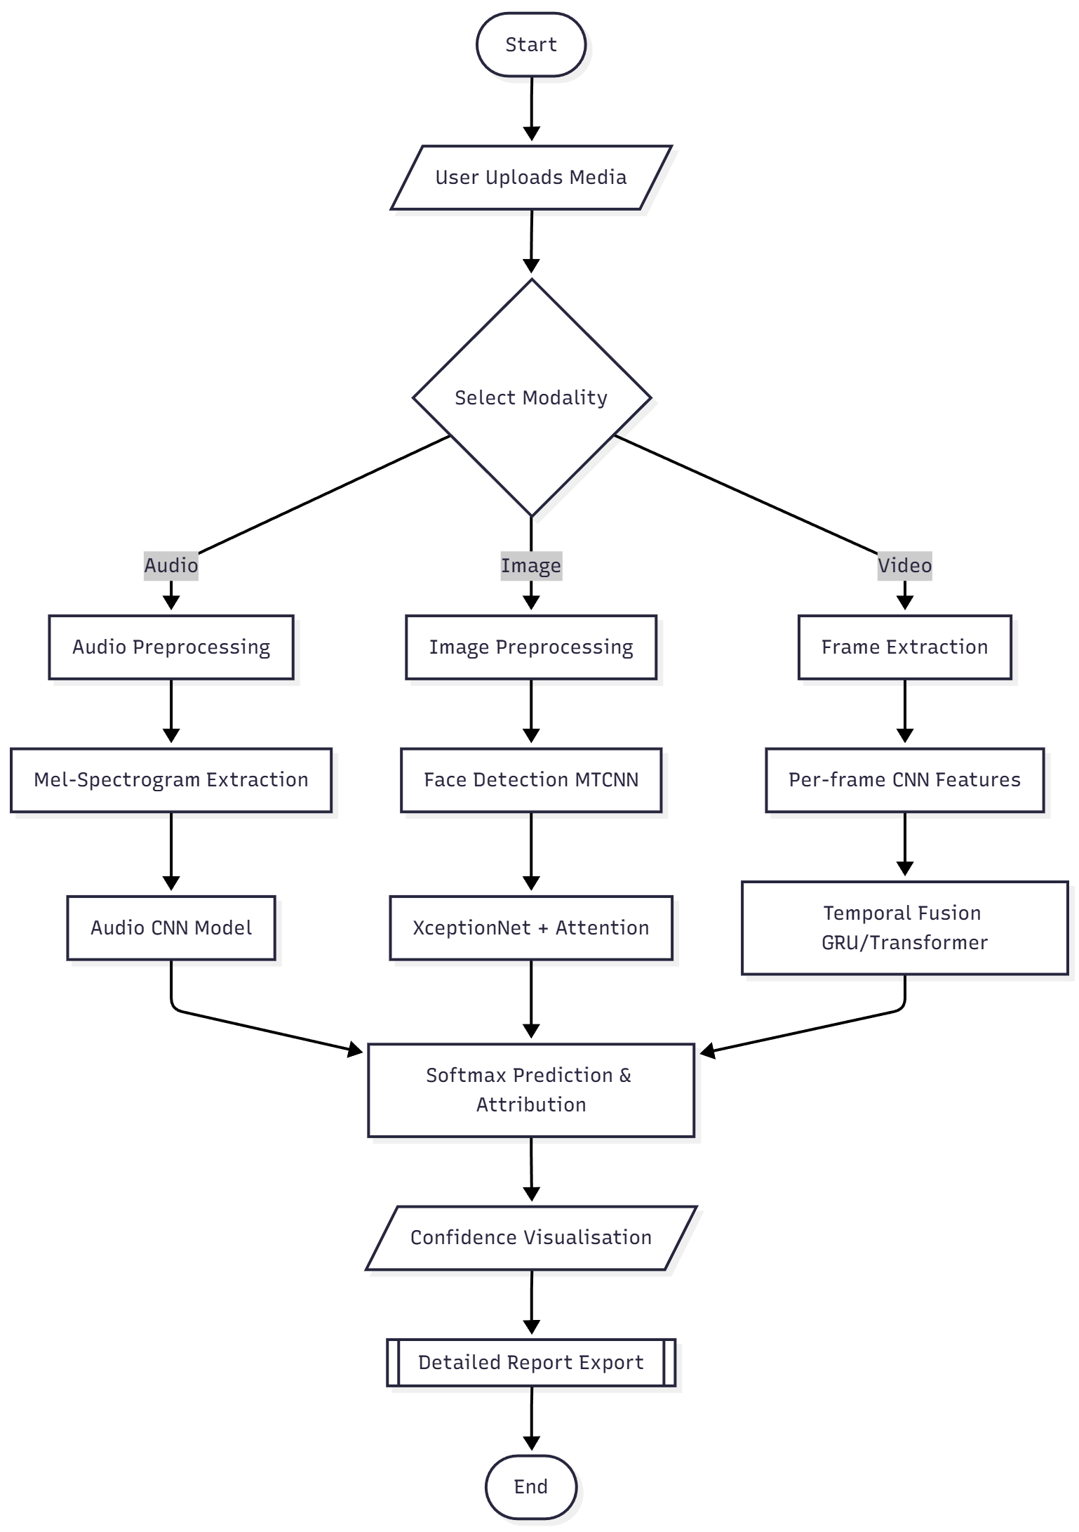
System Architecture Overview
The proposed Deepfake Detection and Attribution system is a modular, multi-model pipeline for integrated audio, image, and video analysis within a single framework.
Each media type will be preprocessed, feature extracted, and inferred on a modality-specific model in the pipeline to output the final prediction, attribution, and visualization via an interactive dashboard.

Slide 6
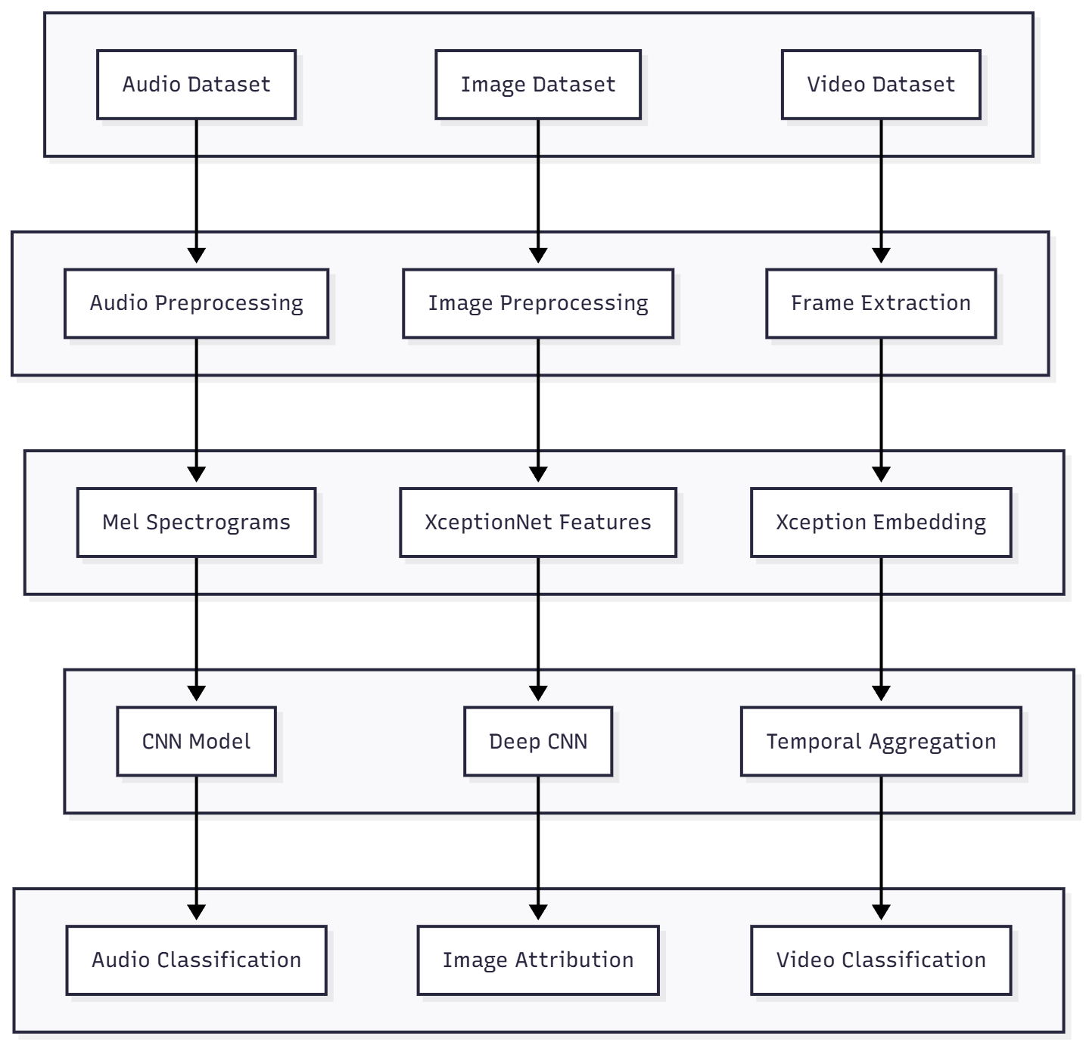
Methodology
Layer 1: Input Data
Layer 2: Preprocessing
Layer 3: Feature Extraction
Layer 4: Model Learning
Layer 5: Outputs

Slide 7
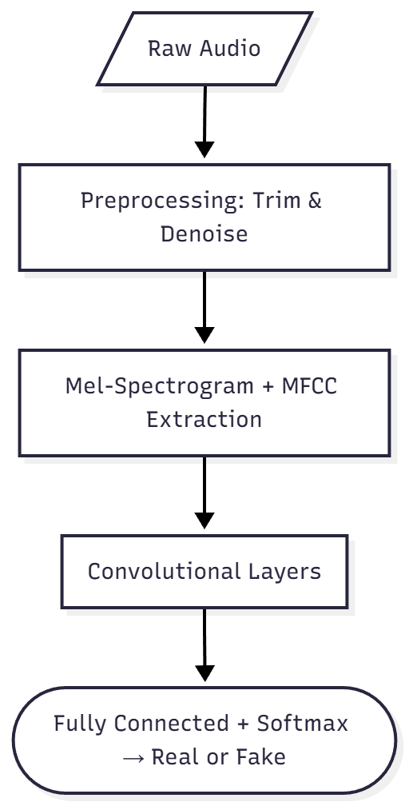
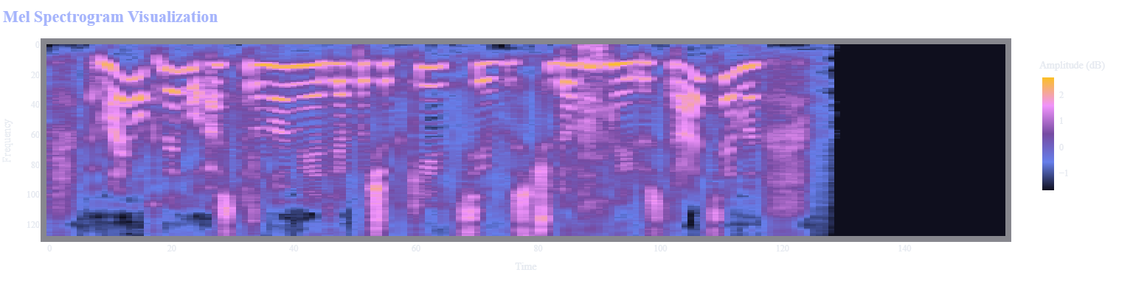
Audio Deepfake Detection Architecture
Analyses speech signals or spectrograms using CNN, RNN, or Transformer models.
Detects frequency artefacts, temporal inconsistencies, and synthetic voice patterns.

Slide 8
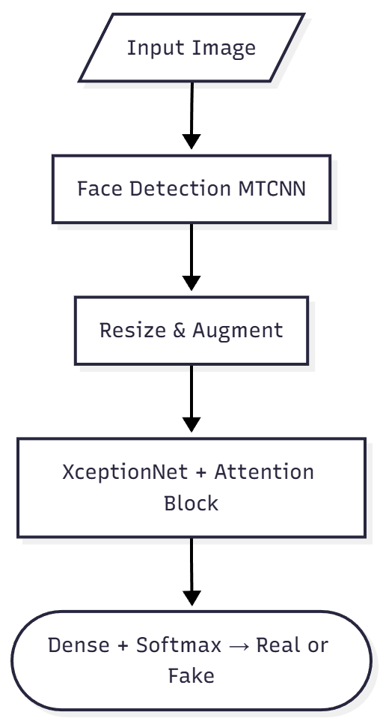
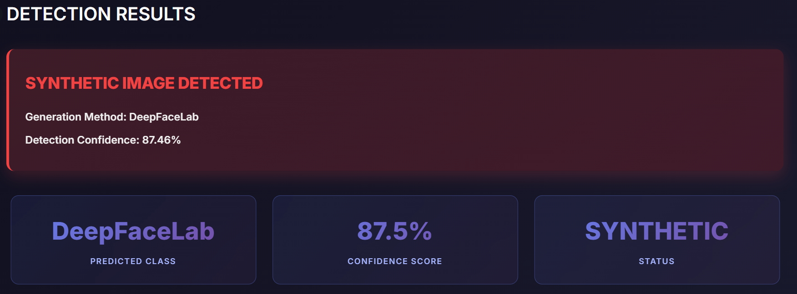
Image Deepfake Detection Architecture
Processes facial images through CNN or Transformer networks.
Identifies pixel-level anomalies, blending artefacts, and texture irregularities in fake faces.

Slide 9
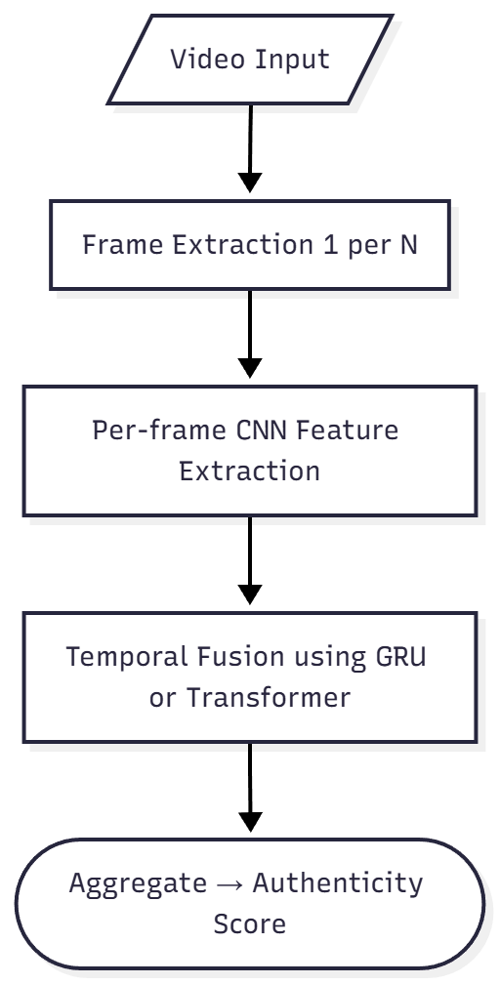
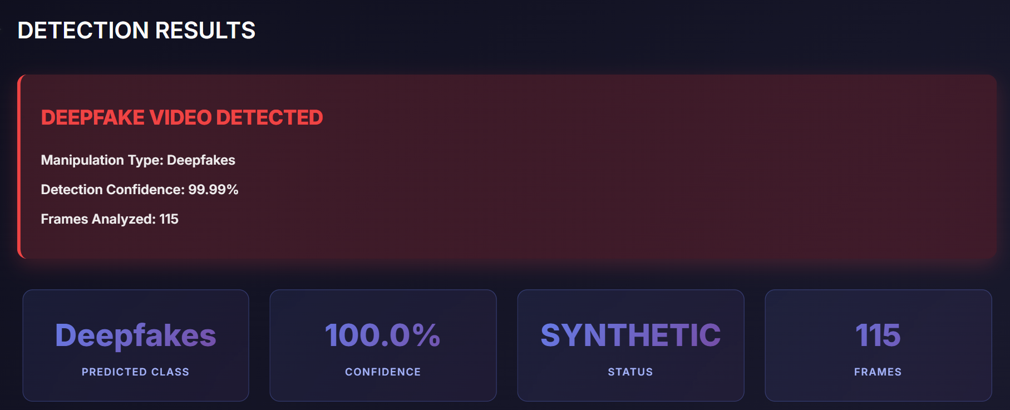
Video Deepfake Detection Architecture
Combines spatial (CNN) and temporal (LSTM/3D CNN) feature analysis.
Detects motion inconsistencies, unnatural expressions, and temporal artefacts across frames.

Slide 10
Performance Metrics
Modality | Accuracy | F1 Score | Strengths | Limitations
Image Model | 99.5% | 0.9954 | Best robustness; strong performance using Xception + Attention | Almost no major limitations
Audio Model | 98.2% | High P/R | Excellent identification of synthetic voices | Slight sensitivity to noisy environments
Video Model | 86.3% | 0.863 | Effective on clean frames | Struggles with low-quality frames; temporal issues

Slide 11
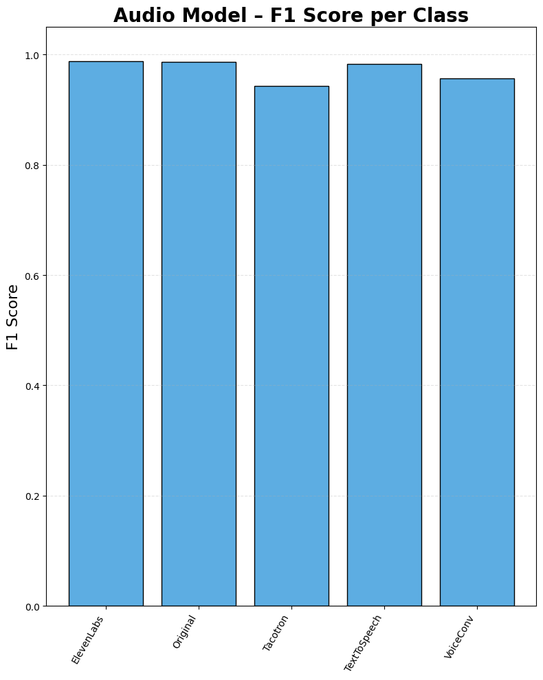
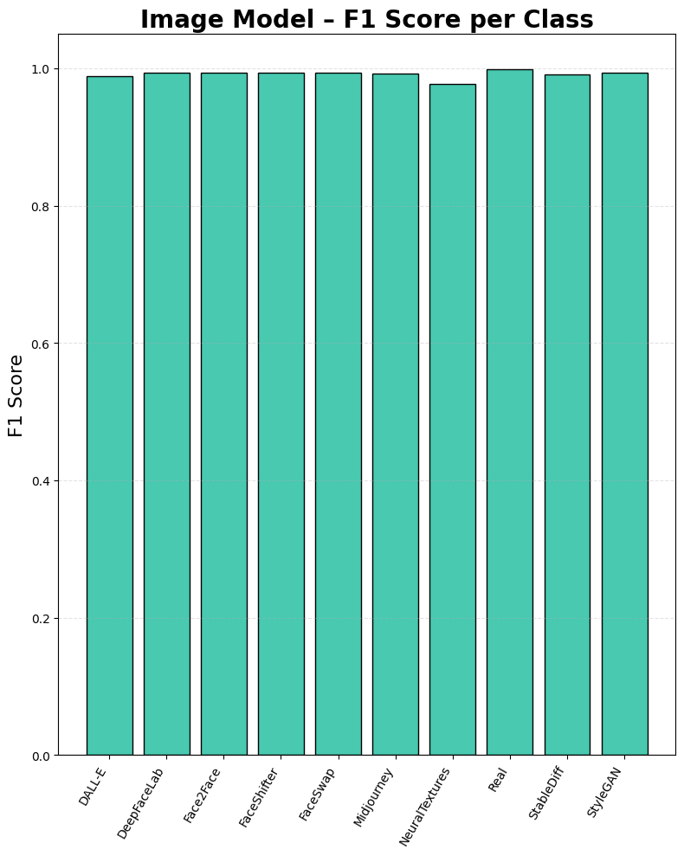
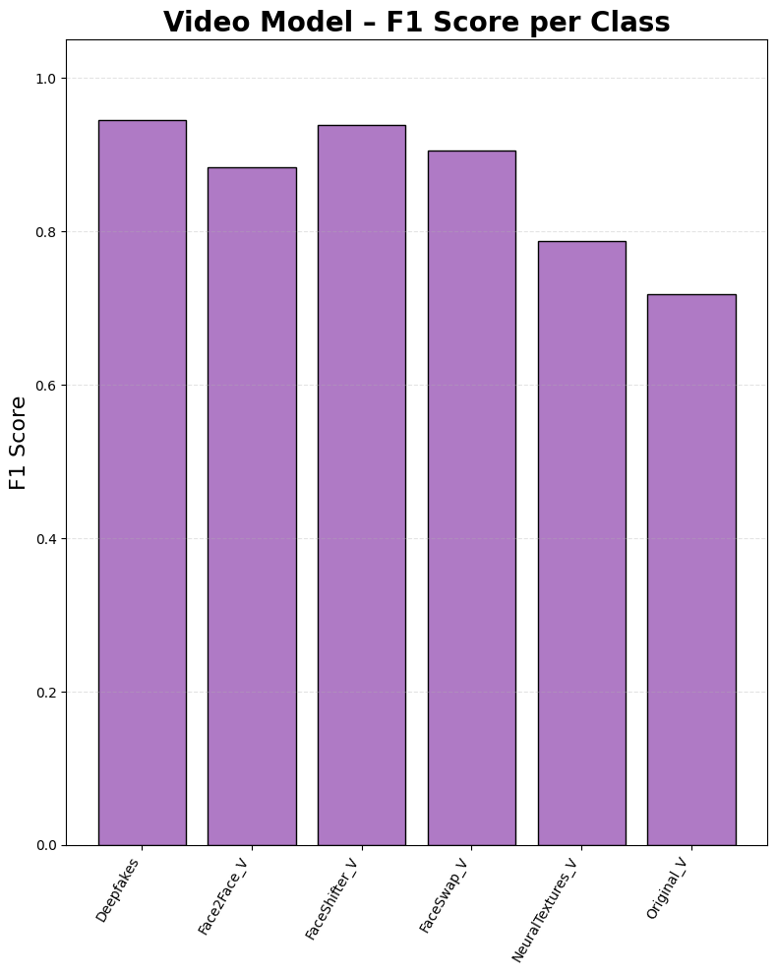
Result & Key Findings
Audio Model
Accuracy : 98.25
Macro F1: 97.14
Image Model
Accuracy : 99.37
Macro F1: 99.16
Video Model
Accuracy : 86.27
Macro F1: 86.31

Slide 12
Social Impact of Our Project
Prevents misinformation & digital manipulation Detects fake media early, reducing spread of misleading or harmful content.
Protects individuals from identity misuse Stops voice cloning, face swaps and reputation-damaging deepfake attacks.
Supports law enforcement & digital forensics Helps verify authenticity of evidence in cybercrime investigations.
Strengthens trust in online media platforms Ensures content users see is real, improving safety and credibility on the internet.

Slide 13
Conclusion
The project successfully establishes a multi-modal deepfake detection framework capable of distinguishing forged audio, image, and video content with high reliability.
It demonstrates that attention-enhanced models and temporal fusion techniques significantly improve detection accuracy and cross-domain consistency.
"Multimodal deepfake detection offers strong reliability across media."

Slide 14
Future Scope
We can improve our system to detect deepfakes in real-time.
We can use transformer and explainable AI models to increase accuracy.
We can optimize the model so it can run on mobile and edge devices.
We can extend this project to multiple fields like media, forensics and finance.
Vision: To develop a deepfake detection system that works reliably in real-world use.

Slide 15
Thank You
Project Title: Deepfake Detection & Attribution
Project Resources:
Source Code Repository
https://github.com/jayanthbottu/Deepfake-Detection-And-Attribution
Demo:
https://huggingface.co/spaces/jayanthbottu/DFDA

