Slide 1
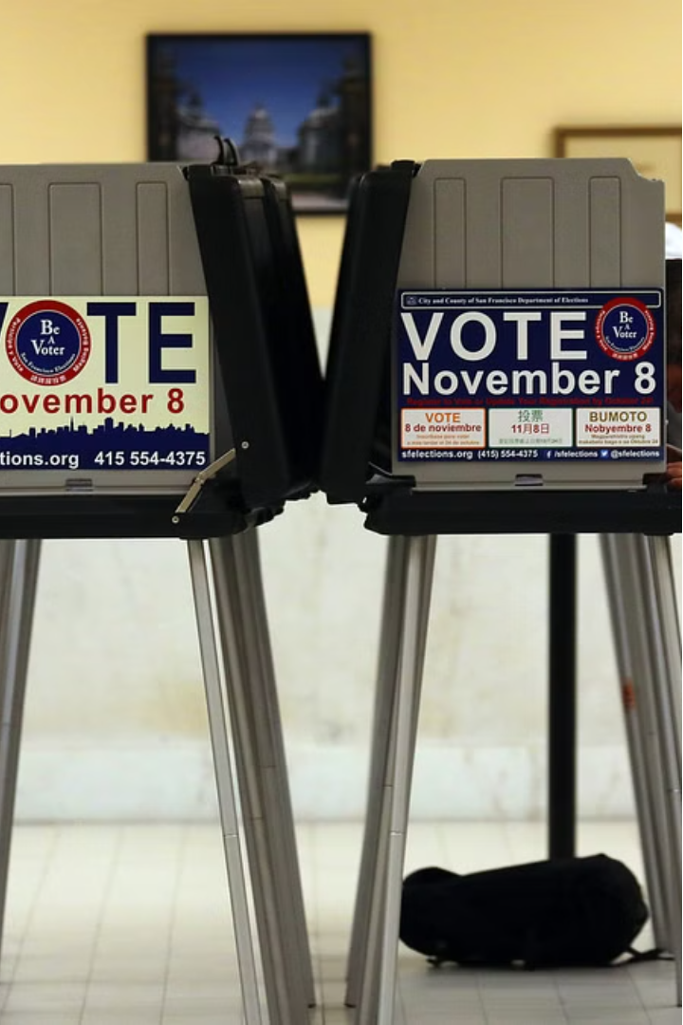

Online Polling System
Online polling systems leverage the internet to gather real-time feedback and insights from a wide audience through surveys, elections, and data collection.
Nikhill Nandan .K (192211750)
Ramesh Reddy .B (192211749)
Jyothieswar Reddy.M (192211468)

Slide 2
Scope of the Project
User-Friendly Interface
Secure Voting
Real-Time Analytics
Develop an intuitive and accessible interface that encourages participation and engagement.
Implement robust security measures to ensure the integrity and confidentiality of the voting process.
Provide detailed reporting and visualization tools to analyze poll results in real-time.

Slide 3
Existing System
1
Paper-Based Polling
2
Limited Reach
Traditional in-person polling methods can be time-consuming, error-prone, and lack accessibility.
Existing online polling systems often have a limited reach, excluding certain demographics.
3
Lack of Engagement
4
Outdated Technology
Current systems sometimes fail to foster user engagement and participation.
Many existing systems are built on outdated technologies, limiting their functionality and scalability.

Slide 4
Proposed System
Seamless User Experience
Robust Security
Develop a modern, mobile-responsive interface that is intuitive and easy to use.
Implement advanced security measures, including encryption and multi-factor authentication, to ensure the integrity of the voting process.
Real-Time Analytics
Increased Accessibility
Provide interactive dashboards and reporting tools to analyze poll results in real-time.
Ensure the system is accessible to users with disabilities, promoting inclusive participation.

Slide 5
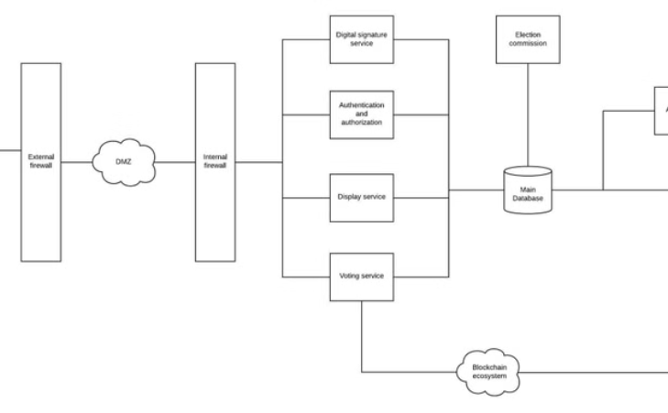
Architecture Diagram
System Architecture
The proposed online polling system will utilize a scalable, cloud-based architecture to handle large volumes of users and data.

Slide 6




Output
Secure Voting
Real-Time Analytics
Inclusive Participation
Users can securely cast their votes through the intuitive web interface.
Administrators can access detailed reports and visualizations to analyze poll results in real-time.
The system's accessible design encourages participation from a diverse user base.

Slide 7



Conclusion and Next Steps
Scalability
Continuous Improvement
Partnerships
Ensure the system can handle increasing user demand and expand to support larger-scale polling efforts.
Gather user feedback and regularly update the system to incorporate new features and best practices.
Explore opportunities to collaborate with organizations and experts in the field of online polling and e-voting.

Slide 8
References
Online Voting Systems: Best Practices and Security Considerations
https://www.example.com/online-voting-best-practices
The Future of Polling: Leveraging Technology for Inclusive Participation
https://www.example.com/future-of-polling
Designing Accessible Online Voting Interfaces
https://www.example.com/accessible-online-voting

Slide 9
Queries
Security Measures
User Authentication
What specific security protocols and technologies will be implemented to ensure the confidentiality and integrity of the voting process?
How will the system verify the identity of users and prevent duplicate or fraudulent votes?
Data Privacy
Accessibility Features
What measures will be taken to protect the personal information and voting data of users?
What accessibility features will be incorporated to ensure the system is inclusive and usable for all users?

