Slide 1
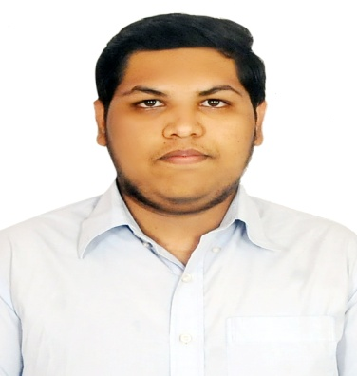



NIKHIL M
Analyst/Software Engineer
Bachelor of Engineering
Computer Science and Engineering: 2019 - 2022
Skills Java 8
Spring Boot
Spring MVC
JPA CRUD
Rabbit MQ
Docker
MERN Stack
ReactJS
Database
My SQL RDS Basics
Web Technologies
HTML5
CSS3
Javascript
AddOns
Github
Maven
Postman
Additional Details
Time management
BANGALORE
NIKHIL.M@CAPGEMINI.COM
+91 6361248190
A4
Full Stack Developer
Software Engineer who is Strong in design and integration with intuitive problem-solving skills. Passionate about implementing and launching new projects..
Hands on experience in creating microservices with Spring Boot, Spring Security, Spring Cloud API Gateway, Eureka server.
Has working knowledge on ReactJS and Java Microservice Development using Spring framework on an intermediate level.
Pharmacy Management Application
Completed end to end case study of Pharmacy Management Application along with JWT authentication, Swagger and responsive UI with ReactJs.
Library Management System
Developed Library Management System using Spring Boot, MySQL and testing all api through postman along with responsive UI with HTML, CSS.
Check out my work on GitHub & Video Profile

