Slide 1
SDE with AI
Kafka and Spring Boot
Asynchronous Communication
Roadmap Day 48
Presented by Nikhil Nair

Slide 2
Today plan
Warm-up quiz
Core concepts for today
Demo 1: Standalone Java producer and consumer
Demo 2: Spring Boot integration and course stats projection
Monitoring and real-world use cases
GUVI | SDE with AI
Day 48

Slide 3
Warm-up quiz

Slide 4
Warm-up instructions
Answer each question with 1, 2, 3, or 4.
Pick the best option.
GUVI | SDE with AI
Day 48

Slide 5
Warmup 1
What is an event in event-driven architecture?
A. A fact that something already happened.
B. A direct function call from one service to another.
C. A database table that stores records.
D. A UI screen that shows data.
GUVI | SDE with AI
Day 48

Slide 6
Warmup 1 Answer
What is an event in event-driven architecture?
A. A fact that something already happened.
B. A direct function call from one service to another.
C. A database table that stores records.
D. A UI screen that shows data.
Correct answer: A
Why:
Events represent facts like “Enrollment created”.
They are not direct calls or storage tables.
GUVI | SDE with AI
Day 48

Slide 7
Warmup 2
What happens in synchronous communication?
A. The caller sends a message and always continues immediately.
B. The caller waits for the response before continuing.
C. The caller stores data and never contacts other services.
D. The caller and callee always run in the same process.
GUVI | SDE with AI
Day 48

Slide 8
Warmup 2 Answer
What happens in synchronous communication?
A. The caller sends a message and always continues immediately.
B. The caller waits for the response before continuing.
C. The caller stores data and never contacts other services.
D. The caller and callee always run in the same process.
Correct answer: B
Why:
In sync calls, the caller blocks until it gets a response.
Async messaging does not require waiting for the consumer.
GUVI | SDE with AI
Day 48

Slide 9
Warmup 3
What is the role of a producer in Kafka?
A. It reads messages from a topic.
B. It tracks offsets for consumers.
C. It writes messages to a topic.
D. It manages user authentication.
GUVI | SDE with AI
Day 48

Slide 10
Warmup 3 Answer
What is the role of a producer in Kafka?
A. It reads messages from a topic.
B. It tracks offsets for consumers.
C. It writes messages to a topic.
D. It manages user authentication.
Correct answer: C
Why:
Producers publish events to Kafka topics.
Consumers read and process those events.
GUVI | SDE with AI
Day 48

Slide 11
Warmup 4
Why do teams use Kafka between microservices?
A. To force services to deploy together.
B. To guarantee exactly-once delivery always.
C. To remove the need for databases.
D. To publish events without waiting for other services to be online.
GUVI | SDE with AI
Day 48

Slide 12
Warmup 4 Answer
Why do teams use Kafka between microservices?
A. To force services to deploy together.
B. To guarantee exactly-once delivery always.
C. To remove the need for databases.
D. To publish events without waiting for other services to be online.
Correct answer: D
Why:
Producers can publish even if consumers are temporarily down.
This reduces runtime coupling between services.
GUVI | SDE with AI
Day 48

Slide 13
Warmup 5 Answer
In ZooKeeper-mode Kafka, ZooKeeper is mainly used for what?
A. Coordinating brokers and storing cluster metadata.
B. Storing business data like enrollments.
C. Encrypting Kafka messages by default.
D. Generating REST API endpoints.
GUVI | SDE with AI
Day 48

Slide 14
Warmup 5 Answer
In ZooKeeper-mode Kafka, ZooKeeper is mainly used for what?
A. Coordinating brokers and storing cluster metadata.
B. Storing business data like enrollments.
C. Encrypting Kafka messages by default.
D. Generating REST API endpoints.
Correct answer: A
Why:
ZooKeeper supports coordination and metadata in this Kafka mode.
It is not where application data is stored.
GUVI | SDE with AI
Day 48

Slide 15
Warmup 6 Answer
If the consumer is down, but producers keep sending messages, what happens?
A. Messages are lost immediately.
B. Kafka deletes the topic automatically.
C. Messages stay in the topic and the consumer can read later.
D. Producers stop sending automatically.
GUVI | SDE with AI
Day 48

Slide 16
Warmup 6 Answer
If the consumer is down, but producers keep sending messages, what happens?
A. Messages are lost immediately.
B. Kafka deletes the topic automatically.
C. Messages stay in the topic and the consumer can read later.
D. Producers stop sending automatically.
Correct answer: C
Why:
Kafka retains messages for a configured time.
Consumers can catch up later if retention still includes those messages.
GUVI | SDE with AI
Day 48

Slide 17
Let’s build!

Slide 18
What are we building today?
Our app already stores enrollments in MongoDB as the source of truth.
Today we publish an event to Kafka when an enrollment changes.
A consumer builds a separate read model in MongoDB called `course_stats`.
This makes dashboard reads fast without scanning the enrollments collection.
We will use one Kafka topic in both demos: `guvi.events`.
GUVI | SDE with AI
Day 48
Notes:
Keep this slide under 60 seconds and move to Demo 1.

Slide 19
What is an event?
An event is a fact about something that already happened.
Example: “Enrollment was created” is a fact other parts of the system can react to.
Producers publish events without knowing who will consume them.
Consumers subscribe and do their own work independently.
Intuition: Events reduce direct dependencies between services.
GUVI | SDE with AI
Day 48

Slide 20
Topic and message key
A topic is a named stream of events stored durably by Kafka.
A message key helps decide where an event is placed within the topic.
Example: key = `courseId` keeps events for one course in order.
For our live coding, we’ll name our topic `guvi.events` and our key is `courseId`.
GUVI | SDE with AI
Day 48
Notes:
Keep partitions explanation minimal here and show it in Demo 1.

Slide 21
Producer and consumer roles
A producer writes events to a Kafka topic.
A consumer reads events from a Kafka topic and runs business logic.
Producers and consumers can be separate apps or separate modules.
Example: Enrollment publishes. Stats builder consumes.
GUVI | SDE with AI
Day 48

Slide 22
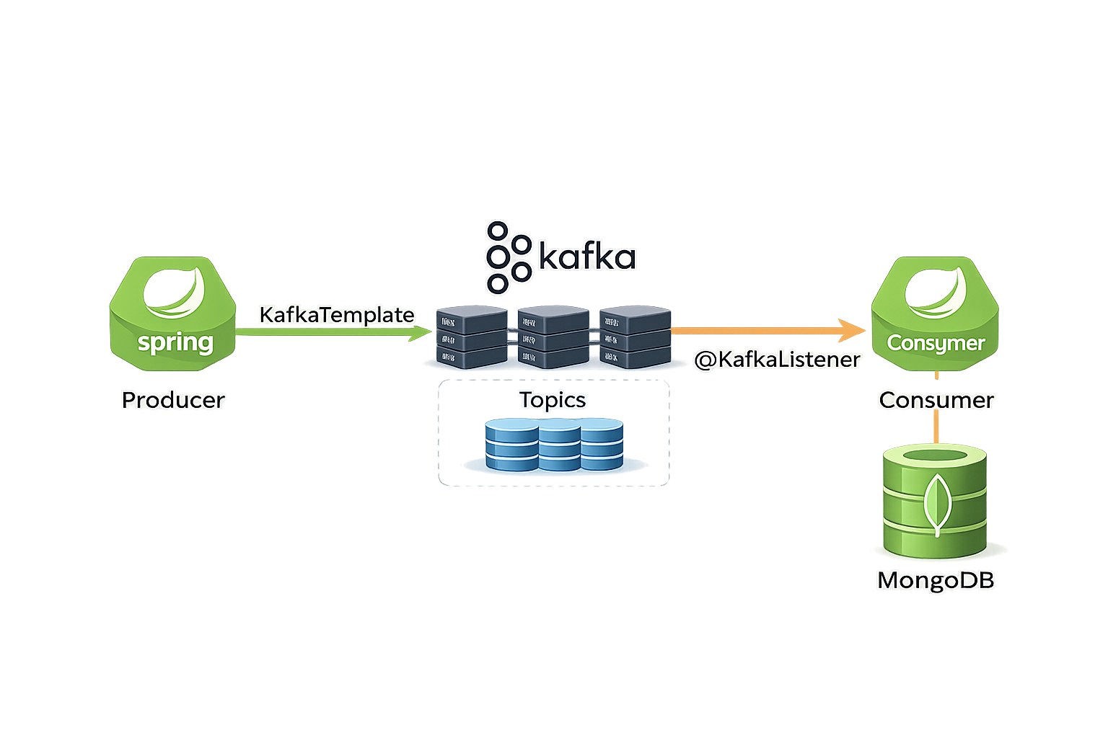
Spring Kafka in one picture
Spring Boot produces messages using KafkaTemplate.
Spring Boot consumes messages using @KafkaListener.
Kafka runs separately and stores events for later consumption.
MongoDB stores both source-of-truth data and the derived read model.
GUVI | SDE with AI
Day 48
Notes:
Draw this as a simple box flow while speaking.

Slide 23
Spring Kafka config we must set
Set `spring.kafka.bootstrap-servers` to your Kafka broker address.
Producer must set a key serializer and a value serializer.
Consumer must set a key deserializer and a value deserializer.
Consumer must set a `group-id` to identify the consumer group.
GUVI | SDE with AI
Day 48
Notes:
Use `auto-offset-reset=earliest` as a practical dev default.

Slide 24
Our event contract
We publish one JSON event per enrollment action.
Fields: eventId, type, enrollmentId, studentId, courseId, status, occurredAt.
Example types: ENROLLMENT_CREATED, ENROLLMENT_STATUS_UPDATED, ENROLLMENT_DELETED.
The message key is courseId to keep course events ordered.
GUVI | SDE with AI
Day 48

Slide 25
Dealing with Duplicates
Consumers can see the same event more than once when retries happen.
This is normal in real distributed systems.
We handle it using an `eventId` idempotency check before updating stats.
Intuition: Make consumers safe to repeat.
GUVI | SDE with AI
Day 48

Slide 26
Demo 1

Slide 27
Demo 1 steps
DEMO
Confirm Kafka and ZooKeeper are running.
Create or verify topic `guvi.events`.
Start the Java consumer and keep it running.
Run the Java producer and send events with multiple `courseId` values.
Observe key, partition, and per-course counts.
cd $KAFKA_HOME
bin/kafka-topics.sh --bootstrap-server localhost:9092 --describe --topic guvi.events
# Run consumer
mvn -q exec:java -Dexec.mainClass="com.guvi.playground.ConsumerApp"
# Run producer
mvn -q exec:java -Dexec.mainClass="com.guvi.playground.ProducerApp"
GUVI | SDE with AI
Day 48
Notes:
This demo is a fast confidence win. Keep it tight.

Slide 28
Demo 1 expected output
DEMO
Consumer prints key and partition for each message.
Messages with the same `courseId` appear in a consistent order.
A running count per `courseId` increases as events arrive.
key=SPRING | partition=1 | count[SPRING]=4
key=JAVA | partition=0 | count[JAVA]=3
key=SPRING | partition=1 | count[SPRING]=5
GUVI | SDE with AI
Day 48
Notes:
If asked “why partitions,” answer in one sentence and move on.

Slide 29
Demo 2

Slide 30
Demo 2 steps 1
DEMO
Add Spring Kafka dependency to the project.
Add Kafka config in `application.properties`.
Create an `EnrollmentEvent` DTO and a producer service.
Publish an event after create and after status update in `EnrollmentService`.
app.kafka.topic=guvi.events
spring.kafka.bootstrap-servers=localhost:9092
spring.kafka.producer.key-serializer=org.apache.kafka.common.serialization.StringSerializer
spring.kafka.producer.value-serializer=org.apache.kafka.common.serialization.StringSerializer
spring.kafka.consumer.group-id=course-stats-builder-v1
spring.kafka.consumer.auto-offset-reset=earliest
spring.kafka.consumer.key-deserializer=org.apache.kafka.common.serialization.StringDeserializer
spring.kafka.consumer.value-deserializer=org.apache.kafka.common.serialization.StringDeserializer
GUVI | SDE with AI
Day 48
Notes:
Reuse existing enrollment APIs so learners feel continuity.

Slide 31
Demo 2 steps 2
DEMO
Create a consumer using `@KafkaListener` for topic `guvi.events`.
Update the `course_stats` projection in MongoDB for each event.
Add idempotency using `eventId` so duplicates do not double-count.
Add a simple read endpoint for `course_stats`.
@KafkaListener(topics = "${app.kafka.topic}", groupId = "${spring.kafka.consumer.group-id}")
public void onMessage(ConsumerRecord<String, String> record) {
// parse JSON event
// update course_stats
}
GUVI | SDE with AI
Day 48
Notes:
If time runs long, idempotency becomes the stretch goal.

Slide 32
Course stats data model
`course_stats` is a derived read model, not the source of truth.
Fields: `courseId`, `totalEnrollments`, `activeEnrollments`, `cancelledEnrollments`, `lastEventAt`.
It is updated only by consuming Kafka events.
Reads are fast because we do not aggregate enrollments on every request.
GUVI | SDE with AI
Day 48

Slide 33
Demo 2 verification
DEMO
Create or update enrollments using Postman.
Confirm the producer publishes events by checking consumer logs.
Confirm MongoDB contains `course_stats` documents that update.
Call the stats endpoint and confirm values match the actions.
POST /api/enrollments
{
"studentId": "<id>",
"courseId": "<id>",
"status": "ACTIVE"
}
GET /api/course-stats/<courseId>
GUVI | SDE with AI
Day 48

Slide 34
Monitoring Kafka

Slide 35
Monitoring with Kafka CLI
DEMO
Use `kafka-topics` to list and describe topics.
Use `kafka-console-consumer` to peek at messages quickly.
Use `kafka-consumer-groups` to inspect consumer group state when needed.
bin/kafka-topics.sh --bootstrap-server localhost:9092 --list
bin/kafka-topics.sh --bootstrap-server localhost:9092 --describe --topic guvi.events
bin/kafka-console-consumer.sh --bootstrap-server localhost:9092 --topic guvi.events --from-beginning
bin/kafka-consumer-groups.sh --bootstrap-server localhost:9092 --describe --group course-stats-builder-v1
GUVI | SDE with AI
Day 48
Notes:
Keep commands on demo slides, not in these bullets.

Slide 36
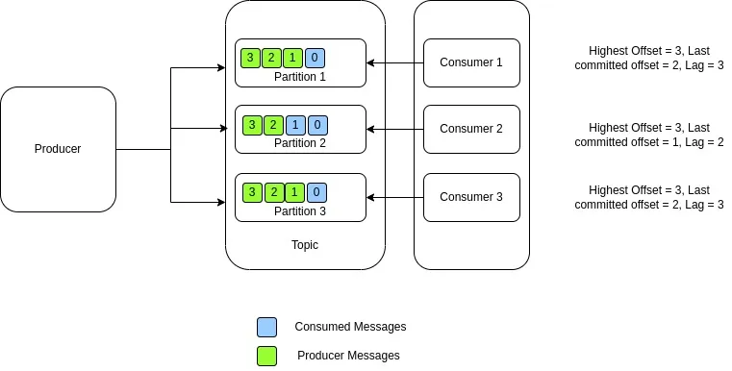
What is consumer lag?
Consumer lag is how far a consumer is behind the latest events.
High lag means consumers are slower than producers.
Lag is a common signal that the system is falling behind under load.
Example: Enrollment spikes can temporarily increase lag.
GUVI | SDE with AI
Day 48

Slide 37
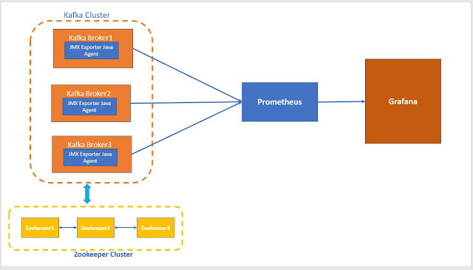
Metrics pipeline for Kafka
Kafka exposes health + performance stats via JMX (e.g., requests/sec, bytes in/out, error rate).
A JMX Exporter acts like a translator: it reads JMX metrics and exposes them in a standard HTTP /metrics format that monitoring tools can collect
Prometheus is one such tool
  it regularly “scrapes” that /metrics endpoint and stores the numbers over time.
Grafana turns those metrics into dashboards + alerts (e.g., “consumer lag is growing”).
GUVI | SDE with AI
Day 48
Notes:
We will not set this up live today unless time permits.

Slide 38
Dashboards that matter
Producer throughput shows how many events are being published.
Consumer throughput shows how many events are being processed.
Consumer lag shows backlog growth or recovery.
Error rate shows failing consumers or bad messages.
GUVI | SDE with AI
Day 48
Notes:
Keep it practical. Avoid deep internals.

Slide 39
Real World Use Cases

Slide 40
Decoupling microservices with events
Producers do not call consumers directly at runtime.
Consumers can be added later without changing producers.
Example: Enrollment publishes once; notifications and analytics consume later.
Intuition: Async events reduce tight coupling and improve resilience.
GUVI | SDE with AI
Day 48

Slide 41
Fan out without tight coupling
One event can be consumed by multiple independent services.
Each consumer can scale and deploy independently.
Example: Enrollment events can update stats, send emails, and trigger audits.
GUVI | SDE with AI
Day 48

Slide 42
Projections and fast reads
A projection is a derived view built from events.
We built `course_stats` as a projection for fast dashboard reads.
This is useful when reads need aggregation but writes must stay simple.
Intuition: Write events once, build many read views.
GUVI | SDE with AI
Day 48

Slide 43
Case study: LinkedIn
Problem: Many systems needed the same stream of user and system activity.
Approach: Publish activity events once and let multiple consumers process them.
Result: Teams can add new consumers without changing the producers.
GUVI | SDE with AI
Day 48

Slide 44
Case study: Netflix
Problem: High-volume operational and user events needed reliable pipelines.
Approach: Use event streaming as a durable buffer between producers and processors.
Result: Monitoring and analytics pipelines can scale independently.
GUVI | SDE with AI
Day 48

Slide 45
Case study: Uber
Problem: Many real-time services must react to rapidly changing events.
Approach: Use event streams to avoid long synchronous call chains.
Result: Systems stay responsive under spikes by decoupling work.
GUVI | SDE with AI
Day 48

Slide 46
Wrap up
We published enrollment events to Kafka on `guvi.events`.
We consumed events to build `course_stats` as a MongoDB projection.
This is a core microservices pattern for async workflows and fast reads.
GUVI | SDE with AI
Day 48
Notes:
If time permits, assign a small extension: add one more stat field to `course_stats`.

