Slide 1
SDE with AI
Event-Driven Architecture
Kafka and ZooKeeper
Roadmap Day 47
Presented by Nikhil Nair

Slide 2
Today Plan
Define monolith and microservices using our Spring Boot project as the reference.
Define synchronous and asynchronous communication with concrete API examples.
Understand Kafka basics needed for producers, consumers, topics, offsets, and groups.
Demo: local install and startup of ZooKeeper and Kafka, then CLI produce and consume.
Live coding: Java producer and consumer for topic guvi.events with key:value messages.
GUVI | SDE with AI
Day 47

Slide 3
Warm-up quiz

Slide 4
Warm Up Quiz
Answer multiple choice questions. Reply format: 1 / 2 / 3 / 4
Topics: OpenAPI, Swagger UI, Postman auth, headers, environment variables
Goal: refresh testing fundamentals before we introduce async systems
GUVI | SDE with AI
Day 47

Slide 5
Swagger Purpose
What is the main purpose of OpenAPI and Swagger in our backend project?
1) Generate UI for database tables
2) Document endpoints and contracts for testing
3) Speed up MongoDB queries
4) Replace Postman completely
GUVI | SDE with AI
Day 47

Slide 6
Swagger Purpose
What is the main purpose of OpenAPI and Swagger in our backend project?
1) Generate UI for database tables
2) Document endpoints and contracts for testing
3) Speed up MongoDB queries
4) Replace Postman completely
Correct answer: 2
Why:
It defines the API contract so humans and tools know what to send and what to expect.
It reduces guesswork during testing by documenting inputs, outputs, and errors.
GUVI | SDE with AI
Day 47

Slide 7
Swagger Artifact
When you open Swagger UI, what are you actually reading?
1) A live database dump
2) The OpenAPI specification for your endpoints
3) The Maven dependency tree
4) The Spring Security filter chain
GUVI | SDE with AI
Day 47

Slide 8
Swagger Artifact
When you open Swagger UI, what are you actually reading?
1) A live database dump
2) The OpenAPI specification for your endpoints
3) The Maven dependency tree
4) The Spring Security filter chain
Correct answer: 2
Why:
Swagger UI is a viewer that renders the OpenAPI spec into a readable page.
The spec describes routes, request fields, response fields, and status codes.
GUVI | SDE with AI
Day 47

Slide 9
401 in Postman
You call GET /api/courses and get 401 in Postman. What is most likely missing?
1) Query param size
2) Authorization header with credentials
3) Content Type header
4) Response body schema
GUVI | SDE with AI
Day 47

Slide 10
401 in Postman
You call GET /api/courses and get 401 in Postman. What is most likely missing?
1) Query param size
2) Authorization header with credentials
3) Content Type header
4) Response body schema
Correct answer: 2
Why:
401 means the server did not receive valid credentials for a protected endpoint.
Adding valid auth is required before the controller logic runs.
GUVI | SDE with AI
Day 47

Slide 11
Basic Auth Header
In Basic Auth, what does Postman send in the request?
1) A JWT token in the body
2) Username and password encoded in the Authorization header
3) A session id cookie generated by MongoDB
4) A random API key from Swagger UI
GUVI | SDE with AI
Day 47

Slide 12
Basic Auth Header
In Basic Auth, what does Postman send in the request?
1) A JWT token in the body
2) Username and password encoded in the Authorization header
3) A session id cookie generated by MongoDB
4) A random API key from Swagger UI
Correct answer: 2
Why:
Basic Auth is transmitted through the Authorization header, not the JSON body.
Postman formats it for you when you choose Basic Auth in the Authorization tab.
GUVI | SDE with AI
Day 47

Slide 13
Environment Variables
Your teammate’s Postman collection works, yours fails. What should you check first?
1) Rename the request
2) Verify environment variables like url and credentials
3) Delete the collection and import again
4) Restart MongoDB
GUVI | SDE with AI
Day 47

Slide 14
Environment Variables
Your teammate’s Postman collection works, yours fails. What should you check first?
1) Rename the request
2) Verify environment variables like url and credentials
3) Delete the collection and import again
4) Restart MongoDB
Correct answer: 2
Why:
If base URL or saved credential variables are wrong, every request can fail.
Fixing environment values is faster than changing requests.
GUVI | SDE with AI
Day 47

Slide 15
Fast Verification
After a Postman request, what is the quickest reliable proof it worked?
1) The response looks long
2) Status code matches expectation and key fields are present
3) The request name is green
4) The console has no logs
GUVI | SDE with AI
Day 47

Slide 16
Fast Verification
After a Postman request, what is the quickest reliable proof it worked?
1) The response looks long
2) Status code matches expectation and key fields are present
3) The request name is green
4) The console has no logs
Correct answer: 2
Why:
Status code confirms the outcome and key fields confirm the response shape.
“Looks fine” is unreliable without those two checks.
GUVI | SDE with AI
Day 47

Slide 17
Monolith vs Microservices

Slide 18
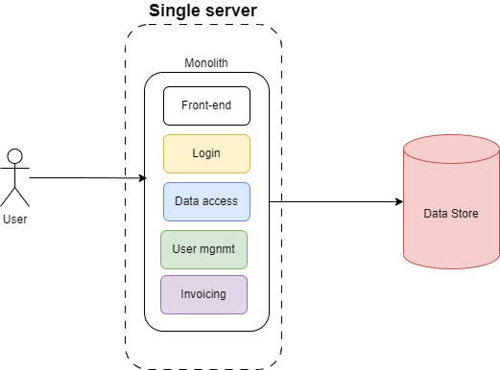
What Is a Monolith
A monolith is a single backend application that contains many features in one codebase and runs as one server process.
Inside a monolith, features call each other using normal method calls, not network calls.
A monolith usually uses one shared database for the whole application, so data access is centralized.
Myth: Monoliths are the old way of building software.
  Not at all - a monolith remains an effective way to build software, given project specific modifications.
GUVI | SDE with AI
Day 47

Slide 19
Monolith in Our Code
One Spring Boot application starts from one main class and runs on one port.
Multiple features live in the same server: students, courses, enrollments, and authentication.
These features are organized as controllers, services, and repositories, but still run in the same JVM.
When EnrollmentService needs Student info, it reads from the same database, not from a remote service.
Note: This is why our application feels like one system. Everything is inside one running app.
GUVI | SDE with AI
Day 47

Slide 20
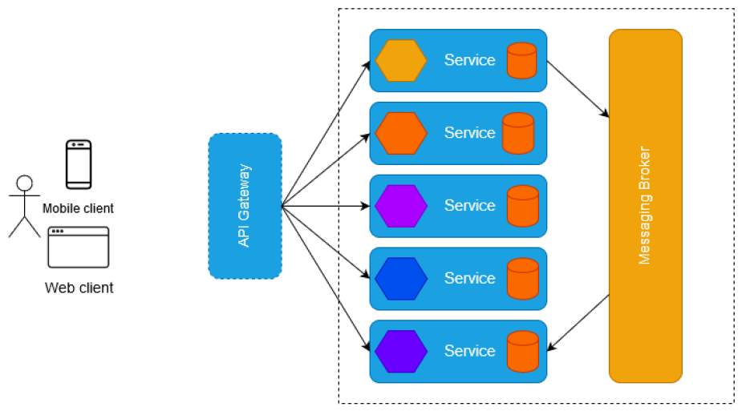
What Are Microservices?
Microservices split a system into multiple small backend applications, each focused on one capability.
Each microservice runs as its own server process, has its own deployment, and can fail independently.
Microservices communicate over the network, so failures and delays are normal and must be handled by design.
A realistic split for our project: Students Service, Courses Service, Enrollments Service, Auth Service.
Note: Microservices are not folders. They are separate applications that talk to each other.
GUVI | SDE with AI
Day 47

Slide 21
When Microservices Help
Multiple teams can release independently because each team owns one service boundary.
You can scale only the hot part of the system instead of scaling everything together.
Failure isolation improves because one service crash does not automatically kill all features.
Integrations become easier because you can add consumers or services without rewriting the core app.
Note: Microservices help when your system and organization grow. They are not required for every product.
GUVI | SDE with AI
Day 47

Slide 22
When Microservices Hurt?
More network calls means more latency and more failure cases than in-process method calls.
Debugging becomes harder because one user action can touch many services, logs, and data stores.
Testing becomes harder because you must test not only services, but also service-to-service failures.
Data modeling becomes harder because you lose the simple “single database” view.
Note: Microservices have real costs. Choose them when benefits outweigh overhead.
GUVI | SDE with AI
Day 47

Slide 23
Synchronous vs Asynchronous

Slide 24
Synchronous Communication
Synchronous communication means Service A sends a request to Service B and waits for a response.
The caller cannot finish until the callee returns success or failure, so the user experience depends on the slowest dependency.
If the dependency is slow or down, the caller may time out or return an error, which can cascade failures.
Example: Postman calls a protected endpoint and waits for 200 or 401 before it can move on.
Think of it like a phone call: you ask a question and stay on the call until you hear the answer.
GUVI | SDE with AI
Day 47

Slide 25
Asynchronous Communication
Asynchronous communication means Service A sends a message or event and does not wait for downstream work to finish.
The message is stored in a broker so consumers can process later, retry safely, and scale independently.
The main request returns after saving core data, while extra work happens in the background.
Example: enrollment API saves enrollment and publishes EnrollmentCreated, notification consumer sends email later.
Think of it like a courier drop: you hand off the parcel and do not wait for delivery.
GUVI | SDE with AI
Day 47

Slide 26
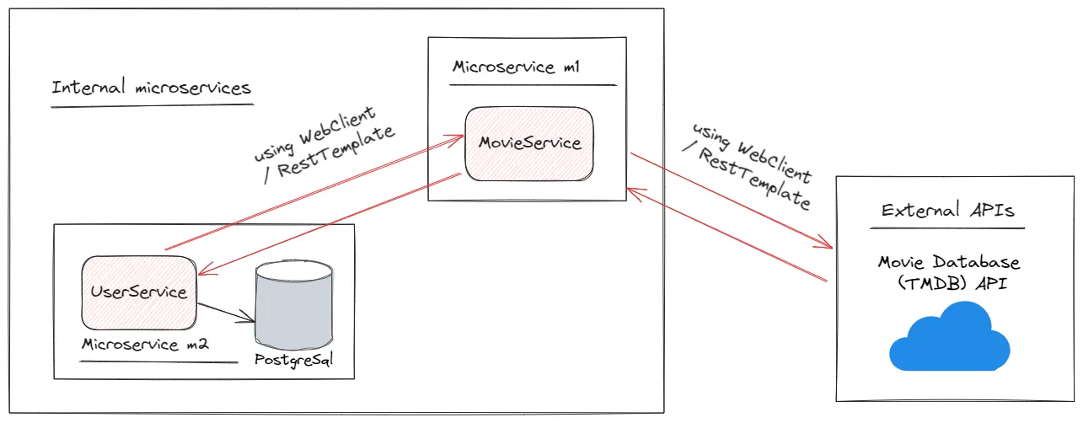
Use Cases for Asynchronous
Async is useful when the main request should finish quickly and extra work can happen after core data is saved.
Notifications: when an enrollment is completed, send an email or SMS.
Audit logs: record important events without slowing down the API response.
Background jobs: exports, reports, heavy computations, and sync jobs run after the response.
Fan out: one event triggers multiple consumers such as audit, analytics, and notifications.
GUVI | SDE with AI
Day 47

Slide 27
Sync vs Async Tradeoffs
Sync is easier to reason about but tightly couples services and makes failures spread faster.
Async reduces coupling and supports fan out, but introduces eventual consistency because results may arrive later.
  Eventual consistency means that changes don’t instantly appear everywhere, but given enough time, all copies will reflect the same value. Eg: when you send a bank transfer: your account shows the deduction right away, but the recipient’s balance may take a little while to reflect the change.
Async requires handling retries and duplicates because the same message can be delivered more than once.
Rule of thumb: sync when the user needs an immediate answer, async when work can complete after the main transaction.
Note: Today we learn mechanics with Kafka. Reliability patterns come in the next sessions.
GUVI | SDE with AI
Day 47

Slide 28
Scenario Check
Enrollment created, then send email
Answer: async, because email can happen after enrollment is saved
Payment status check during checkout
Answer: sync, because user needs an immediate yes or no
Generate a report and send a link later
Answer: async, because it is heavy work and can complete later
GUVI | SDE with AI
Day 47

Slide 29
Event Driven Architecture

Slide 30
Event Driven Architecture
Event-driven architecture means systems publish events that represent facts, instead of calling each other for every step.
An event is something that happened: EnrollmentCreated, CourseUpdated, PasswordChanged.
In such an architecture, producers publish events without knowing consumers, which reduces coupling and makes the system easier to extend.
Consumers subscribe and react when ready, supporting retries and scaling under load.
Note: we’ll learn about Kafka, which stores, delivers, and lets us replay these events reliably.
GUVI | SDE with AI
Day 47

Slide 31
Event Flow Example
Consider a scenario: sending a notification after successfully enrolling a student.
How does this work in an event driven scenario?
  Step 1: EnrollmentController saves enrollment using EnrollmentService and EnrollmentRepository.
  Step 2: After saving, publish EnrollmentCreated to Kafka on a topic.
  Step 3: Notification service consumes and sends email without blocking the enrollment API.
  Step 4: Audit service consumes the same event and writes an audit log.
Note: The API stays fast and new consumers can be added without changing the producer.
GUVI | SDE with AI
Day 47

Slide 32
Producer and Consumer Roles
Roles & Responsibilities
  Producer: publish the right event to the right topic with enough data for consumers.
  Consumer: process events safely, retry on failure, and avoid incorrect duplicates.
Key benefit
  Add a new consumer like analytics without changing the producer code.
Note: Keep this mental model when we integrate Kafka into Spring Boot later.
GUVI | SDE with AI
Day 47

Slide 33
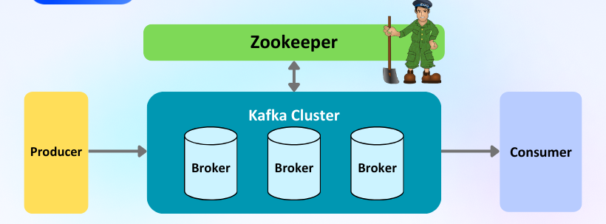
Kafka and ZooKeeper
Kafka is a broker that stores events and delivers them to consumers using topics.
ZooKeeper is required for today’s local setup mode and must be started before Kafka.
We will prove Kafka works using CLI tools, then write Java code that produces and consumes messages.
GUVI | SDE with AI
Day 47

Slide 34
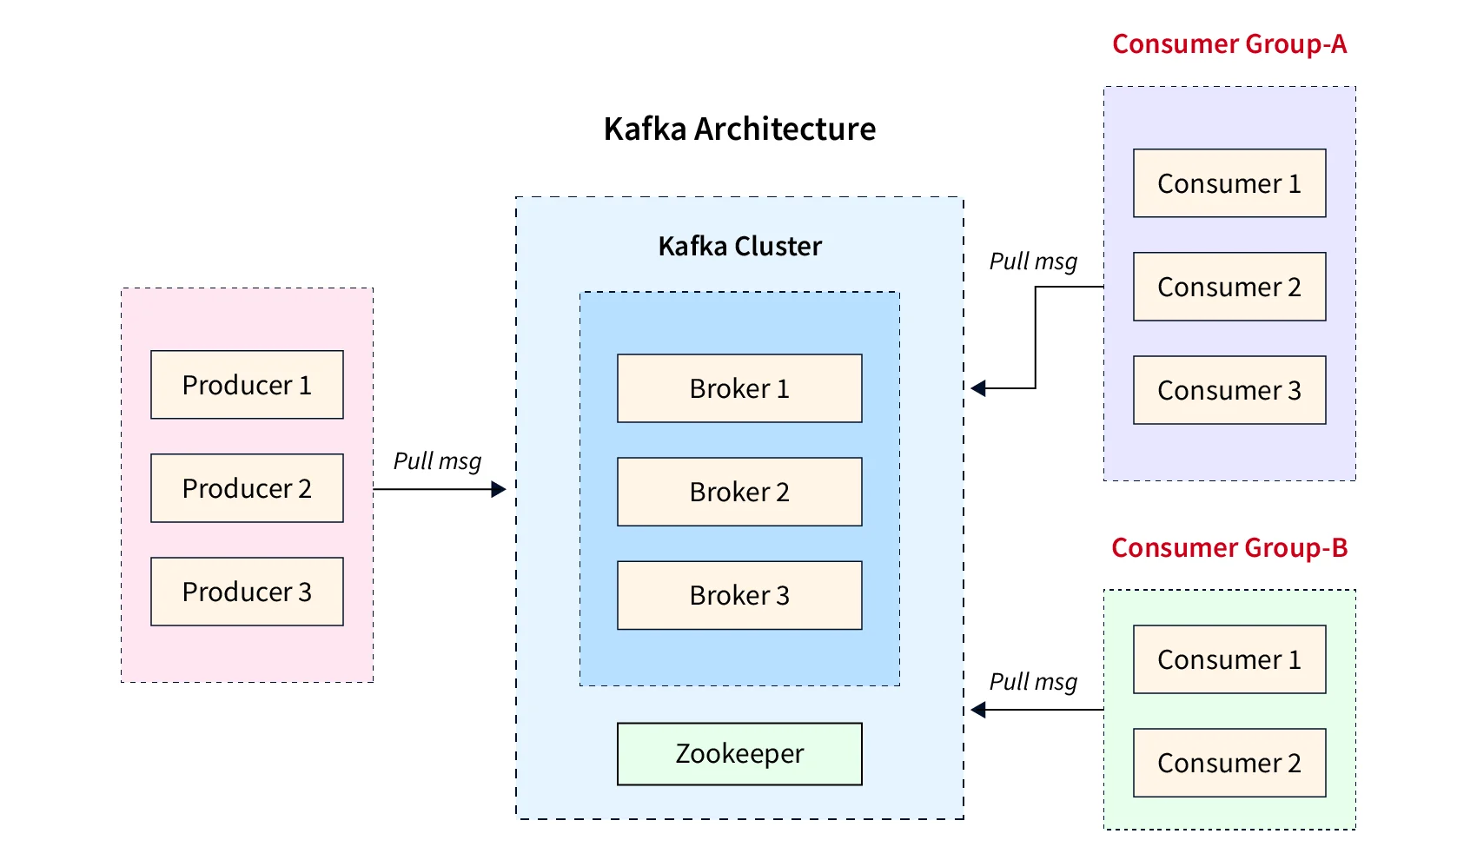
Broker and Topic
Broker: the Kafka server that stores events and serves producers and consumers.
Topic: a named stream of events, like guvi.events, that producers write to and consumers read from.
Think of a topic as a shared channel name for one kind of event flow.
Note: In our demo, producer and consumer meet through the topic, not by calling each other directly.
GUVI | SDE with AI
Day 47

Slide 35
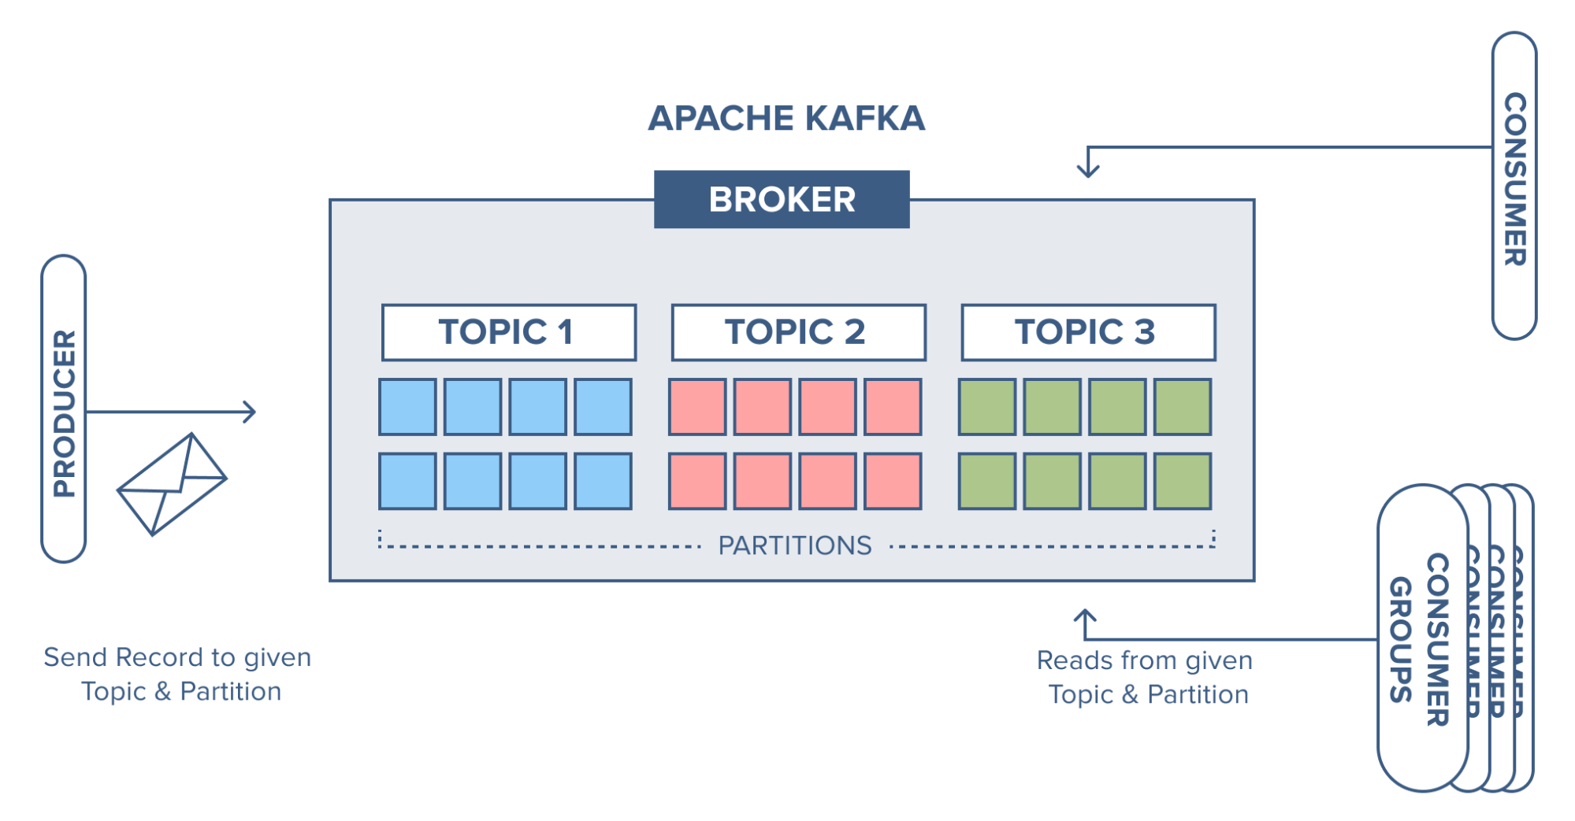
Partition, Offset, Consumer Group
Partition: a topic is split into partitions so Kafka can scale and process events in parallel.
Offset: each event in a partition has a position number; consumers use offsets to track progress and replay.
Consumer group: a set of consumers that share work so messages are balanced across instances.
  Different groups means fan out: each group gets its own copy of the events.
  Microservice mapping: notification and audit are different groups reading the same topic.
Note: These three ideas decide scaling, replay, and fan out in microservice systems.
GUVI | SDE with AI
Day 47

Slide 36
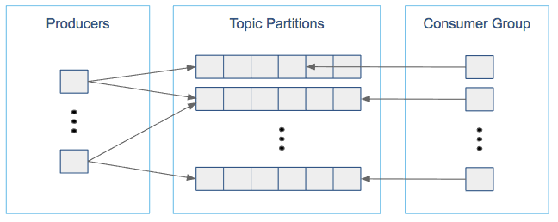
Partitions (contd.)
Topics are where producers publish and consumers subscribe.
Partitions allow parallel reading because different consumers can read different partitions.
Ordering is guaranteed only within a partition, not across the whole topic.
For today, we use one partition so behavior is predictable.
GUVI | SDE with AI
Day 47

Slide 37
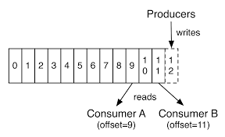
Offsets (contd.)
Offsets enable replay and progress tracking: consumers store the last offset they processed.
From beginning means start from the earliest offset and replay the history.
Restarting a consumer uses offsets to continue where it left off, depending on group and config.
Note: Offsets are why Kafka is useful for event history, not just real-time delivery.
GUVI | SDE with AI
Day 47

Slide 38
ZooKeeper Role
ZooKeeper stores coordination information used by Kafka in this mode.
Kafka relies on ZooKeeper being available, which is why ZooKeeper must start first and stay running.
If ZooKeeper stops, Kafka may fail to operate correctly or fail on restarts.
Note: Treat ZooKeeper as a required dependency today.
GUVI | SDE with AI
Day 47

Slide 39
Installation

Slide 40
Local Setup Goal
Demo: start ZooKeeper and Kafka locally in ZooKeeper mode.
Demo: create topic guvi.events.
Demo: prove it works using console producer and console consumer.
Evidence: capture one proof (topic list output or consumer output).
GUVI | SDE with AI
Day 47

Slide 41
Install Checklist
Java installed and java -version works.
Kafka distribution installed or extracted on your machine.
Two terminals ready: one for ZooKeeper and one for Kafka.
Ports free: 2181 for ZooKeeper, 9092 for Kafka.
GUVI | SDE with AI
Day 47

Slide 42
Start ZooKeeper
DEMO
Demo: start ZooKeeper and keep this terminal running for the entire class.
Success signal: process stays running and does not exit with an error.
# Terminal 1
bin/zookeeper-server-start.sh config/zookeeper.properties
GUVI | SDE with AI
Day 47

Slide 43
Start Kafka
DEMO
Demo: start Kafka broker after ZooKeeper is running.
Success signal: broker stays running and CLI commands can connect.
# Terminal 2
bin/kafka-server-start.sh config/server.properties
GUVI | SDE with AI
Day 47

Slide 44
Create Topic
DEMO
Demo: create topic guvi.events with one partition and replication factor one.
Demo: list topics and confirm guvi.events exists.
bin/kafka-topics.sh --bootstrap-server localhost:9092 \
+ --create --topic guvi.events --partitions 1 --replication-factor 1
# Verify
bin/kafka-topics.sh --bootstrap-server localhost:9092 --list
GUVI | SDE with AI
Day 47

Slide 45
Console Producer
DEMO
Demo: start producer for guvi.events and type three key:value messages.
Tip: use your name as the key so you can identify your messages.
bin/kafka-console-producer.sh --bootstrap-server localhost:9092 \
+ --topic guvi.events \
+ --property "parse.key=true" --property "key.separator=:"
# Type messages like
nikhil:hello-1
GUVI | SDE with AI
Day 47

Slide 46
Console Consumer
DEMO
Demo: start consumer and read messages from the beginning.
Expected: you see key and value printed for the messages you produced.
bin/kafka-console-consumer.sh --bootstrap-server localhost:9092 \
+ --topic guvi.events --from-beginning \
+ --property print.key=true --property key.separator=" | "
GUVI | SDE with AI
Day 47

Slide 47
Setup Checklist
Topic exists: kafka-topics --list includes guvi.events.
Producer sends messages without error.
Consumer prints messages, including earlier messages with from-beginning.
Note: If you have this proof, you are ready for Java code.
GUVI | SDE with AI
Day 47

Slide 48
Common Fixes
Port in use: stop old ZooKeeper or Kafka processes and retry.
Broker not available: Kafka may still be starting. Wait 10 seconds and retry.
Consumer shows nothing: confirm topic name, use from-beginning, and send new messages.
Topic create fails: Kafka not fully started. Retry after a short wait.
GUVI | SDE with AI
Day 47

Slide 49
Producer & Consumer in Java

Slide 50
Java Producer and Consumer
Demo: live code a Java producer that publishes key:value messages to guvi.events.
Demo: live code a Java consumer that prints key, value, partition, and offset.
This proves real applications can publish and consume events using Kafka clients.
Note: We keep this separate from Spring Boot today and integrate tomorrow.
GUVI | SDE with AI
Day 47

Slide 51
Java Config Values
bootstrap.servers: localhost:9092
topic: guvi.events
group.id: demo-group
serializers: String for key and String for value
Note: These four values are the minimum to build a working producer and consumer.
GUVI | SDE with AI
Day 47

Slide 52
Producer Steps
Create producer properties with bootstrap server and String serializers.
Create KafkaProducer and send five messages with a key and a value.
Print publish metadata so learners can see partition and offset returned by Kafka.
Close the producer cleanly so messages flush before exit.
GUVI | SDE with AI
Day 47

Slide 53
Consumer Steps
Create consumer properties with bootstrap server, group id, and String deserializers.
Subscribe to guvi.events and poll in a loop.
Print key, value, partition, and offset for each record.
Note: The consumer output is our final proof that the pipeline works.
GUVI | SDE with AI
Day 47

Slide 54
Run Order
Start ZooKeeper first and keep it running.
Start Kafka second and keep it running.
Start the Java consumer so it is ready to read messages.
Run the Java producer to publish messages into the topic.
Note: When you see producer success and consumer output, you have full end-to-end proof.
GUVI | SDE with AI
Day 47

Slide 55
That Is a Wrap
You learned when async communication makes sense in microservices and what tradeoffs it introduces.
You ran ZooKeeper and Kafka locally, created guvi.events, and verified CLI produce and consume.
You built a Java producer and consumer that published and consumed real messages from Kafka.
Next: integrate Kafka with Spring Boot and discuss practical patterns for reliability.
GUVI | SDE with AI
Day 47

