Slide 1
InscripLens
AI-Assisted Recognition and Interpretation
of Historical Kannada Veeragallu Inscriptions
Presentation 3 · UQ25CA741A Capstone Project
Nikhil Vasista N R
PES1PG25CA305 · MCA Semester III
Guide: Archana N
Faculty Associate, Department of MCA
PES University · Academic Year 2026–27
InscripLens · Presentation 3
1
Notes:
Source: supplied phase2.pptx. Current implementation statements supersede proposed Phase 2 functionality.

Slide 2
Abstract
InscripLens provides a local workflow for analysing historical Kannada inscription images.
The prototype combines pretrained enhancement, candidate character detection, experimental recognition and human review.
The broader HOG/SVM recognizer matches 77 of 300 supplied-box reference labels. Automatic localization plus recognition succeeds on 52 of 300.
Full-text transcription, modern Kannada conversion and English interpretation remain unfinished.
InscripLens · Presentation 3
2
Notes:
Sources: outputs/broad_clean_study/summary.json; outputs/broad_pipeline_study/summary.json. Results use reused validation and source annotations, not independent epigraphic verification.

Slide 3
Problem, purpose and scope
Weathering, shallow carving and historical glyph variation make stone text difficult to distinguish.
Purpose: assist inspection and correction while preserving image and source provenance.
Current scope: character suggestions, review records and published-reading comparison for a hero-stone pilot.
Original scope also includes modern Kannada and English interpretation. These remain objectives, not delivered outputs.
InscripLens · Presentation 3
3
Notes:
Source: supplied phase2.pptx. Current implementation statements supersede proposed Phase 2 functionality.

Slide 4
Progress since Presentation 2
Expanded from initial images to a public annotated pilot and a broader training corpus.
Implemented local enhancement, region recognition, review alternatives, history and JSON export.
Compared SVM, CNN and frozen pretrained features using recorded evaluation protocols.
Added published-source review and a separate printed-Kannada OCR draft demonstration.
InscripLens · Presentation 3
4
Notes:
Source: supplied phase2.pptx. Current implementation statements supersede proposed Phase 2 functionality. Sources: application code and outputs/*_study/summary.json.

Slide 5
Literature survey 1
Preprocessing techniques for recognition of ancient Kannada epigraphs
A. L. Somashekharaiah and A. Deshpande
IJECE, vol. 14, no. 1, pp. 358–365, 2024
Preprocessing addresses noise, contrast and character separation before recognition.
Relevance: image preparation. Better-looking images still require a recognition evaluation.
InscripLens · Presentation 3
5
Notes:
A. L. Somashekharaiah and A. Deshpande, “Preprocessing techniques for recognition of ancient Kannada epigraphs,” IJECE, vol. 14, no. 1, pp. 358–365, 2024. https://zenodo.org/records/10460339
Method summary follows the supplied Phase 2 survey unless independently checked. Do not compare published headline accuracy with InscripLens without matching data and metrics.

Slide 6
Literature survey 2
Hybrid method for enhancement of low-resolution ancient Kannada Stone Inscription images
B. Agasar and G. Mukarambi
Digital Applications in Archaeology and Cultural Heritage, vol. 35, e00385, 2024
Combines region separation, filtering and adaptive thresholding for degraded stone images.
Relevance: enhancement choices. Reported enhancement performance is not directly comparable to character accuracy.
InscripLens · Presentation 3
6
Notes:
B. Agasar and G. Mukarambi, “Hybrid method for enhancement of low-resolution ancient Kannada Stone Inscription images,” Digital Applications in Archaeology and Cultural Heritage, vol. 35, e00385, 2024. https://doi.org/10.1016/j.daach.2024.e00385
Method summary follows the supplied Phase 2 survey unless independently checked. Do not compare published headline accuracy with InscripLens without matching data and metrics.

Slide 7
Literature survey 3
SIFT and HOG features for the retrieval of ancient Kannada epigraphs
R. Parashivamurthy, C. Naveena and Y. H. Sharath Kumar
IET Image Processing, vol. 14, no. 17, pp. 4657–4662, 2020
Uses local visual descriptors and character retrieval after segmentation.
Relevance: feature-based recognition baseline. InscripLens uses HOG/SVM, not a reproduction of the complete SIFT retrieval method.
InscripLens · Presentation 3
7
Notes:
R. Parashivamurthy, C. Naveena and Y. H. Sharath Kumar, “SIFT and HOG features for the retrieval of ancient Kannada epigraphs,” IET Image Processing, vol. 14, no. 17, pp. 4657–4662, 2020. https://doi.org/10.1049/iet-ipr.2020.0715
Method summary follows the supplied Phase 2 survey unless independently checked. Do not compare published headline accuracy with InscripLens without matching data and metrics.

Slide 8
Literature survey 4
Impact of Total Variation Regularization on Character Segmentation from Historical Stone Inscriptions
H. T. Chandrakala, G. Thippeswamy and R. J. Martis
Pattern Recognition and Image Analysis, vol. 31, pp. 35–48, 2021
Studies regularization for separating characters in historical inscription images.
Relevance: segmentation quality. Performance on impressions does not establish performance on the current stone-image pilot.
InscripLens · Presentation 3
8
Notes:
H. T. Chandrakala, G. Thippeswamy and R. J. Martis, “Impact of Total Variation Regularization on Character Segmentation from Historical Stone Inscriptions,” Pattern Recognition and Image Analysis, vol. 31, pp. 35–48, 2021. https://doi.org/10.1134/S1054661821010041
Method summary follows the supplied Phase 2 survey unless independently checked. Do not compare published headline accuracy with InscripLens without matching data and metrics.

Slide 9
Literature survey 5
Kannada Manuscript Digitization through OCR and Machine Learning
A. R. Borah, A. Vijapur and B. Mahesh Kumar
IEEE IC2PCT, 2024
Uses preprocessed character images and CNN-based recognition for Kannada manuscripts.
Relevance: learned visual features. Manuscript handwriting differs from carved and damaged inscriptions.
InscripLens · Presentation 3
9
Notes:
A. R. Borah, A. Vijapur and B. Mahesh Kumar, “Kannada Manuscript Digitization through OCR and Machine Learning,” IEEE IC2PCT, 2024. https://doi.org/10.1109/IC2PCT60090.2024.10486458
Method summary follows the supplied Phase 2 survey unless independently checked. Do not compare published headline accuracy with InscripLens without matching data and metrics.

Slide 10
Literature survey 6
Optical Character Recognition for Sanskrit Using Convolution Neural Networks
M. Avadesh and N. Goyal
IAPR DAS, pp. 447–452, 2018
Segments characters and treats compound forms as separate CNN classes.
Relevance: character-class design. Separate compound classes increase training coverage requirements.
InscripLens · Presentation 3
10
Notes:
M. Avadesh and N. Goyal, “Optical Character Recognition for Sanskrit Using Convolution Neural Networks,” IAPR DAS, pp. 447–452, 2018. https://doi.org/10.1109/DAS.2018.50
Method summary follows the supplied Phase 2 survey unless independently checked. Do not compare published headline accuracy with InscripLens without matching data and metrics.

Slide 11
Literature survey 7
Improving Kannada OCR Using a Stroke-Based Approach
E. Arun, J. Vinith, C. Pattar and K. George
IEEE TENCON, pp. 1611–1615, 2019
Adds generated stroke sequences to character-image information.
Relevance: complementary visual information. Generated strokes may also introduce errors.
InscripLens · Presentation 3
11
Notes:
E. Arun, J. Vinith, C. Pattar and K. George, “Improving Kannada OCR Using a Stroke-Based Approach,” IEEE TENCON, pp. 1611–1615, 2019. https://doi.org/10.1109/TENCON.2019.8929606
Method summary follows the supplied Phase 2 survey unless independently checked. Do not compare published headline accuracy with InscripLens without matching data and metrics.

Slide 12
Literature survey 8
AI Powered OCR Solution for Tamil Historical Document
T. Saraswathi, Harish S and Abishek Kumar B
IEEE ICISS, pp. 1002–1009, 2026
The Phase 2 survey identifies visual features, sequence recognition and limited-label training strategies.
Relevance: historical-script sequence recognition. Tamil results are not a Kannada benchmark.
InscripLens · Presentation 3
12
Notes:
T. Saraswathi, Harish S and Abishek Kumar B, “AI Powered OCR Solution for Tamil Historical Document,” IEEE ICISS, pp. 1002–1009, 2026. https://doi.org/10.1109/ICISS67859.2026.11453612
Method summary follows the supplied Phase 2 survey unless independently checked. Do not compare published headline accuracy with InscripLens without matching data and metrics.

Slide 13
Literature survey 9
Advanced Deep Learning OCR Algorithm for Deciphering and Digitizing Chola Period Tamil Inscriptions
M. Rajalakshmi et al.
IEEE ICMCSI, pp. 1487–1493, 2026
The Phase 2 survey describes deep-learning detection and recognition for Chola-period inscriptions.
Relevance: separating detection and recognition evaluation. Different script, corpus and protocol limit comparison.
InscripLens · Presentation 3
13
Notes:
M. Rajalakshmi et al., “Advanced Deep Learning OCR Algorithm for Deciphering and Digitizing Chola Period Tamil Inscriptions,” IEEE ICMCSI, pp. 1487–1493, 2026. https://doi.org/10.1109/ICMCSI67283.2026.11412629
Method summary follows the supplied Phase 2 survey unless independently checked. Do not compare published headline accuracy with InscripLens without matching data and metrics.

Slide 14
Literature survey 10
AI-Powered Ancient Inscription Analysis and Translation (Halmidi)
Prekshitha K R et al.
ITM Web of Conferences, vol. 81, 01020, 2026
Proposes an integrated image-processing, recognition and language-processing pipeline.
Relevance: overall project scope. A curated Halmidi study does not establish transfer to varied hero stones.
InscripLens · Presentation 3
14
Notes:
Prekshitha K R et al., “AI-Powered Ancient Inscription Analysis and Translation (Halmidi),” ITM Web of Conferences, vol. 81, 01020, 2026. https://doi.org/10.1051/itmconf/20268101020
Method summary follows the supplied Phase 2 survey unless independently checked. Do not compare published headline accuracy with InscripLens without matching data and metrics.

Slide 15
Research used in the implementation
Shilalekhya: pretrained inscription binarization model used for enhancement.
EpiSAM: public images, character annotations and line polygons. The project also studies neighbor-aware segmentation.
Project work: data filtering, controlled comparisons, candidate detection, review workflow and local application.
Published readings support source comparison. They do not supply hidden answers to the validation recognizer.
InscripLens · Presentation 3
15
Notes:
Sources: https://github.com/ihdia/shilalekhya-binarization ; https://ihdia.iiit.ac.in/episam/ ; THIRD_PARTY.md. Shilalekhya paper: P. Jena et al., Unveiling Text in Challenging Stone Inscriptions: A Character-Context-Aware Patching Strategy for Binarization, ICVGIP 2025, doi:10.1145/3774521.3774539.

Slide 16
Dataset and evaluation protocol
Data stage | Size | Role
Hero-stone pilot | 27 images / 1,399 crops | Focused source annotations
Broader cleaned training | 109 images / 9,925 crops | 764 raw label types
Development subset | 359 crops, including 308 hero crops | Model selection by location
Reused validation | 6 hero stones / 300 crops | Diagnostic evaluation
Source labels are unreviewed. Validation is reused; enhancement pretraining overlap is incompletely known.
InscripLens · Presentation 3
16
Notes:
Sources: broad_clean_study/summary.json; work/hero_pilot/manifest.json. Development is drawn from training-source locations and excluded from development fitting.

Slide 17
Tools and technologies
Purpose | Implemented tools
Application and local history | Python, Streamlit, SQLite, JSON
Images and numerical features | Pillow, NumPy, HOG implementation
Recognition experiments | scikit-learn SVM, PyTorch CNN / BiLSTM / CTC
Printed-source baseline | Tesseract Kannada LSTM
Development and provenance | Git/GitHub, SHA-256, recorded scripts and reports
CPU inference and local storage support operation without a hosted OCR service.
InscripLens · Presentation 3
17
Notes:
Sources: requirements.txt; requirements-inference.txt; outputs/inscriplens_app.py; outputs/app_backend.py.

Slide 18
Functional requirements
User action | Current behaviour
Upload and enhance | Accept image, orient/resize, run local enhancement
Inspect and recognize | Show mask, propose regions, predict raw character labels
Review suggestions | Offer ranked alternatives and annotated training examples
Record corrections | Preserve original prediction, model hash and user suggestion
Revisit and export | Browse saved analyses and download structured results
Compare published reading | Show source scan, annotation groups and editable OCR draft
InscripLens · Presentation 3
18
Notes:
Sources: outputs/inscriplens_app.py; outputs/app_backend.py. Users: student/researcher as operator; reviewer supplies suggestions. No implemented account-role system.

Slide 19
Non-functional requirements
Privacy: images and history remain local in the current application.
Reliability: reject unsupported or excessive image input, validate box bounds and retain error messages.
Traceability: retain image hashes, model hashes, source labels and user suggestions separately.
Performance: CPU inference is available with bounded image dimensions and worker timeout. Large-scale throughput has not been established.
Usability: previews, source links, ranked alternatives and downloadable records support review.
InscripLens · Presentation 3
19
Notes:
Sources: outputs/app_backend.py; outputs/inscriplens_app.py. No production security certification, multiuser scalability claim or latency SLA.

Slide 20
Implemented architecture
Presentation layer: Streamlit upload, analysis, dataset, review and history views.
Processing layer: local enhancement worker, connected components and HOG/SVM prediction.
Review layer: ranked candidates, training examples, source comparison and correction records.
Storage layer: source images and masks on disk, analysis/review records in SQLite, JSON export.
InscripLens · Presentation 3
20
Notes:
Source: outputs/inscriplens_app.py and outputs/app_backend.py. These describe actual modules rather than the larger proposed Phase 2 system.

Slide 21
ML process and controls
Prepare annotations and images, then exclude validation locations from training.
Generate predicted masks and extract character crops using source boxes for controlled recognition tests.
Fit fixed candidate models on training locations and select using held-out development locations.
Evaluate exact source-label agreement and automatic localization separately.
Keep failed experiments and limitations in recorded reports.
InscripLens · Presentation 3
21
Notes:
Sources: outputs/compare_broad_cleaned.py; compare_paired_features.py; broad_pipeline_study/summary.json. Sequence recognition is experimental and not deployed.

Slide 22
Implemented relational schema
Table | Key fields | Relationship
runs | id (PK), created, filename, sha256, image_path, mask_path, details | One analysis may have many reviews
character_reviews | id (PK), run_id (FK), bbox, prediction, model, model_sha256, suggested_label, reviewer, note, status | run_id references runs.id
SQLite stores analysis and review provenance. No translation table or user account system is implemented.
InscripLens · Presentation 3
22
Notes:
Source: outputs/app_backend.py connect(), save_review(), review_export().

Slide 23
Pseudocode of implemented modules
ANALYSE: validate image, apply orientation, resize, save input, invoke enhancement worker, check output dimensions, insert analysis record.
RECOGNIZE: obtain candidate or adjusted box, crop mask, extract median-filtered HOG, predict label, rank alternatives.
REVIEW: validate box, retain original prediction and model hash, append user suggestion with unverified status.
EXPORT: collect analysis metadata and review records, preserve provenance, download JSON.
InscripLens · Presentation 3
23
Notes:
Sources: outputs/app_backend.py; outputs/recognize_regions.py; outputs/recognition_alternatives.py. No modernization or translation step is implemented.

Slide 24
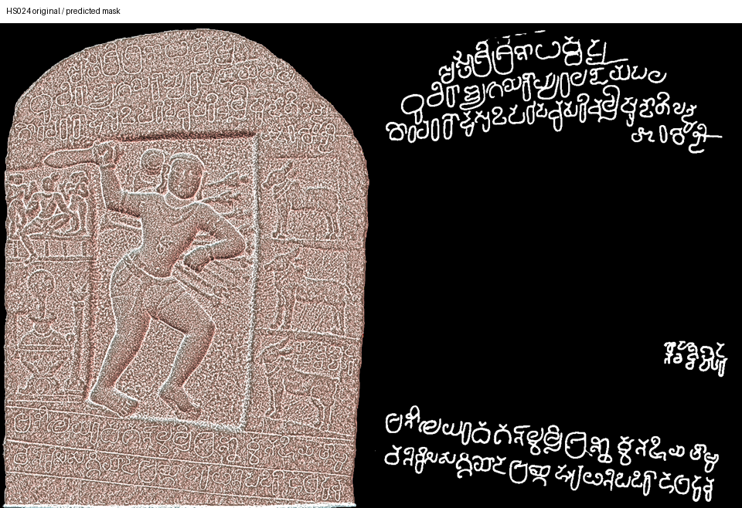
Implementation evidence: enhanced image
Kumbalahalli source image and predicted mask. Improved visibility does not guarantee correct characters.
InscripLens · Presentation 3
24
Notes:
Local artifact: outputs/full_binarizer/HS024_comparison.png. EpiSAM / Mythic Society imagery, CC BY-SA 4.0. Enhancement uses pretrained Shilalekhya.

Slide 25
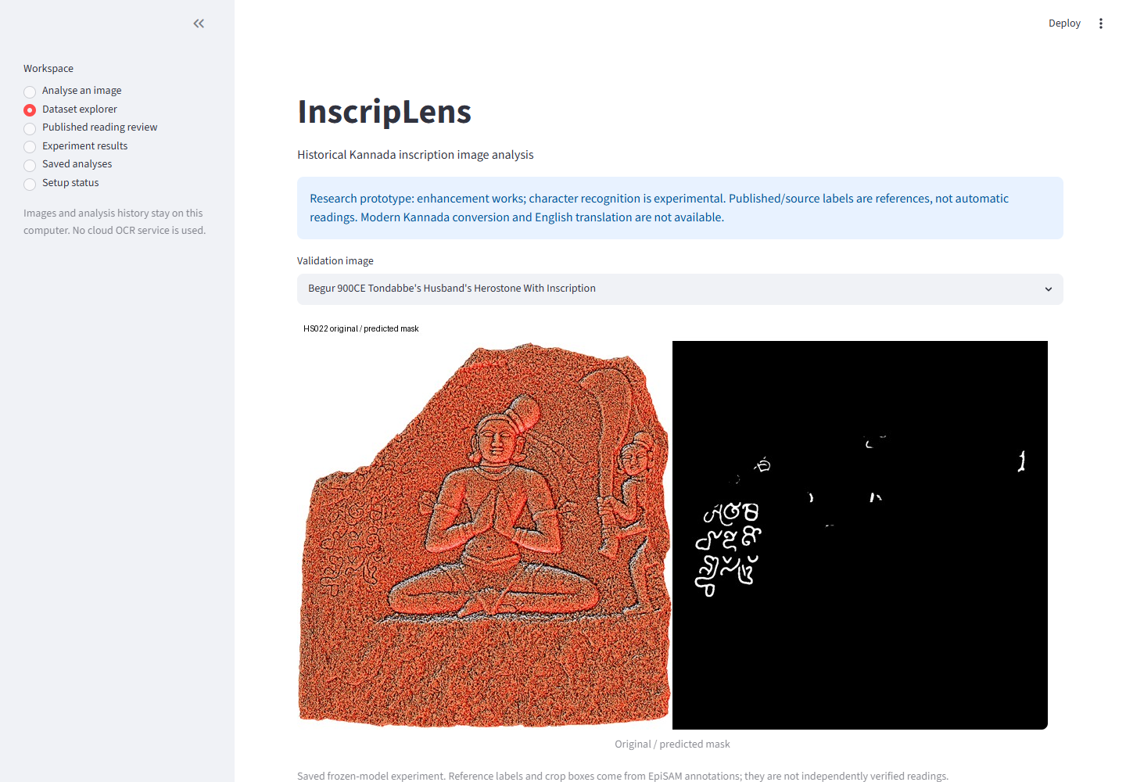
Implementation evidence: dataset view
Live local Streamlit view captured for this presentation. Labels are source annotations, not verified readings.
InscripLens · Presentation 3
25
Notes:
Screenshot of local application on 4 November 2026. Source: outputs/inscriplens_app.py. EpiSAM imagery attribution applies.

Slide 26
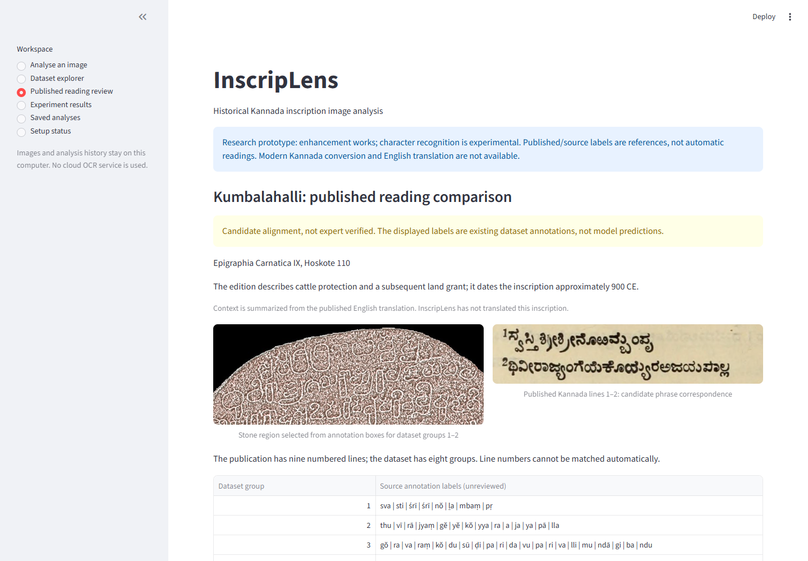
Implementation evidence: published reading
Stone region, printed reading and source-labelled comparison. Correspondence remains a candidate alignment.
InscripLens · Presentation 3
26
Notes:
Screenshot of local application on 4 November 2026. EC IX Hoskote110: Roman p125, English p102, Kannada p224. https://archive.org/details/epigraphiacarnat09myso . Stone imagery EpiSAM / Mythic Society CC BY-SA4.0.

Slide 27
Model comparison on the same cohort
Recognition model | Training crops | Correct / 300 | Exact-label accuracy
Mask HOG + SVM | 949 | 63 | 21.00%
Small CNN | 949 | 44 | 14.67%
Frozen ResNet18 + SVM | 949 | 46 | 15.33%
Supplied boxes and reused validation. These are classifier comparisons, not complete inscription transcription.
InscripLens · Presentation 3
27
Notes:
Sources: matched_mask_study/summary.json; cnn_study/summary.json; transfer_study/summary.json. Same source-box validation cohort.

Slide 28
Broader training and automatic recognition
Measure | Result | Meaning
Broader HOG/SVM recognition | 77/300 = 25.67% | Supplied character boxes
Correct automatic localization + label | 52/300 = 17.33% | Detection and classification both succeed
Localization recall | 196/300 = 65.33% | One-to-one IoU ≥ 0.5 matches
Localization precision | 196/330 = 59.39% | Matched proposals / all proposals
Top-three label inclusion | 122/300 = 40.67% | Reference appears among suggestions
Broader model uses 9,925 crops. Top-three inclusion is not automatic accuracy or measured reviewer success.
InscripLens · Presentation 3
28
Notes:
Sources: broad_clean_study/summary.json; broad_pipeline_study/summary.json; review_alternatives_study/summary.json.

Slide 29
Latest development experiment
Features | Hero development | All development
Predicted-mask HOG | 63/308 | 78/359
Original + mask HOG | 67/308 | 82/359
Net gain: four hero characters. Thirteen errors fixed, nine introduced. Validation of this candidate is pending.
InscripLens · Presentation 3
29
Notes:
Source: paired_feature_study/summary.json. 9566 fit characters. Fixed C10, gamma scale. No validation run or production change.

Slide 30
Error analysis and sequence experiment
Of 223 broader-model errors, only seven involve labels absent from training.
131 errors occur on nonconstant masks with at least 20 training examples for the reference label.
Line preparation exposed adjacent text, clipped glyphs and nearly blank enhanced crops.
After filtering, 207 training and 21 development line candidates remain. A four-example CNN–BiLSTM–CTC sanity check reached 3/4 exact, not the required 4/4.
InscripLens · Presentation 3
30
Notes:
Sources: recognition_failure_audit/summary.json; sequence_data_audit/crop_audit.json; overfit_foreground_check_vertical_packed_600steps.json. These are descriptive errors, not causal proof. Tiny-subset memorization is not OCR accuracy.

Slide 31
Printed-book OCR as a supporting feature
A separate pretrained Tesseract Kannada engine produces editable drafts from manually cropped publication text.
One user-checked prose heading required seven edits over 55 normalized Unicode codepoints: 12.73% error.
The draft-review workflow preserves original OCR and edited text separately.
This single-heading result does not measure stone recognition, general book accuracy or translation.
InscripLens · Presentation 3
31
Notes:
Sources: book_ocr_study/heading_evaluation.json; heading111_user_reference.txt. Normalization: NFC and collapsed whitespace, punctuation retained. https://tesseract-ocr.github.io/tessdoc/Command-Line-Usage.html

Slide 32
Software testing
Check | Recorded result | Limit
Navigation across application views | Pass | Smoke test, not complete browser E2E
Review storage and provenance | Checks implemented | User suggestions remain unverified
Model comparison protocol | Baseline reproduced at 63/308 | Development reused
OCR edit-distance checks | Known examples passed | One printed reference only
Sequence sanity check | Fail: 3/4 at 600 steps | No larger training approved by gate
Positive and negative input checks exist for invalid boxes, missing assets and model/reference mismatch.
InscripLens · Presentation 3
32
Notes:
Sources: check_app.py; check_review_storage.py; check_review_alternatives.py; compare_paired_features.py; evaluate_book_heading.py. Review storage validation was run in prior development, navigation rerun during this presentation workflow.

Slide 33
Demonstration sequence
Open Analyse an image and display the available public sample or upload a local inscription image.
Run enhancement and inspect the resulting mask and character candidates.
Select a region, show its prediction and ranked alternatives, then save a review suggestion.
Open Saved analyses and export the recorded result.
Open Published reading review to show source provenance and the editable printed-text draft.
InscripLens · Presentation 3
33
Notes:
Local run: python -m streamlit run outputs/inscriplens_app.py . Ensure models and local assets are present. Allow for CPU processing; do not promise a fixed duration.

Slide 34
Remaining implementation
Validate the fixed original-plus-mask candidate before adopting it.
Improve reliable segmentation and recognition across inscription styles.
Complete verified line-level references and full-text transcription evaluation.
Modern Kannada conversion and English interpretation remain unimplemented.
The present evidence does not support an 80% completion claim for the original scope.
InscripLens · Presentation 3
34
Notes:
Source: restart checkpoint and recorded project status. The presentation brief requires at least80%; that requirement is not evidence that it has been met. Avoid substituting OCR accuracy for project completion.

Slide 35
References 1
[1] A. L. Somashekharaiah and A. Deshpande, “Preprocessing techniques for recognition of ancient Kannada epigraphs,” IJECE, vol. 14, no. 1, pp. 358–365, 2024. https://zenodo.org/records/10460339
[2] B. Agasar and G. Mukarambi, “Hybrid method for enhancement of low-resolution ancient Kannada Stone Inscription images,” Digital Applications in Archaeology and Cultural Heritage, vol. 35, e00385, 2024. https://doi.org/10.1016/j.daach.2024.e00385
[3] R. Parashivamurthy, C. Naveena and Y. H. Sharath Kumar, “SIFT and HOG features for the retrieval of ancient Kannada epigraphs,” IET Image Processing, vol. 14, no. 17, pp. 4657–4662, 2020. https://doi.org/10.1049/iet-ipr.2020.0715
[4] H. T. Chandrakala, G. Thippeswamy and R. J. Martis, “Impact of Total Variation Regularization on Character Segmentation from Historical Stone Inscriptions,” Pattern Recognition and Image Analysis, vol. 31, pp. 35–48, 2021. https://doi.org/10.1134/S1054661821010041
[5] A. R. Borah, A. Vijapur and B. Mahesh Kumar, “Kannada Manuscript Digitization through OCR and Machine Learning,” IEEE IC2PCT, 2024. https://doi.org/10.1109/IC2PCT60090.2024.10486458
InscripLens · Presentation 3
35
Notes:
Bibliographic details from supplied Phase2 deck and linked primary metadata. Institutional IEEE/Scopus eligibility should be confirmed before submission; DOI metadata for the preprocessing paper is inconsistent with the supplied article.

Slide 36
References 2
[6] M. Avadesh and N. Goyal, “Optical Character Recognition for Sanskrit Using Convolution Neural Networks,” IAPR DAS, pp. 447–452, 2018. https://doi.org/10.1109/DAS.2018.50
[7] E. Arun, J. Vinith, C. Pattar and K. George, “Improving Kannada OCR Using a Stroke-Based Approach,” IEEE TENCON, pp. 1611–1615, 2019. https://doi.org/10.1109/TENCON.2019.8929606
[8] T. Saraswathi, Harish S and Abishek Kumar B, “AI Powered OCR Solution for Tamil Historical Document,” IEEE ICISS, pp. 1002–1009, 2026. https://doi.org/10.1109/ICISS67859.2026.11453612
[9] M. Rajalakshmi et al., “Advanced Deep Learning OCR Algorithm for Deciphering and Digitizing Chola Period Tamil Inscriptions,” IEEE ICMCSI, pp. 1487–1493, 2026. https://doi.org/10.1109/ICMCSI67283.2026.11412629
[10] Prekshitha K R et al., “AI-Powered Ancient Inscription Analysis and Translation (Halmidi),” ITM Web of Conferences, vol. 81, 01020, 2026. https://doi.org/10.1051/itmconf/20268101020
InscripLens · Presentation 3
36
Notes:
Bibliographic details from supplied Phase2 deck and linked primary metadata. Institutional IEEE/Scopus eligibility should be confirmed before submission; DOI metadata for the preprocessing paper is inconsistent with the supplied article.

Slide 37
Data and implementation references
EpiSAM dataset and project: ihdia.iiit.ac.in/episam/
Shilalekhya enhancement: github.com/ihdia/shilalekhya-binarization
Epigraphia Carnatica IX: archive.org/details/epigraphiacarnat09myso
Tesseract documentation: tesseract-ocr.github.io/tessdoc/
Project repository: github.com/Nikhilnr46/InscripLens
InscripLens · Presentation 3
37
Notes:
Full citations: EpiSAM project by A. Sharma, P. Jena, A. Joseph and R. K. Sarvadevabhatla; see project publication metadata. P. Jena et al., ICVGIP2025, doi:10.1145/3774521.3774539. B. Lewis Rice, Epigraphia Carnatica, vol.IX, Bangalore District, 1905. Third-party notices: repository THIRD_PARTY.md.

Slide 38
Appendix: Architecture diagram
Streamlit
Image and review UI
Local worker
Enhancement
Recognition
Regions + HOG/SVM
History / export
SQLite + JSON
The interface invokes local processing and records analysis provenance. Review suggestions retain the original prediction.
InscripLens · Presentation 3
38
Notes:
Source: outputs/inscriplens_app.py; outputs/app_backend.py. Boxes represent implemented modules, not separate deployed services.

Slide 39
Appendix: ML methodology diagram
Location split
Fit / development
Feature extraction
Original and masks
Fixed model fit
Development comparison
Evaluation
Reused validation
Model selection uses development locations. Latest paired-feature candidate has not yet been evaluated on validation.
InscripLens · Presentation 3
39
Notes:
Source: compare_paired_features.py; broad_clean_study/summary.json.

Slide 40
Appendix: Entity relationship diagram
runs
character_reviews
id (primary key)
created, filename, sha256
image_path, mask_path
details
1 many
id (primary key)
run_id (foreign key)
bbox, prediction, model hash
suggestion, reviewer, status
Each review belongs to one saved analysis. Corrections do not overwrite original model predictions.
InscripLens · Presentation 3
40
Notes:
Source: outputs/app_backend.py. Actual SQLite tables. run_id foreign key points to runs.id.

