Slide 1

InscripLens
AI-Assisted Recognition and Interpretation
of Historical Kannada Veeragallu Inscriptions
Presentation 3 · UQ25CA741A Capstone Project
Nikhil Vasista N R
PES1PG25CA305 · MCA Semester III
Guide: Archana N
Faculty Associate, Department of MCA
PES University · Academic Year 2026–27
PES University | Department of MCA | Semester III | Capstone Project - Phase 3
1
Notes:
Source: supplied phase2.pptx. Current implementation statements supersede proposed Phase 2 functionality.

Slide 2
Abstract
InscripLens provides a local workflow for analysing historical Kannada inscription images.
The prototype combines pretrained enhancement, candidate character detection, experimental recognition and human review.
The broader HOG/SVM recognizer matches 77 of 300 supplied-box reference labels. Automatic localization plus recognition succeeds on 52 of 300.
Full-text transcription, modern Kannada conversion and English interpretation remain unfinished.
PES University | Department of MCA | Semester III | Capstone Project - Phase 3
2
Notes:
Sources: outputs/broad_clean_study/summary.json; outputs/broad_pipeline_study/summary.json. Results use reused validation and source annotations, not independent epigraphic verification.

Slide 3
Problem, purpose and scope
Weathering, shallow carving and historical glyph variation make stone text difficult to distinguish.
Purpose: assist inspection and correction while preserving image and source provenance.
Current scope: character suggestions, review records and published-reading comparison for a hero-stone pilot.
Original scope also includes modern Kannada and English interpretation. These remain objectives, not delivered outputs.
PES University | Department of MCA | Semester III | Capstone Project - Phase 3
3
Notes:
Source: supplied phase2.pptx. Current implementation statements supersede proposed Phase 2 functionality.

Slide 4
Progress since Presentation 2
Expanded from initial images to a public annotated pilot and a broader training corpus.
Implemented enhancement and review, then integrated a React/Vite Studio with a FastAPI backend.
Compared SVM, CNN and frozen pretrained features using recorded evaluation protocols.
Added published-source review and a separate printed-Kannada OCR draft demonstration.
PES University | Department of MCA | Semester III | Capstone Project - Phase 3
4
Notes:
Source: supplied phase2.pptx. Current implementation statements supersede proposed Phase 2 functionality. Sources: application code and outputs/*_study/summary.json.

Slide 5
Background: existing resources and systems
Resource / approach | What it provides | What InscripLens adds
Epigraphia Carnatica readings | Published textual readings and historical context | Candidate image-to-reading comparison, with manual verification
EpiSAM annotations | Images, character boxes and line polygons | Filtered pilot, location-based splits and recorded evaluations
Shilalekhya pretrained model | Inscription foreground / background masks | Image upload, candidate regions, prediction and review history
Printed Kannada OCR (Tesseract) | Draft recognition of printed text | Editable publication-text review, separate from stone OCR
A dataset, a published reading and an enhancement model solve different parts of the task.
PES University | Department of MCA | Semester III | Capstone Project - Phase 3
5
Notes:
Sources: https://archive.org/details/epigraphiacarnat09myso ; https://ihdia.iiit.ac.in/episam/ ; https://github.com/ihdia/shilalekhya-binarization ; outputs/book_ocr_study/heading_evaluation.json. Comparison describes roles, not measured superiority.

Slide 6
Research gap and project contribution
Historical glyph variation, erosion and uncertain character boundaries make transfer to new stones difficult.
Existing resources provide images, readings or specialist methods. This pilot needs a connected, traceable inspection and review workflow.
InscripLens integrates local enhancement, candidate localization, experimental predictions and unverified reviewer suggestions.
The research contribution is the recorded data preparation, model comparisons and failure analysis. The application contribution is the integrated review workflow.
No claim of a new pretrained binarizer, superior published-paper accuracy or reliable full-stone transcription is made.
PES University | Department of MCA | Semester III | Capstone Project - Phase 3
6
Notes:
Evidence: THIRD_PARTY.md; outputs/broad_clean_study/summary.json; outputs/broad_pipeline_study/summary.json; api/server.py; outputs/app_backend.py. This is a project-specific gap, not a claim that no other review platform exists.

Slide 7
LITERATURE SURVEY
1. Preprocessing techniques for recognition of ancient Kannada epigraphs
Authors: A. L. Somashekharaiah and A. Deshpande
Publication / year: IJECE, vol. 14, no. 1, pp. 358–365, 2024
Method
Grayscale conversion, binarization, smoothing, edge detection and text/character segmentation.
Dataset / result
Shows reduced noise and clearer inscription images. No measured recognition gain is given in the Phase 2 review.
Relevance to InscripLens
Supports preprocessing of faded Veeragallu images before character recognition.
Drawback
Image enhancement examples alone do not establish OCR accuracy.
Paper link: https://zenodo.org/records/10460339
PES University | Department of MCA | Semester III | Capstone Project - Phase 3
7
Notes:
Source: phase2.pptx slides 8–19. A. L. Somashekharaiah and A. Deshpande, Preprocessing techniques for recognition of ancient Kannada epigraphs, IJECE, vol. 14, no. 1, pp. 358–365, 2024. https://zenodo.org/records/10460339
Reported results belong to each paper, not InscripLens. Preserve verification qualifications shown on the slide.
Brief citation/indexing audit: outputs/presentation/REFERENCE_CHECK.md. IEEE publication and Scopus coverage are separate checks. Paper 10 method confirmed by IEEE abstract: https://ieeexplore.ieee.org/abstract/document/11453612

Slide 8
LITERATURE SURVEY
2. Hybrid method for enhancement of low-resolution ancient Kannada Stone Inscription images
Authors: B. Agasar and G. Mukarambi
Publication / year: Digital Applications in Archaeology and Cultural Heritage, vol. 35, e00385, 2024
Method
Separates text/non-text regions, applies median filtering and grayscale enhancement, then fuzzy adaptive thresholding.
Dataset / result
110 low-resolution Kannada inscription images. Reported enhancement accuracy: 78.18%.
Relevance to InscripLens
Informs enhancement choices for low-quality photographs before OCR.
Drawback
The reported enhancement measure is not character recognition accuracy.
Paper link: https://doi.org/10.1016/j.daach.2024.e00385
PES University | Department of MCA | Semester III | Capstone Project - Phase 3
8
Notes:
Source: phase2.pptx slides 8–19. B. Agasar and G. Mukarambi, Hybrid method for enhancement of low-resolution ancient Kannada Stone Inscription images, Digital Applications in Archaeology and Cultural Heritage, vol. 35, e00385, 2024. https://doi.org/10.1016/j.daach.2024.e00385
Reported results belong to each paper, not InscripLens. Preserve verification qualifications shown on the slide.
Brief citation/indexing audit: outputs/presentation/REFERENCE_CHECK.md. IEEE publication and Scopus coverage are separate checks. Paper 10 method confirmed by IEEE abstract: https://ieeexplore.ieee.org/abstract/document/11453612

Slide 9
LITERATURE SURVEY
3. Digitization and Recognition of Kannada Inscription Dynasty
Authors: Mallamma V. Reddy and Sachchidanand Sidramappa
Publication / year: The Scientific Temper, vol. 16, no. 10, pp. 4858–4863, 2025
Method
Digitizes inscriptions and uses image processing, pattern recognition and machine-learning classification, including KNN/DSAL approaches.
Dataset / result
Predicts the era or dynasty of Kannada inscriptions. Dataset size and final test results are unclear in the supplied survey.
Relevance to InscripLens
Provides a possible future direction for historical metadata and context.
Drawback
Era classification does not solve transcription; evaluation details need clarification.
Paper link: https://doi.org/10.58414/SCIENTIFICTEMPER.2025.16.10.03
PES University | Department of MCA | Semester III | Capstone Project - Phase 3
9
Notes:
Source: phase2.pptx slides 8–19. Mallamma V. Reddy and Sachchidanand Sidramappa, Digitization and Recognition of Kannada Inscription Dynasty, The Scientific Temper, vol. 16, no. 10, pp. 4858–4863, 2025. https://doi.org/10.58414/SCIENTIFICTEMPER.2025.16.10.03
Reported results belong to each paper, not InscripLens. Preserve verification qualifications shown on the slide.
Brief citation/indexing audit: outputs/presentation/REFERENCE_CHECK.md. IEEE publication and Scopus coverage are separate checks. Paper 10 method confirmed by IEEE abstract: https://ieeexplore.ieee.org/abstract/document/11453612

Slide 10
LITERATURE SURVEY
4. Kannada Stone Inscription Image Enhancement using Modified Approach for Binarization and Detection of Text Regions using Deep Learning YOLO Models
Authors: Bhagyashri Agasar and Gururaj Mukarambi
Publication / year: International Journal of Engineering Trends and Technology, vol. 74, no. 4, pp. 155–169, 2026
Method
Linear contrast scaling, CLAHE, Otsu thresholding and morphology, followed by YOLOv8–YOLOv11 text-region detection.
Dataset / result
370 inscription images. Reported highest detection accuracy: 85.20% with YOLOv11s.
Relevance to InscripLens
Supports locating inscription/text regions before recognition.
Drawback
Small corpus; severely eroded colour photographs remain difficult. Detection is not OCR.
Paper link: https://doi.org/10.14445/22315381/IJETT-V74I4P112
PES University | Department of MCA | Semester III | Capstone Project - Phase 3
10
Notes:
Source: phase2.pptx slides 8–19. Bhagyashri Agasar and Gururaj Mukarambi, Kannada Stone Inscription Image Enhancement using Modified Approach for Binarization and Detection of Text Regions using Deep Learning YOLO Models, International Journal of Engineering Trends and Technology, vol. 74, no. 4, pp. 155–169, 2026. https://doi.org/10.14445/22315381/IJETT-V74I4P112
Reported results belong to each paper, not InscripLens. Preserve verification qualifications shown on the slide.
Brief citation/indexing audit: outputs/presentation/REFERENCE_CHECK.md. IEEE publication and Scopus coverage are separate checks. Paper 10 method confirmed by IEEE abstract: https://ieeexplore.ieee.org/abstract/document/11453612

Slide 11
LITERATURE SURVEY
5. SIFT and HOG features for the retrieval of ancient Kannada epigraphs
Authors: R. Parashivamurthy, C. Naveena and Y. H. Sharath Kumar
Publication / year: IET Image Processing, vol. 14, no. 17, pp. 4657–4662, 2020
Method
Connected components, SIFT and HOG descriptors, PCA feature reduction and K-D tree character retrieval.
Dataset / result
Reports up to 90% retrieval accuracy on its own epigraph collection.
Relevance to InscripLens
Motivates visual feature extraction. InscripLens tests HOG/SVM, not the complete published retrieval pipeline.
Drawback
Matching depends on correct character separation and reference coverage.
Paper link: https://doi.org/10.1049/iet-ipr.2020.0715
PES University | Department of MCA | Semester III | Capstone Project - Phase 3
11
Notes:
Source: phase2.pptx slides 8–19. R. Parashivamurthy, C. Naveena and Y. H. Sharath Kumar, SIFT and HOG features for the retrieval of ancient Kannada epigraphs, IET Image Processing, vol. 14, no. 17, pp. 4657–4662, 2020. https://doi.org/10.1049/iet-ipr.2020.0715
Reported results belong to each paper, not InscripLens. Preserve verification qualifications shown on the slide.
Brief citation/indexing audit: outputs/presentation/REFERENCE_CHECK.md. IEEE publication and Scopus coverage are separate checks. Paper 10 method confirmed by IEEE abstract: https://ieeexplore.ieee.org/abstract/document/11453612

Slide 12
LITERATURE SURVEY
6. Impact of Total Variation Regularization on Character Segmentation from Historical Stone Inscriptions
Authors: H. T. Chandrakala, G. Thippeswamy and R. J. Martis
Publication / year: Pattern Recognition and Image Analysis, vol. 31, pp. 35–48, 2021
Method
Uses Total Variation regularization to separate characters in degraded historical inscription impressions.
Dataset / result
Reports segmentation improvements; the supplied survey gives no comparable numerical OCR result.
Relevance to InscripLens
Supports investigation of segmentation quality before recognition.
Drawback
Results on digitized impressions require testing on direct stone photographs.
Paper link: https://doi.org/10.1134/S1054661821010041
PES University | Department of MCA | Semester III | Capstone Project - Phase 3
12
Notes:
Source: phase2.pptx slides 8–19. H. T. Chandrakala, G. Thippeswamy and R. J. Martis, Impact of Total Variation Regularization on Character Segmentation from Historical Stone Inscriptions, Pattern Recognition and Image Analysis, vol. 31, pp. 35–48, 2021. https://doi.org/10.1134/S1054661821010041
Reported results belong to each paper, not InscripLens. Preserve verification qualifications shown on the slide.
Brief citation/indexing audit: outputs/presentation/REFERENCE_CHECK.md. IEEE publication and Scopus coverage are separate checks. Paper 10 method confirmed by IEEE abstract: https://ieeexplore.ieee.org/abstract/document/11453612

Slide 13
LITERATURE SURVEY
7. Kannada Manuscript Digitization through OCR and Machine Learning
Authors: A. R. Borah, A. Vijapur and B. Mahesh Kumar
Publication / year: IEEE IC2PCT, 2024
Method
Recognizes preprocessed Kannada manuscript characters with a CNN; also explores linguistic clues to manuscript age.
Dataset / result
Demonstrates manuscript digitization. No numerical accuracy is established in the supplied survey.
Relevance to InscripLens
Supports a learned character-recognition baseline for historical Kannada.
Drawback
Handwriting coverage matters, and manuscripts differ from weathered carvings.
Paper link: https://doi.org/10.1109/IC2PCT60090.2024.10486458
PES University | Department of MCA | Semester III | Capstone Project - Phase 3
13
Notes:
Source: phase2.pptx slides 8–19. A. R. Borah, A. Vijapur and B. Mahesh Kumar, Kannada Manuscript Digitization through OCR and Machine Learning, IEEE IC2PCT, 2024. https://doi.org/10.1109/IC2PCT60090.2024.10486458
Reported results belong to each paper, not InscripLens. Preserve verification qualifications shown on the slide.
Brief citation/indexing audit: outputs/presentation/REFERENCE_CHECK.md. IEEE publication and Scopus coverage are separate checks. Paper 10 method confirmed by IEEE abstract: https://ieeexplore.ieee.org/abstract/document/11453612

Slide 14
LITERATURE SURVEY
8. Optical Character Recognition for Sanskrit Using Convolution Neural Networks
Authors: M. Avadesh and N. Goyal
Publication / year: IAPR DAS, pp. 447–452, 2018
Method
Segments degraded Sanskrit manuscript images and uses a CNN with compound forms represented as separate classes.
Dataset / result
Addresses variations in contrast, font and deterioration. No numerical result is carried over from the supplied survey.
Relevance to InscripLens
Informs class design and segmentation for historical-script OCR.
Drawback
Separate compound classes increase labelled-data requirements; the script is Devanagari.
Paper link: https://doi.org/10.1109/DAS.2018.50
PES University | Department of MCA | Semester III | Capstone Project - Phase 3
14
Notes:
Source: phase2.pptx slides 8–19. M. Avadesh and N. Goyal, Optical Character Recognition for Sanskrit Using Convolution Neural Networks, IAPR DAS, pp. 447–452, 2018. https://doi.org/10.1109/DAS.2018.50
Reported results belong to each paper, not InscripLens. Preserve verification qualifications shown on the slide.
Brief citation/indexing audit: outputs/presentation/REFERENCE_CHECK.md. IEEE publication and Scopus coverage are separate checks. Paper 10 method confirmed by IEEE abstract: https://ieeexplore.ieee.org/abstract/document/11453612

Slide 15
LITERATURE SURVEY
9. Improving Kannada OCR Using a Stroke-Based Approach
Authors: E. Arun, J. Vinith, C. Pattar and K. George
Publication / year: IEEE TENCON, pp. 1611–1615, 2019
Method
Adds generated stroke sequences to character-image information to improve robustness to broken or noisy strokes.
Dataset / result
Reports improved tolerance to cracks and gaps; no comparable numerical result is given in the supplied survey.
Relevance to InscripLens
Relevant to incomplete strokes in weathered Veeragallu photographs.
Drawback
Incorrectly generated strokes can introduce recognition errors.
Paper link: https://doi.org/10.1109/TENCON.2019.8929606
PES University | Department of MCA | Semester III | Capstone Project - Phase 3
15
Notes:
Source: phase2.pptx slides 8–19. E. Arun, J. Vinith, C. Pattar and K. George, Improving Kannada OCR Using a Stroke-Based Approach, IEEE TENCON, pp. 1611–1615, 2019. https://doi.org/10.1109/TENCON.2019.8929606
Reported results belong to each paper, not InscripLens. Preserve verification qualifications shown on the slide.
Brief citation/indexing audit: outputs/presentation/REFERENCE_CHECK.md. IEEE publication and Scopus coverage are separate checks. Paper 10 method confirmed by IEEE abstract: https://ieeexplore.ieee.org/abstract/document/11453612

Slide 16
LITERATURE SURVEY
10. AI Powered OCR Solution for Tamil Historical Document
Authors: T. Saraswathi, Harish S and Abishek Kumar B
Publication / year: IEEE ICISS, pp. 1002–1009, 2026
Method
CNN/ResNet50 spatial features and BiLSTM sequence modelling, with data augmentation and semi-supervised pseudo-labelling.
Dataset / result
Targets historical Tamil documents with limited labels. A numerical result was not established in the supplied survey.
Relevance to InscripLens
Informs sequence-model and data-augmentation experiments.
Drawback
Wrong pseudo-labels can reinforce errors; Tamil results do not establish Kannada performance.
Paper link: https://doi.org/10.1109/ICISS67859.2026.11453612
PES University | Department of MCA | Semester III | Capstone Project - Phase 3
16
Notes:
Source: phase2.pptx slides 8–19. T. Saraswathi, Harish S and Abishek Kumar B, AI Powered OCR Solution for Tamil Historical Document, IEEE ICISS, pp. 1002–1009, 2026. https://doi.org/10.1109/ICISS67859.2026.11453612
Reported results belong to each paper, not InscripLens. Preserve verification qualifications shown on the slide.
Brief citation/indexing audit: outputs/presentation/REFERENCE_CHECK.md. IEEE publication and Scopus coverage are separate checks. Paper 10 method confirmed by IEEE abstract: https://ieeexplore.ieee.org/abstract/document/11453612

Slide 17
LITERATURE SURVEY
11. Advanced Deep Learning OCR Algorithm for Deciphering and Digitizing Chola Period Tamil Inscriptions
Authors: M. Rajalakshmi, Shanthi Jeyabal, Manoj Ranjan Mishra, Bibhuti Bhusan Dash, Utpal Chandra De and Sudhansu Shekhar Patra
Publication / year: IEEE ICMCSI, pp. 1487–1493, 2026
Method
The Phase 2 survey describes YOLOv8 detection/segmentation with deep-learning recognition using TensorFlow/PyTorch.
Dataset / result
The paper targets Chola-period Tamil inscription OCR. Numerical results are omitted here because the full-text figures were not verified.
Relevance to InscripLens
Relevant to separating text detection from character recognition in inscriptions.
Drawback
Tamil corpus and evaluation differ from this pilot; headline results are not directly comparable.
Paper link: https://doi.org/10.1109/ICMCSI67283.2026.11412629
PES University | Department of MCA | Semester III | Capstone Project - Phase 3
17
Notes:
Source: phase2.pptx slides 8–19. M. Rajalakshmi, Shanthi Jeyabal, Manoj Ranjan Mishra, Bibhuti Bhusan Dash, Utpal Chandra De and Sudhansu Shekhar Patra, Advanced Deep Learning OCR Algorithm for Deciphering and Digitizing Chola Period Tamil Inscriptions, IEEE ICMCSI, pp. 1487–1493, 2026. https://doi.org/10.1109/ICMCSI67283.2026.11412629
Reported results belong to each paper, not InscripLens. Preserve verification qualifications shown on the slide.
Brief citation/indexing audit: outputs/presentation/REFERENCE_CHECK.md. IEEE publication and Scopus coverage are separate checks. Paper 10 method confirmed by IEEE abstract: https://ieeexplore.ieee.org/abstract/document/11453612

Slide 18
LITERATURE SURVEY
12. AI-Powered Ancient Inscription Analysis and Translation (Halmidi)
Authors: Prekshitha K. R., Karthik Kumar S. V., Kushaal B., Ponnamma K. M. and Ayesha Taranum
Publication / year: ITM Web of Conferences, vol. 81, 01020, 2026
Method
Image enhancement, hybrid CNN–CRNN recognition and post-OCR linguistic correction for the Halmidi inscription.
Dataset / result
Reports a recognition-to-language pipeline on curated inscription data. Unverified accuracy and BLEU figures are omitted.
Relevance to InscripLens
Reference for the proposed recognition and language-processing pipeline.
Drawback
Transfer from curated Halmidi data to varied, degraded hero stones is unestablished.
Paper link: https://doi.org/10.1051/itmconf/20268101020
PES University | Department of MCA | Semester III | Capstone Project - Phase 3
18
Notes:
Source: phase2.pptx slides 8–19. Prekshitha K. R., Karthik Kumar S. V., Kushaal B., Ponnamma K. M. and Ayesha Taranum, AI-Powered Ancient Inscription Analysis and Translation (Halmidi), ITM Web of Conferences, vol. 81, 01020, 2026. https://doi.org/10.1051/itmconf/20268101020
Reported results belong to each paper, not InscripLens. Preserve verification qualifications shown on the slide.
Brief citation/indexing audit: outputs/presentation/REFERENCE_CHECK.md. IEEE publication and Scopus coverage are separate checks. Paper 10 method confirmed by IEEE abstract: https://ieeexplore.ieee.org/abstract/document/11453612

Slide 19
Literature comparison: preparation and features
Study | Technique / task | Use in InscripLens
Preprocessing; hybrid enhancement | Filtering and thresholding | Image preparation rationale
Dynasty classification | Era / dynasty prediction | Future contextual metadata
YOLO text-region detection | Locate text before OCR | Alternative detection direction
SIFT + HOG retrieval | Visual descriptors and matching | Feature-based baseline rationale
TV regularization | Character separation | Segmentation research direction
PES University | Department of MCA | Semester III | Capstone Project - Phase 3
19
Notes:
Source: phase2.pptx literature survey. This maps relevance, not a claim that each published method has been implemented.

Slide 20
Literature comparison: recognition and gaps
Study | Technique / task | Remaining gap
Kannada manuscripts; Sanskrit CNN | Character classification | Domain shift and compound classes
Kannada stroke-based OCR | Complementary stroke features | Missing or wrongly inferred strokes
Tamil historical / Chola OCR | Detection and sequence recognition | Transfer to Kannada not established
Halmidi analysis and translation | Integrated OCR + language stages | Curated corpus vs varied hero stones
InscripLens contribution: an integrated local review workflow and recorded model comparisons on a hero-stone pilot.
PES University | Department of MCA | Semester III | Capstone Project - Phase 3
20
Notes:
Source: phase2.pptx. Comparative structure informed by the supplied Presentation 3 references.

Slide 21
Research used in the implementation
Shilalekhya: pretrained inscription binarization model used for enhancement.
EpiSAM: public images, character annotations and line polygons. The project also studies neighbor-aware segmentation.
Project work: data filtering, controlled comparisons, candidate detection, review workflow and local application.
Published readings support source comparison. They do not supply hidden answers to the validation recognizer.
PES University | Department of MCA | Semester III | Capstone Project - Phase 3
21
Notes:
Sources: https://github.com/ihdia/shilalekhya-binarization ; https://ihdia.iiit.ac.in/episam/ ; THIRD_PARTY.md. Shilalekhya paper: P. Jena et al., Unveiling Text in Challenging Stone Inscriptions: A Character-Context-Aware Patching Strategy for Binarization, ICVGIP 2025, doi:10.1145/3774521.3774539.

Slide 22
Dataset and evaluation protocol
Data stage | Size | Role
Hero-stone pilot | 27 images / 1,399 crops | Focused source annotations
Broader cleaned training | 109 images / 9,925 crops | 764 raw label types
Development subset | 359 crops, including 308 hero crops | Model selection by location
Reused validation | 6 hero stones / 300 crops | Diagnostic evaluation
Source labels are unreviewed. Validation is reused; enhancement pretraining overlap is incompletely known.
PES University | Department of MCA | Semester III | Capstone Project - Phase 3
22
Notes:
Sources: broad_clean_study/summary.json; work/hero_pilot/manifest.json. Development is drawn from training-source locations and excluded from development fitting.

Slide 23
Tools: application and reused components
Category | Technology / resource | Actual role
Current application | React 19, JSX/TSX, Vite, CSS | Browser interface and production asset build
Local API / persistence | FastAPI, Uvicorn, SQLite, JSON | HTTP service, saved runs and review records
Image processing / recognition | Python, Pillow, NumPy, SciPy, scikit-learn | Image preparation, connected components and deployed HOG/SVM
Reused enhancement | Shilalekhya U-Net + PyTorch CPU | Pretrained binarizer in a separate worker
Reused research data | EpiSAM + published readings | Source annotations and candidate reference readings
Vite builds the frontend. FastAPI serves it locally. Shilalekhya supplies reused pretrained enhancement.
PES University | Department of MCA | Semester III | Capstone Project - Phase 3
23
Notes:
Sources: frontend/package.json; api/server.py; outputs/binarizer_core.py; outputs/segment_candidates.py; outputs/run_character_benchmark.py; THIRD_PARTY.md.

Slide 24
Tools: experiments and supporting workflows
Category | Tool / method | Status and role
Recognition comparisons | Small CNN; frozen ResNet18 + SVM | Offline experiments, not deployed recognizers
Sequence research | CNN–BiLSTM–CTC with PyTorch | Tiny-subset sanity experiment; gate not passed
Feature study | Original + mask HOG/SVM | Development candidate; validation pending
Printed-source support | Tesseract Kannada + Streamlit | Publication OCR drafts and legacy review views
Provenance / reproducibility | Git, SHA-256, scripts and reports | Versioning, model identity and repeatable checks
YOLO, SIFT retrieval and TV regularization are literature topics, not implemented application modules.
PES University | Department of MCA | Semester III | Capstone Project - Phase 3
24
Notes:
Sources: outputs/cnn_study; transfer_study; sequence_data_audit; paired_feature_study; book_ocr_study; outputs/inscriplens_app.py.

Slide 25
Functional requirements
User action | Current behaviour
Upload and enhance | Accept image, orient/resize, run local enhancement
Inspect and recognize | Show mask, propose regions, predict raw character labels
Review suggestions | Studio offers ranked labels; legacy app also shows source examples
Record corrections | Preserve original prediction, model hash and user suggestion
Revisit and export | Studio: run history; legacy Streamlit: structured JSON export
Compare published reading | Legacy Streamlit: source scan and editable OCR draft
PES University | Department of MCA | Semester III | Capstone Project - Phase 3
25
Notes:
Sources: outputs/inscriplens_app.py; outputs/app_backend.py. Users: student/researcher as operator; reviewer supplies suggestions. No implemented account-role system.

Slide 26
Non-functional requirements
Privacy: images and history remain local in the current application.
Reliability: reject unsupported or excessive image input, validate box bounds and retain error messages.
Traceability: retain image hashes, model hashes, source labels and user suggestions separately.
Performance: CPU inference is available with bounded image dimensions and worker timeout. Large-scale throughput has not been established.
Usability: previews, source links, ranked alternatives and downloadable records support review.
PES University | Department of MCA | Semester III | Capstone Project - Phase 3
26
Notes:
Sources: outputs/app_backend.py; outputs/inscriplens_app.py. No production security certification, multiuser scalability claim or latency SLA.

Slide 27
Implemented architecture
Presentation layer: React/Vite landing page and three-panel Studio with image canvas, candidate strip and inspector.
API layer: FastAPI serves the compiled frontend and bridges local enhancement, detection and HOG/SVM prediction.
Review layer: ranked labels, correction records and run history. Published-source and dataset tools remain in Streamlit.
Storage layer: source images and masks on disk, analysis/review records in SQLite, JSON export.
PES University | Department of MCA | Semester III | Capstone Project - Phase 3
27
Notes:
Source: outputs/inscriplens_app.py and outputs/app_backend.py. These describe actual modules rather than the larger proposed Phase 2 system.

Slide 28
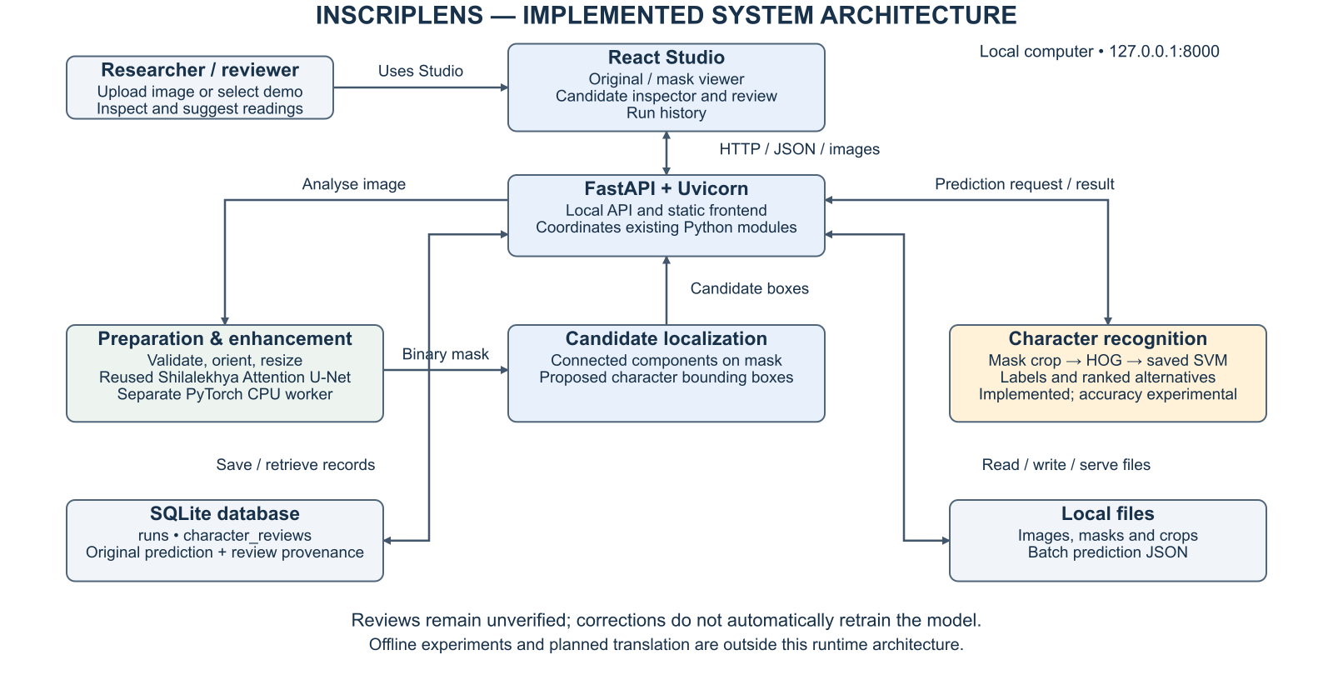
System Architecture
PES University | Department of MCA | Semester III | Capstone Project - Phase 3
28
Notes:
Verified against api/server.py, outputs/app_backend.py, binarizer_core.py and recognize_regions.py. Reused pretrained enhancement is identified; deployed recognition remains experimental. Editable source: outputs/presentation/diagrams/InscripLens_System_Architecture.drawio.

Slide 29
ML process and controls
Prepare annotations and images, then exclude validation locations from training.
Generate predicted masks and extract character crops using source boxes for controlled recognition tests.
Fit fixed candidate models on training locations and select using held-out development locations.
Evaluate exact source-label agreement and automatic localization separately.
Keep failed experiments and limitations in recorded reports.
PES University | Department of MCA | Semester III | Capstone Project - Phase 3
29
Notes:
Sources: outputs/compare_broad_cleaned.py; compare_paired_features.py; broad_pipeline_study/summary.json. Sequence recognition is experimental and not deployed.

Slide 30
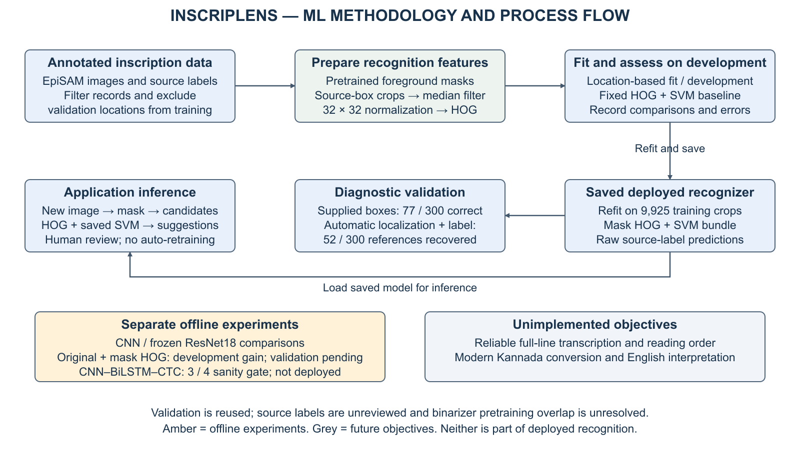
ML Methodology / Process Flow
PES University | Department of MCA | Semester III | Capstone Project - Phase 3
30
Notes:
Verified against compare_broad_cleaned.py, broad_clean_study/summary.json, broad_pipeline_study/summary.json and paired_feature_study/summary.json. Validation reused; source labels unreviewed. Experiments are separate from deployed inference. Editable source: outputs/presentation/diagrams/InscripLens_ML_Methodology.drawio.

Slide 31
Implemented relational schema
Table | Key fields | Relationship
runs | id (PK), created, filename, sha256, image_path, mask_path, details | One analysis may have many reviews
character_reviews | id (PK), run_id (FK), bbox, prediction, model, model_sha256, suggested_label, reviewer, note, status | run_id references runs.id
SQLite stores analysis and review provenance. No translation table or user account system is implemented.
PES University | Department of MCA | Semester III | Capstone Project - Phase 3
31
Notes:
Source: outputs/app_backend.py connect(), save_review(), review_export().

Slide 32
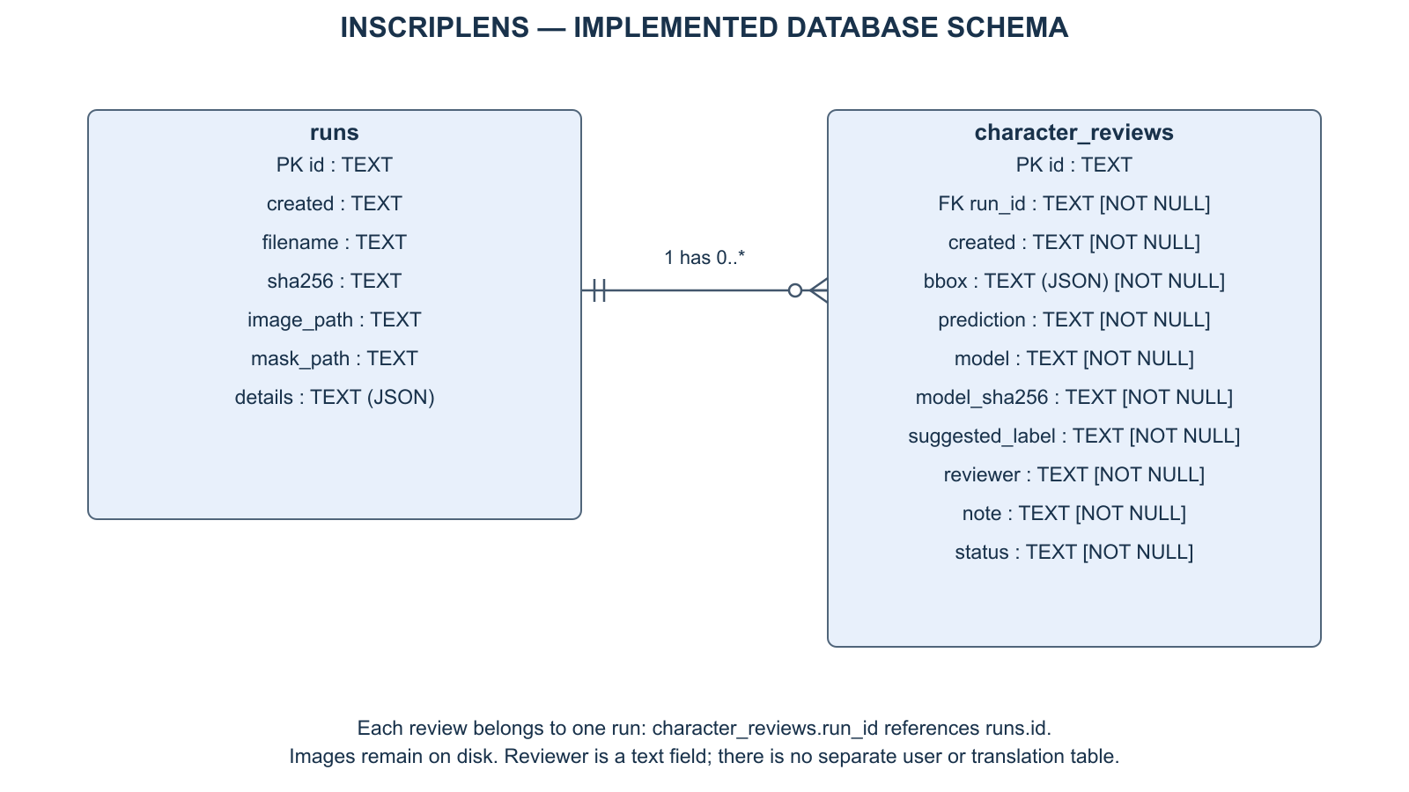
Entity Relationship Diagram
PES University | Department of MCA | Semester III | Capstone Project - Phase 3
32
Notes:
Verified against live history.sqlite3 schema and outputs/app_backend.py connect(). One run can have zero or many reviews, each review belongs to one run. All fields use TEXT; bbox and details serialize JSON. No user or translation table. Editable source: outputs/presentation/diagrams/InscripLens_ER_Diagram.drawio.

Slide 33
Pseudocode of implemented modules
ANALYSE: validate image, apply orientation, resize, save input, invoke enhancement worker, check output dimensions, insert analysis record.
RECOGNIZE: select a candidate box, crop its mask, extract HOG features, apply the saved SVM and rank label alternatives.
REVIEW: validate box, retain original prediction and model hash, append user suggestion with unverified status.
HISTORY / EXPORT: Studio retrieves saved analyses through the API. Legacy Streamlit exports metadata and review records as JSON.
PES University | Department of MCA | Semester III | Capstone Project - Phase 3
33
Notes:
Sources: outputs/app_backend.py; outputs/recognize_regions.py; outputs/recognition_alternatives.py. No modernization or translation step is implemented.

Slide 34
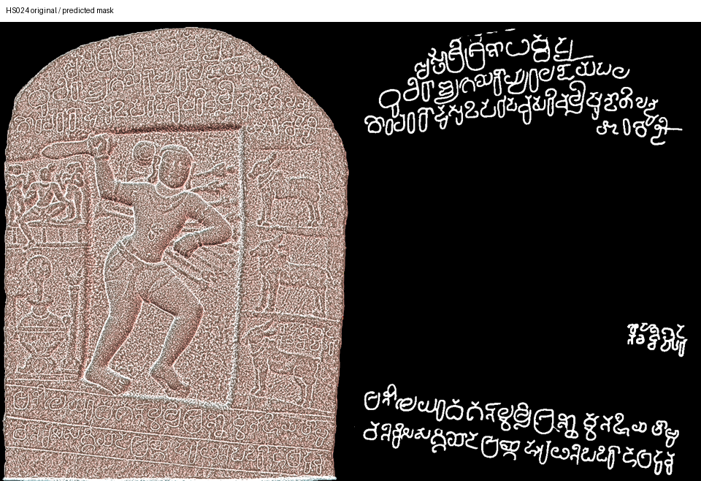
Implementation evidence: enhanced image
Kumbalahalli source image and predicted mask. Improved visibility does not guarantee correct characters.
PES University | Department of MCA | Semester III | Capstone Project - Phase 3
34
Notes:
Local artifact: outputs/full_binarizer/HS024_comparison.png. EpiSAM / Mythic Society imagery, CC BY-SA 4.0. Enhancement uses pretrained Shilalekhya.

Slide 35
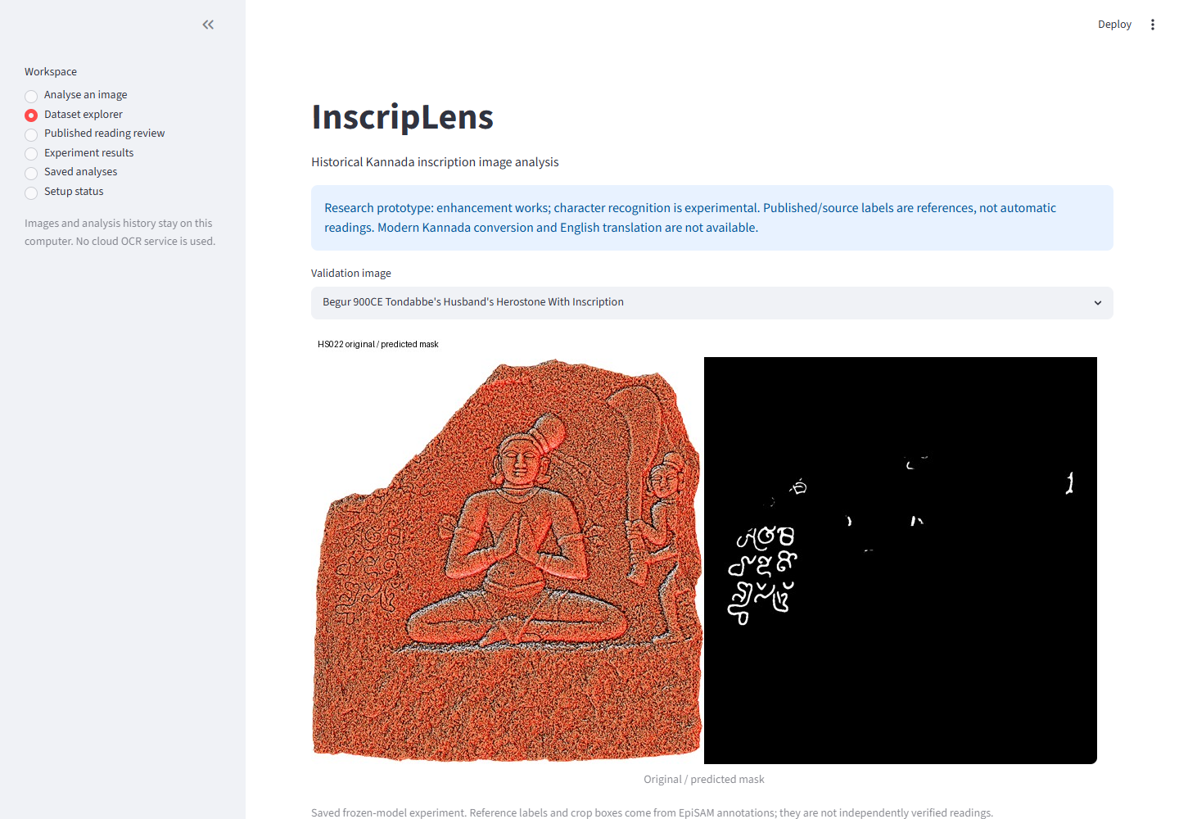
Supporting tool: legacy dataset view
Live local Streamlit view captured for this presentation. Labels are source annotations, not verified readings.
PES University | Department of MCA | Semester III | Capstone Project - Phase 3
35
Notes:
Screenshot of local application on 4 November 2026. Source: outputs/inscriplens_app.py. EpiSAM imagery attribution applies.

Slide 36
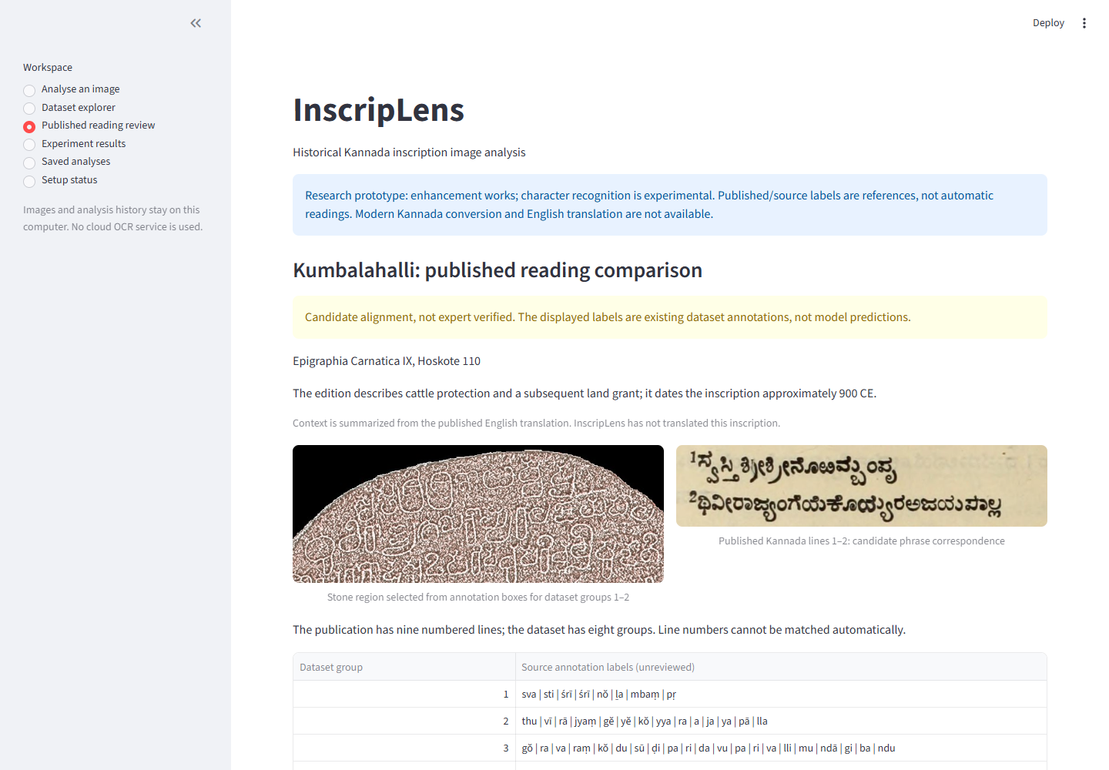
Supporting tool: legacy published reading
Stone region, printed reading and source-labelled comparison. Correspondence remains a candidate alignment.
PES University | Department of MCA | Semester III | Capstone Project - Phase 3
36
Notes:
Screenshot of local application on 4 November 2026. EC IX Hoskote110: Roman p125, English p102, Kannada p224. https://archive.org/details/epigraphiacarnat09myso . Stone imagery EpiSAM / Mythic Society CC BY-SA4.0.

Slide 37
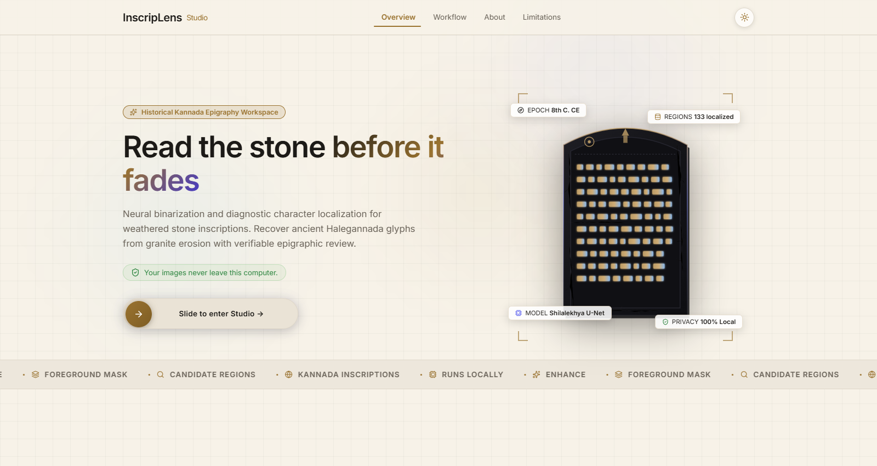
Studio: landing page
Current React/Vite landing page, captured from the locally running application.
PES University | Department of MCA | Semester III | Capstone Project - Phase 3
37
Notes:
Source: frontend/src/pages/LandingPage.jsx. Captured 4 November 2026 after production build.

Slide 38
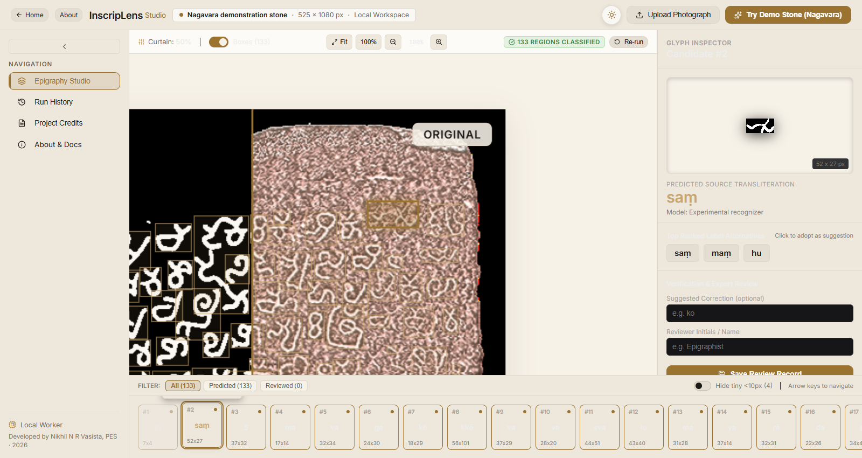
Studio: analysis and review workspace
Nagavara demo: 133 proposed regions, original/mask canvas and experimental character inspector.
PES University | Department of MCA | Semester III | Capstone Project - Phase 3
38
Notes:
Source: frontend/src/App.jsx; api/server.py. Local smoke test, 4 November 2026. Candidate regions are not verified characters. EpiSAM / Mythic Society imagery, CC BY-SA 4.0.

Slide 39
Studio startup and endpoint verification
Check | Observed result
npm install and production build | Pass; Vite output generated
GET /api/status | 200; enhancement, recognizer and demo present
GET /api/demo and demo image | 200; 525 × 1080 image
GET / and /studio | 200; production SPA served
Demo analysis + batch recognition | 133 candidate regions; 133 predictions
One measured demo enhancement run took 23.37 s on this machine. Predictions remain unverified.
PES University | Department of MCA | Semester III | Capstone Project - Phase 3
39
Notes:
Source: local verification on 4 November 2026; work/phase3_build/studio_health.json, studio_demo_run.json, studio_batch.json.

Slide 40
Model comparison on the same cohort
Recognition model | Training crops | Correct / 300 | Exact-label accuracy
Mask HOG + SVM | 949 | 63 | 21.00%
Small CNN | 949 | 44 | 14.67%
Frozen ResNet18 + SVM | 949 | 46 | 15.33%
Supplied boxes and reused validation. These are classifier comparisons, not complete inscription transcription.
PES University | Department of MCA | Semester III | Capstone Project - Phase 3
40
Notes:
Sources: matched_mask_study/summary.json; cnn_study/summary.json; transfer_study/summary.json. Same source-box validation cohort.

Slide 41
Broader training and automatic recognition
Measure | Result | Meaning
Broader HOG/SVM recognition | 77/300 = 25.67% | Supplied character boxes
Correct automatic localization + label | 52/300 = 17.33% | Detection and classification both succeed
Localization recall | 196/300 = 65.33% | One-to-one IoU ≥ 0.5 matches
Localization precision | 196/330 = 59.39% | Matched proposals / all proposals
Top-three label inclusion | 122/300 = 40.67% | Reference appears among suggestions
Broader model uses 9,925 crops. Top-three inclusion is not automatic accuracy or measured reviewer success.
PES University | Department of MCA | Semester III | Capstone Project - Phase 3
41
Notes:
Sources: broad_clean_study/summary.json; broad_pipeline_study/summary.json; review_alternatives_study/summary.json.

Slide 42
Latest development experiment
Features | Hero development | All development
Predicted-mask HOG | 63/308 | 78/359
Original + mask HOG | 67/308 | 82/359
Net gain: four hero characters. Thirteen errors fixed, nine introduced. Validation of this candidate is pending.
PES University | Department of MCA | Semester III | Capstone Project - Phase 3
42
Notes:
Source: paired_feature_study/summary.json. 9566 fit characters. Fixed C10, gamma scale. No validation run or production change.

Slide 43
Error analysis and sequence experiment
Of 223 broader-model errors, only seven involve labels absent from training.
131 errors occur on nonconstant masks with at least 20 training examples for the reference label.
Line preparation exposed adjacent text, clipped glyphs and nearly blank enhanced crops.
After filtering, 207 training and 21 development line candidates remain. A four-example CNN–BiLSTM–CTC sanity check reached 3/4 exact, not the required 4/4.
PES University | Department of MCA | Semester III | Capstone Project - Phase 3
43
Notes:
Sources: recognition_failure_audit/summary.json; sequence_data_audit/crop_audit.json; overfit_foreground_check_vertical_packed_600steps.json. These are descriptive errors, not causal proof. Tiny-subset memorization is not OCR accuracy.

Slide 44
Printed-book OCR as a supporting feature
A separate pretrained Tesseract Kannada engine produces editable drafts from manually cropped publication text.
One user-checked prose heading required seven edits over 55 normalized Unicode codepoints: 12.73% error.
The draft-review workflow preserves original OCR and edited text separately.
This single-heading result does not measure stone recognition, general book accuracy or translation.
PES University | Department of MCA | Semester III | Capstone Project - Phase 3
44
Notes:
Sources: book_ocr_study/heading_evaluation.json; heading111_user_reference.txt. Normalization: NFC and collapsed whitespace, punctuation retained. https://tesseract-ocr.github.io/tessdoc/Command-Line-Usage.html

Slide 45
Testing 1: startup and analysis
ID / test | Input / action | Expected result | Observed result
T01 · Startup | GET status, demo, / and /studio | HTTP 200; required assets available | PASS: all 200; readiness flags true
T02 · Demo analysis | Analyse Nagavara demo | Mask and candidate boxes returned | PASS: 133 boxes; one run 23.37 s
T03 · Batch prediction | Recognize all demo candidates | One label per proposed region | PASS: 133 predictions returned
T04 · Invalid request | No image; no batch ID; reversed crop box | Reject each request with HTTP 400 | PASS: all three returned 400
Evidence: recorded API responses and onboarding report. Candidate count is not a recognition-accuracy metric.
PES University | Department of MCA | Semester III | Capstone Project - Phase 3
45
Notes:
Evidence: outputs/presentation/TEST_EVIDENCE.md and outputs/STUDIO_STARTUP_VERIFICATION.md. API observations recorded during onboarding on 4 November 2026. Storage, backend and canvas regression scripts rerun for this review. PASS means the stated behaviour was observed, not that predictions are correct.

Slide 46
Testing 2: review and input integrity
ID / test | Input / action | Expected result | Observed result
T05 · API review | Save blank-suggestion QA record; retrieve it | Record retained as unverified | PASS: saved and read back
T06 · Unicode review | Store Kannada suggestion alongside original ka | Preserve both; do not mark as ground truth | PASS: suggestion and original retained
T07 · Invalid review | Unknown run; negative / outside-image box | Reject all invalid records | PASS: all three raised ValueError
T08 · Bad image | Supply non-image bytes to backend | Reject; no saved analysis | PASS: exception; history empty
Evidence: check_review_storage.py and check_app_backend.py rerun successfully; API review from onboarding.
PES University | Department of MCA | Semester III | Capstone Project - Phase 3
46
Notes:
Evidence: outputs/presentation/TEST_EVIDENCE.md and outputs/STUDIO_STARTUP_VERIFICATION.md. API observations recorded during onboarding on 4 November 2026. Storage, backend and canvas regression scripts rerun for this review. PASS means the stated behaviour was observed, not that predictions are correct.

Slide 47
Testing 3: processing and known limits
ID / test | Input / action | Expected result | Observed result
T09 · Worker output | Enhance 512 × 512 test patch | Same size; binary mask; saved run | PASS: 512 × 512; values 0/255; reload works
T10 · Canvas regression | 2000 × 1000 upload; mocked 1600 × 800 mask | API reports processed coordinates | PASS: response 1600 × 800
T11 · Review export | Export two stored test reviews | Retain provenance; ground truth false | PASS: 2 reviews; original labels retained
T12 · Sequence gate | Fit four short training examples | Memorize 4/4 exactly before scaling | NOT MET: 3/4 after 600 steps
T10 isolates API geometry with mocked inference. T12 is a training sanity gate, not held-out OCR accuracy.
PES University | Department of MCA | Semester III | Capstone Project - Phase 3
47
Notes:
Evidence: outputs/presentation/TEST_EVIDENCE.md and outputs/STUDIO_STARTUP_VERIFICATION.md. API observations recorded during onboarding on 4 November 2026. Storage, backend and canvas regression scripts rerun for this review. PASS means the stated behaviour was observed, not that predictions are correct. T12 source: outputs/sequence_data_audit/overfit_foreground_check_vertical_packed_600steps.json; prior recorded experiment, not rerun.

Slide 48
Demonstration sequence
Open http://127.0.0.1:8000 and enter the Studio from the landing page.
Choose the Nagavara demo, wait for enhancement, then inspect the original/mask curtain and proposed regions.
Classify all candidates or select one region to inspect its predicted label and alternatives.
Save a clearly marked review suggestion and revisit the analysis through Run History.
Use the separate legacy Streamlit interface for published-reading comparison and printed-text draft review.
PES University | Department of MCA | Semester III | Capstone Project - Phase 3
48
Notes:
Startup: work/studio_env/Scripts/python.exe -m uvicorn server:app --app-dir api --host 127.0.0.1 --port 8000. Legacy: python -m streamlit run outputs/inscriplens_app.py.

Slide 49
Remaining implementation
Validate the fixed original-plus-mask candidate before adopting it.
Improve reliable segmentation and recognition across inscription styles.
Complete verified line-level references and full-text transcription evaluation.
Modern Kannada conversion and English interpretation remain unimplemented.
The present evidence does not support an 80% completion claim for the original scope.
PES University | Department of MCA | Semester III | Capstone Project - Phase 3
49
Notes:
Source: restart checkpoint and recorded project status. The presentation brief requires at least80%; that requirement is not evidence that it has been met. Avoid substituting OCR accuracy for project completion.

Slide 50
References 1
[1] A. L. Somashekharaiah and A. Deshpande, “Preprocessing techniques for recognition of ancient Kannada epigraphs,” IJECE, vol. 14, no. 1, pp. 358–365, 2024. https://zenodo.org/records/10460339
[2] B. Agasar and G. Mukarambi, “Hybrid method for enhancement of low-resolution ancient Kannada Stone Inscription images,” Digital Applications in Archaeology and Cultural Heritage, vol. 35, e00385, 2024. https://doi.org/10.1016/j.daach.2024.e00385
[3] Mallamma V. Reddy and Sachchidanand Sidramappa, “Digitization and Recognition of Kannada Inscription Dynasty,” The Scientific Temper, vol. 16, no. 10, pp. 4858–4863, 2025. https://doi.org/10.58414/SCIENTIFICTEMPER.2025.16.10.03
[4] Bhagyashri Agasar and Gururaj Mukarambi, “Kannada Stone Inscription Image Enhancement using Modified Approach for Binarization and Detection of Text Regions using Deep Learning YOLO Models,” International Journal of Engineering Trends and Technology, vol. 74, no. 4, pp. 155–169, 2026. https://doi.org/10.14445/22315381/IJETT-V74I4P112
PES University | Department of MCA | Semester III | Capstone Project - Phase 3
50
Notes:
Bibliographic details from supplied Phase2 deck and linked primary metadata. Institutional IEEE/Scopus eligibility should be confirmed before submission; DOI metadata for the preprocessing paper is inconsistent with the supplied article.

Slide 51
References 2
[5] R. Parashivamurthy, C. Naveena and Y. H. Sharath Kumar, “SIFT and HOG features for the retrieval of ancient Kannada epigraphs,” IET Image Processing, vol. 14, no. 17, pp. 4657–4662, 2020. https://doi.org/10.1049/iet-ipr.2020.0715
[6] H. T. Chandrakala, G. Thippeswamy and R. J. Martis, “Impact of Total Variation Regularization on Character Segmentation from Historical Stone Inscriptions,” Pattern Recognition and Image Analysis, vol. 31, pp. 35–48, 2021. https://doi.org/10.1134/S1054661821010041
[7] A. R. Borah, A. Vijapur and B. Mahesh Kumar, “Kannada Manuscript Digitization through OCR and Machine Learning,” IEEE IC2PCT, 2024. https://doi.org/10.1109/IC2PCT60090.2024.10486458
[8] M. Avadesh and N. Goyal, “Optical Character Recognition for Sanskrit Using Convolution Neural Networks,” IAPR DAS, pp. 447–452, 2018. https://doi.org/10.1109/DAS.2018.50
PES University | Department of MCA | Semester III | Capstone Project - Phase 3
51
Notes:
Bibliographic details from supplied Phase2 deck and linked primary metadata. Institutional IEEE/Scopus eligibility should be confirmed before submission; DOI metadata for the preprocessing paper is inconsistent with the supplied article.

Slide 52
References 3
[9] E. Arun, J. Vinith, C. Pattar and K. George, “Improving Kannada OCR Using a Stroke-Based Approach,” IEEE TENCON, pp. 1611–1615, 2019. https://doi.org/10.1109/TENCON.2019.8929606
[10] T. Saraswathi, Harish S and Abishek Kumar B, “AI Powered OCR Solution for Tamil Historical Document,” IEEE ICISS, pp. 1002–1009, 2026. https://doi.org/10.1109/ICISS67859.2026.11453612
[11] M. Rajalakshmi, Shanthi Jeyabal, Manoj Ranjan Mishra, Bibhuti Bhusan Dash, Utpal Chandra De and Sudhansu Shekhar Patra, “Advanced Deep Learning OCR Algorithm for Deciphering and Digitizing Chola Period Tamil Inscriptions,” IEEE ICMCSI, pp. 1487–1493, 2026. https://doi.org/10.1109/ICMCSI67283.2026.11412629
[12] Prekshitha K. R., Karthik Kumar S. V., Kushaal B., Ponnamma K. M. and Ayesha Taranum, “AI-Powered Ancient Inscription Analysis and Translation (Halmidi),” ITM Web of Conferences, vol. 81, 01020, 2026. https://doi.org/10.1051/itmconf/20268101020
PES University | Department of MCA | Semester III | Capstone Project - Phase 3
52
Notes:
Bibliographic details from supplied Phase2 deck and linked primary metadata. Institutional IEEE/Scopus eligibility should be confirmed before submission; DOI metadata for the preprocessing paper is inconsistent with the supplied article.

Slide 53
Data and implementation references
EpiSAM dataset and project: ihdia.iiit.ac.in/episam/
Shilalekhya enhancement: github.com/ihdia/shilalekhya-binarization
Epigraphia Carnatica IX: archive.org/details/epigraphiacarnat09myso
Tesseract documentation: tesseract-ocr.github.io/tessdoc/
Project repository: github.com/Nikhilnr46/InscripLens
PES University | Department of MCA | Semester III | Capstone Project - Phase 3
53
Notes:
Full citations: EpiSAM project by A. Sharma, P. Jena, A. Joseph and R. K. Sarvadevabhatla; see project publication metadata. P. Jena et al., ICVGIP2025, doi:10.1145/3774521.3774539. B. Lewis Rice, Epigraphia Carnatica, vol.IX, Bangalore District, 1905. Third-party notices: repository THIRD_PARTY.md.

