Slide 1

HOUSING PROJECT Presented By: NIKHIL MAHESHWARI

Slide 2
Agenda
Problem statement
Executive summary
EDA
Tools
Steps and Assumption
Visualization
Model development and evaluation
Hyper-parameter tuning
Conclusion and next steps

Slide 3
Problem statement
To build a model using Machine Learning in order to predict the actual value of the prospective properties and decide whether to invest in them or not. For this company wants to know:
Which variables are important to predict the price of variable?
How do these variables describe the price of the house?
Data source- The research, references and data source I got for this PFA housing project is from FLIP ROBO technologies which guided me to get complete analysis through this project.

Slide 4

Executive summary
The comprehensive summary of the research done on the project is the higher the number of utilities in the house , will be having high sale price of houses.
This model will then be used by the management to understand how exactly the prices vary with the variables. They can accordingly manipulate the strategy of the firm and concentrate on areas that will yield high returns. Further, the model will be a good way for the management to understand the pricing dynamics of a new market and model score is 89.9

Slide 5
EDA
Descriptive and prescriptive modelling is performed during the model construction with having data set of 1000 records with 80 columns. Prediction made is by filling null values with mode.
Descriptive and prescriptive modelling is performed during the model construction with having data set of 1000 records with 80 columns. Prediction made is by filling null values with mode and outliers weren’t removed as it got handled by regressor booster.
Mostly features having more than 75% data missing were removed..

Slide 6
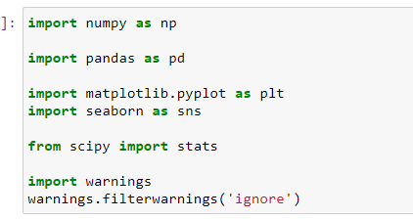
Tools
the hardware and software requirements along with the tools, libraries and packages used-
These packages were used for making lot of graph to check the effect on sale prices and for data cleaning and feature engineering

Slide 7
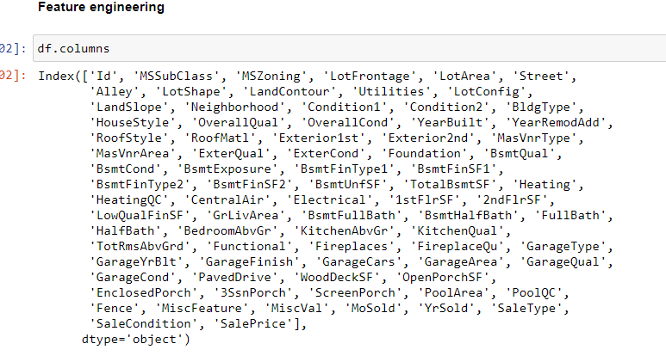
Steps and Assumption
Mostly data was filled with mode values and columns with missing data was dropped and visualised with seaborn and matplotlib.

Slide 8
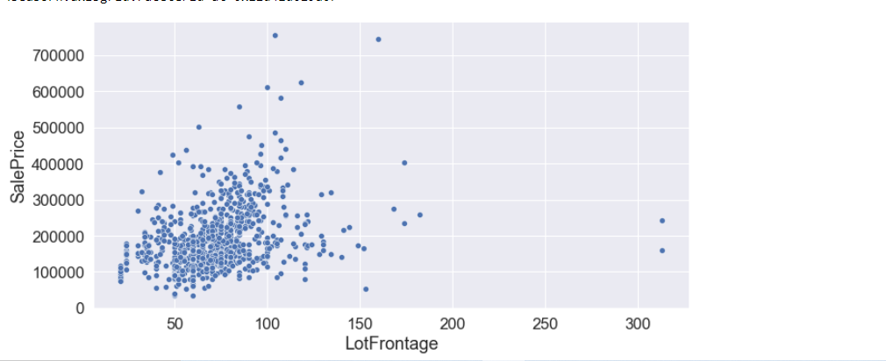
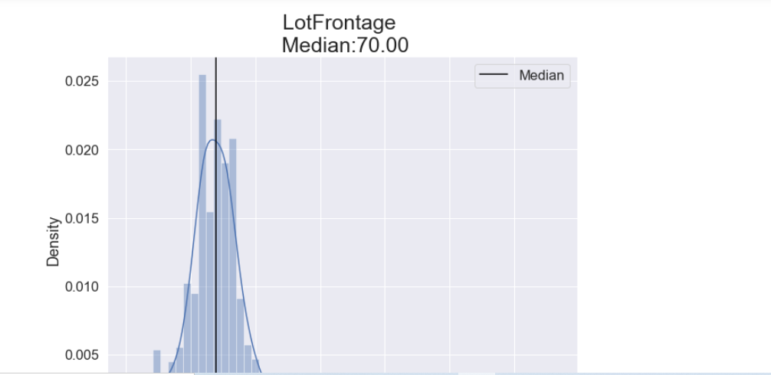
Visualization
Summarising Graphs that were made via matplotlib and seaborn, where sale price was checked with effect of inputs for num/cat variables.

Slide 9
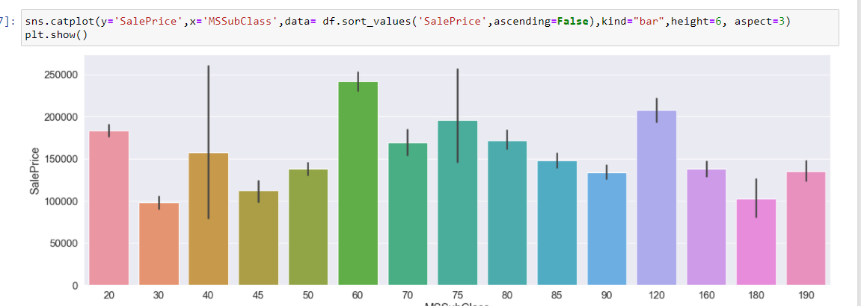
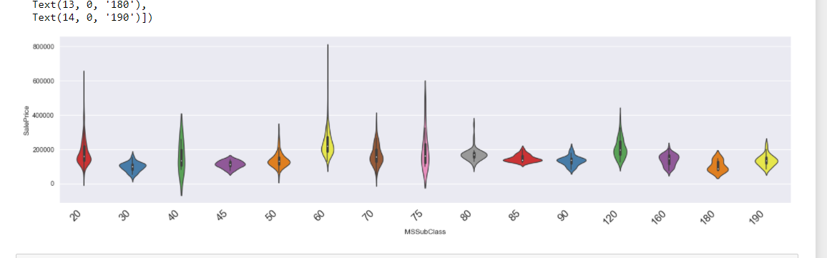
Visualization
Types- rel plot, catplot, median bar graphs, violen plots, count plot etc.. were used.

Slide 10
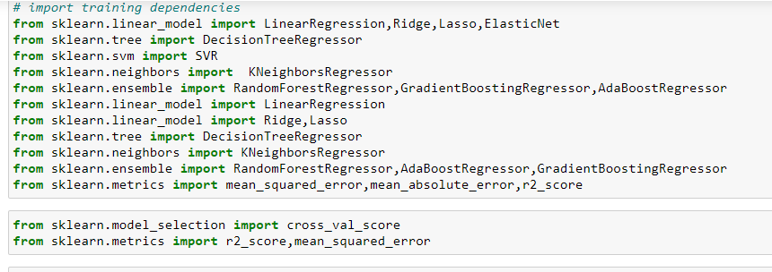
Model development and evaluation
Testing of Identified Approaches (Algorithms)

Slide 11
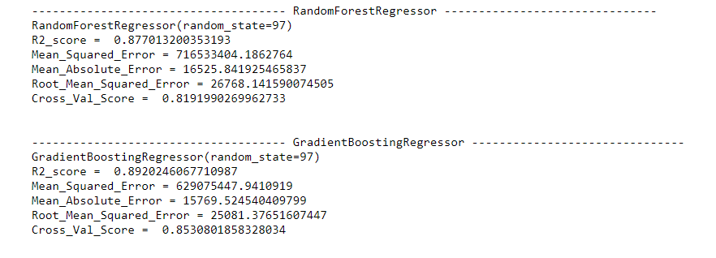
Model development and evaluation
Out of all gradient boosting regressor gave high score of R2

Slide 12
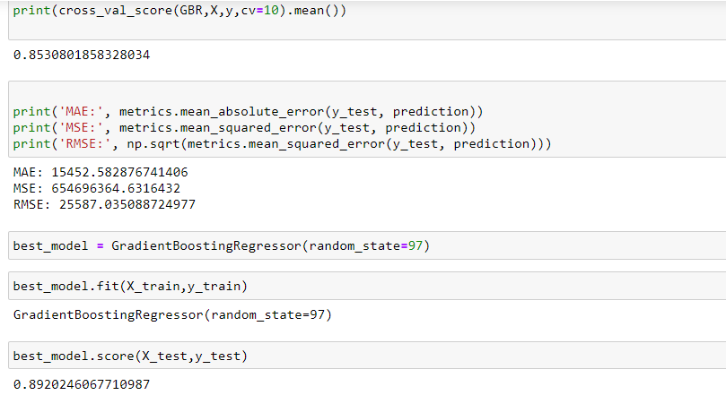
Hyper-parameter tuning
Randomized search cv made model score to 89.

Slide 13
Conclusion and next steps
My key findings are as company can look to buy those houses with key variables as 1 kitchen , 4-5 bedrooms, basement bathroom, and the conditions variable of the houses which will cost them at median prices, company should not buy houses having numbers of bedrooms and bathroom because that just increase prices.
From the power of visualization, data cleaning and various algorithms used, company can look to buy those houses with key variables as 1 kitchen , 4-5 bedrooms, basement bathroom, and the conditions variable of the houses which will cost them at median prices, company should not buy houses having numbers of bedrooms and bathroom because that just increase prices.

Slide 14
Q AND A

