Slide 1

CSP 2026-27 | Community Service Project
AgriSeva-AI: Multilingual Farmer Query Support, Decision-Support Platform & India-Wide Mandi Price Intelligence
Research Scholars / Project Team:
TEAM AGRISEVA-AI
Nikhilsai (99240040748), 2nd Year, CSE
Kowshik Reddy (99240040758), 2nd Year, CSE
Shanbu Sundar Reddy (992400550), 2nd Year, CSE
Thilak (9924005117), 2nd Year, ECE
Project Supervisors:
Faculty Project Supervisor & CSP Committee,
Department of Computer Science & Engineering,
Kalasalingam Academy of Research and Education (KARE).
SCHOOL OF COMPUTING
DEPARTMENT OF COMPUTER SCIENCE AND ENGINEERING

Slide 2
PROBLEM STATEMENT & COMMUNITY CONTEXT
Smallholder farmers across rural India experience severe information asymmetry, delayed agricultural extension, and economic exploitation.
Conventional manual extension services reach less than 15% of smallholders due to high agent-to-farmer ratios.
Farmers face critical gaps in:
Impact on Community:
Core Need:
Real-time localized agronomic advice
Crop loss & poor input selection
An accessible, AI-powered multilingual platform offering instant decision support, market price intelligence, and expert human escalation.
Transparent India-Wide Mandi price discovery
Asymmetric middleman pricing
Verified chemical safety guidance
Community Service Project | AgriSeva-AI Platform
02

Slide 3
ABSTRACT & SYSTEM OVERVIEW
This project presents AgriSeva-AI, an intelligent, multi-channel decision-support platform engineered to empower smallholder farming communities through real-time advisory, voice assistance, and price transparency.
The architecture integrates LlamaIndex Retrieval-Augmented Generation (RAG), FastMCP microservices, Plivo voice telephony, and live Agmarknet mandi commodity price tools. An automated Chemical Safety Guard verifies pesticide recommendations against banned toxicity lists, while low-confidence queries escalate to Primary Agricultural Experts (PAE).
AgriSeva-AI transforms traditional extension into a safe, transparent, and highly accessible digital ecosystem, enhancing crop yields and farmer livelihoods.
Community Service Project | AgriSeva-AI Platform
03

Slide 4
PROJECT OBJECTIVES
1
To build a multilingual GenAI RAG engine supporting voice and text query resolution in regional languages
2
To provide India-Wide Mandi crop price intelligence via Agmarknet FastMCP microservice tools
3
To enforce domain safety by auditing chemical recommendations against banned pesticide registries
4
To implement an automated PAE expert escalation queue with workload balancing and SLA timers
5
To integrate district-level IMD weather forecasts and soil health nutrient verification metrics
6
To empower smallholders with actionable agricultural decision support and fair price discovery
7
To mitigate toxic chemical hazards and prevent crop failure from delayed extension support
8
To evaluate community impact, query resolution trends, and system SLA through admin dashboards
Community Service Project | AgriSeva-AI Platform
04

Slide 5
LITERATURE REVIEW: CORE BENCHMARKS
Author(s) & Ref | Methodology & Approach | Journal / Publisher | Year | Key Contribution & Research Gap
Singh et al. | Farmer.Chat: RAG + GenAI for smallholders | arXiv:2409.08916v2 | 2024 | Scales voice advisory to 15k+ farmers; lacks live mandi market price discovery
Owhal et al. | AgriSaathi: LLMs & Multimodal AI Survey | IJFMR (Vol 7, Issue 6) | 2025 | Outlines LLM-RAG multimodal vision; lacks automated chemical safety guardrails
Kumbhar et al. | Agrimitraa: Multilingual LLM Assistant | IJNRD (Vol 11, Issue 3) | 2026 | Demonstrates Indic language prompting; lacks human expert escalation queues
Usip et al. | Multilingual Farm Advisory & Safety | Academic Journal | 2024 | Highlights pesticide toxicity risks; lacks vector RAG and live price integration
Community Service Project | AgriSeva-AI Platform
05

Slide 6
LITERATURE REVIEW: SYSTEM COMPARISONS
Evaluation of Agricultural AI & Decision Systems
Author(s) | Methodology | Journal / Publisher | Year | Inference & Gap Addressed by AgriSeva-AI
Chaurpagar et al. | AgriTech: Multilingual Advisory System | IRJIET (Vol 10, Issue 5) | 2026 | Effective localized advisory; lacks modular FastMCP microservice architecture
Srivastava & Patel | AI-Based Farmer Query Support System | IJCRT (Vol 14, Issue 4) | 2026 | Demonstrates RAG utility; lacks real-time voice call telephony integration
Digital Green | AI Extension Agent Assistant Platform | Research Report | 2023 | Assists human agents; lacks direct farmer price transparency tools
ICAR / Agmarknet | Government Market Data Portal | Govt Report | 2024 | Provides raw market prices; lacks natural language conversational query interface
Community Service Project | AgriSeva-AI Platform
06

Slide 7
RESEARCH GAP ANALYSIS & SYSTEM POSITIONING
Comparison of Existing Studies vs. AgriSeva-AI Solution
Advisory Dimension | Existing Research | Identified Research Gap | AgriSeva-AI Solution
Market Intelligence | Static web portals / manual visits | No conversational price access | FastMCP Agmarknet Mandi price tool
Chemical Safety | Unverified LLM text output | Risk of toxic pesticide advice | Automated Chemical Safety Guard check
Expert Escalation | Fully automated AI or manual queues | AI hallucinations on complex cases | PAE Expert Escalation with SLA tracking
Voice Telephony | Text-only web interfaces | Inaccessible to illiterate farmers | Plivo WebSockets & Sarvam Voice Hotline
Community Service Project | AgriSeva-AI Platform
07

Slide 8
LIMITATIONS OF CONVENTIONAL ADVISORY
1
Lack of transparent, conversational India-Wide Mandi price discovery
2
Absence of automated chemical toxicity and banned pesticide verification
3
No human expert escalation mechanism for ambiguous or edge-case AI outputs
4
Lack of interactive voice telephony interfaces accessible to illiterate farmers
5
Fragmented integration of soil nutrient data and real-time IMD weather alerts
6
No expert workload balancing or review SLA tracking in conventional extension
Farmers suffer from crop failure, health risks, and middleman price exploitation
Community Service Project | AgriSeva-AI Platform
08

Slide 9
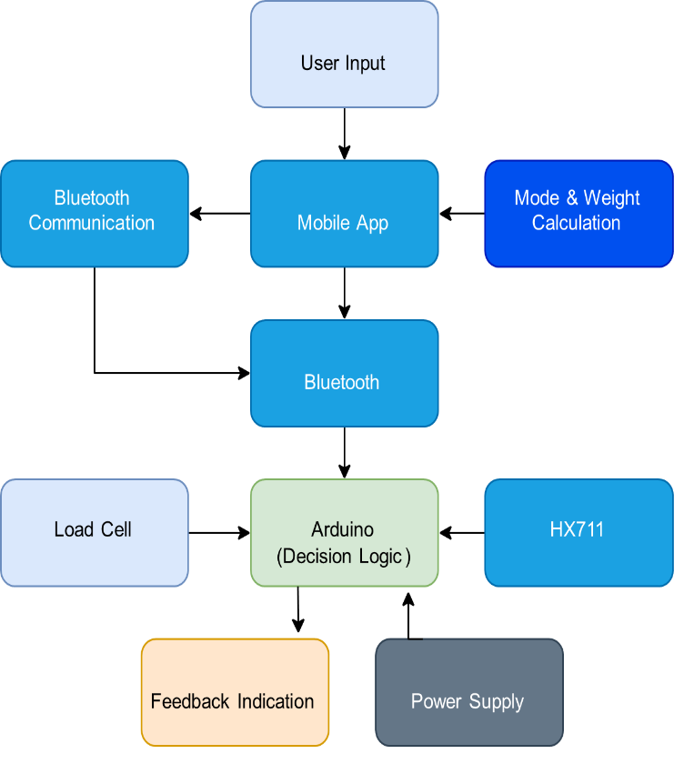
AGRISEVA-AI SYSTEM ARCHITECTURE
Community Service Project | AgriSeva-AI Platform
09

Slide 10
PROPOSED SYSTEM METHODOLOGY
Multi-channel Query Ingestion (Web, Plivo Voice Call Hotline, WhatsApp)
Indic Speech Translation & Intent Classification (Sarvam AI + Gemma)
FastMCP Tool Execution (Agmarknet Mandi Prices, IMD Weather, Soil Health)
Vector Retrieval-Augmented Generation (LlamaIndex + PyMongo Vector Store)
1
2
3
4
Chemical Safety Guard Audit (Banned Pesticides Database Registry)
Confidence Evaluation & Automated PAE Expert Escalation
Multi-channel Response Dispatch & Admin Dashboard Analytics Tracking
5
6
7
Community Service Project | AgriSeva-AI Platform
10

Slide 11
DETAILED MODULE BREAKDOWN
1
Plivo Telephony & Audio Streaming: Handles voice calls via WebSocket audio streams
2
India-Wide Mandi Price Tool: Fetches live Agmarknet market commodity prices
3
LlamaIndex RAG Engine: Retrieves agronomic knowledge from vector database
4
Chemical Safety Guardrail: Verifies pesticide advice against banned toxicity registry
5
PAE Escalation Queue: Routes complex queries to human experts with SLA timers
6
IMD Weather & Soil Verification: Checks district climate data & NPK soil guidelines
7
Semantic LLM Cache Proxy: Delivers sub-50ms cache hits for repetitive queries
8
Admin & Performance Dashboard: Tracks expert heatmaps, queue TAT, and metrics
Community Service Project | AgriSeva-AI Platform
11

Slide 12
IMPLEMENTATION STATUS & FUTURE SCOPE
Core FastMCP RAG Engine & Vector Search Infrastructure [Implemented]
India-Wide Mandi Commodity Market Price Feature [Implemented]
1
2
Plivo Voice Telephony & WebSocket Audio Streaming [Implemented]
Chemical Safety Guardrail & Compliance Verification System [Implemented]
3
4
PAE Expert Escalation Queue & Admin Analytics Dashboard [Implemented]
AI Price Trend Prediction Models & Crop Calendar Reminders [Future Scope]
5
6
Community Service Project | AgriSeva-AI Platform
12

Slide 13
ACADEMIC REFERENCES
[1] D. A. García-Barrios, “Epistemic partner or cognitive crutch: A conceptual model of cognitive offloading in human–artificial intelligence collaboration,” IEEE, pp. 7–8, Jan. 2026, doi: 10.1109/MIC.2025.3626694.
[2] R. Varghese, Ananya R., N. V., Sagarika T. H., and Sanjana N., “Smart crutches using IOT,” Int. J. Innov. Res. Sci. Eng. Technol. (IJIRSET), vol. 13, no. 8, pp. 15549-15551, Aug. 2024.
[5] M. Mukherjee, A. I. Faisal, N. Balakrishnan, S. Kumar, and M. J. Deen, “An inferential model for understanding the effects of demographic and gait factors and their interactions on the human gait index: A beta regression approach,” IEEE Journal of Biomedical and Health Informatics, vol. 29, no. 10, Oct. 2025.
[6] V. A. Arcobelli, M. Zauli, G. Galteri, L. Cristofolini, L. Chiari, A. Cappello and L. De Marchi,“mCrutch: A Novel m-Health Approach Supporting Continuity of Care,” Sensors, vol. 23, no. 8, 2023, doi: 10.3390/s23084151.
[7] P. P. Sarkar, M. A. Tohin, M. A. Khaled, and M. S. Rahman, “Implementation of an instrumented crutch with scalable E-care architecture using IoT,” in Proc. 2020 IEEE Region 10 Symposium (TENSYMP), 2020, pp. 242-245.
[8] R. Sugiyama, N. Tsuda, N. Kato, and Y. Nomura, “Modelling of crutch walk training system with falling sensation device,” in Proc. 2018 IEEE Int. Conf. Systems, Man, and Cybernetics (SMC), 2018.
[3] Z. Guo, Y. Li, Y. Wang, H. Liu, R. Guo, J. Ma, X. Wu, D. Jiang, T.Ren, “Intelligent diagnosis and predictive rehabilitation assessment of chronic ankle instability using shoe-integrated sensor system,” IEEE Trans. Neural Syst. Rehabil. Eng., vol. 33, 2025.
[4] B. Naets, Z. Guo, Y. Li, Y. Wang, H. Liu, J. Ma, X. Wu, T. Ren, D. Jiang, and R. Guo, “Smart walker design for clinical rehabilitation,” IEEE,2022, doi:10.1109/ACCESS.2022.2973815.
1. Singh et al. (2024). Farmer.Chat: Scaling AI-Powered Agricultural Services for Smallholder Farmers. arXiv:2409.08916v2.
2. Owhal et al. (2025). AgriSaathi: A Survey on Large Language Models and Multimodal AI for Agricultural Advisory Systems. IJFMR, 7(6).
3. Kumbhar et al. (2026). Agrimitraa: A Multilingual Context-Aware Agricultural Assistant Using Large Language Models. IJNRD, 11(3).
4. Chaurpagar et al. (2026). Agri Tech: An AI-Powered Multilingual Farmer Advisory System for Smart Decision-Making. IRJIET, 10(5).
5. Usip et al. (2024). An Intelligent Multilingual Farm Advisory System for Controlling Hazardous Pesticide Effects. Academic Journal.
6. Srivastava & Patel (2026). AI-Based Farmer Query Support and Advisory System. IJCRT, 14(4).
Community Service Project | AgriSeva-AI Platform
13

