Slide 1

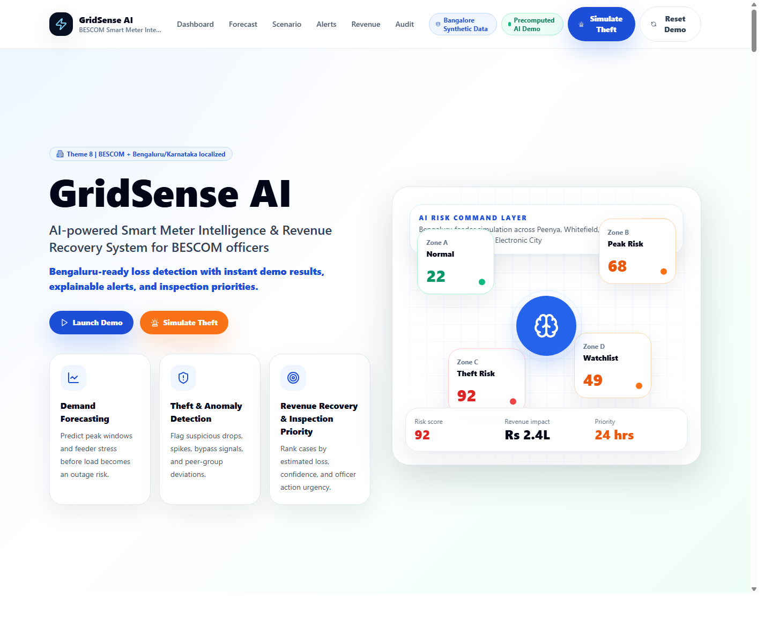
GridSense AI
Simple smart meter intelligence for BESCOM
Hello. This is our project GridSense A I. It helps BESCOM understand smart meter data in a simple way.
GridSense AI demo for hackathon presentation

Slide 2
Main Dashboard
Main dashboard with demand and zone risk view
This is the main dashboard. It shows the overall system view, demand information, and risk zones in one place.
GridSense AI demo for hackathon presentation

Slide 3
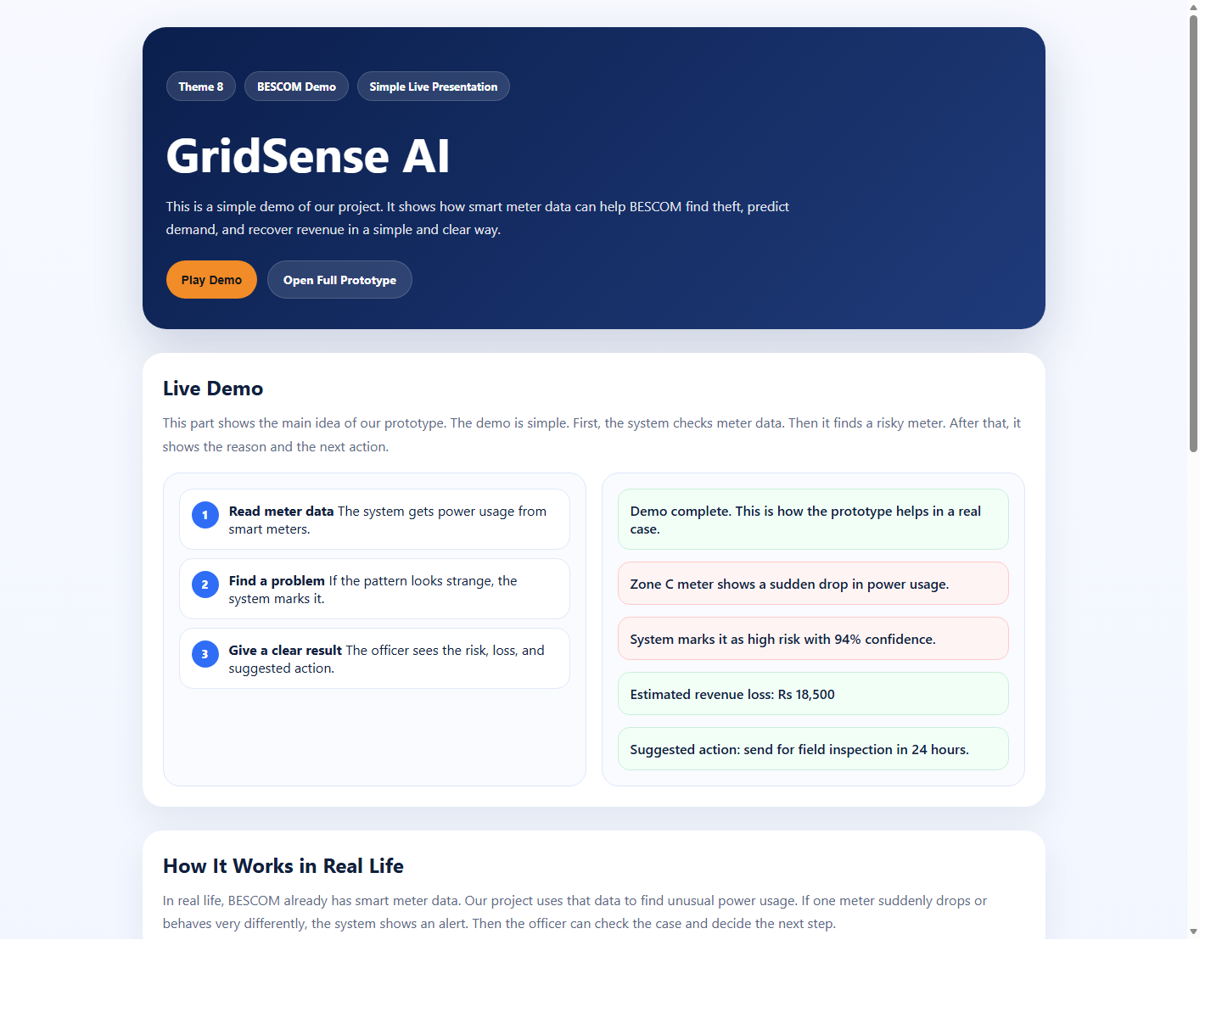
Live Demo
Live demo with alert, loss, and next action
Here the demo shows a risky meter. It also shows the possible revenue loss and the next action for the officer.
GridSense AI demo for hackathon presentation

Slide 4

Useful Features
Forecasting, alerts, and simple officer support
The system can predict demand, detect unusual usage, support human review, and help make better field decisions.
GridSense AI demo for hackathon presentation

Slide 5
Why It Helps
Simple, useful, and easy to understand
In real life, this can help reduce theft, save time, and support faster recovery. It does not replace officers. It helps them work in a smarter way.
GridSense AI demo for hackathon presentation

