Slide 1








Spider Robot for Hazard Detection and Rescue Operations
Guided by : Prof. Abha Marathe
SY-AI&DS-C: Batch-3 Group-06
Aryan Sable 82
Nikhil Wagh 80
Sujal Tawale 58
Tushar Ghorpade 59

Slide 2
Introduction
This project develops an Spider Robot for hazard detection and rescue. Using IoT-enabled sensors, it navigates dangerous environments and provides real-time data via a web interface. Users can remotely monitor conditions and control movements through a React & Node.js platform.
Key Features:
Navigation in hazardous environments.
Live camera feed for remote monitoring.
Web-based control interface using React and Node.js.
IoT-based communication for seamless data transmission.
Project Objectives:
To develop a 4-legged robotic spider with stable mobility.
To implement IoT-enabled hazard detection for safety applications.
To provide real-time monitoring through a user-friendly web dashboard.
To enhance the efficiency of rescue operations in high-risk environment

Slide 3
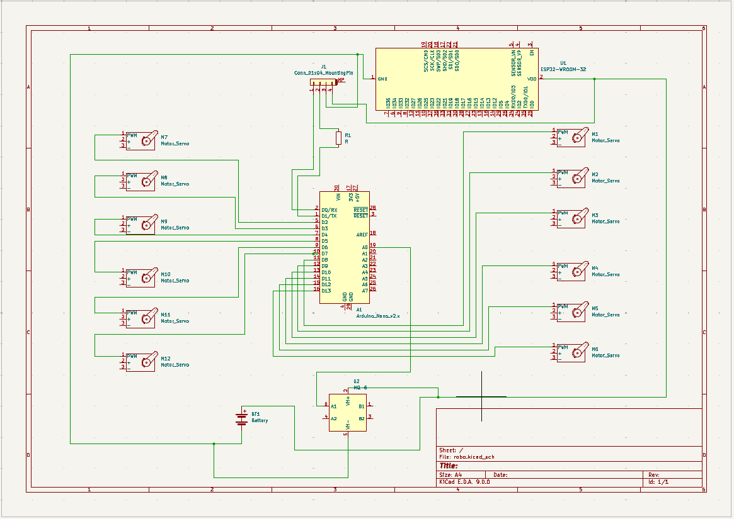
Circuit Diagram

Slide 4
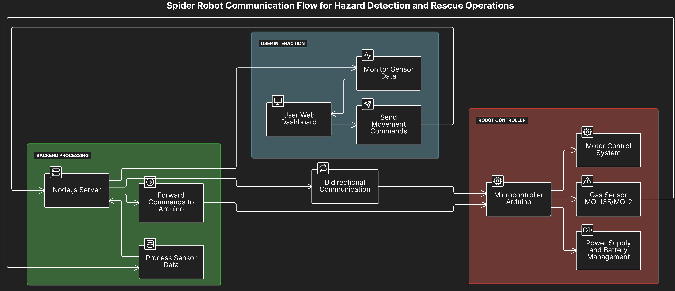
Block Diagram

Slide 5
Cost of project
Sr. no | Name of Component | Quantity | Pricing
1 | Arduino Nano | 1 | 250 Rs
2 | Bluetooth Module | 1 | 212 Rs
3 | Servo Motor | 12 | 1014 Rs
4 | ESP 8266 | 1 | 250 Rs
5 | MQ135 Sensor | 1 | 198 Rs
6 | ESP32 Cam Module | 1 | 550 Rs
7 | Dc-Dc Buck Module | 1 | 45 Rs
8 | Li-Ion Battery | 1 | 350 Rs
9 | 3D Printed Parts | As required | 750 Rs
10 | Jumper Wire Set | 1 | 25 Rs
11 | Burg Male + Female Connectors | 2 | 27 Rs
12 | PBT Connector 2 | 1 | 8 Rs
TOTAL |  |  | 3679 Rs
Sr. no | Name of Component | Quantity | Pricing
1 | Arduino Nano | 1 | 250 Rs
2 | Bluetooth Module | 1 | 212 Rs
3 | Servo Motor | 12 | 1014 Rs
4 | ESP 8266 | 1 | 250 Rs
5 | MQ135 Sensor | 1 | 198 Rs
6 | ESP32 Cam Module | 1 | 550 Rs
7 | Dc-Dc Buck Module | 1 | 45 Rs
8 | Li-Ion Battery | 1 | 350 Rs
9 | 3D Printed Parts | As required | 750 Rs
10 | Jumper Wire Set | 1 | 25 Rs
11 | Burg Male + Female Connectors | 2 | 27 Rs
12 | PBT Connector 2 | 1 | 8 Rs
TOTAL |  |  | 3679 Rs

Slide 6
Work done till date
Week | Duration | Work
Week 1 | 4th - 10th Feb 2025 | Research & finalization of project scope.
Week 2 | 11th - 17th Feb 2025 | Component selection & procurement.
Week 3 | 18th - 24th Feb 2025 | Hardware assembly.
Week 4 | 25th Feb - 3rd Mar 2025 | Web dashboard development (React js)

Slide 7
Time line (work plan week wise)
Week | Duration | Work
Week 5 | 4th - 10th Mar 2025 | circuit setup
Week 6 | 11th - 17th Mar 2025 | Microcontroller programming & motor testing.
Week 7 | 18th - 24th Mar 2025 | IoT connectivity setup (MQTT/WebSockets).
Week 8 | 25th - 31st Mar 2025 | Backend development (Node.js & database (Mysql) ).

Slide 8
Time line (work plan week wise)
Week | Duration | Work
Week 9 | 1st - 7th Apr 2025 | Integrating frontend with backend.
Week 10 | 8th - 14th Apr 2025 | Testing complete system.
Week 11 | 15th - 21st Apr 2025 | Debugging and final improvements.
Week 12 | 22nd - 28th Apr 2025 | Final testing

