Slide 1
ANgular

Slide 2
What is Angular
Open source frontend application framework to build client side applications
Great for Single page applications ( part of the page gets updated asynchronously without reloading entire page.
If any application relies mainly on javascript, Angular is best choice.
By design, it promotes modularity(application is in clear structure)
The component structure makes the code reusable
Inbuilt capabilities like validation, routing etc makes development easier.
Unit testable
Developed by google. Uses typescript for Microsoft.

Slide 3
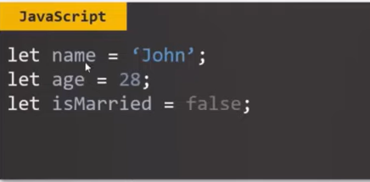
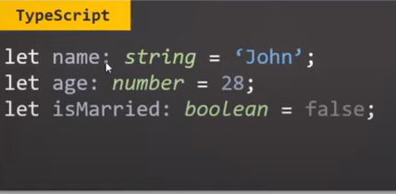
Why Angular uses typescript?
Type script is superset of javascript. So, every js code can be converted into type script.
Type script is strongly typed.
Errors can be identified at compile time
Have object oriented features like interface, which we don’t have in javascript

Slide 4
Project folder and structure
Node_modules : third party libraries from npm. (for development purpose). Not present in production
Package.json : project related configuration
When we share a project, node_modules wont be passed.
Then to run the project, npm install command should be used, which goes to package.json and installs all the modules needed.
Angular.json : all configurations for angular project
Package-lock.json: where all the versions are registered.
Src : components are present

Slide 5
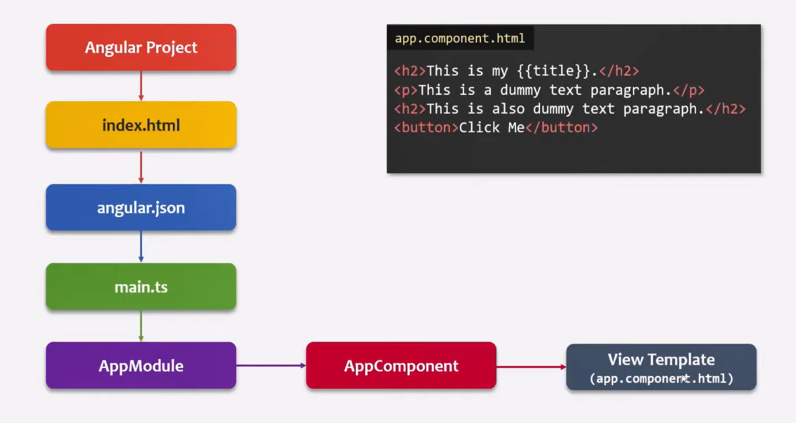
Bootstrapping Angular Application
Bootstrapping : initialising or loading the angular application

Slide 6
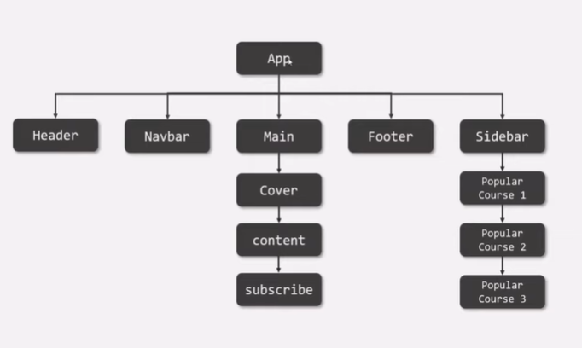
What is component
Angular : component based js framework for building client-side application
A component is piece of user interface
Every angular app -> atleast one component
Angular application -> a tree of components
Combining all components forms a UI

Slide 7
Create a component
Create a typescript class and export it
Decorate the class with @Component decorator
Declare the class in main module
(or)
In angular CLI : ng generate component header

Slide 8
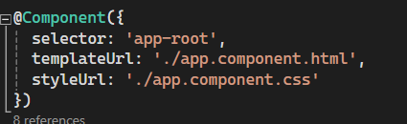
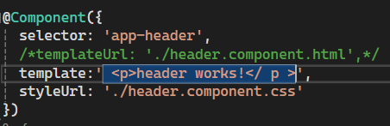
View template

Slide 9
Data binding
Allow us to communicate between a component class and its corresponding view template and vice versa
One way data binding : data can be passed from component to view or vice versa
Two way data binding : class to view and view to component class. It is a combination of property and event binding

Slide 10
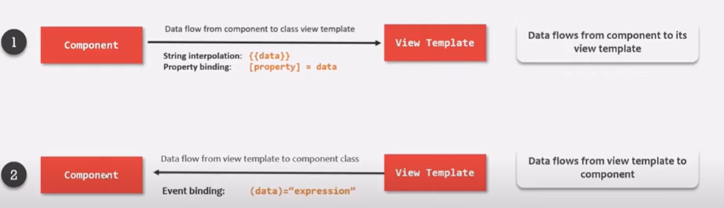
One way data binding

Slide 11
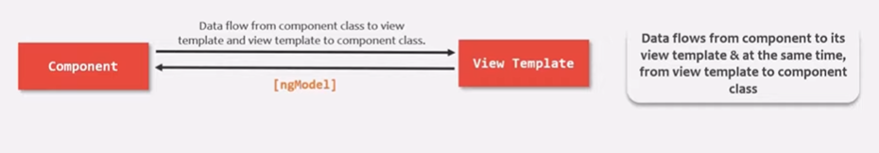
Two way data binding

Slide 12
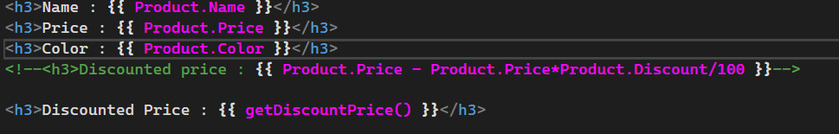
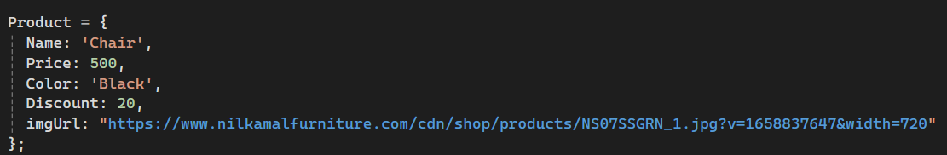
String interpolation

Slide 13
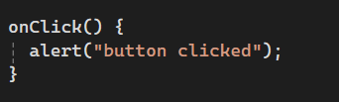

Event Binding

Slide 14
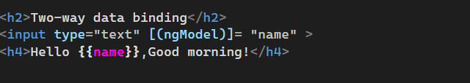
Two way data binding

Slide 15
directives
Instructions to the DOM ( document object model)
can add new behavior to the elements in the template or modify existing behavior.
Three types:
Component directive
Attribute directive
Structural Directive

Slide 16
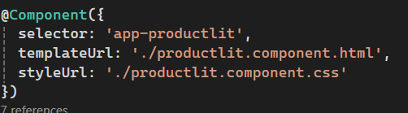
Component directive
Directive with template

Slide 17
Attribute directive
We can change appearance of DOM
Don’t add or remove anything from template
Built in directives:
ngStyle
ngClass

Slide 18
Structural directives
Adding or removing elements
Built in directives
ngFor
ngIf
ngSwitch

Slide 19
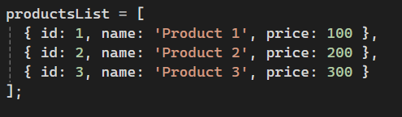
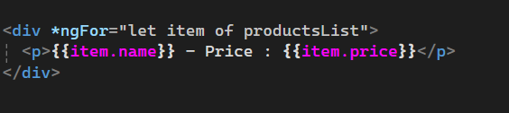
ngfor
Iterates over a collection of data like an array, list, etc.
Structural directive

Slide 20
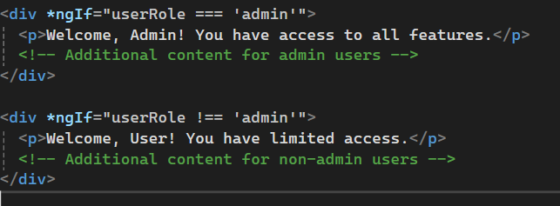
ngif
conditionally display content based on a boolean expression

Slide 21
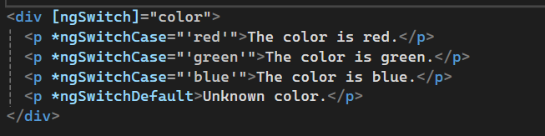
ngswitch
conditionally display different content based on multiple conditions. It's similar to the switch statement in JavaScript.

Slide 22
ngstyle
Allows to set styles dynamically to add style dynamically at run time
<div [ngStyle]="{ 'color': isError ? 'red' : 'black', 'font-size.px': isDisabled ? '14' : '16' }">This is another styled div.</div>
in ts file
isError:: Boolean= true;
isDisabled: boolean = false;

Slide 23
NgClass
add some class dynamically at run time but class also holds some css content, so indirectly you are also adding css here dynamically
<div [ngClass]="{ 'error': isError, 'disabled': isDisabled }">This is a styled div.</div>
.error{
Color:red;
}
.disabled{
Color:white;
}

Slide 24
Angular life cycle hooks
Life cycle hooks : methods that angular invokes on directives and components as it creates, changes and destroys them.
Once a new component class is instantiated, angular calls multiple methods.
When angular application starts, it creates and renders the root component.
Then it creates and renders the children and its children.
After loading, starts to render the view ( checks input properties, evaluate data bindings and render the projected content, etc)
Also removes component from dom when no longer needed.

Slide 25
Change detection cycle
Mechanism by which angular keeps the template in sink with component
<div> Hello {{name}} </div>
How does angular know, when the name property change? The change detection cycle is runned.
During the cycle, it checks every binded property in the component class, if any change it updates the dom.
Life cycle hooks are raised during this cycle.

Slide 26
constructor
Life cycle of component begins when angular creates the component
First method invoked-> constructor
It is neither life cycle hook nor specific to angular. It is js feature, a method invoked when class is created.
When constructor is called, none of components input properties are updated and available to use
Child components are not constructed
Used to inject the dependencies.

Slide 27
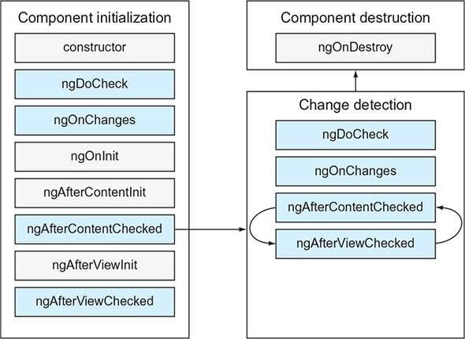

Slide 28
decorators
Functions that adds metadata to the class, members, services
Class decorator : @Component, @NgModule
Property decorator : @Input, @Output
Method decorator : @HostListner
Parameter decorator : @Inject

