Slide 1
DOT NET CORE
By Palla Nikhita

Slide 2
What is dotnet Core?
Free, Open source, modular, cross platform framework developed by Microsoft.
Re-Implementation of .net framework to be more lightweight, flexible and modular
Includes a runtime, a set of libraries, and a development environment that supports multiple programming languages such as C#, Visual Basic, and F#.

Slide 3
Why Dotnet Core?
Dotnet framework has many limitations that are solved by dotnet core:
Crossplatform compatibility : Can run in other operating system, other than windows
Performance : Improved startup time and memory usage.
Open source where the .net framework is not an open source software
Because of its light weight nature, it is best suited to build cloud based applications(uses less resources)
Has support for different moder frameworks like the Angular, react
Modularity and flexibility (Include only necessary libraries for application and flexible to be included in modern development practices like micro services and containerisation

Slide 4
Characteristics of Dotnet core
Free and open source
Cross Platform
Sharable
Modern
Fast
Light Weight
Friendly

Slide 5
Free and Open source
Dotnet core source code available in GitHub
Any developer can get involved in dotnet core development
Thousands of active developers are adding code, fixing bugs and issues
Non-profit organisation called .net foundation manages .net core.
More than 60,000 employees and 3700 companies are supporting the dotnet ecosystem.
Licensed under Apache Licenses

Slide 6
Cross Platform
Supports and runs on Windows, macOS, and Linux operating systems.
.NET Core is consistent across architecture, including x64, x86, and ARM.
The same assemblies and libraries can be imported and used on multiple platforms.
The assemblies and libraries are built using one of the .NET languages, C#, VB.NET, or F#.

Slide 7
Sharable
Uses one consistent API model written in .NET Standard that is common to all .NET applications.
The same API or library can be used with multiple platforms in multiple languages.

Slide 8
Modern
Mobile friendly
Build once run everywhere
Scalable
High performance
Supports IOT devices and gaming consoles
object-oriented and modular programming, generics, collections, lambdas, Language Integrated Query (LINQ), and asynchronous programming, which makes developers productive.

Slide 9
Other characteristics of .net core
Fast
Light weight
Friendly

Slide 10
Applications using dotnet core
Web applications : asp .net core(using mvc), razor using c# and type script
Mobile :Xamarin allows developers to build native iOS, Android, Windows, and macOS apps on a shared .NET codebase.
Desktop applications : windows forms
Microservices architecture is supported in .NET Core, which allows cross-platform services
.NET Core's modularity, lightweight, and flexibility make it easier to deploy .NET Core apps into containers.
.NET Core and C# apps can be deployed on Azure via Visual Studio 2019.
Supports IOT development
Machine learning
Games

Slide 11
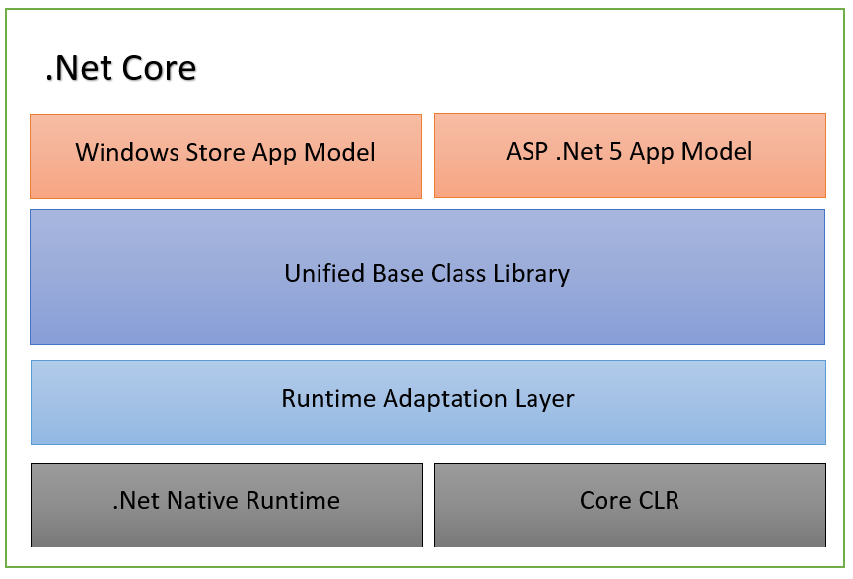
Dotnet core Architecture

Slide 12
Core CLR
runtime component of .NET Core.
responsible for executing managed code
Cross platform compatibility
JIT Compilation (convert Intermediate Language (IL) code into native machine code at runtime)
Security
Type System
Extensibility
Performance Optimisation

Slide 13
Base Class Library
The BCL provides a rich set of APIs and types for common programming tasks, such as file I/O, networking, collections, and cryptography.
It includes classes, interfaces, and value types that developers can use to build applications.

Slide 14
CoreFX
CoreFX is a set of foundational libraries that extend the functionality of the BCL and provide additional APIs for building cross-platform applications.
It includes libraries for tasks such as XML processing, JSON serialization, cryptography, and parallel programming.

Slide 15
ASP.NET Core
ASP.NET Core is a cross-platform framework for building web applications and services.
ASP.NET Core is built on top of .NET Core and provides support for building both MVC (Model-View-Controller) and API-based applications.

Slide 16
Project file structure
Controllers: Contains your MVC controller classes. These handle incoming requests, process user input, and return appropriate responses.
Views: Contains the views (HTML templates) that are rendered to generate the user interface. Views typically contain HTML markup along with C# code to dynamically generate content.
Models: Contains your model classes, which represent the data used by your application. Models are typically plain C# classes that define the structure of your data.
wwwroot: Contains static files such as CSS, JavaScript, images, etc., that are served directly to clients.
Startup.cs: Contains the configuration code for your ASP.NET Core application, including middleware configuration, dependency injection setup, and routing configuration.
appsettings.json: Contains configuration settings for your application, such as connection strings, API keys, etc.

