Slide 1



Department of Computational Intelligence
Application Development Project - II
FitFusion
A Smart Fitness, Diet and Daily Motivation App
BATCH NO : 22
PRESENTED BY:
INTERNAL GUIDE:
22N31A6629 - Bochkar Nikhith
22N31A6614 - Avudoddi Mounika
22N31A6628 - Bhukya Kalyan
Mrs. N. Radhika
Assistant Professor
Dept of CI

Slide 2


01 | Abstract
02 | Introduction
03 | Existing System
04 | Limitations of Existing System
05 | Proposed System
06 | Advantages of Proposed System
07 | System Requirements (Hardware and Software)
08 | System Architecture and UML Diagrams
09 | Conclusion
Contents

Slide 3
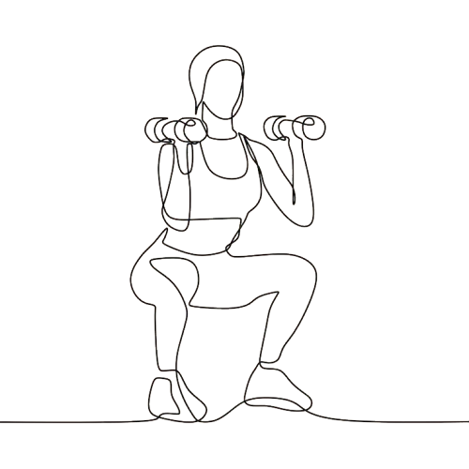
Abstract
01/10
FitFusion is an AI-powered fitness app that delivers personalized workout plans, diet recommendations, and motivational content based on user data. It integrates fitness, nutrition, and wellness seamlessly, leveraging Machine Learning for predictions, Collaborative Filtering for suggestions, Genetic Algorithms for diet optimization, and NLP for motivational content.
With dynamic adaptations to user progress, a Smart Progress Dashboard for insights, and an intuitive interface powered by React.js and Python (Django/Flask), FitFusion redefines fitness with a holistic, intelligent, and user-centric approach.

Slide 4


02/10
Introduction
FitFusion, a comprehensive fitness application designed to revolutionize personal health management. FitFusion addresses the limitations of existing fitness tools by integrating personalized workout plans, tailored diet recommendations, and daily motivational content into a single, cohesive platform. Using advanced statistical algorithms, it dynamically adapts to user progress, providing real-time adjustments for a seamless fitness journey.
Our goal is to offer a holistic approach to fitness and wellness, empowering users to achieve their health goals efficiently and sustainably. FitFusion combines innovative technology, user-centric design, and real-time analytics to deliver a smarter, adaptable, and engaging fitness experience. This presentation will walk you through its methodology, system design, and unique features that set it apart in the fitness industry.

Slide 5

03/10
MyFitnessPal: Focuses on diet tracking but lacks real-time adjustments and integration with workouts and wellness.
Nike Training Club: Offers static workout plans with minimal personalization and no diet or mental wellness support.
Lose It!: Primarily diet-focused, with no integration of fitness or motivational tools.
Headspace: Specializes in mental wellness but lacks fitness and nutrition features.
Jefit: Workout-centric with no AI-driven adjustments, diet recommendations, or motivational content.
Existing System

Slide 6
04/10
Limitations of Existing System
Lack of Integration
Limited Personalization
Existing platforms often fail to combine fitness, diet, and mental wellness into a cohesive experience.
Most systems offer generic solutions rather than tailored advice based on comprehensive user data.
Static Recommendations
Many apps do not dynamically adjust plans based on user progress or preferences.

Slide 7
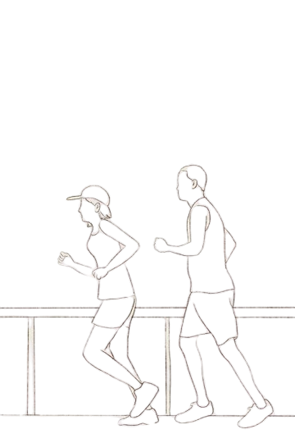
Proposed System
05/10
FitFusion addresses the shortcomings of existing systems by introducing a truly integrated, AI-driven platform that combines personalized fitness, nutrition, and mental wellness in one cohesive solution. The app dynamically adjusts workout and diet plans using advanced algorithms, such as Linear Regression and Genetic Algorithms, while NLP ensures engaging, motivational content tailored to individual user needs. Its Smart Progress Dashboard provides real-time performance insights, fostering continuous improvement. By offering seamless adaptability, predictive analytics, and a user-friendly interface, FitFusion stands out as an innovative, all-in-one fitness companion that prioritizes user progress and engagement.

Slide 8

06/10
Advantages of Proposed System
Comprehensive Integration
Dynamic Adaptability
Panoramic User Engagement
FitFusion seamlessly combines workout, diet, and mental wellness into a unified platform using a modular architecture that ensures real-time syncing and consistency.
Through statistical algorithms like Linear Regression and Genetic Optimization, the app adjusts plans in real-time based on user progress, overcoming the static nature of existing tools.
Features like the Smart Progress Dashboard and tailored motivational content ensure a user-centric experience, addressing fragmentation and fostering continuous improvement.

Slide 9

System Requirements
07/10
HARDWARE SPECIFICATIONS
PROCESSOR: INTEL I5 OR ABOVE
MEMORY: 4GB OR ABOVE
HARD DISK: 128GB OR ABOVE
SOFTWARE SPECIFICATIONS
IDE: Visual Studio Code
Python 3.6 or later
Web Framework: Flask
Frontend: HTML, CSS, JS
Standard Python Libraries

Slide 10
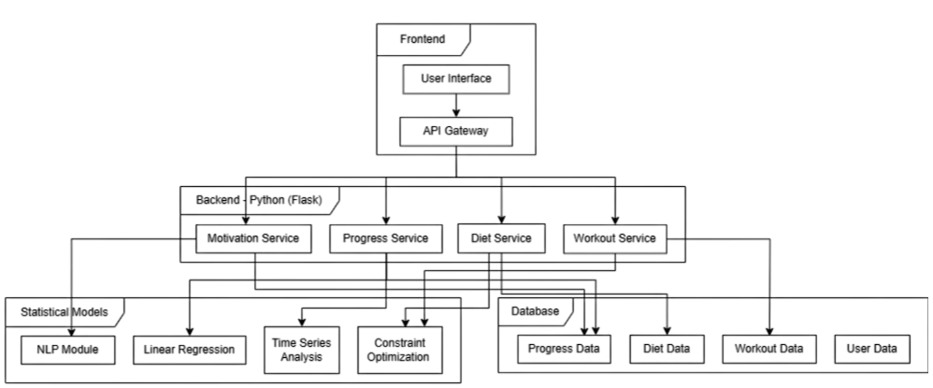
System Architecture
08/10

Slide 11
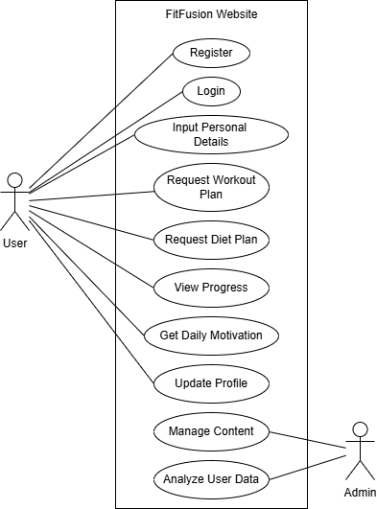
Use Case Diagram

Slide 12
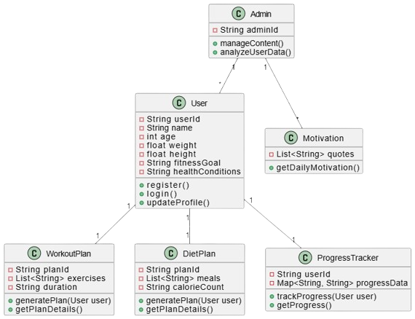
Class Diagram

Slide 13
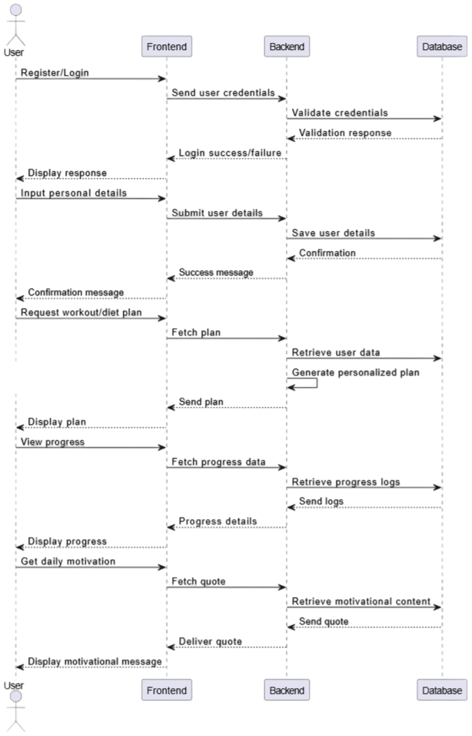
Sequence Diagram

Slide 14
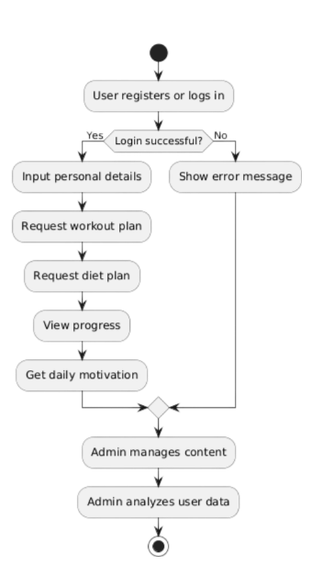
Activity Diagram

Slide 15
09/10
FitFusion represents a groundbreaking solution in the fitness domain, addressing key shortcomings of existing systems with its integrated and adaptive approach. By seamlessly combining personalized workout plans, tailored diet recommendations, and motivational content, it provides users with a comprehensive and dynamic fitness companion. With features like real-time adaptability, predictive analytics, and user-centric design, FitFusion ensures a holistic wellness journey that is both engaging and effective. This innovative platform redefines fitness, empowering users to achieve their health goals with precision and ease.
Conclusion

Slide 16
10/10
THANK YOU

