Slide 1


MALLAREDDY COLLEGE OF ENGINEERING & TECHNOLOGY
(AUTONOMUS INSTITUTION –UGC, GOVT. OF INDIA)
Affiliated to JNTUH; Approved by AICTE, NBA-Tier 1 & NAAC with A-GRADE| ISO 9001:2015
Fit Fusion – A Smart Fitness, Diet and Daily Motivation
Team Members
III Year B.Tech - II Semester – CSE(AIML)
Under the Guidance of
Mrs. N. Radhika
Assistant Professor
22N31A6629 - Bochkar Nikhith
22N31A6614 - Avudoddi Mounika
22N21A6628 - Bhukya Kalyan
1

Slide 2

Agenda
MALLA REDDY COLLEGE OF ENGINEERING AND TECHNOLOGY
Abstract
Introduction
Existing System
Limitations of Existing System
Proposed System
Advantages of Proposed System
System Architecture
Requirements Specifications
System Models (UML Diagram)
Implementation & Testcases
Conclusion & Future Enhancement
Conclusion
References

Slide 3
Abstract
MALLA REDDY COLLEGE OF ENGINEERING AND TECHNOLOGY
FitFusion is an AI-powered fitness app that delivers personalized workout plans, diet recommendations, and motivational content based on user data. It integrates fitness, nutrition, and wellness seamlessly, leveraging Machine Learning for predictions, Collaborative Filtering for suggestions, Genetic Algorithms for diet optimization, and NLP for motivational content.
With dynamic adaptations to user progress, a Smart Progress Dashboard for insights, and an intuitive interface powered by Python (Streamlit), FitFusion redefines fitness with a holistic, intelligent, and user-centric approach.

Slide 4
Introduction
MALLA REDDY COLLEGE OF ENGINEERING AND TECHNOLOGY
In today’s world, modern fitness apps often fall short in providing a truly personalized and engaging experience. Users struggle with inconsistent workout tracking, lack of proper diet recommendations, and no proper motivation, leading to disengagement. Also, most fitness platforms focus only on either workouts or nutrition, failing to offer a complete approach to health.
FitFusion is designed to bridge this gap by integrating workout tracking, diet recommendations, and motivational support into a single, smart dashboard. With interactive progress meters, AI-driven workout and diet suggestions, and daily motivational quotes, FitFusion ensures users stay on track toward their fitness goals. Also making it easier for users to achieve and maintain a healthy lifestyle.

Slide 5
Existing System
MALLA REDDY COLLEGE OF ENGINEERING AND TECHNOLOGY
MyFitnessPal: Focuses on diet tracking but lacks real-time adjustments and integration with workouts and wellness.
Nike Training Club: Offers static workout plans with minimal personalization and no diet or mental wellness support.
Lose It!: Primarily diet-focused, with no integration of fitness or motivational tools.
Headspace: Specializes in mental wellness but lacks fitness and nutrition features.
Jefit: Workout-centric with no AI-driven adjustments, diet recommendations, or motivational content.

Slide 6
Proposed System
MALLA REDDY COLLEGE OF ENGINEERING AND TECHNOLOGY
AI-Driven Integration: Combines fitness, nutrition, and mental wellness into a single cohesive platform.
Dynamic Adjustments: Uses Linear Regression and Genetic Algorithms to modify workout and diet plans in real time.
Engaging Content: NLP-driven motivational content tailored to individual user needs.
Smart Progress Dashboard: Provides real-time performance insights for continuous improvement.
Innovative & User-Centric: Ensures adaptability, predictive analytics, and a user-friendly interface.

Slide 7
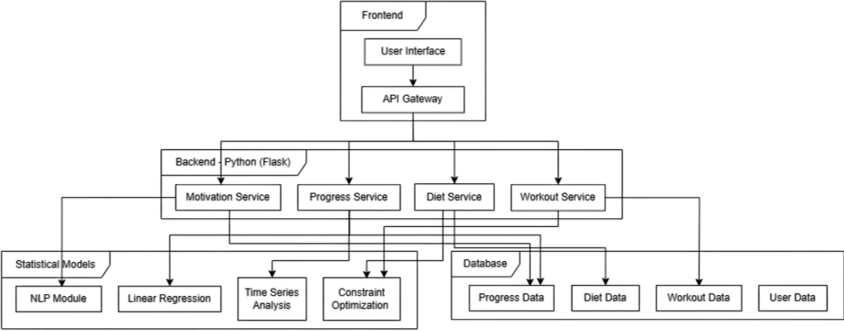
System Architecture
MALLA REDDY COLLEGE OF ENGINEERING AND TECHNOLOGY

Slide 8
Requirement Specifications
MALLA REDDY COLLEGE OF ENGINEERING AND TECHNOLOGY
8

Slide 9
Software Requirements Specifications
MALLA REDDY COLLEGE OF ENGINEERING AND TECHNOLOGY
Operating System: Windows 10/11, macOS, or Linux
Programming Language: Python 3.13
Web Framework: Streamlit (for UI and interactivity)
Data Processing: Pandas, NumPy
Visualization Libraries: Plotly, Matplotlib
Storage: CSV files for workout and diet recommendations, Cloud Storage
Deployment: Streamlit Cloud, for hosting the web application
Version Control System: Git/GitHub for code management and collaboration

Slide 10
Hardware Requirements Specifications
MALLA REDDY COLLEGE OF ENGINEERING AND TECHNOLOGY
Processor: Intel Core i5 or AMD Ryzen 5 (or higher)
RAM: Minimum 8GB (16GB recommended for smoother performance)
Storage: Minimum 256GB SSD (500GB+ preferred for large data handling)
GPU: Integrated graphics (Dedicated GPU recommended for heavy visualization processing)
Internet: High-speed internet required for real-time data retrieval and updates

Slide 11
System Models
(UML Diagrams)
MALLA REDDY COLLEGE OF ENGINEERING AND TECHNOLOGY

Slide 12
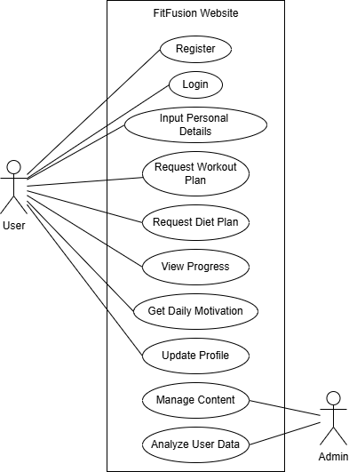
Use Case Diagram
MALLA REDDY COLLEGE OF ENGINEERING AND TECHNOLOGY

Slide 13
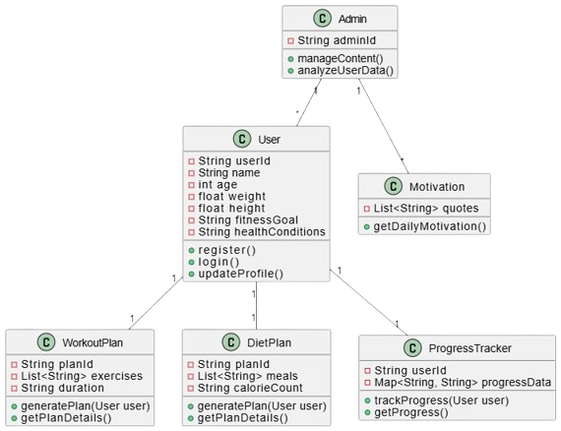
Class Diagram
MALLA REDDY COLLEGE OF ENGINEERING AND TECHNOLOGY

Slide 14
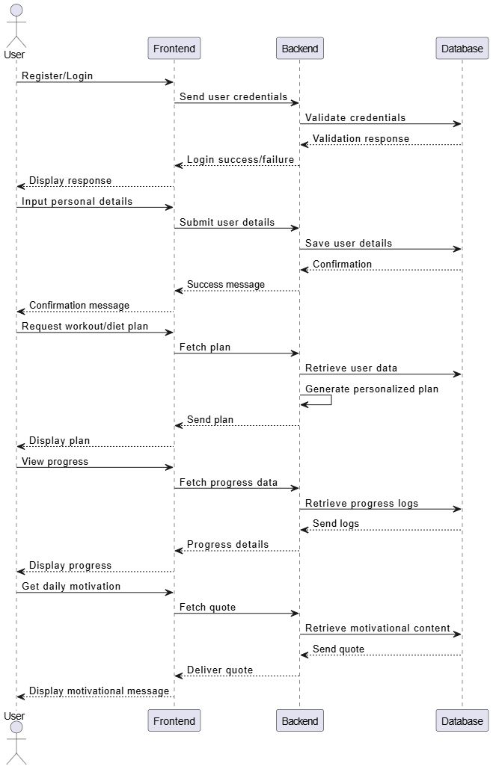
Sequence Diagram
MALLA REDDY COLLEGE OF ENGINEERING AND TECHNOLOGY

Slide 15
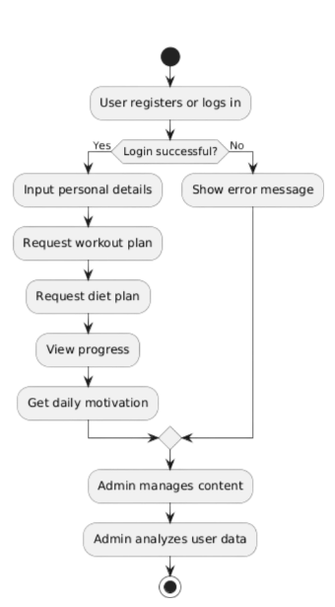
Activity Diagram
MALLA REDDY COLLEGE OF ENGINEERING AND TECHNOLOGY

Slide 16
Conclusion
MALLA REDDY COLLEGE OF ENGINEERING AND TECHNOLOGY
FitFusion successfully addresses the limitations of traditional fitness applications by offering AI-driven, personalized workout and diet plans based on user-specific inputs. By leveraging machine learning, it adapts to individual goals, fitness levels, and dietary preferences, ensuring a more tailored and effective approach to health and wellness. The platform enhances user engagement, eliminates guesswork, and provides data-driven recommendations, making fitness more accessible and results-oriented.
Moving forward, FitFusion can be expanded by integrating wearable device data, mental wellness tracking, and AI-powered virtual coaching for a more holistic fitness experience. With its intelligent, user-centric approach, FitFusion sets a new standard for digital fitness solutions, promoting smarter and more sustainable health transformations.

