Slide 1

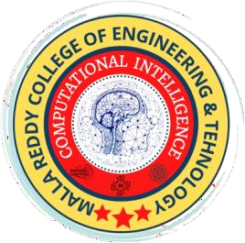
MALLAREDDY COLLEGE OF ENGINEERING & TECHNOLOGY
(AUTONOMUS INSTITUTION –UGC, GOVT. OF INDIA)
Affiliated to JNTUH; Approved by AICTE, NBA-Tier 1 & NAAC with A-GRADE| ISO 9001:2015
Fit Fusion – A Smart Fitness, Diet and Daily Motivation
Team Members
III Year B.Tech - II Semester – CSE(AIML)
Under the Guidance of
Mrs. N. Radhika
Assistant Professor
22N31A6629 - Bochkar Nikhith
22N31A6614 - Avudoddi Mounika
22N21A6628 - Bhukya Kalyan

Slide 2

Agenda
MALLA REDDY COLLEGE OF ENGINEERING AND TECHNOLOGY
Abstract
Introduction
Existing System
Limitations of Existing System
Proposed System
Advantages of Proposed System
System Architecture
Requirements Specifications
System Models (UML Diagram)
Implementation & Testing
Conclusion & Future Enhancement

Slide 3
Abstract
MALLA REDDY COLLEGE OF ENGINEERING AND TECHNOLOGY
FitFusion is an AI-powered fitness app that delivers personalized workout plans, diet recommendations, and motivational content based on user data. It integrates fitness, nutrition, and wellness seamlessly, leveraging Machine Learning for predictions, Collaborative Filtering for suggestions, Genetic Algorithms for diet optimization, and NLP for motivational content.
With dynamic adaptations to user progress, a Smart Progress Dashboard for insights, and an intuitive interface powered by Python (Streamlit), FitFusion redefines fitness with a holistic, intelligent, and user-centric approach.

Slide 4
Introduction
MALLA REDDY COLLEGE OF ENGINEERING AND TECHNOLOGY
In today’s world, modern fitness apps often fall short in providing a truly personalized and engaging experience. Users struggle with inconsistent workout tracking, lack of proper diet recommendations, and no proper motivation, leading to disengagement. Also, most fitness platforms focus only on either workouts or nutrition, failing to offer a complete approach to health.
FitFusion is designed to bridge this gap by integrating workout tracking, diet recommendations, and motivational support into a single, smart dashboard. With interactive progress meters, AI-driven workout and diet suggestions, and daily motivational quotes, FitFusion ensures users stay on track toward their fitness goals. Also making it easier for users to achieve and maintain a healthy lifestyle.

Slide 5
Existing System
MALLA REDDY COLLEGE OF ENGINEERING AND TECHNOLOGY
MyFitnessPal: Focuses on diet tracking but lacks real-time adjustments and integration with workouts and wellness.
Nike Training Club: Offers static workout plans with minimal personalization and no diet or mental wellness support.
Lose It!: Primarily diet-focused, with no integration of fitness or motivational tools.
Headspace: Specializes in mental wellness but lacks fitness and nutrition features.
Jefit: Workout-centric with no AI-driven adjustments, diet recommendations, or motivational content.

Slide 6
Proposed System
MALLA REDDY COLLEGE OF ENGINEERING AND TECHNOLOGY
AI-Driven Integration: Combines fitness, nutrition, and mental wellness into a single cohesive platform.
Dynamic Adjustments: Uses Linear Regression and Genetic Algorithms to modify workout and diet plans in real time.
Engaging Content: NLP-driven motivational content tailored to individual user needs.
Smart Progress Dashboard: Provides real-time performance insights for continuous improvement.
Innovative & User-Centric: Ensures adaptability, predictive analytics, and a user-friendly interface.

Slide 7
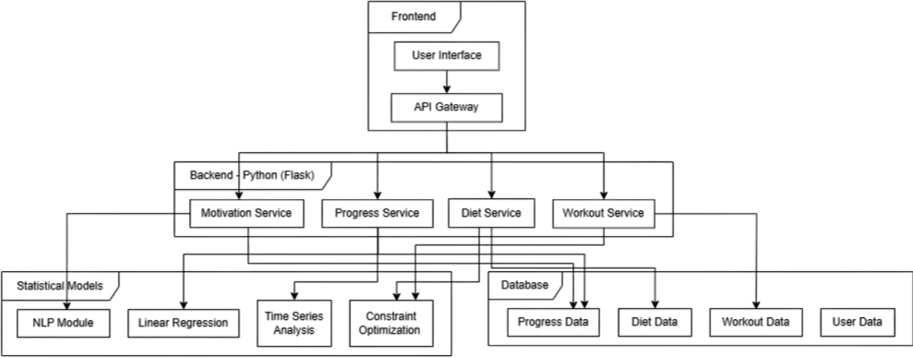
System Architecture
MALLA REDDY COLLEGE OF ENGINEERING AND TECHNOLOGY

Slide 8
Requirement Specifications
MALLA REDDY COLLEGE OF ENGINEERING AND TECHNOLOGY

Slide 9
Software Requirements Specifications
MALLA REDDY COLLEGE OF ENGINEERING AND TECHNOLOGY
Operating System: Windows 10/11, macOS, or Linux
Programming Language: Python 3.13
Web Framework: Streamlit (for UI and interactivity)
Data Processing: Pandas, NumPy
Visualization Libraries: Plotly, Matplotlib
Storage: CSV files for workout and diet recommendations, Cloud Storage
Deployment: Streamlit Cloud, for hosting the web application
Version Control System: Git/GitHub for code management and collaboration

Slide 10
Hardware Requirements Specifications
MALLA REDDY COLLEGE OF ENGINEERING AND TECHNOLOGY
Processor: Intel Core i5 or AMD Ryzen 5 (or higher)
RAM: Minimum 8GB (16GB recommended for smoother performance)
Storage: Minimum 256GB SSD (500GB+ preferred for large data handling)
GPU: Integrated graphics (Dedicated GPU recommended for heavy visualization processing)
Internet: High-speed internet required for real-time data retrieval and updates

Slide 11


Functional Requirements
MALLA REDDY COLLEGE OF ENGINEERING AND TECHNOLOGY
Fitness Recommendation Engine: Uses Random Forest to generate and adjust personalized workout and diet plans based on user data and goals.
Workout Plan Generator: Creates daily, goal-based routines tailored to fitness level, including cardio, strength, and flexibility.
Diet Plan Generator: Offers custom meal plans aligned with user preferences and fitness goals, supporting the workout regimen.
Motivational Quote Generator: Displays a new daily quote to boost motivation and consistency.
Progress Tracking (Optional): Allows logging of workouts/meals and visualizes progress through basic analytics.
B.Tech III Year – II Sem | Dept of Computational Intelligence| Application Development – II | Project Review

Slide 12
Non - Functional Requirements
MALLA REDDY COLLEGE OF ENGINEERING AND TECHNOLOGY
Performance: Process data and deliver fitness/diet plans within 2–3 seconds, ensuring minimal latency and smooth user experience.
Usability: Provide an intuitive, visually appealing UI that's easy to navigate for users of all ages and technical skills.
Scalability: Design the backend for easy integration of complex models and larger datasets, with future cloud deployment support.
Maintainability: Ensure clean, modular, and well-documented code for easy updates and enhancements, with version control in place.
Availability and Reliability: Maintain high reliability and minimal downtime, especially during peak usage, for web-based deployment.
B.Tech III Year – II Sem | Dept of Computational Intelligence| Application Development – II | Project Review

Slide 13
System Models
(UML Diagrams)
MALLA REDDY COLLEGE OF ENGINEERING AND TECHNOLOGY

Slide 14
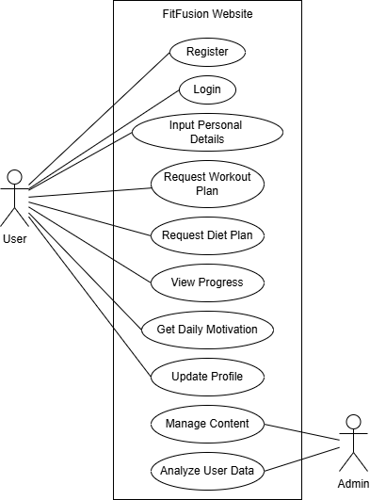
Use Case Diagram
MALLA REDDY COLLEGE OF ENGINEERING AND TECHNOLOGY

Slide 15
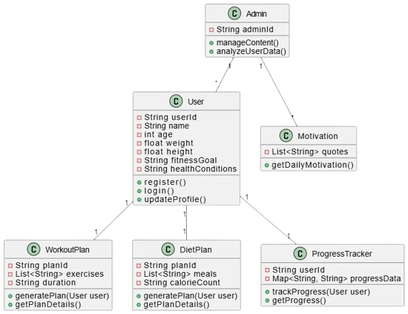
Class Diagram
MALLA REDDY COLLEGE OF ENGINEERING AND TECHNOLOGY

Slide 16
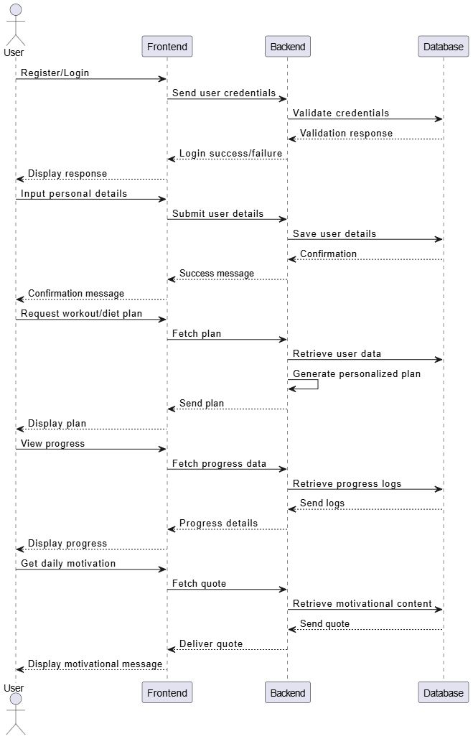
Sequence Diagram
MALLA REDDY COLLEGE OF ENGINEERING AND TECHNOLOGY

Slide 17
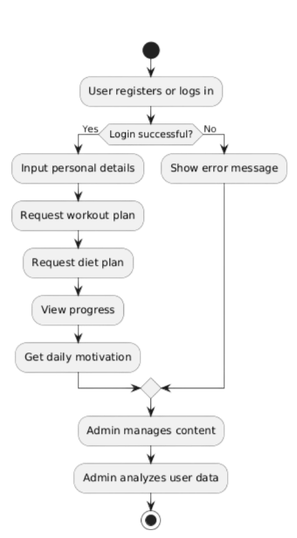
Activity Diagram
MALLA REDDY COLLEGE OF ENGINEERING AND TECHNOLOGY

Slide 18
MALLA REDDY COLLEGE OF ENGINEERING AND TECHNOLOGY
Implementation &
Testing
B.Tech III Year – II Sem | Dept of Computational Intelligence| Application Development – II | Project Review

Slide 19
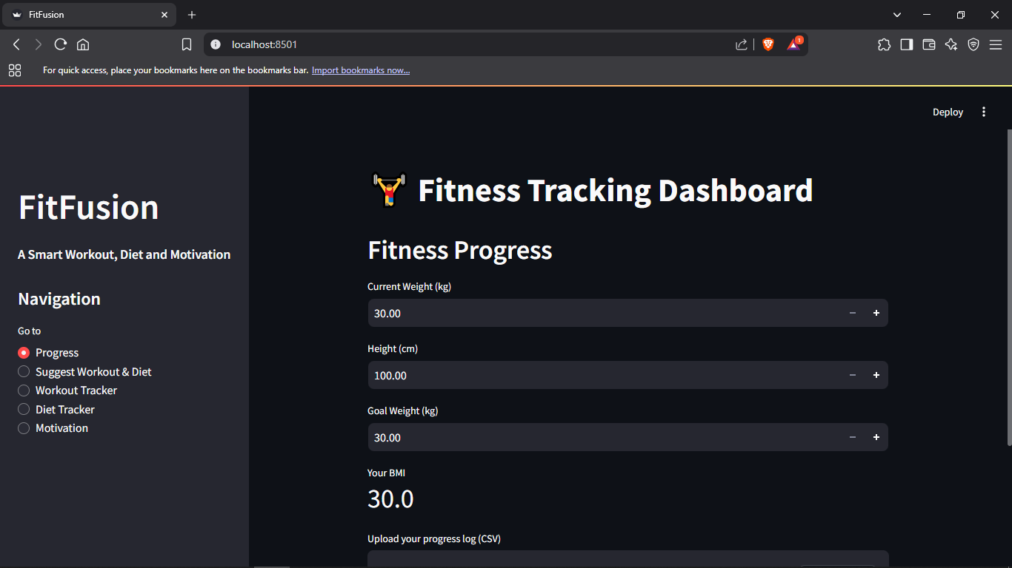
Output 1 - Progress Dashboard
MALLA REDDY COLLEGE OF ENGINEERING AND TECHNOLOGY
B.Tech III Year – II Sem | Dept of Computational Intelligence| Application Development – II | Project Review

Slide 20
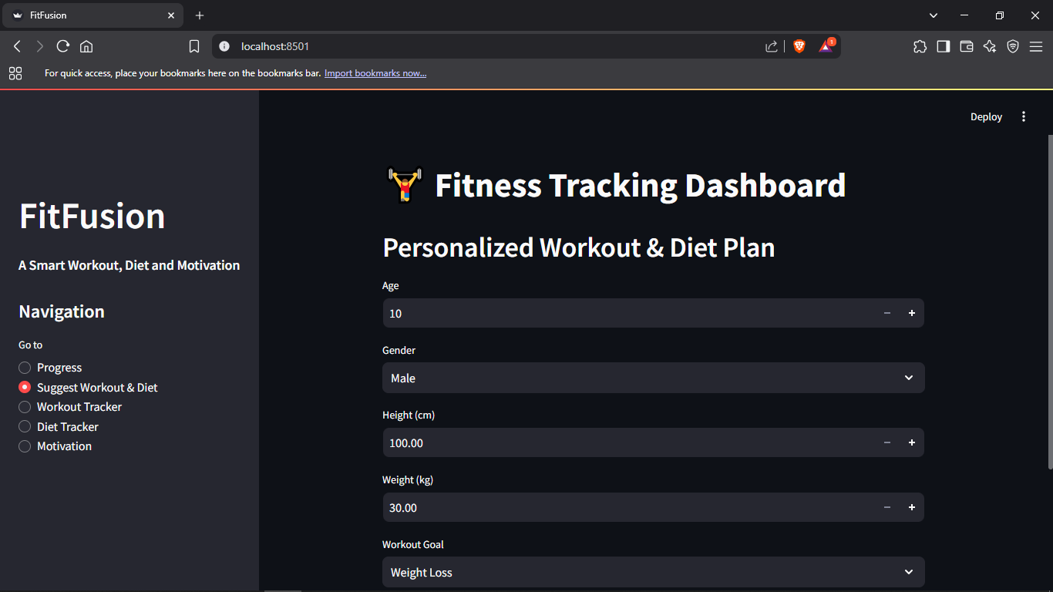
MALLA REDDY COLLEGE OF ENGINEERING AND TECHNOLOGY
Output 2 - Workout and Diet Suggestion
B.Tech III Year – II Sem | Dept of Computational Intelligence| Application Development – II | Project Review

Slide 21
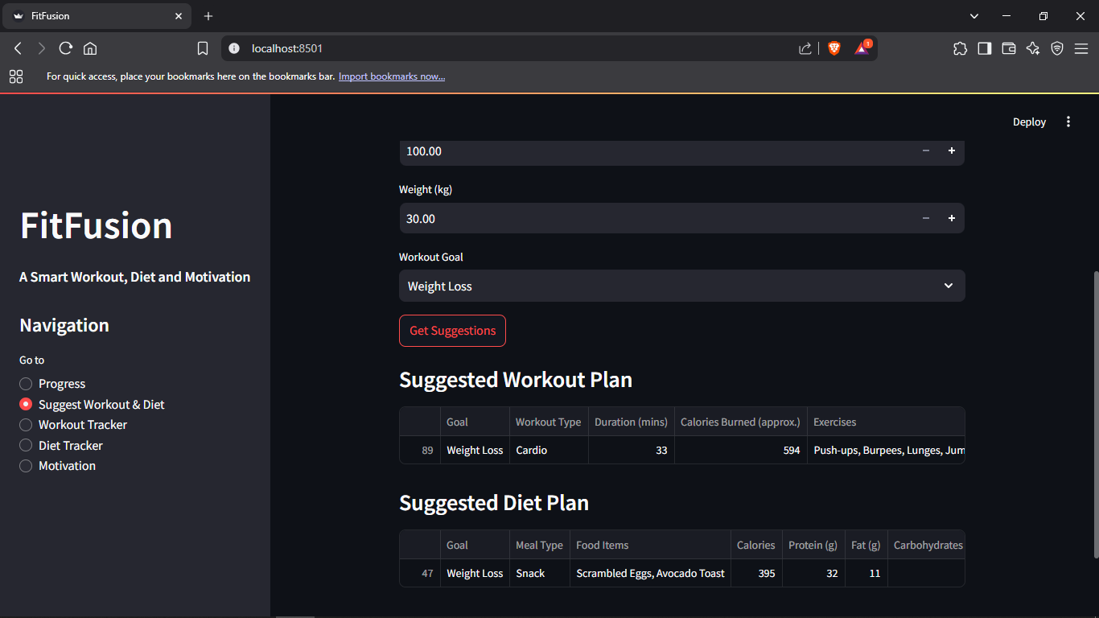
MALLA REDDY COLLEGE OF ENGINEERING AND TECHNOLOGY
Output 3 - Result of Workout and Diet Suggestion
B.Tech III Year – II Sem | Dept of Computational Intelligence| Application Development – II | Project Review

Slide 22
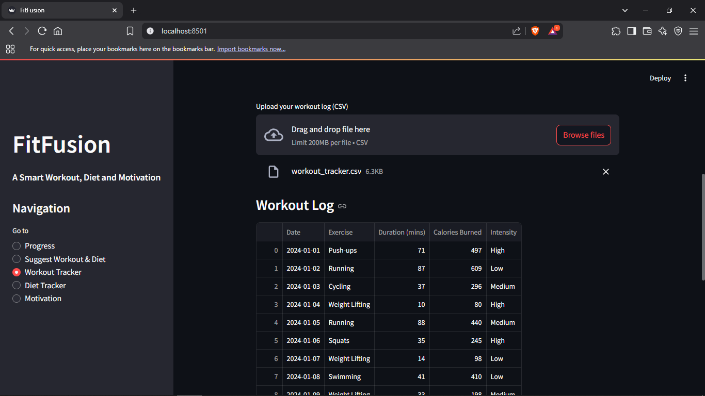
MALLA REDDY COLLEGE OF ENGINEERING AND TECHNOLOGY
Output 4 - Workout Tracker
B.Tech III Year – II Sem | Dept of Computational Intelligence| Application Development – II | Project Review

Slide 23
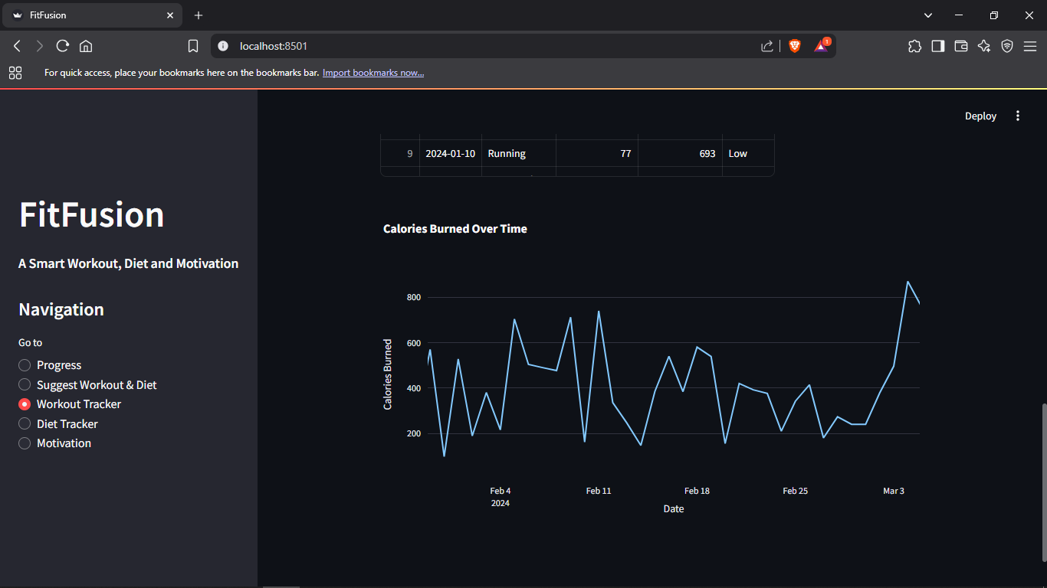
MALLA REDDY COLLEGE OF ENGINEERING AND TECHNOLOGY
Output 5 - Calories Burned Analysis
B.Tech III Year – II Sem | Dept of Computational Intelligence| Application Development – II | Project Review

Slide 24
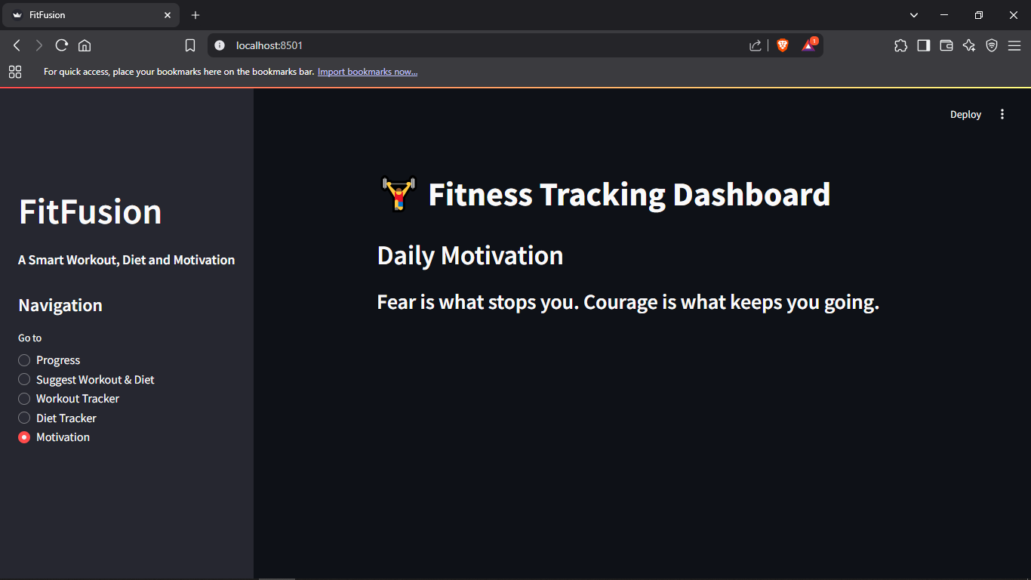
MALLA REDDY COLLEGE OF ENGINEERING AND TECHNOLOGY
Output 6 - Daily Motivation Page
B.Tech III Year – II Sem | Dept of Computational Intelligence| Application Development – II | Project Review

Slide 25
Testing
MALLA REDDY COLLEGE OF ENGINEERING AND TECHNOLOGY
The testing phase encompasses various types of testing, including functional testing, integration testing, and user acceptance testing. It helps identify and rectify any bugs, inconsistencies, or performance issues before deployment. By simulating real-world scenarios and user interactions, system testing ensures the software behaves as expected, enhances user satisfaction, and confirms the system's readiness for final release. In the context of the AI-driven fitness recommendation system, system testing verifies the accuracy, reliability, and performance of the personalized workout and diet suggestions generated for users based on their input parameters.
B.Tech III Year – II Sem | Dept of Computational Intelligence| Application Development – II | Project Review

Slide 26
Conclusion & Future Enhancements
MALLA REDDY COLLEGE OF ENGINEERING AND TECHNOLOGY
In conclusion, the Personalized Fitness and Diet Recommendation System successfully demonstrates how artificial intelligence and machine learning can be leveraged to deliver tailored workout and nutritional guidance based on individual user profiles. Combining user data with intelligent algorithms, the system enhances user engagement, promotes healthier lifestyles, and simplifies the decision-making process for fitness beginners. And future enhancements could include real-time activity tracking through wearable device integration, voice-enabled assistance for hands-free operation, and community features for peer motivation, incorporating advanced recommendation models, emotional well-being tracking, and multilingual support can further personalize and enrich the user experience.
B.Tech III Year – II Sem | Dept of Computational Intelligence| Application Development – II | Project Review

Slide 27
Thank you
MALLA REDDY COLLEGE OF ENGINEERING AND TECHNOLOGY
Bochkar Nikhith - 22N31A6629
Avudoddi Mounica - 22N31A6614
Bhukya Kalyan - 22N31A6628
B.Tech III Year – II Sem | Dept of Computational Intelligence| Application Development – II | Project Review

