Slide 1
Enhanced Software Defect Prediction Using Ensemble Learning by Adaptive Variable Sparrow Search Algorithm
Vanama Nikhith 23VV1F0027
September 3, 2025

Slide 2
Problem Statement
Software defect prediction plays a crucial role in improving software quality and reducing maintenance costs. However, traditional machine learning models often suffer from limited accuracy due to the imbalanced and noisy nature of software defect datasets.
Many optimization-based approaches have been introduced to enhance classifier performance, but existing algorithms often face challenges such as slow convergence, premature stagnation in local optima, and poor generalization to diverse datasets.
There is a need for an advanced and adaptive optimization method that can effectively balance exploration and exploitation, overcome limitations of current techniques, and improve defect prediction accuracy across multiple software repositories.

Slide 3
Introduction
Prediction of software defects is essential to ensure high quality software and reduce development and maintenance costs.
Traditional prediction models often struggle due to noisy, imbalanced datasets and the dynamic nature of software projects.
Evolutionary and swarm intelligence algorithms have been used to optimize classifiers, but they often suffer from premature convergence and poor scalability.
There is a growing need for adaptive and robust optimization methods that can improve prediction accuracy and efficiency in diverse data sets.

Slide 4
Dataset
NASA Datasets
Projects: PC1, CM1, MC2, MW1
Characteristic number: 37
Samples range: 125 – 735
Defect rates: 0.0830 – 0.3520
AEEEM Datasets
Projects: JDT, PDE, ML
Characteristic number: 61
Samples range: 997 – 1862
Defect rates: 0.1321 – 0.2066

Slide 5
Dataset
MORPH Datasets
Projects: ant-1.3, arc, camel-1.0
Characteristic number: 20
Samples range: 125 – 339
Defect rates: 0.0383 – 0.1600
JIRA Datasets
Projects: activemq-5.0.0, hbase-0.94.0, hive-0.9.0, groovy-1.6 BETA 1, jruby-1.1
Characteristic number: 65
Samples range: 731 – 1884
Defect rates: 0.0852 – 0.2058

Slide 6
Algorithms Used
Extreme Learning Model (ELM): A fast learning algorithm for single-hidden layer feedforward neural networks that randomly assigns input weights and biases.
Sparrow Search Algorithm (SSA): A swarm intelligence optimization algorithm inspired by the foraging and anti-predation behavior of sparrows.
Adaptive Variable Sparrow Search Algorithm (AVSSA): An improved SSA that adaptively adjusts search strategies to balance exploration and exploitation.
Sparrow Eagle Based Algorithm (SEB): A hybrid approach combining sparrow search dynamics with eagle strategy to enhance global optimization.
Adaptive Variable Sparrow Eagle Based Algorithm (AVSEB): The proposed algorithm that adaptively tunes parameters of SEB for better convergence and prediction accuracy.

Slide 7
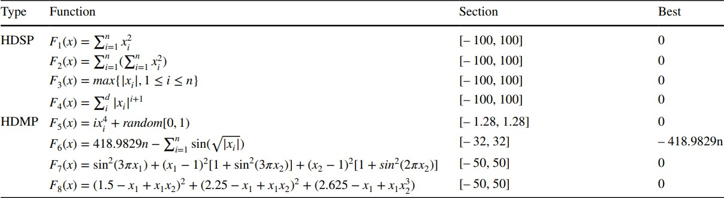
Benchmark Functions
Standard mathematical benchmark functions, such as Sphere, Rastrigin, Ackley, Griewank, and Rosenbrock, are widely used to test optimization algorithms.
They evaluate algorithm performance in terms of convergence speed, stability, and ability to achieve global search capability.

Slide 8
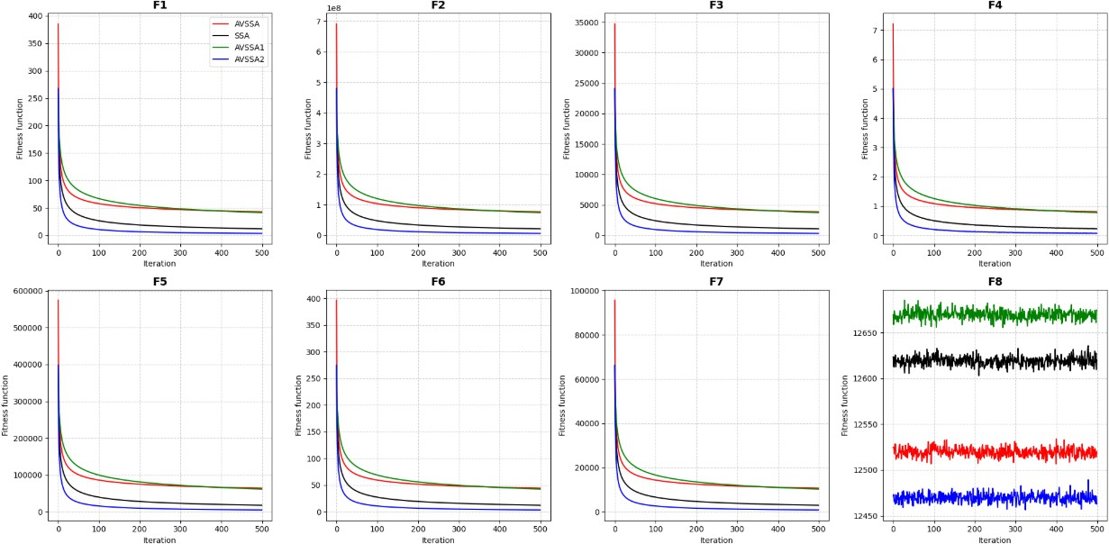
Convergence Graphs
Note: Convergence graphs illustrate how quickly and effectively algorithms approach the optimal solution over iterations.
Convergence behavior of AVSEB vs other algorithms.

Slide 9
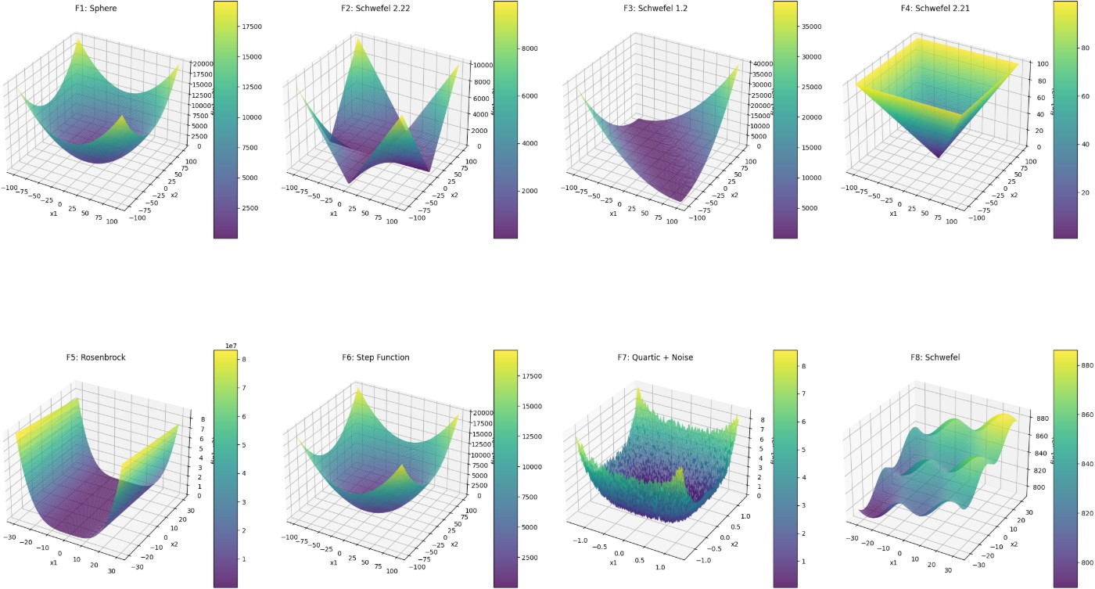
3D Heatmaps
Note: 3D heatmaps depict how algorithms search the solution space, highlighting regions of intensification and diversification.
Visualization of solution space exploration and exploitation.

Slide 10
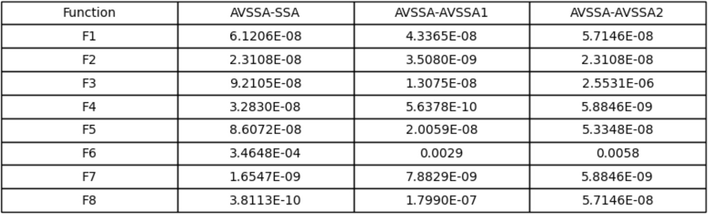
Wilcoxon Rank Test
A non-parametric statistical test used to compare two paired samples.
Helps validate whether differences in algorithm performance are statistically significant.
Applied to compare AVSEB against baseline algorithms across datasets.

Slide 11
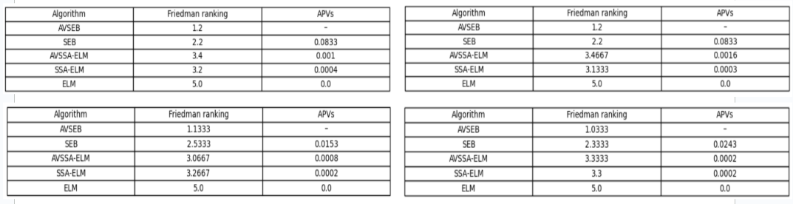
Friedman Average Ranking
Non-parametric test for multiple algorithm comparison across multiple datasets.
Produces average ranking of algorithms based on performance.
Used to confirm robustness and generalization ability of AVSEB.

Slide 12
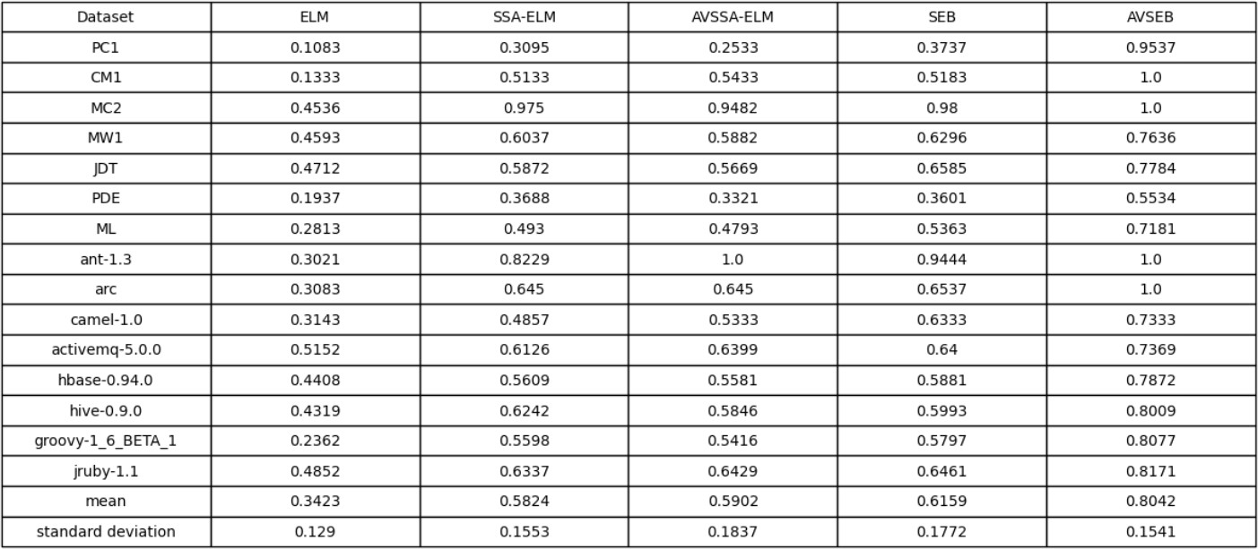
Evaluation Metrics
•
Recall: Recall =
TP
TP+FN
Measures the proportion of actual defects correctly identified by the model.

Slide 13
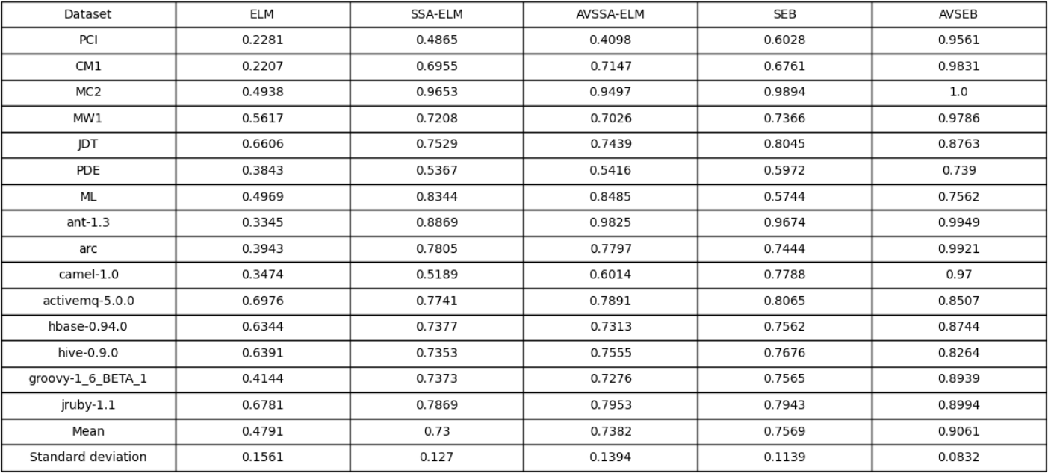
Evaluation Metrics
G-Mean: G -Mean = ^{q}
TP TN
×
TP+FN TN+FP
Evaluates the balance between sensitivity (recall) and specificity.

Slide 14
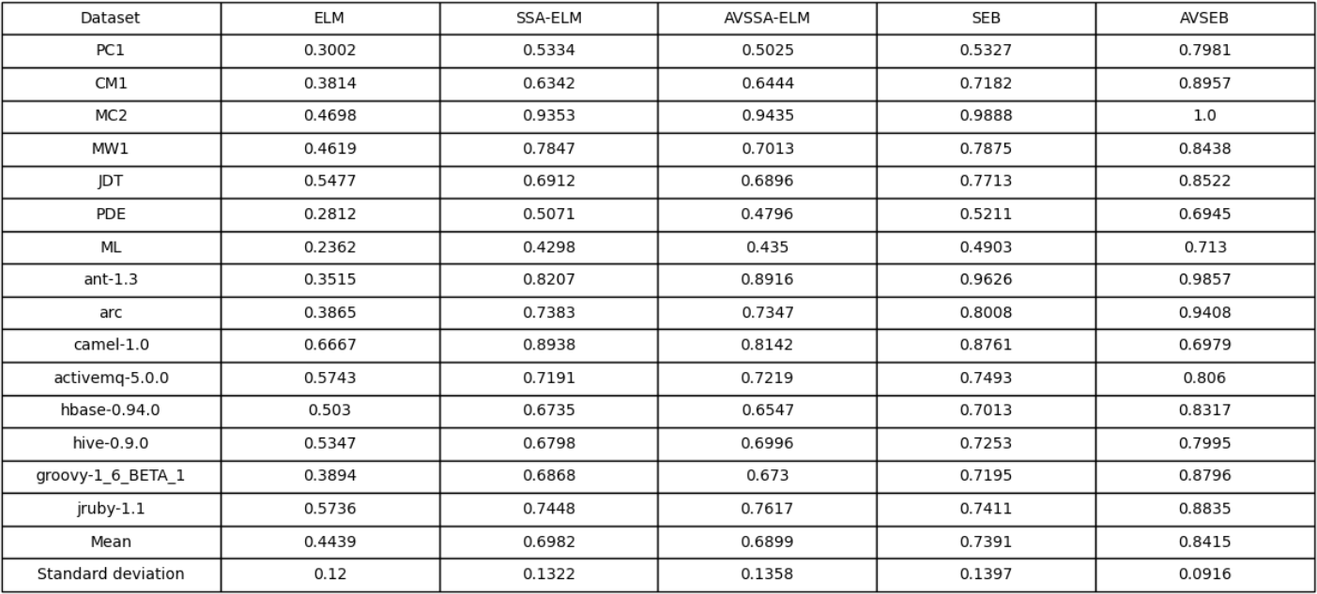
Evaluation Metrics
•
F-Measure: F =
2×Precision×Recall
Precision+Recall
Represents the harmonic mean of precision and recall.

Slide 15
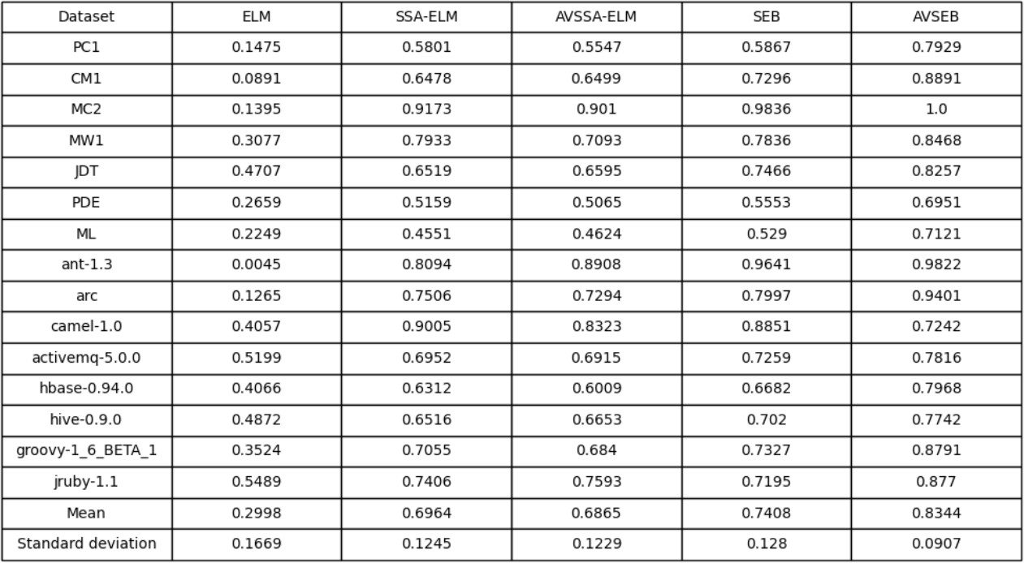
Evaluation Metrics
MCC: MCC = √
TP×TN−FP×FN
(TP+FP)(TP+FN)(TN+FP)(TN+FN)
Provides a balanced evaluation even on imbalanced datasets.

Slide 16
Results and Analysis
The proposed AVSEB algorithm was evaluated on multiple benchmark functions (F1–F8) to validate its convergence speed, stability, and global optimization ability.
Results show that AVSEB consistently outperformed traditional SSA, AVSSA, SEB, and baseline classifiers across most benchmark functions.
On software defect datasets (NASA, AEEEM, MORPH, and JIRA), AVSEB achieved higher recall, F-measure, G-Mean, and MCC values compared to other algorithms.
Statistical tests (Wilcoxon rank-sum and Friedman average ranking) confirmed that the performance improvements of AVSEB are statistically significant.
Convergence graphs indicate that AVSEB avoids premature stagnation and achieves faster convergence toward optimal solutions.
3D heatmap visualizations demonstrate that AVSEB balances exploration and exploitation more effectively than competing methods.

Slide 17
Conclusion
The proposed AVSEB algorithm effectively improves software defect prediction by adaptively balancing exploration and exploitation in optimization.
Experimental results on benchmark functions and real-world datasets (NASA, AEEEM, MORPH, JIRA) demonstrate superior performance over SSA, AVSSA, SEB, and baseline models.
Statistical validation using Wilcoxon rank-sum and Friedman tests confirmed the significance and robustness of AVSEB’s improvements.
Convergence and heatmap visualizations highlighted AVSEB’s capability to avoid premature convergence and maintain strong search diversity.
Overall, AVSEB provides a reliable and efficient approach for enhancing defect prediction accuracy and can be extended to other optimization-based software engineering tasks.

Slide 18
The End

