Slide 1
FLIPKART REVIEW SENTIMENT ANALYSIS

Slide 2
ABSTRACT
Flipkart review sentiment analysis involves the application of natural language processing (NLP) techniques and machine learning algorithms to analyze customer reviews on the Flipkart platform. This process aims to classify reviews into positive, negative, or neutral sentiments, providing valuable insights into customer satisfaction and product quality.
Naïve Bayes Classifier: Achieved 89% accuracy using TF-IDF for feature extraction but struggled with nuanced sentiments in binary classification.
Hybrid Ensemble Model (HEM): Combined Naïve Bayes, SVM, and Decision Trees to achieve 90% accuracy, effectively addressing class imbalance.
SVM with TF-IDF: Reached 85% accuracy with efficient binary classification but faced challenges in handling subtle sentiment differences.

Slide 3
Problem Statement
In the era of e-commerce, customer feedback plays a pivotal role in shaping business decisions. For Flipkart, one of India’s leading online marketplaces, comprehending customer sentiment from a sea of reviews is paramount. This sentiment analysis will not only provide valuable insights into customer satisfaction but also enable Flipkart to swiftly identify areas for improvement in products and services.

Slide 4
Introduction
Flipkart review sentiment analysis involves evaluating customer feedback and reviews to identify the underlying sentiment, such as positive, negative, or neutral. This process leverages natural language processing (NLP) techniques and machine learning algorithms to understand customer opinions and preferences. By analyzing reviews, businesses can gain actionable insights into product performance, customer satisfaction, and areas for improvement.

Slide 5
Proposed Methodologies
1.Data Cleaning : Extract product reviews from Flipkart using web scraping tools or APIs. Reviews should include text, ratings, timestamps, and user information (if available)
2.Data Pre-processing : Remove irrelevant elements like HTML tags, URLs, special characters, and stopwords. Normalize text by converting to lowercase and performing stemming or lemmatization. Handle code-mixed and multilingual data by identifying language and translating to a unified language (e.g., English).
3.Feature Extraction : Use NLP techniques such as Bag-of-Words (BoW), TF-IDF (Term Frequency Inverse Document Frequency), or word embeddings (e.g., Word2Vec, GloVe) to convert textual data into numerical vectors.:
4.Sentiment Classification : Implement models like NaIve Bayes, Support Vector Machines (SVM), Random Forests, or Gradient Boosting for baseline classification tasks.

Slide 6
Algorithms
A decision tree algorithm is a supervised machine learning algorithm used for both classification and regression tasks. It works by making a series of decisions based on features of the data to ultimately arrive at a prediction or decision.It is a type of machine learning algorithm that makes decisions based on a series of if-else statements. It works by recursively partitioning the data based on the values of its features, leadington hierarchical tree-like structure of decisions.

Slide 7
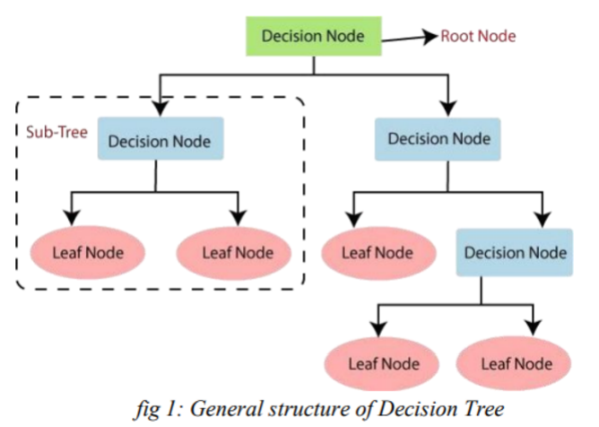
Decision Tree Terminologies :
• Root Node: Root node is from where the decision tree starts. It represents the entire dataset, which further gets divided into two or more homogeneous sets.
• Leaf Node: Leaf nodes are the final output node, and the tree cannot be segregated further after getting a leaf node.

Slide 8


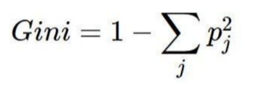
How Decision Trees Make Decisions :
Information Gain: Measures the reduction in entropy to determine the best feature for splitting data during decision tree construction.
Entropy: Quantifies impurity or randomness in data, helping evaluate feature splits in classification tasks.
Gini Index: Calculates impurity in a dataset, guiding the selection of features for splitting in decision trees.

Slide 9
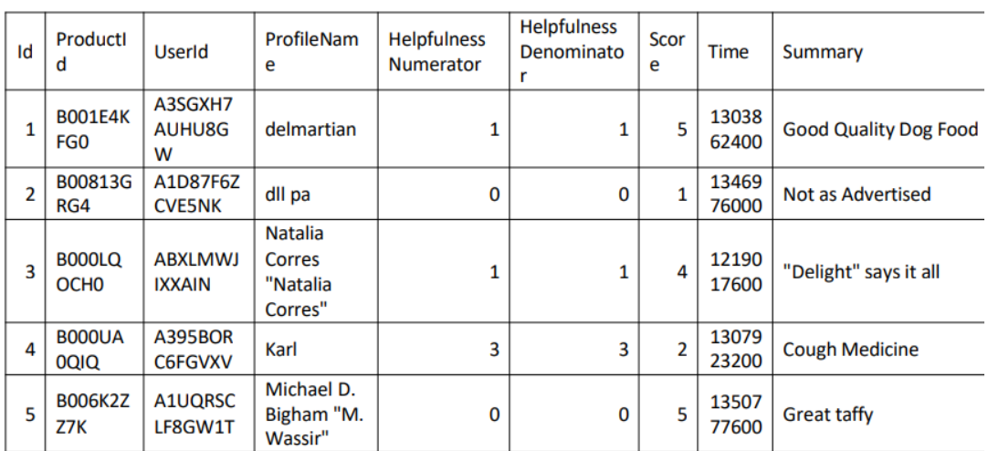
Dataset
The dataset utilized in this project is a collection of customer reviews obtained from the Flipkart e-commerce platform. It serves as the foundation for sentiment analysis, allowing us to understand and categorize customer sentiments towards various products and services offered on Flipkart.

Slide 10
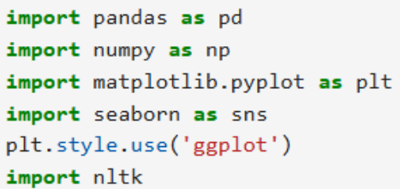

Implementation in Jupyter Notebook :
1.Loading Packages :
In Jupyter Notebook, packages are loaded using the import statement, allowing you to access libraries like numpy, pandas, or matplotlib.
2.Loading Dataset :
Loading a dataset in Jupyter Notebook can be done using libraries like pandas or numpy. For example, pandas.readcsv() is commonly used to load a CSV file, allowing efficient data manipulation and analysis within the notebook.

Slide 11
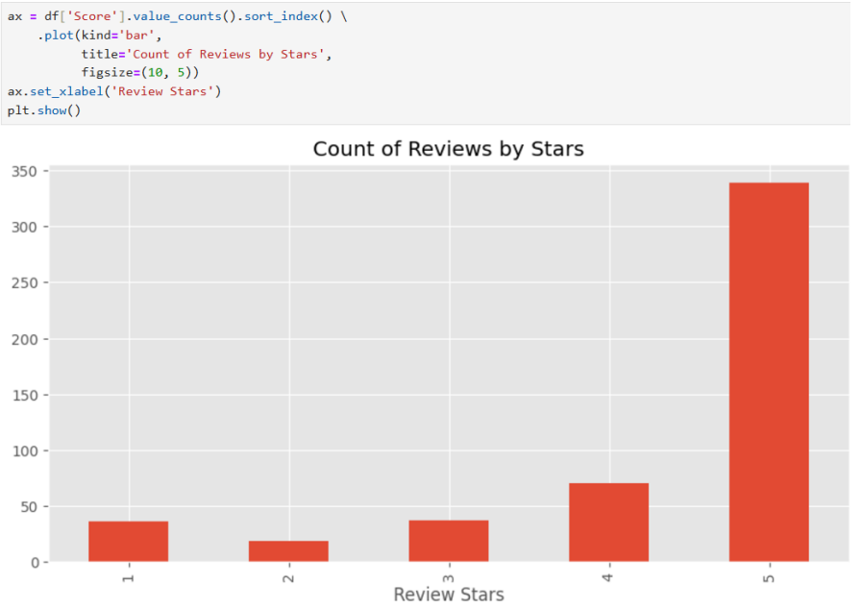
3.Displaying Reviews by Stars “
The data in the dataset will displayed in the form of graph by taking the reviews as Stars:
4.Usage of NPL :
Natural Language Processing (NLP) is a branch of AI that enables computers to understand, interpret, and generate human language using algorithms and linguistic rules. It processes and analyzes text or speech data for various applications

Slide 12
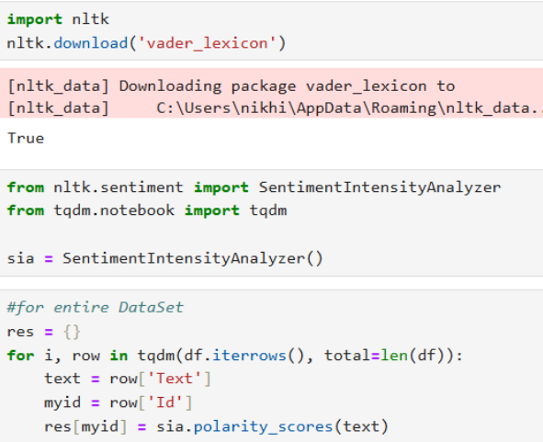
Common approach in sentiment analysis, a specific application of Natural Language Processing (NLP). In sentiment analysis, text data is analyzed to determine the sentiment expressed in it, often categorized as positive, negative, or neutral.
These sentiment values are typically categorized as positive, negative, or neutral based on predefined

Slide 13
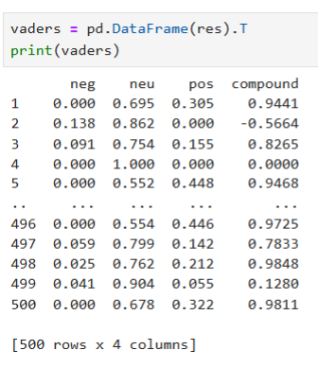
sentiment lexicons or dictionaries
.
5.Sentiment Analysis with Compound Values :
In the NLP system, sentiment analysis assigns sentiment scores to words or phrases, categorizing them as positive, negative, or neutral based on sentiment lexicons. Positive words get positive scores, negative words receive negative scores, and neutral words have scores close to zero.

Slide 14
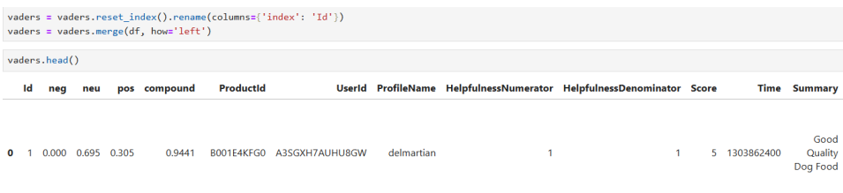
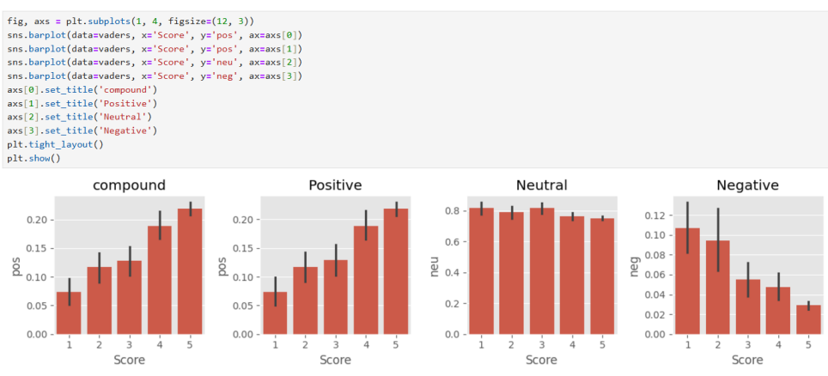
Positive Words receive positive scores, negative words receive negative scores, and neutral words may have scores close to zero.

Slide 15
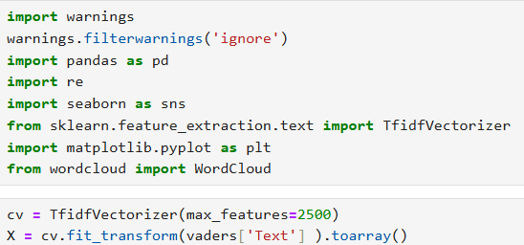
6.Converting text into Vectors :
TF-IDF calculates that how relevant a word in a series or corpus is to a text. The meaning increases proportionally to the number of times in the text a word appears but is compensated by the word frequency in the corpus (data-set).
7.Python Implementation of Decision Tree “
Now we will implement the Decision tree using Python.For this, we will use the dataset ”Reviews.csv”

Slide 16
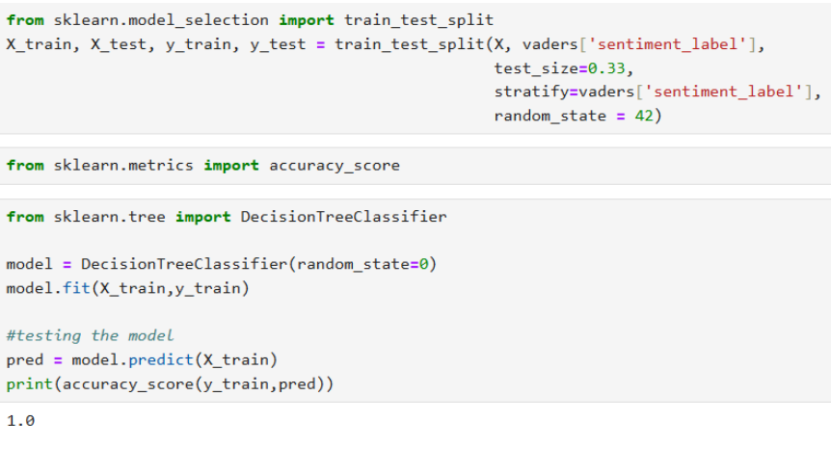
which we have used in previous classification models. By using the same dataset, we can compare the Decision tree classifier with other classification models such as KNN, SVM, Logistic Regression, etc.

Slide 17
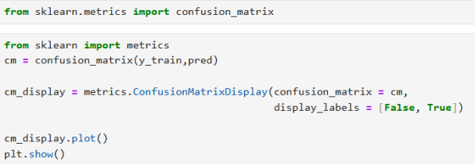
Result
The performance of the sentiment analysis model is evaluated using a confusion matrix, which categorizes predictions into True Positives (TP), True Negatives (TN), False Positives (FP), and False Negatives (FN). For binary classification, the matrix is 2x2, while for multi-class classification, it is an nXn matrix, where n is the number of classes.

Slide 18
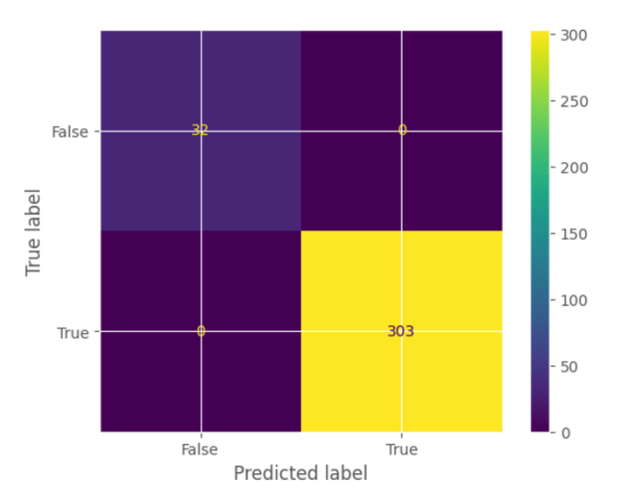
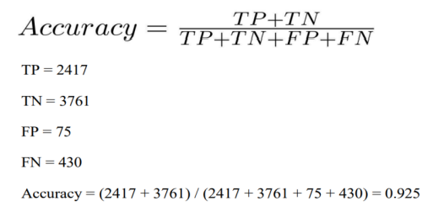
The output is displayed as:
Accuracy: Alongside the confusion matrix, we will also gauge the model’s accuracy. This metric represents the proportion of correctly classified reviews, offering a broad overview of the model’s overall correctness.

Slide 19
Future Scope
Real-Time Sentiment Tracking: Analyze incoming reviews in real-time to address customer concerns promptly.
Multi-Language Analysis: Enhance models to process reviews in multiple languages and regional dialects.
Fake Review Detection: Use advanced algorithms and verification technologies to filter fake reviews.
Contextual Understanding: Leverage deep learning models to capture sarcasm, mixed sentiments, and nuanced feedback.

Slide 20
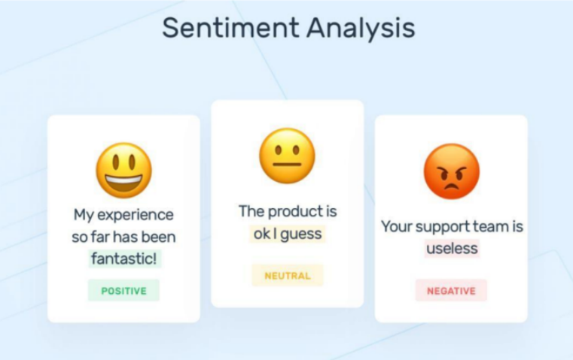
Conclusion
In this project, we analyzed diverse product reviews to uncover customer sentiments using tools like VADER, quantifying positivity, neutrality, and negativity. Through meticulous preprocessing and integration, sentiment scores were merged with the dataset for comprehensive insights. This analysis aids decision-making, enhances customer trust, and maintains Flipkart's competitive edge. With advancements in AI and NLP, the scope for refining sentiment analysis and improving customer experiences is immense.

Slide 21
Thank
You

