Slide 1
Graphical Password Authentication
1602-20-737-087 M. Nikhitha
1602-20-737-081 B. Manisha
1602-20-737-309 N. Madhukar

Slide 2
Problem statement
A Graphical Password Authentication system is an authentication system that uses some combination of graphical images replacing the regular passwords. Graphical passwords may offer better security than text-based passwords because most of the people use regular, popular passwords everywhere and are prone to social engineering attacks. So graphical passwords can put stop to many attacks of this kind.

Slide 3
Motivation
Resistance to Popular Attacks
Bruteforce
After reaching max tries, the user will be notified via message through email. And the further authentication through the generic URL/website is disabled for that user account, instead, they have to use the link that will be sent by the company in the notification email. This also lets the legitimate user know about the adversary.
Shoulder Surfing
Shoulder surfing is a type of social engineering technique used to obtain information such as personal identification numbers (PINs), passwords and other confidential data by looking over the victim's shoulder. The system we adopt is similar to the Phone pattern system. The pattern is invisible on the screen when the users draw it. This makes it incredibly tough for the adversary to see the images on the grid that the user clicks.

Slide 4
Spyware
Graphical password systems resist spyware more easily than regular passwords. Key-loggers secretly capture keystrokes and transfer, but if the spyware wants to track the mouse movements, it can be tracked, but the adversary wouldn’t know which part of the mouse event is actually the graphical password. The timeline vs mouse-event graph is too difficult to get the pattern
Hidden Camera
There will be a camera in front of the user which identifies a face while authentication i.e., the number of pixels the face occupies should be 80-90% of the total pixels in the current frame and if this condition is not satisfied then the screen does not show the graphical password. It alerts the user to cover the screen with a proper posture. But this will be a costly operation.
Phishing
Since the adversary is made to believe that the password is a set of images, it’s not possible to make a fake page, since the adversary thinks he doesn’t know the images. Moreover, we restrict the user to one attempt and suggest the user to give a fake password every time so that he triggers the server to send and URL in email so that he can log in through the legitimate login page, and the adversary cannot send the URL to users from a legitimate server. However, when the adversary knows the technique this attack might be still possible.

Slide 5
Architecture
Segmented Images Authentication
Password Image Authentication
Obscured Images Authentication
Garbled Images Authentication

Slide 6
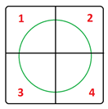
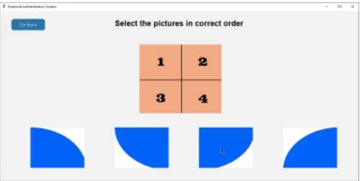
Segmented Images Authentication
For this layer, the user will be showed 4 different images. These images will be a division of a whole image. User will have to select the correct order of the images. The logic can be explained better with the following picture:
As can be seen in the above image, a circle is divided into 4 parts. These 4 parts will be randomly displayed on the screen and user will be asked to select the pieces in correct order. If an image is clicked first, it will be selected as the first image and so on. If a user selects all 4 pieces in the correct order, he/she will be authenticated.

Slide 7
Password Images Authentication
Whenever a user registers, he/she is asked to select an image category from the 3 given categories:
Chocolates
Dog breeds
Flowers
Whatever the user selects, is associated with his/her password and every time the user logs in, he/she will be asked to select the same image from the randomly displayed images.
Now here’s the twist. We have stored multiple images for each category. So, if a user selects cat, he/she will not be displayed the same cat every single time. The images per category are different.

Slide 8
Obscure Images Authentication
In this layer, not only are we preventing bots but we are also enhancing security by introducing image-to-speech-to-text concept. Let’s dig deeper into what this concept really is.
Image-to-Speech-to-Text:
In this concept, a user is displayed an image with obscure text. The reason for adding this obscurity is to confuse a NLP type mechanisms in bypassing the authentication. Random words are generated on a file which is then covered with an obscure text.

Slide 9
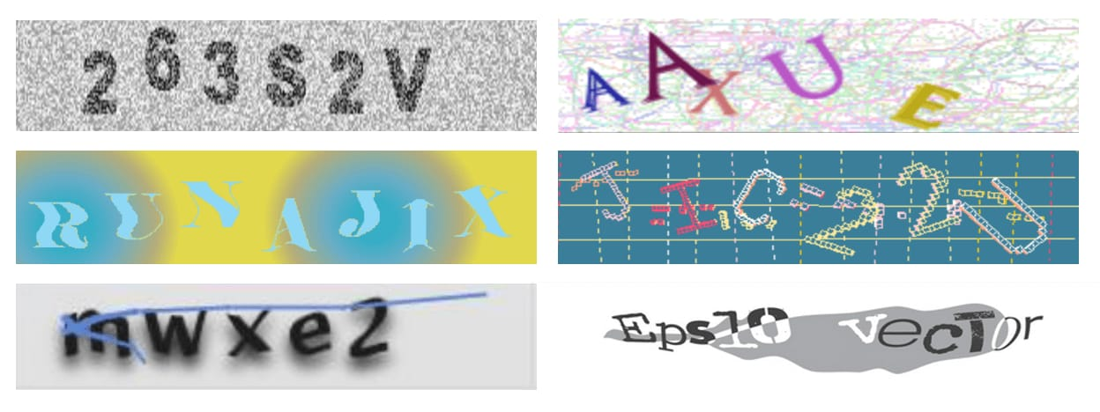
Garbled Images Authentication
In this layer, the user will be displayed a Garbled text whose readability will be really low and user will be asked to read and then type in the text. The garbled texts will be randomly generated.
User is shown a random image in the start of this layer and is asked to type in the correct text. Whatever the user types is then compared to the already stored correct values and if the answer is correct, then user will be authenticated and authentication dialogue box will pop up.

Slide 10
Thank You!

