Slide 1





FUTURE INTERNS
SOC&SIEMLogAnalysisUsing Splunk
CYBER SECURITY
Submitted by:
Nikhitha DhanamJaya Kondreddy
College:
Sri Vasavi Engineering College
TASK2_PPT
Internship:
Future Interns – Cyber Security Internship
Repository: FUTURE_CS_02

Slide 2





INTRODUCTION
• Securitymonitoringisimportant fordetecting cyber threats.
• SIEM tools help analyze logs and suspicious activities. • Splunk is used for log monitoring and alert analysis.
OBJECTIVE
• Analyze security logs
• Detect suspicious activities
• Identify security alerts
• Perform basic incident response analysis

Slide 3




Tools Used
• Splunk Enterprise
• Sample Security Logs
• Windows Operating System
Uploading Logs into splunk
• Created sample_logs.txt
• Uploaded logs into Splunk • Indexed logs for analysis

Slide 4
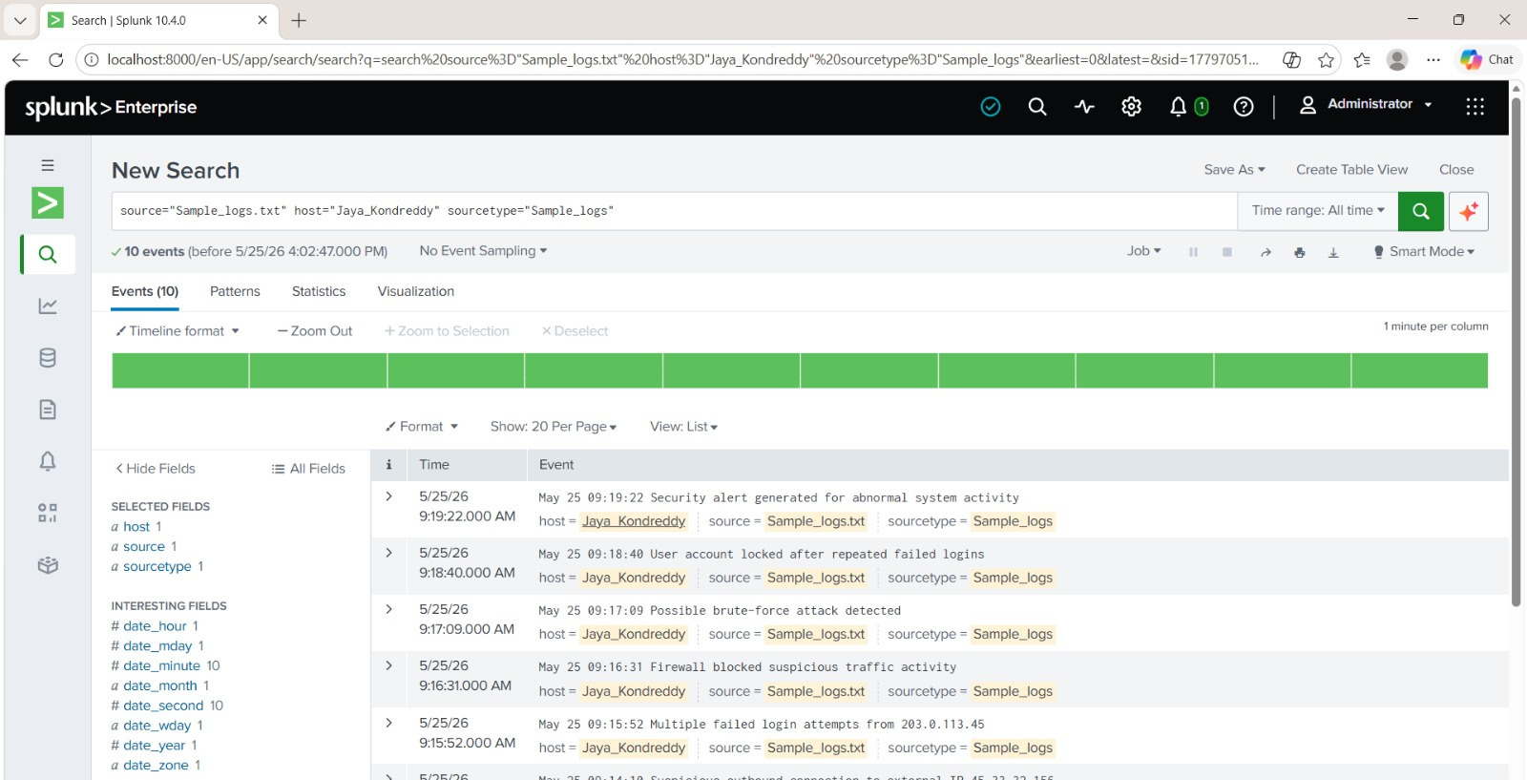


Slide 5



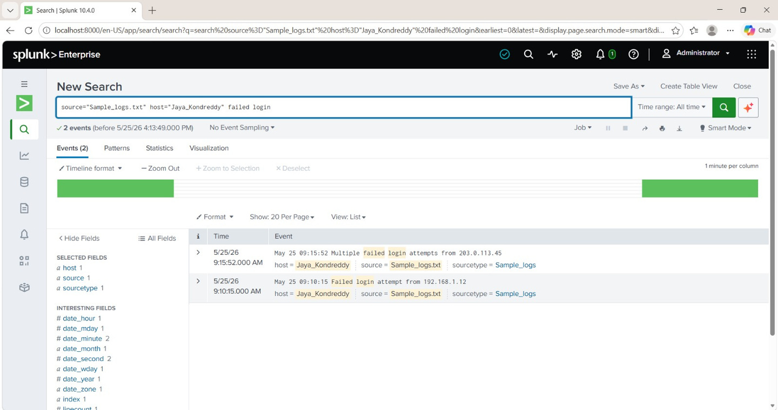

FAILED LOGIN DETECTION
• Multiple failedlogin attempts detected
• Possible brute-force activity observed • Alert severity classified as Medium

Slide 6

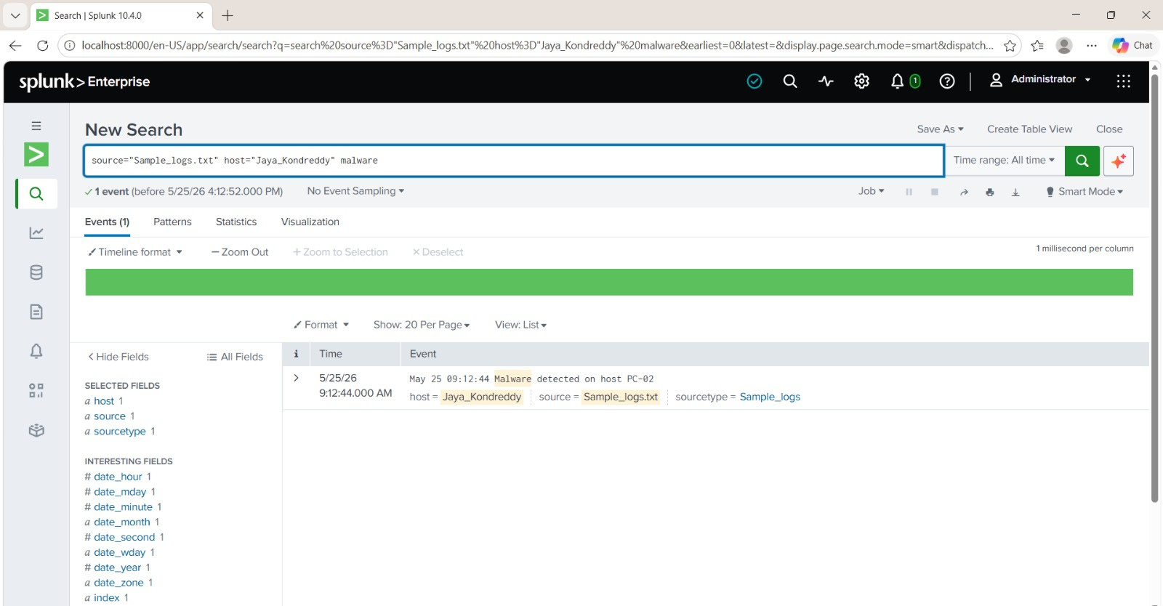
MALWARE DETECTION
• Malware activitydetectedin logs
• System monitoring identified suspicious behavior • Alert severity classified as High

Slide 7


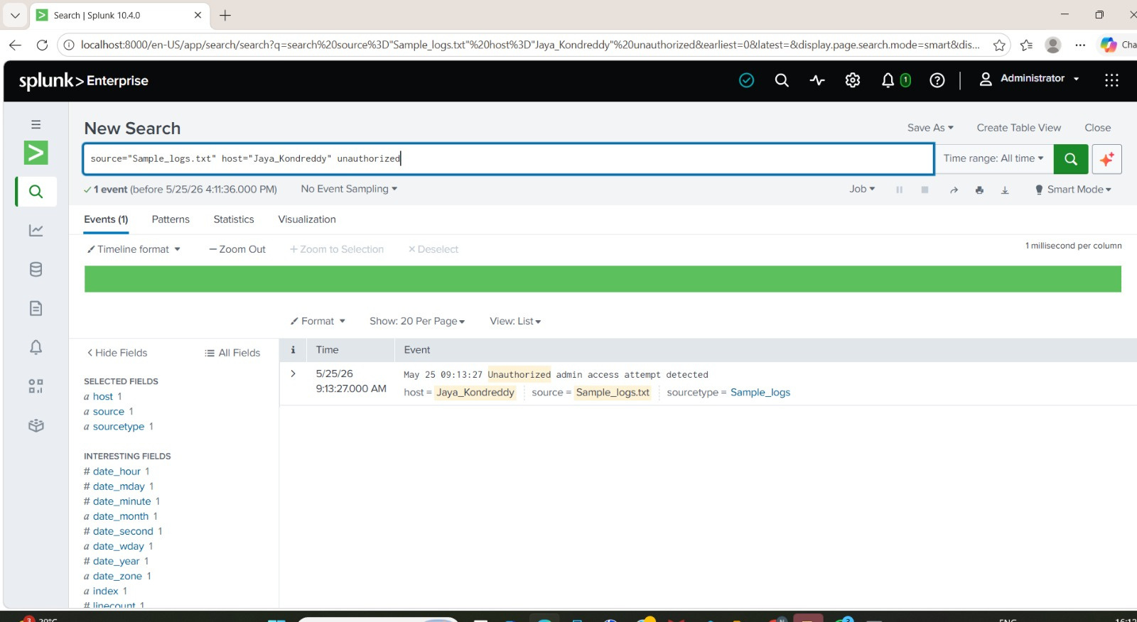
UNAUTHORIZED ACCESS ATTEMPT
• Unauthorizedadminaccess attemptidentified
• Suspicious activity requires investigation • Alert severity classified as High

Slide 8
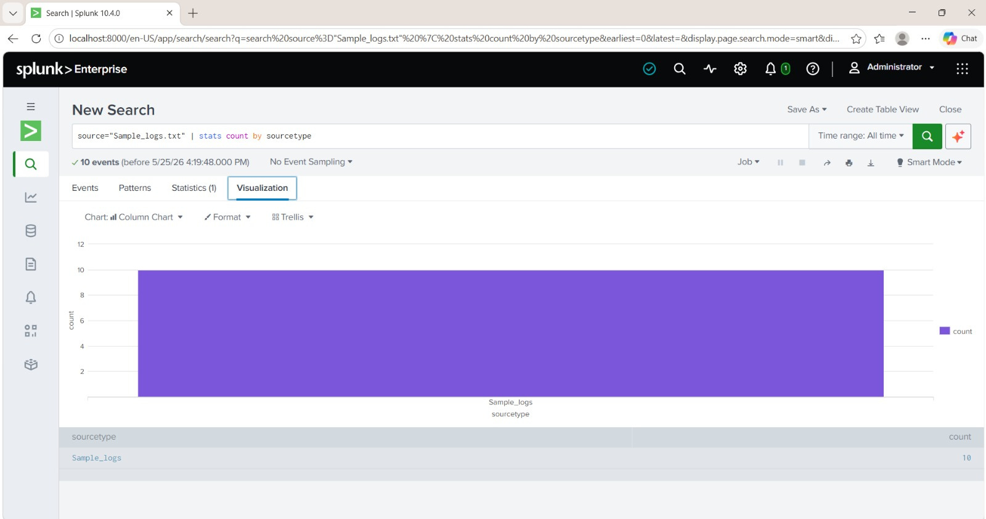
LOG VISUALIZATION
• Splunk visualization graphsweregenerated
• Charts help monitor security events effectively

Slide 9

RECOMMENDATIONS
• Usestrongauthentication
• Monitor suspicious login attempts • Restrict unauthorized access
• Perform regular log monitoring
CONCLUSION
Thisprojectprovided practical experience in SIEM monitoring,log analysis and
incident response using Splunk Enterprise.

