Slide 1




FUTURE INTERNS
API SECURITY RISK ANALYSIS REPORT
Submitted by:
Nikhitha DhanamJaya Kondreddy
College:
Sri Vasavi Engineering College
Internship:
Future Interns – Cyber Security Internship
Repository:
FUTURE_CS_03
CYBER SECURITY
TASK3_PPT

Slide 2


INTRODUCTION
• APIs are widely used for communication between applications.
• API security testing helps identify security weaknesses.
• Postman is used for API request and response analysis.
OBJECTIVE
• Test API endpoints using Postman
• Analyze request and response data
• Identify security risks in APIs
• Understand API security concepts

Slide 3
Tools Used
• Postman
• JSONPlaceholder API
• Windows Operating System
API Endpoint Testing
1. https://jsonplaceholder.typicode.com/users
2. https://jsonplaceholder.typicode.com/posts

Slide 4
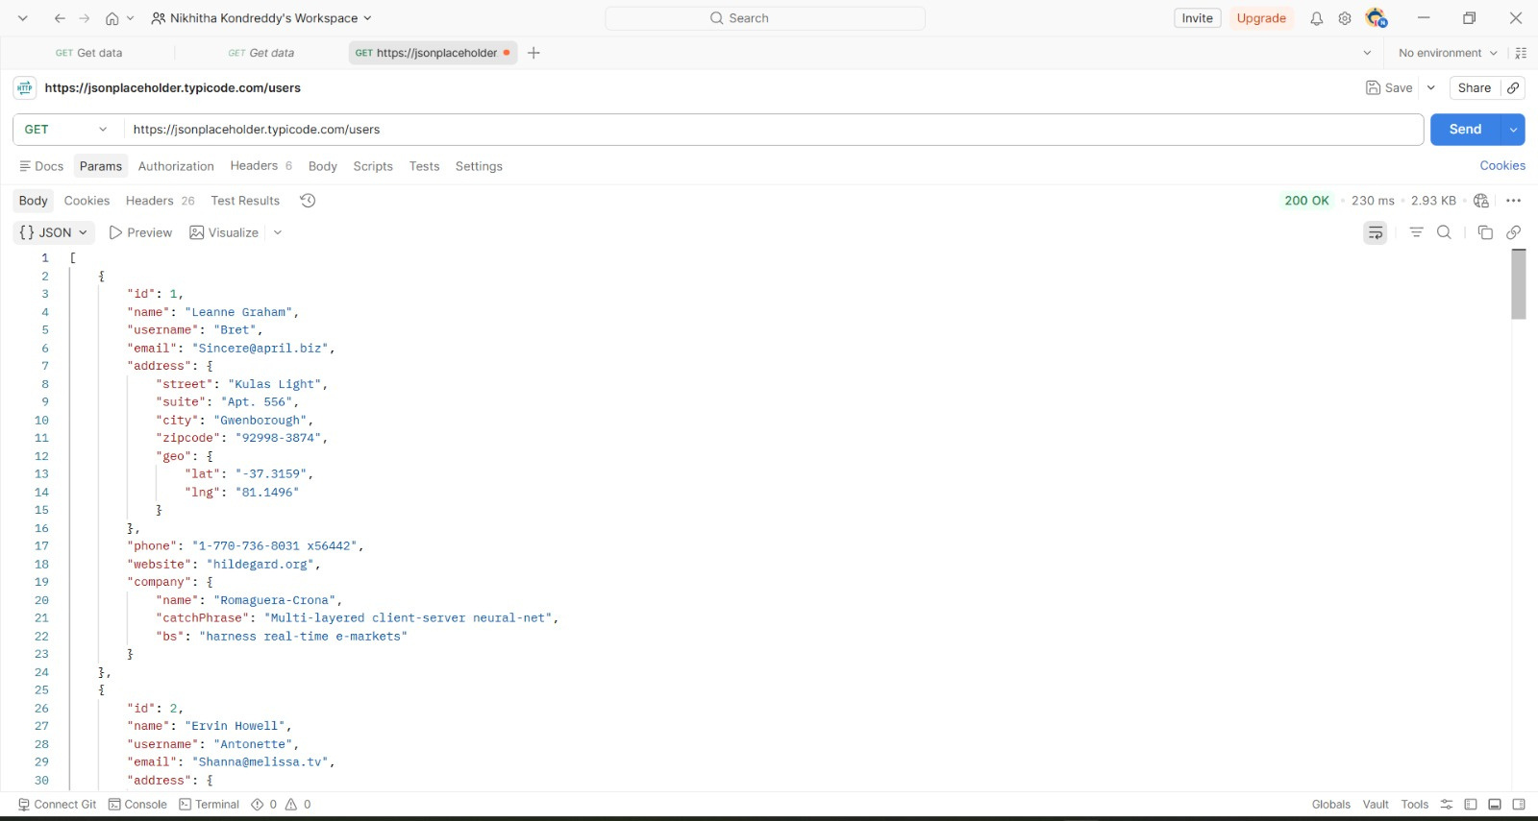
Response Body Analysis
• JSON formatted data received
• User information successfully retrieved
• API communication verified successfully

Slide 5

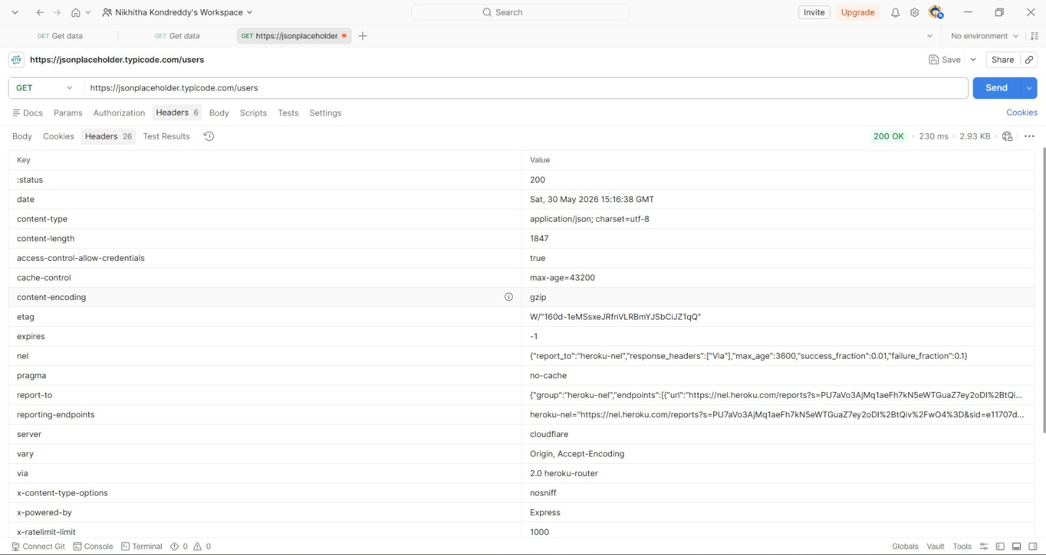
Headers & Status Code
• HTTP Status Code: 200 OK
• Response headers analyzed
• Content-Type and server information observed

Slide 6
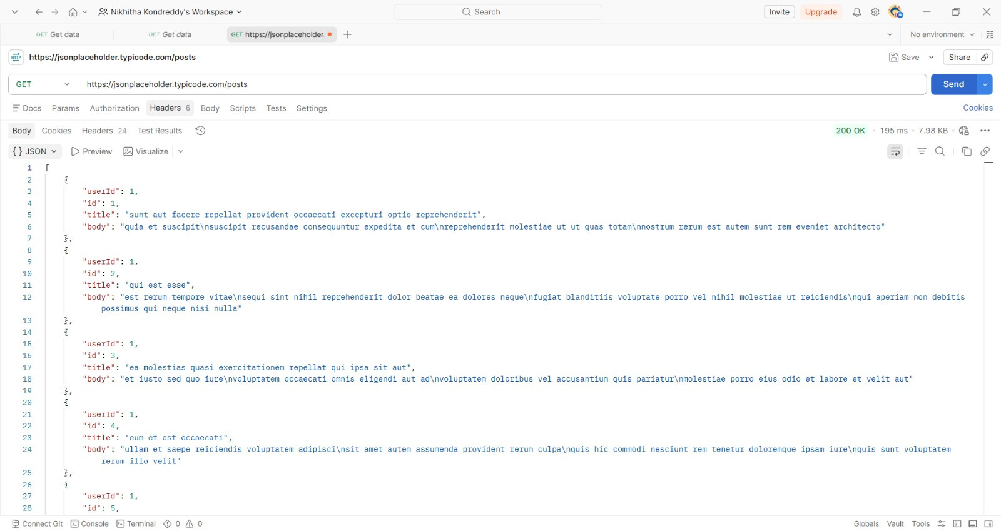
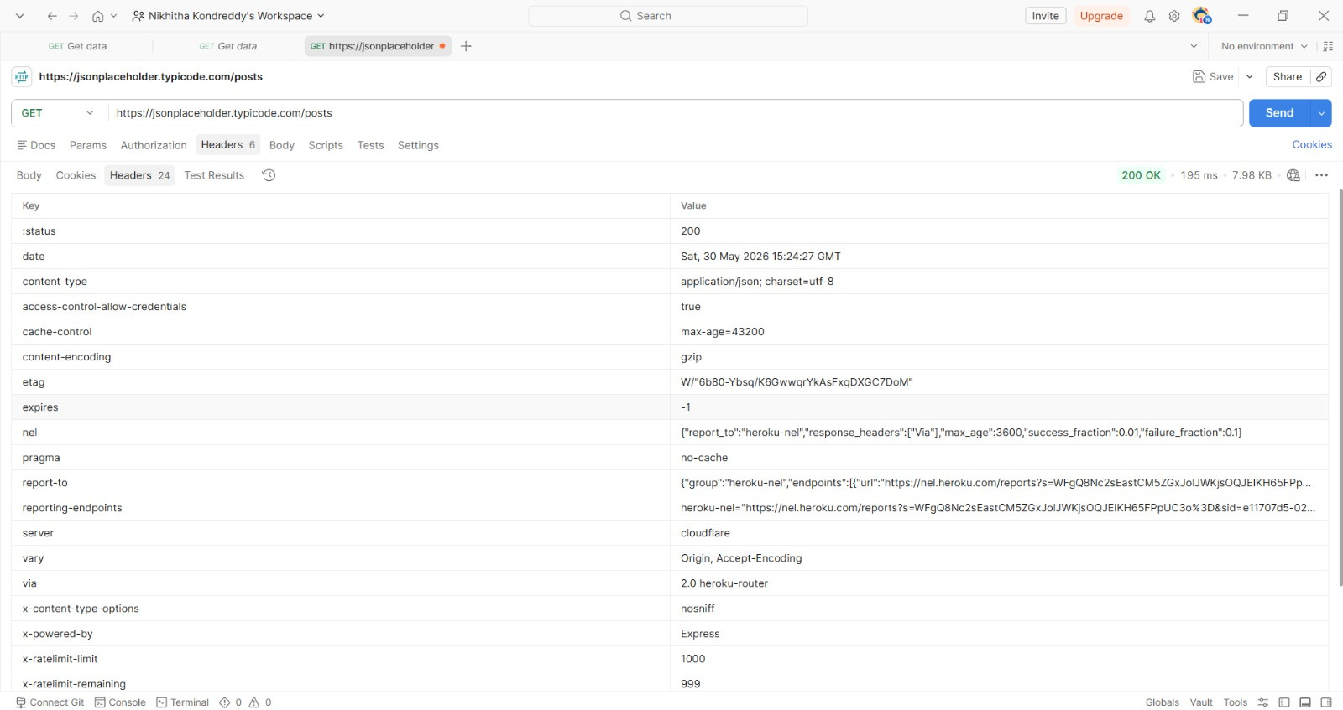

Slide 7
Security Risks Identified
• Missing Authentication
• Excessive Data Exposure
• Missing Rate Limiting
• Public API Accessibility
RECOMMENDATIONS
• Implement API authentication mechanisms
• Apply rate limiting for API requests
• Restrict unnecessary data exposure
• Use proper API security headers
• Monitor API activity regularly

Slide 8
CONCLUSION
This project provided practical exposure to API security testing and risk analysis using Postman. The analysis helped in understanding API request handling, response monitoring, and common API security risks.

