Slide 1
PROJECT TITLE:
SIH ID:1591
A solution/idea that can boost the current situation of the tourism industries including hotels, travel and others.
Team Name: Travel Tribe

Slide 2
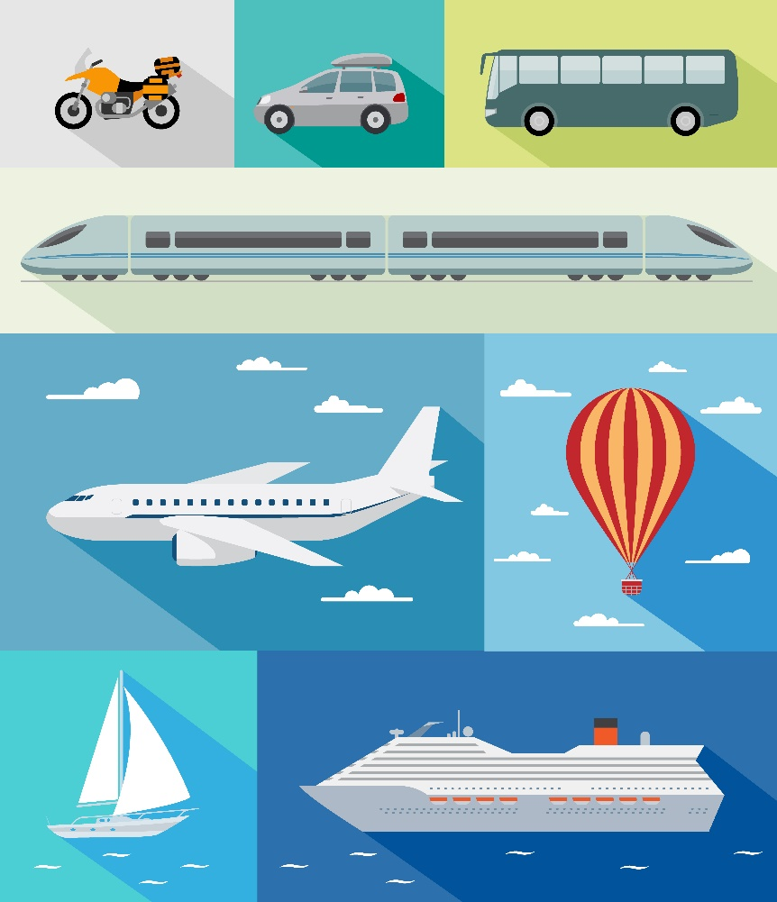
Travel and Tourism Management
Tour & Travels
Abstract
Tourism is one of the most affected industries due to global uncertainties, changing travel regulations, and evolving customer expectations. To boost the current situation of tourism, hotels, and travel agencies, a digital transformation approach is essential. This project proposes an innovative web-based solution using HTML and CSS to create an interactive and user-friendly platform that enhances tourism experiences.

Slide 3
Introduction
What is the project about?
This project is a web-based smart tourism platform designed to enhance the tourism industry, including hotels, travel agencies, and local attractions. It provides a centralized, interactive, and visually appealing website where travelers can find destination details, book accommodations, explore virtual tours, and get AI-powered recommendations. The platform is built using HTML and CSS, ensuring a user-friendly and responsive experience across all devices.
Why was this idea chosen?
The tourism industry has faced significant challenges due to travel restrictions, changing consumer preferences, and digital transformation gaps. Many small hotels, local travel agencies, and tourist attractions struggle with visibility, resulting in lower engagement and revenue. This idea was chosen to bridge the gap between tourists and service providers by offering an interactive, easy-to-navigate, and information-rich platform that helps travelers plan their trips seamlessly.
How does it help solve a real-world problem?
The project addresses several key issues in the tourism industry:
Lack of Digital Presence – Many local hotels and travel services lack a well-structured online presence, making it hard for tourists to discover them. This platform provides a centralized hub to showcase their services.
Inefficient Travel Planning – Tourists often struggle with scattered information across multiple websites. This solution integrates travel details, hotels, and activities in one place.
Low Customer Engagement – A visually appealing and interactive platform with reviews, ratings, and virtual tours encourages travelers to make informed decisions.
Post-Pandemic Recovery – By boosting digital visibility and simplifying bookings, the project helps the tourism industry recover faster and attract more visitors.
2
Copyright © Texas Education Agency, 2015. All rights reserved.

Slide 4
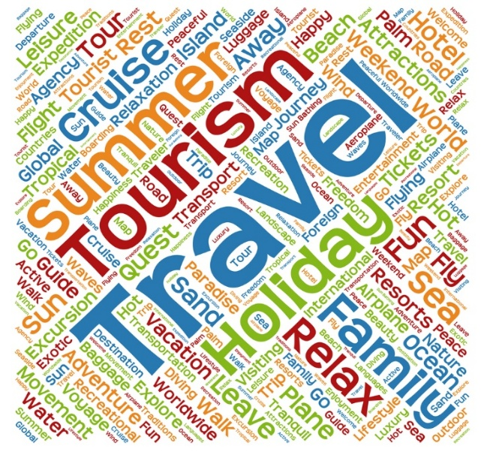
Problem Statement & Solution
Define the Problem
The tourism industry faces challenges such as low digital visibility, fragmented travel information, inefficient booking systems, and lack of engaging user experiences. Small hotels, local travel agencies, and tourist attractions struggle to reach potential visitors, leading to reduced tourism and revenue loss.
Existing Solutions (if any)
Online Travel Agencies (OTAs) like Booking.com & Expedia – Focus on bookings but lack localized travel insights.
Government Tourism Websites – Provide information but often lack interactive features and user engagement.
Social Media & Travel Blogs – Good for recommendations but not centralized or structured for bookings.
How Your Project is Different/Better
All-in-One Travel Hub – Combines destination guides, hotel listings, virtual tours, and AI-based recommendations in one platform.
Built for Local Businesses – Empowers small hotels, tour guides, and local attractions with an easy-to-use digital presence.
Interactive & User-Friendly – Uses HTML, CSS, and modern UI elements for a seamless, visually engaging experience.
SEO & Mobile-Optimized – Ensures better reach and accessibility for travelers on all devices.
3
Copyright © Texas Education Agency, 2015. All rights reserved.
Notes:
The travel and tourism industry is divided into two parts:
Travel – involves businesses that physically move people from one place to another
Tourism – involves businesses that organize and promote travel and vacations

Slide 5
Objectives
Objectives
Key Goals of the Project
Develop a responsive and interactive tourism website using HTML & CSS.
Provide centralized travel information, hotel listings, and virtual tours.
Enhance visibility for small hotels, travel agencies, and local attractions.
Offer personalized recommendations based on user preferences.
Ensure mobile-friendly, fast-loading, and SEO-optimized design.
.
User Benefits
Easy travel planning with a one-stop platform.
Seamless booking & real-time travel updates.
Engaging UI with virtual tours & user reviews.
Supports local tourism businesses and boosts the economy
4
Copyright © Texas Education Agency, 2015. All rights reserved.
Notes:
Travel businesses include:
Airlines - a company that owns and operates many airplanes which are used for carrying passengers and goods to different places.
Car rentals - automobiles that rented for short periods of time, generally ranging from a few hours to a few weeks.
Cruise lines - a passenger ship used for pleasure voyages, where the voyage itself and the ship's amenities are a part of the experience, as well as the different destinations along the way.
Taxi and ferry services:
Taxi - a car that carries passengers to a place for an amount of money that is based on the distance traveled.
Ferry - to carry or move (someone or something) on a vehicle (such as a boat or a car) usually for a short distance between two places.
Train and bus services:
Train - a connected line of railroad cars with or without a locomotive.
Bus- a large motor vehicle carrying passengers by road, especially one serving the public on a fixed route and for a fare.

Slide 6
Technologies Used
1. HTML (HyperText Markup Language)
Structures the website with semantic elements (<header>, <nav>, <section>, <footer>).
Used to create interactive travel pages, hotel listings, and booking sections.
Ensures accessibility and SEO optimization for better visibility.
2. CSS (Cascading Style Sheets)
Enhances the website’s visual appeal and responsiveness.
Utilizes Flexbox & Grid for a structured, mobile-friendly layout.
Includes animations, hover effects, and parallax scrolling for an engaging UI.
Uses media queries to ensure seamless performance on all devices.
5
Copyright © Texas Education Agency, 2015. All rights reserved.
Notes:
Tourism businesses include:
Convention and visitors bureau – a nonprofit organization that promotes tourism and provides services to travelers.
Cruise companies – a company that owns and operates cruise ships for pleasure voyages.
Meeting and convention planners – coordinate all aspects of professional meetings and events.
Tour operators - a person whose job duties include organizing tours, whether they be for holidays or historic places.
Travel agencies - businesses that help to make arrangements for people who want to travel.
Travel and tourism offices - an office where visitors to a place can get information about what to see and do, especially while on holiday, or an official organization that runs these offices.

Slide 7

Methodology
Development Process
Requirement Gathering
Identified key features such as travel information, hotel listings, virtual tours, and booking systems.
Design Phase
Created wireframes and mockups using HTML & CSS for responsive layouts.
Implementation
Developed the website using HTML5 for structure and CSS3 for styling, ensuring mobile optimization.
Testing & Deployment
Conducted cross-browser testing, user experience evaluations, and deployed the site for user feedback.
Agile Methodology (if applicable)
Sprint 1: Basic website structure with navigation and static content.
Sprint 2: Integration of dynamic content (hotel listings, travel information).
Sprint 3: Implementation of responsive design and user interface enhancements.
Sprint 4: Final testing, bug fixes, and deployment.
6
Notes:
Employees from both the travel and tourism industries must interact so people on business or vacation have successful trips.

Slide 8
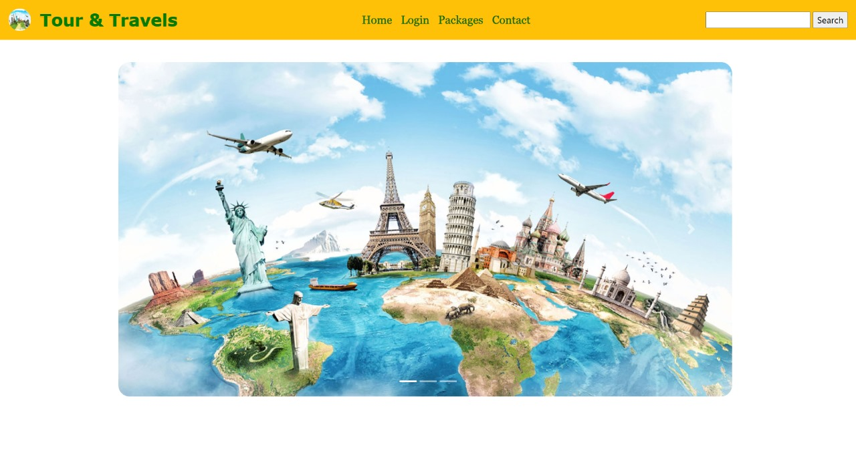
Home page
7
Copyright © Texas Education Agency, 2015. All rights reserved.
Notes:
Each travel business is unique and may perform most of the functions in the departments within a travel and tourism business.
In a small business, one person may perform several of these functions.
In a large business, each function will have a separate department with many people for each function.

Slide 9
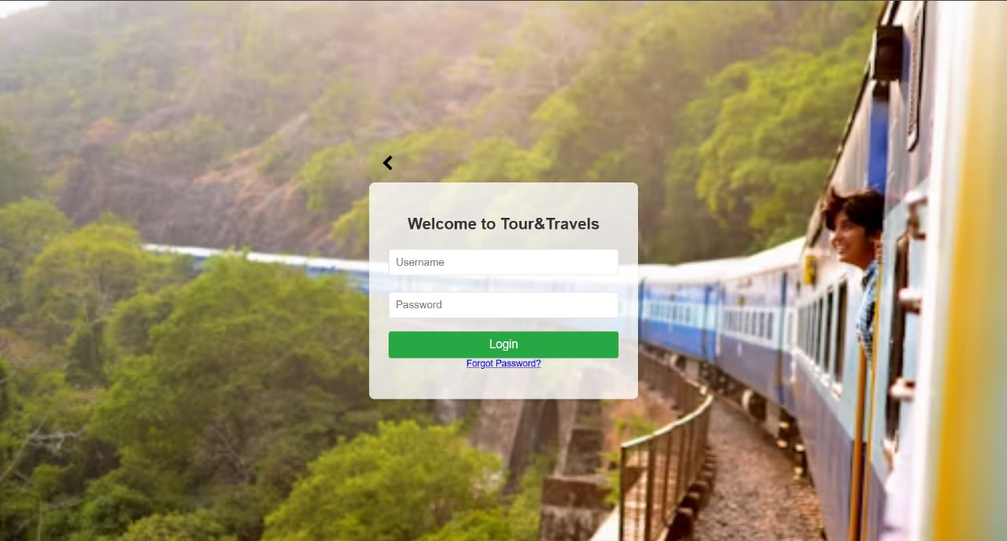
login PAGE
8
Copyright © Texas Education Agency, 2015. All rights reserved.
Notes:
Departments and their functions include:
Accounting - keeps track of all the money that flows into and out of the business.
Customer service or guest services - handles all activities involved with complaints, concierge services and customer inquiries.
Engineering - makes sure that all the equipment, plumbing, electricity and building facilities are working properly.
Human resources - manages all employee issues including benefits, firing and hiring, pay and training.
Management – oversees all functions of the business including making sure the business is operating profitably.
Marketing and sales – promotes the business, develops marketing plans and sells the products and services.
Purchasing and receiving – keeps track of purchases and inventory for the business.
Reservations and bookings - handles all activities involved with customers reserving rooms, seats, tours and more.
Safety – secures property for the safety of the guests and employees and oversees emergency procedures.
Technology – maintains computer software and data storage; may also oversee business website.

Slide 10
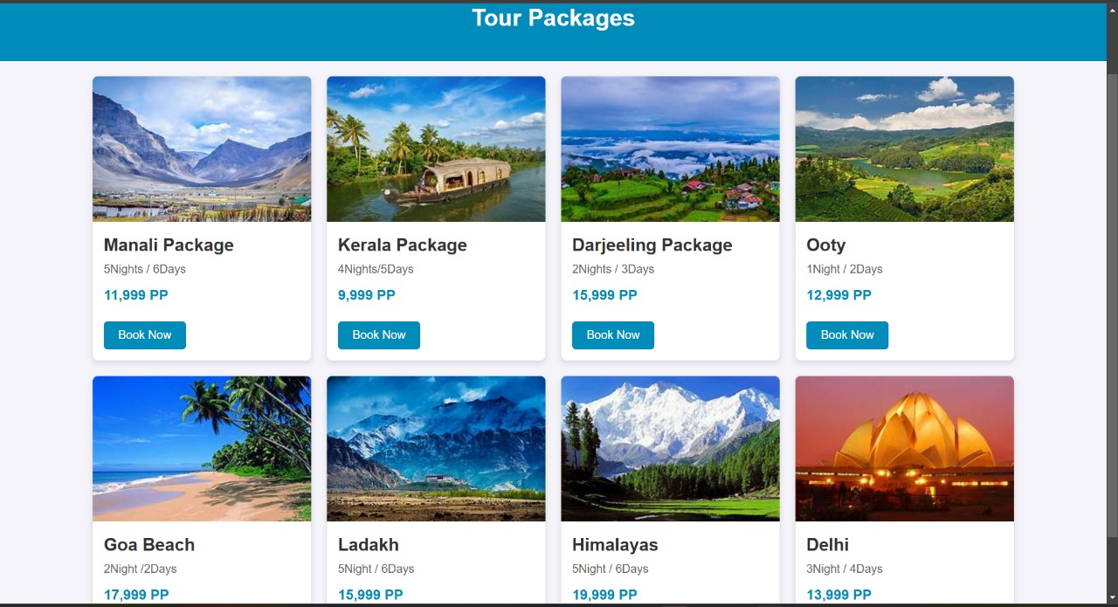
Packages page
9
Copyright © Texas Education Agency, 2015. All rights reserved.
Notes:
All of the business departments must work together.
Each of these main departments are necessary for the day-to-day operations for businesses.
Communication between departments is critical.
Many of the departments are linked through industry related software.
Technology departments in today’s business is often the connecting media. The company network and intercompany communication (email, instant messaging) is critical in today’s environment.
These are just a few examples of how departments work together. For businesses to succeed in today’s environment, communication and departmental interaction must work together like well-designed interlocking gears.

Slide 11
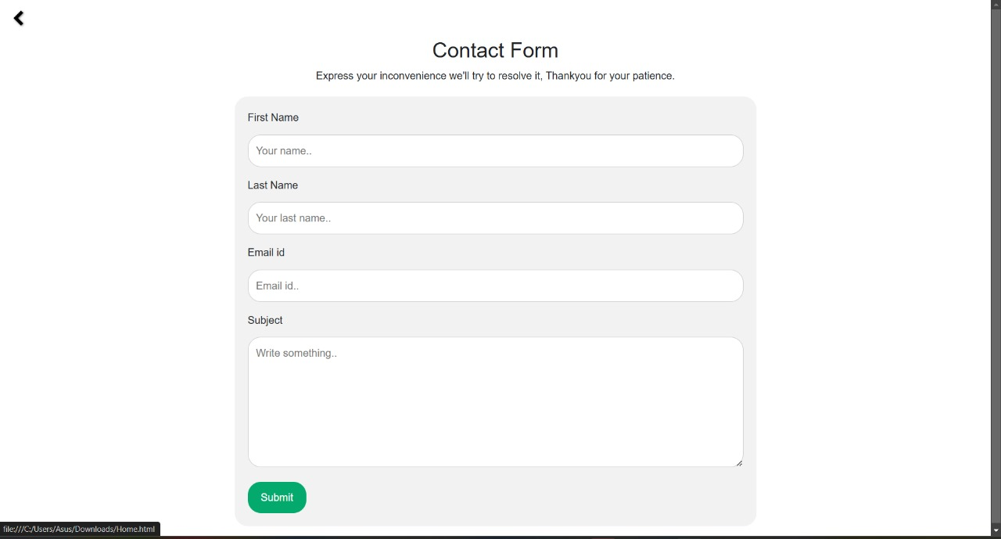
Contact page
(image from video)
10
Copyright © Texas Education Agency, 2015. All rights reserved.
Notes:
Click on the hyperlink to view video:
Travel Effect: The Movement
It's a great impact the travel has on our lives, on our organizations and our way on our way of life. Whether it comes as business productivity, family relationships, education, memories, long-term, this is a huge opportunity well beyond just the value of the individual trip.
https://youtu.be/A4BA2L44plk

