Slide 1

ADVANCED ALGORITHMS (CS354) PROJECT Under Prof. Manish Kumar Bajpai

Slide 2
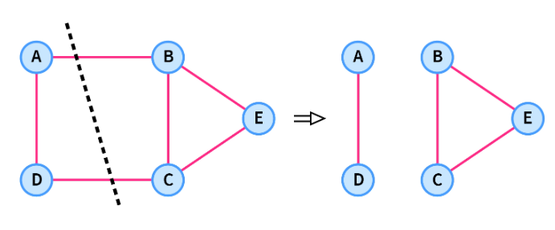
THE MINIMUM CUT PROBLEM
(Karger-Stein Algorithm)
https://www.scaler.com/topics/data-structures/maximum-flow-and-minimum-cut/

Slide 3
PROBLEM STATEMENT
Our project aims to implement the Karger-Stein algorithm for finding the minimum cut in a graph.
A minimum cut is a set of edges of minimum weight whose removal disconnects a given graph.
Given a graph with n vertices and m (possibly weighted) edges, we wish to partition the vertices into two nonempty sets to minimize the number or total weight of edges crossing between them.

Slide 4
PROBLEM STATEMENT (Contd.)
The problem has two variants:
In the s-t min-cut problem, we require that the two specified vertices s and t be on opposite sides of the cut.
In what we call the min-cut problem (Global min-cut problem) there is no such restriction.
The minimum k-cut problem is NP-complete.

Slide 5
PREVIOUS SOLUTIONS
Minimum cut algorithms historically applied duality with maximum flows and thus had the same running time as maximum flow algorithms.
Recently, approaches that find minimum cuts without computing any maximum flows have been developed.

Slide 6
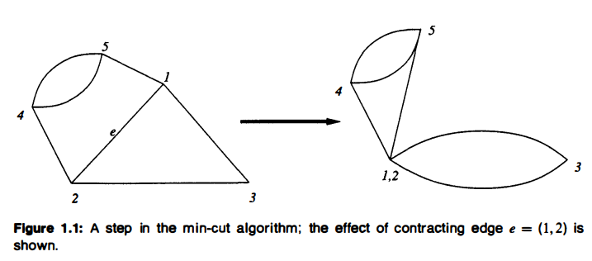
KARGER’S ALGORITHM
Karger developed the Contraction Algorithm, which uses uniform random selection to choose an edge to contract.
In graph G, contraction of edge e with endpoints u and v is the replacement of u and v with a single vertex whose incident edges are the edges other than e that were incident to u or v.
(Figure taken from Randomized ·algorithms / Rajeev Motwani, Prabhakar Raghavan.)

Slide 7
KARGER’S ALGORITHM (Contd.)
procedure MinCut (G = (V, E))
while | V | > 2
choose e ∈ E uniformly and random
G→G/e
return the only cut in G

Slide 8
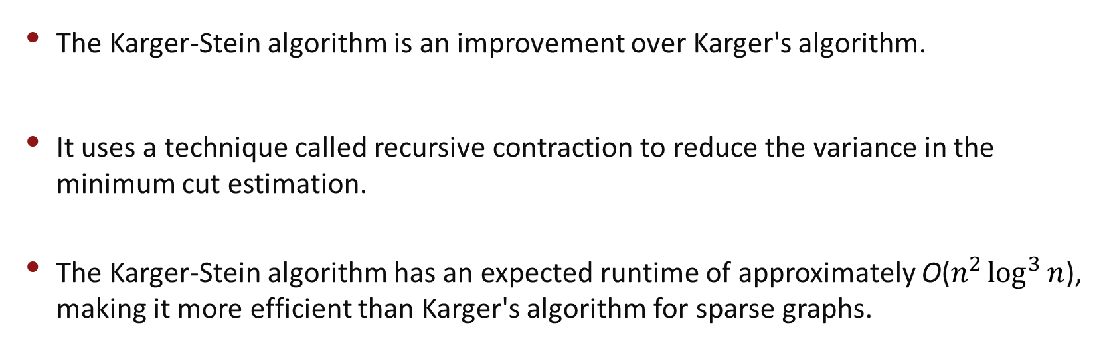
KARGER-STEIN APPROACH
The Karger-Stein algorithm is an improvement over Karger's algorithm.
It uses a technique called recursive contraction to reduce the variance in the minimum cut estimation.
The Karger-Stein algorithm has an expected runtime of approximately O($n^{2}\log^{3}{n}$), making it more efficient than Karger's algorithm for sparse graphs.

Slide 9
RECURSIVE CONTRACTION
procedure FastMinCut (G)
if |V| < 6
MinCut(G,2)
Else
t = 1 + |V|/sqrt(2)
G1 = MinCut(G,t)
G2 = MinCut(G,t)
return min (FastMinCut(G1), FastMinCut(G2))
The running time of FastMinCut(G) is O($η^{2}\log{n}$), where n = |V(G)|.

Slide 10
KARGER-STEIN ALGORITHM
def FastMinCut (graph):
if len (graph) < 6:
return MinCut (graph, 2)
else :
t = 1 + int (len (graph) / math.sqrt(2))
graph-1 = MinCut (graph, t) graph_2 = MinCut (graph, t)
if len (graph_1) > len (graph_2):
return FastMin Cut (graph_2)
else: return Fast Min Cut (graph_1)
# Running times
count = int ( math.log (len ( graph ))) * int( math.log (len ( graph )))
while i < count:
graph1 = copy. deepcopy (graph)
g = FastMin Cut (graph1)
i += 1

Slide 11
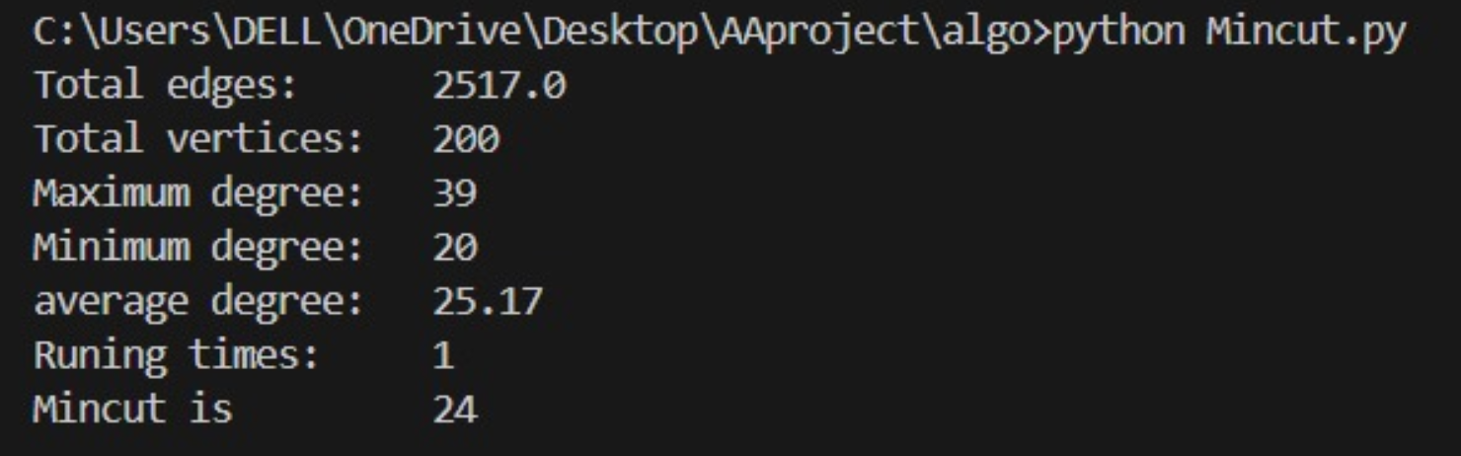
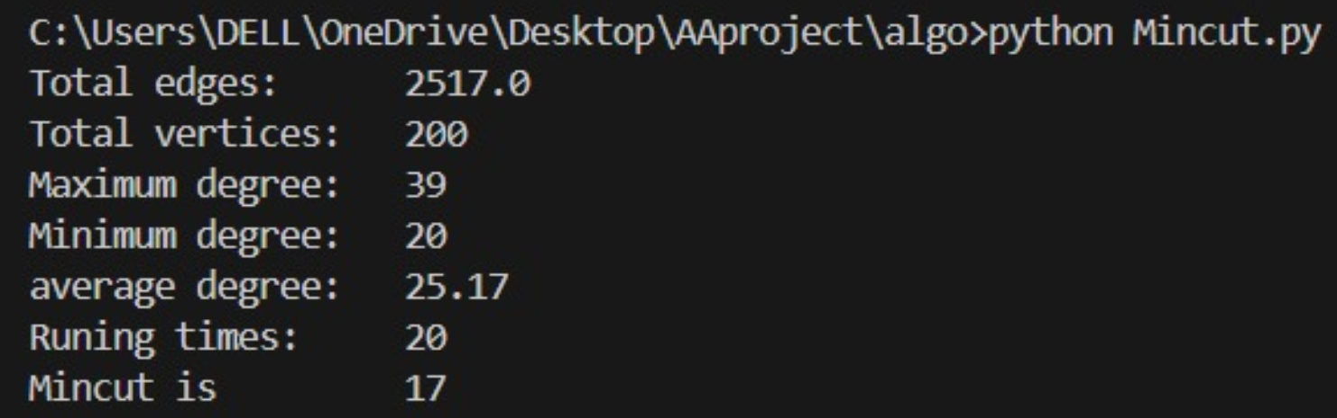
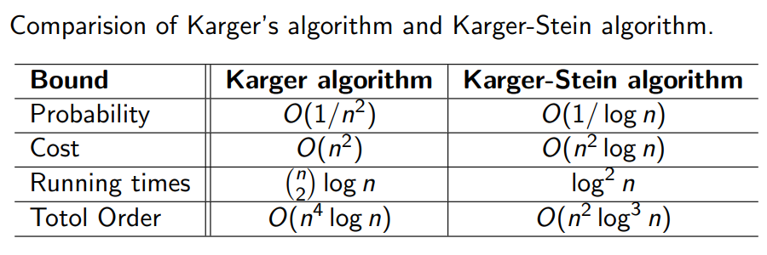
RESULTS OBTAINED ON IMPLEMENTATION
KARGER’S ALGORITHM
KARGER-STEIN ALGORITHM

Slide 12
LIMITATIONS AND IMPROVEMENTS
Like Karger's algorithm, the Karger-Stein algorithm provides an approximate solution to the minimum cut problem. While it reduces variance and improves accuracy compared to Karger's algorithm, it is not guaranteed to find the exact minimum cut in all cases.
Like many randomized algorithms, the Karger-Stein algorithm may converge to a local minimum
While the Karger-Stein algorithm quite efficient compared to Karger's algorithm, further reduction in running times can be explored. This would involve optimizing the recursive contraction process and possibly exploring parallel algorithms.

Slide 13
REFERENCES
https://people.csail.mit.edu/karger/Papers/fastcut.pdf
https://rajsain.files.wordpress.com/2013/11/randomized-algorithms-motwani-and-raghavan.pdf
https://dl.ebooksworld.ir/books/Introduction.to.Algorithms.4th.Leiserson.Stein.Rivest.Cormen.MIT.Press.9780262046305.EBooksWorld.ir.pdf

Slide 14
THANK YOU
TEAM MEMBERS :
21CSB0B34 M NIKHITHA REDDY
21CSB0B45 R NAGA SAI CHARITHA
21CSB0B59 TATTUKOLLA CHARISHMA

