Slide 1

OLYMPICS DBMS PROJECT
Team Members :
Nikhitha Reddy(21CSB0B34)
Priyanka Kota(21CSB0B44)
Notes:
Line spacing + Page numbers

Slide 2
Contents
Problem Statement
ER Diagram
Relational Schema
Regarding Normalization
Relations outputs

Slide 3

PROBLEM STATEMENT
01
The Olympic games is a multi-sport event, considered as one of the largest and most prestigious international events. So, there is a need to design a modern database management system to store and manage information related to athletes, countries, events, results , schedules and more....
This system helps support the planning, execution, and evaluation of the Olympic games, ensuring data is accurate, up-to-date, and readily available.

Slide 4
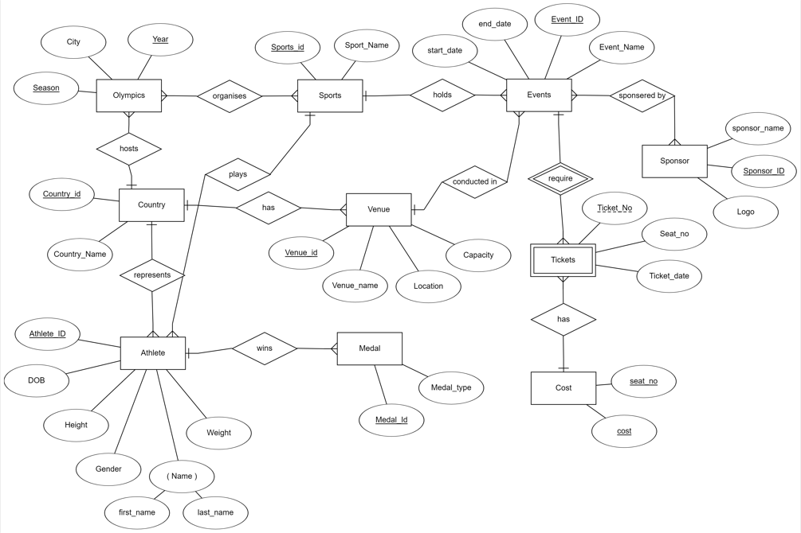
ER DIAGRAM
02

Slide 5
ASSUMPTIONS
Olympics can organize many sports and one sport is played in many Olympic years.
One sport can have many events but event is related to one sport only.
One event can be sponsored by many sponsors . At the same time a sponsor can sponsor to many events.
Only one country can host the Olympics each time.
A country can have many venues.
In one venue many events can occur.
Many athletes can participate in Olympics from one country.
An athlete can win more than one medal.
Without the event there are no tickets.
A group of seats have same cost and for every event and every venue this cost is same.

Slide 6
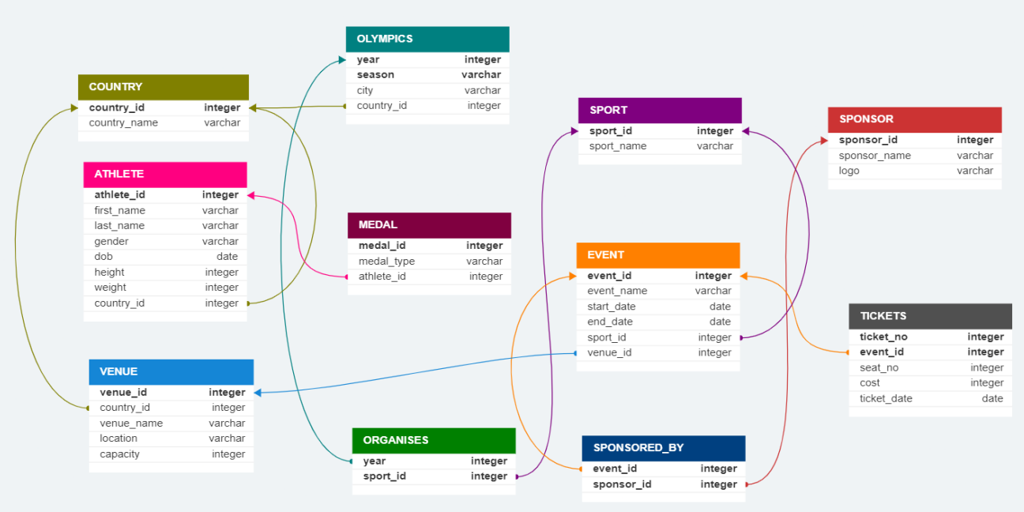
RELATIONAL SCHEMA

Slide 7
Normalization
A relation is said to be in :-
1NF : If it does not contain multivalued attributes and contains primary key for identification.
2NF : 1NF + No partial dependencies
3NF : 2NF + No transitive dependencies
BCNF : 3NF+ Super keys in LHS of all Functional Dependencies

Slide 8



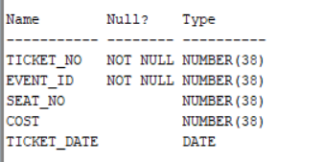
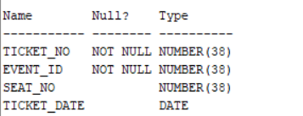
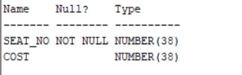


Normalizing the tables
The Ticket relation is having transitive dependency of seat_no -> cost.
So to eliminate this , we’re decomposing it into 2 tables(tickets and cost) :-

Slide 9
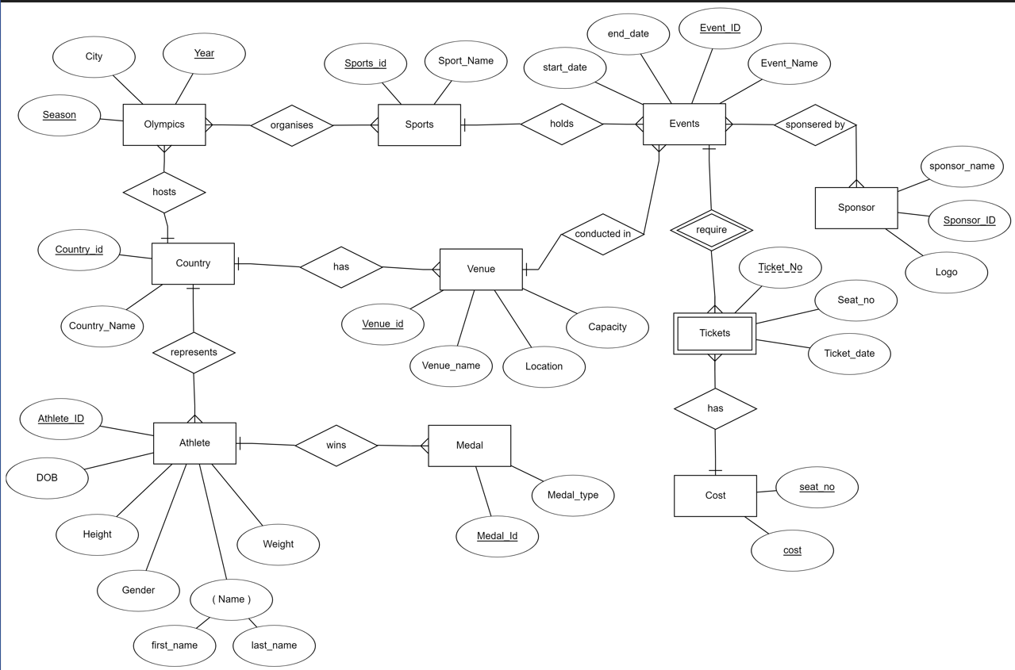
ER DIAGRAM AFTER NORMALIZATION

Slide 10
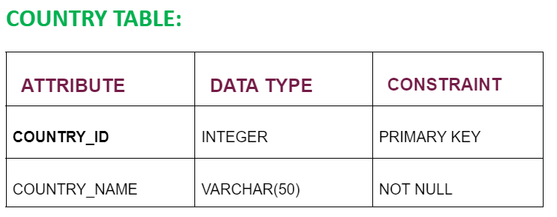
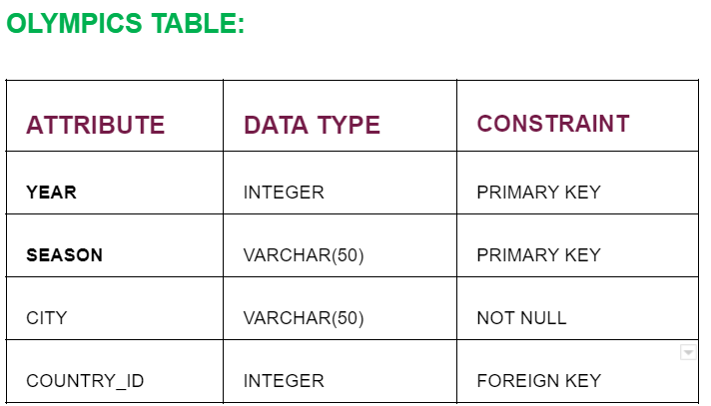

Slide 11
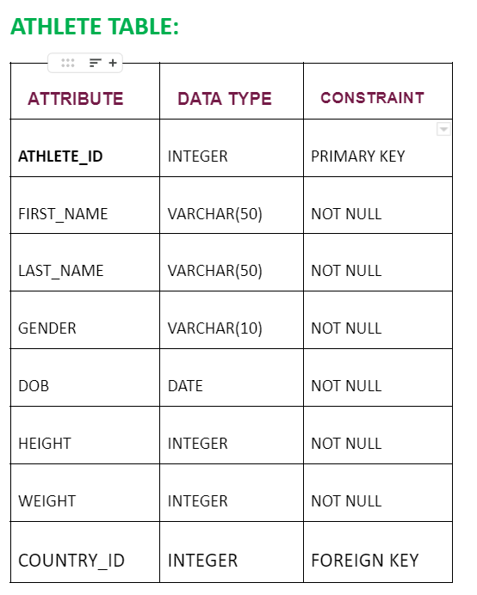
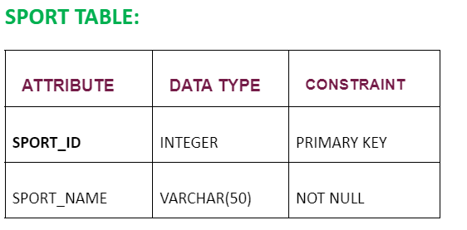
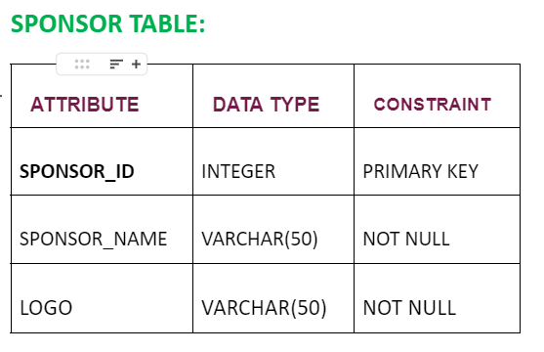

Slide 12
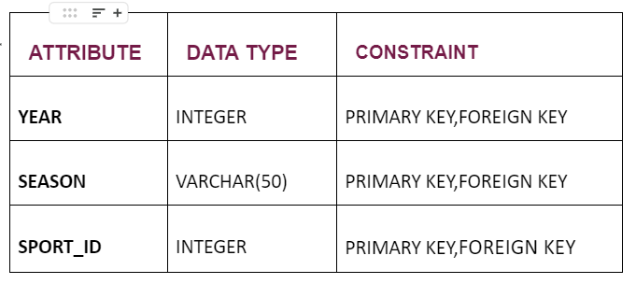
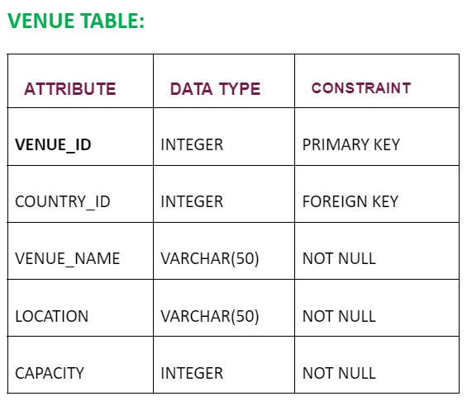
ORGANISES TABLE:

Slide 13
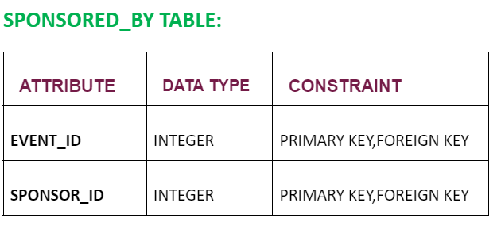
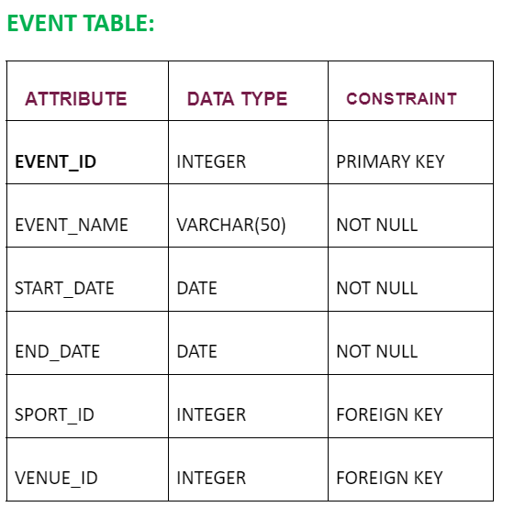
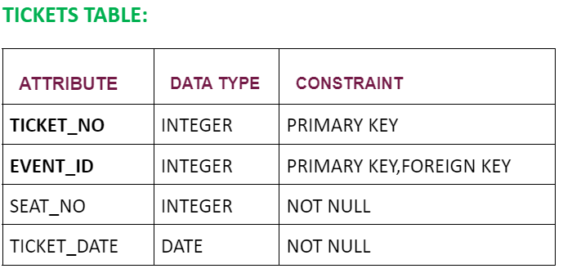

Slide 14
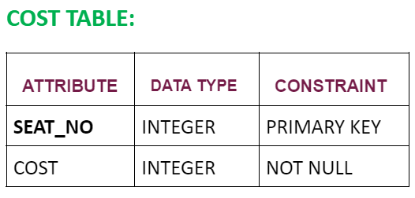
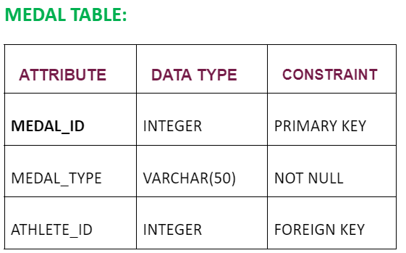

Slide 15


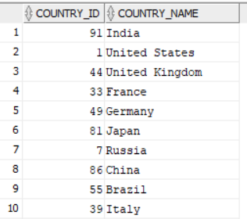

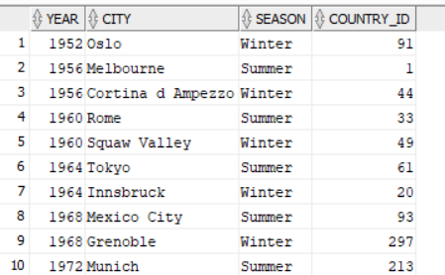

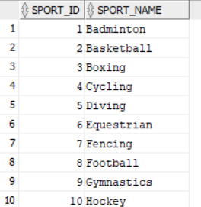
04

Slide 16

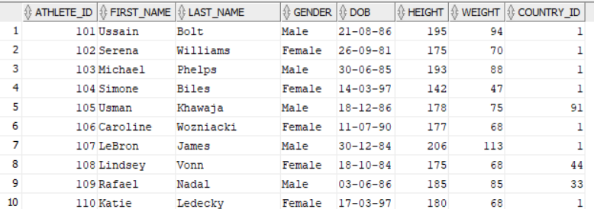

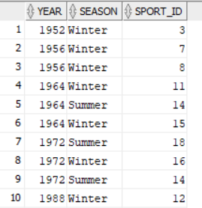
Jun

Slide 17

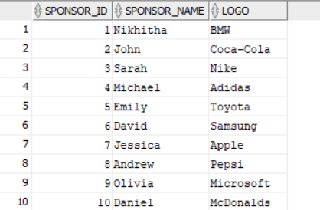

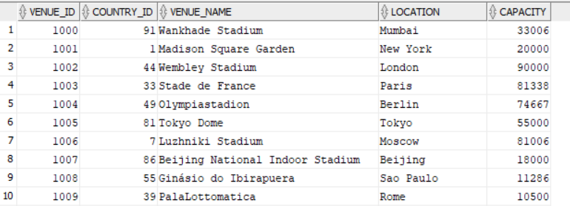

Slide 18

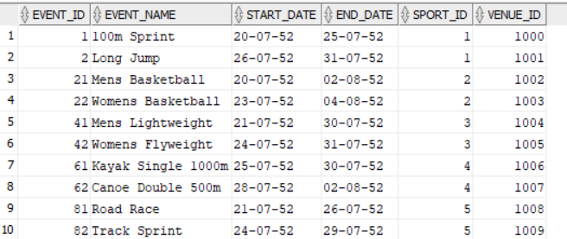

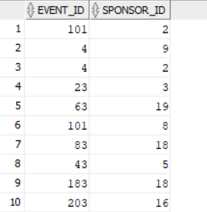

Slide 19

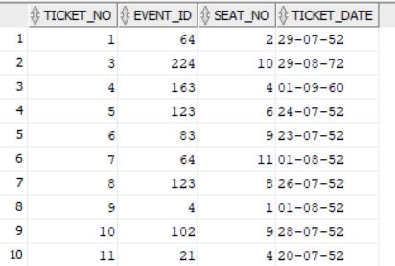

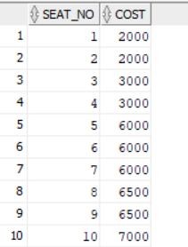

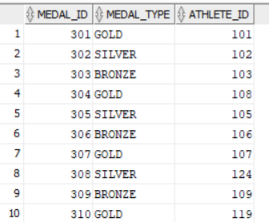

Slide 20

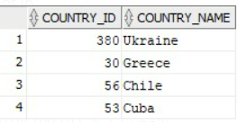
1.Countries which does not have venue to conduct Olympics.
select * from country where country_id not in(select country_id from venue group by country_id);

Slide 21
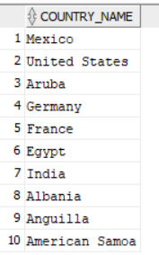
2.Country’s which have hosted most Olympic Games.
select country_name from country where country_id in(select country_id
from olympics
group by country_id
having count(*) in (select max(count(*)) from olympics group by country_id));

Slide 22

05

