Slide 1
Event Management
Team Name : SparkSquad
Team Members
B.Sai Durga Rao (22A51A1205)
B.Nikhitha (22A51A1210)
S.Praneetha (22A51A1255)
N.Pallavi (22A51A1243)

Slide 2

Problem Statement
Managing large-scale events involves complex tasks like coordinating vendors, communicating with team members, managing budgets, and ensuring a great attendee experience. Event organizers face challenges like last-minute changes and unexpected issues. An adaptable event management solution is essential to streamline these processes, enhance collaboration, and ensure event success from planning to execution.

Slide 3

Solution
Use centralized event management software to handle planning, scheduling, and communication. Automate emails and reminders, track budgets, and manage risks. Engage attendees with interactive tools and analytics. Incorporate eco-friendly practices and train staff on new technologies for a smooth event execution.

Slide 4

Approach
Managing large-scale events involves coordinating vendors, team communication, budget management, and delivering a great attendee experience. Event organizers face last-minute changes and unexpected issues. An adaptable event management solution streamlines processes, enhances collaboration, and ensures event success.

Slide 5

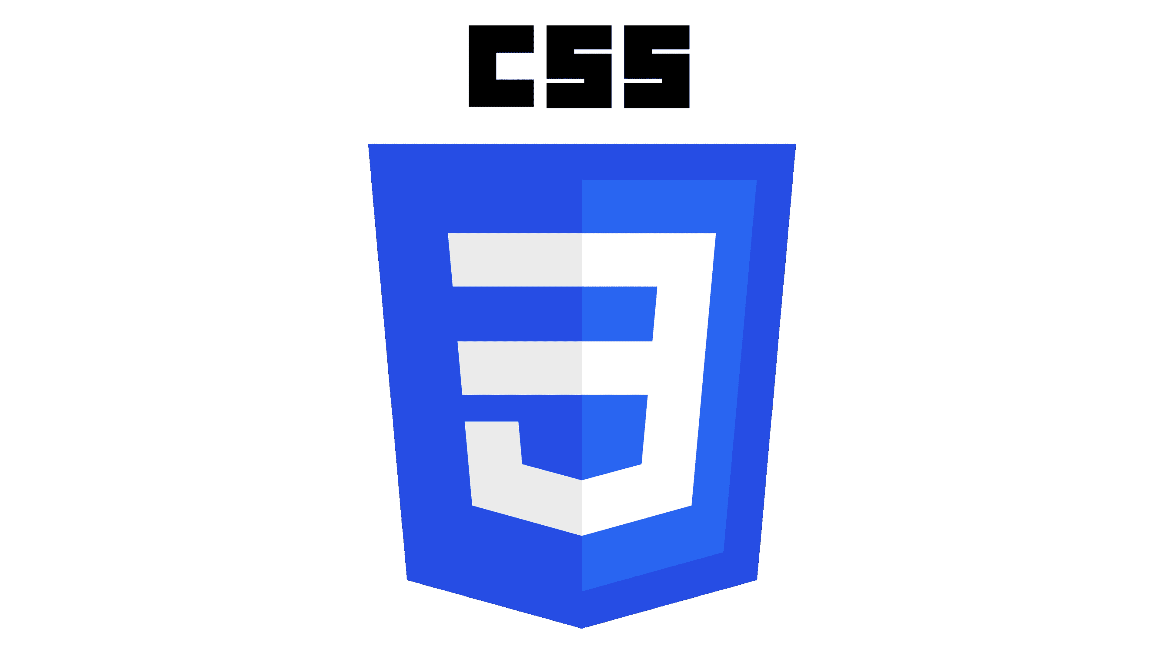

Technologies Used
HTML provides the structure for the webpage, allowing you to define elements such as headings, paragraphs, forms, and links.
CSS controls the presentation of HTML elements, enabling you to style text, images, buttons, and other elements. It ensures your website looks attractive and is consistent with your brand’s identity.
JavaScript brings interactivity to the website. It allows users to interact with elements such as forms, buttons, and navigation menus dynamically.

Slide 6
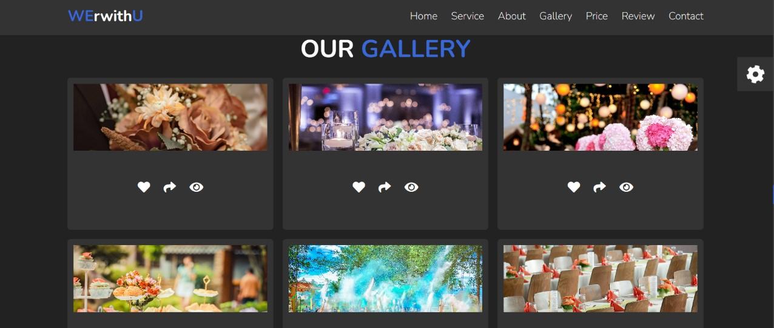
Timeline 1: evening (0-8 Hours)
Plan: Define website goals and key features.
Setup: customize a template.
Design: Create wireframes and basic layout.
Content: Write main page content and gather images.
Timeline 2: morning (9-16 Hours)
Develop: Build main pages and set up navigation.
Features: Add event listings, calendars, and forms.
Style: Fine-tune CSS and ensure responsiveness.
Timeline 3: Afternoon (17-24 Hours)
Test: Check the website on various devices and browsers.
Adjust: Fix any issues and make final tweaks.
Launch: Publish the website and share it.

