Slide 1
Securing Data hiding in images using steganography
CAPSTONE PROJECT
Presented By:
Student Name : Nikhitha Konnikkara Chandran
College Name & Department : Rajagiri School of Engineering and Technology, Kochi , Kerala – Computer Science Department

Slide 2
OUTLINE
Problem Statement
Technology used
Wow factor
End users
Result
Conclusion
Git-hub Link
Future scope

Slide 3
Problem Statement
In today's digital era, securing sensitive information is crucial. Traditional encryption methods can attract attention, making data vulnerable to attacks. This project implements image steganography using Python and OpenCV to hide secret messages within images, ensuring covert communication. The encrypted message can only be retrieved with a password, enhancing security and confidentiality.
The objective is to provide a covert and efficient means of secure communication while preserving the integrity of the image.

Slide 4
Technology used
Programming Language: Python 3.13
Libraries:
OpenCV (cv2) – For image processing
OS – For file handling and system operations
Platform: Works on Windows (used here)(with Python installed)
IDE/Execution: Python 3.13 IDE (here) and Command Line Terminal

Slide 5
Wow factors
Simple Yet Effective Steganography – Uses pixel manipulation to embed messages within an
image without noticeable distortion.
Password-Protected Decryption – Ensures that only authorized users can retrieve the
hidden message, adding a layer of security.
Lightweight & Fast – Uses OpenCV for efficient image processing, making encryption
and decryption quick and seamless.
Preserves Image Integrity – The modified image remains visually unchanged, making
the presence of hidden data undetectable.
Cross-Platform Compatibility – Can be run on Windows, Linux, and macOS with Python installed.
Customizable & Extendable – Can be improved with stronger encryption techniques, different
embedding algorithms, or even a GUI for user-friendliness.

Slide 6
End users
Cybersecurity Enthusiasts – Individuals interested in learning and experimenting
with steganography techniques.
Researchers & Students – Those studying cryptography, digital forensics, or
secure communication methods.
Military & Defense Organizations – For secure and covert communication during
critical operations.

Slide 7
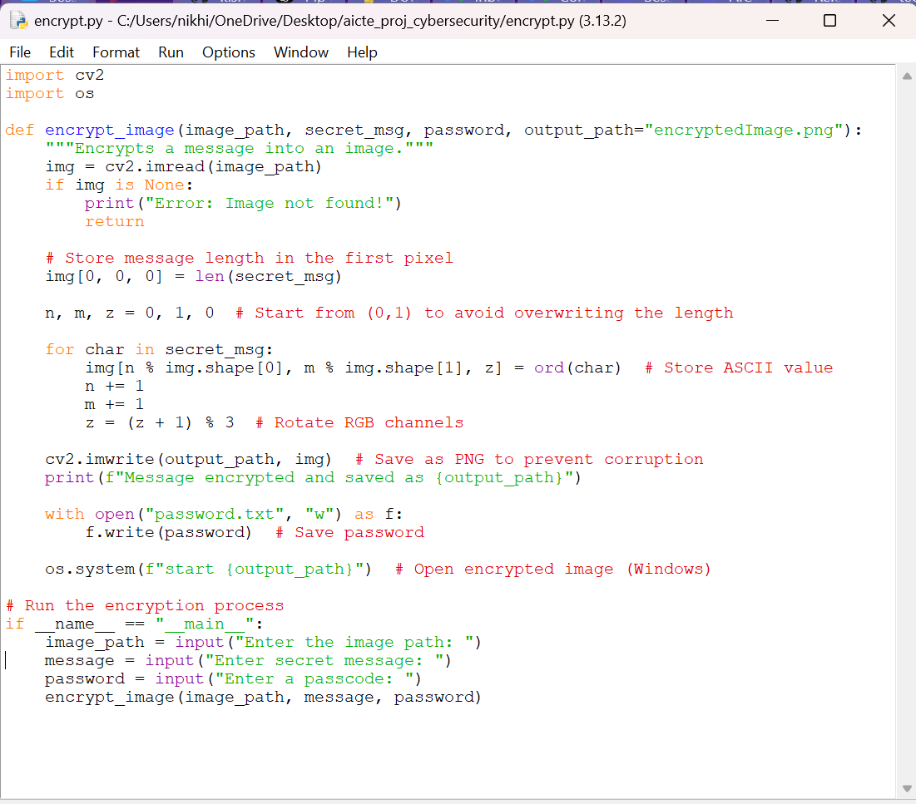
Results
encrypt.py →

Slide 8
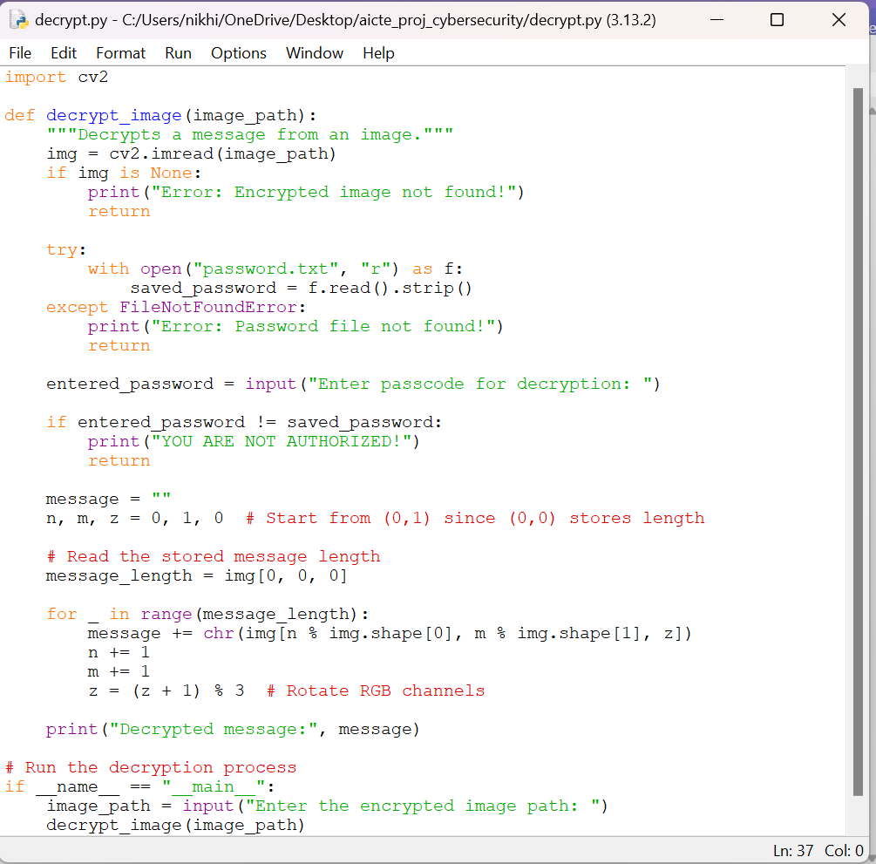
decrypt.py →

Slide 9
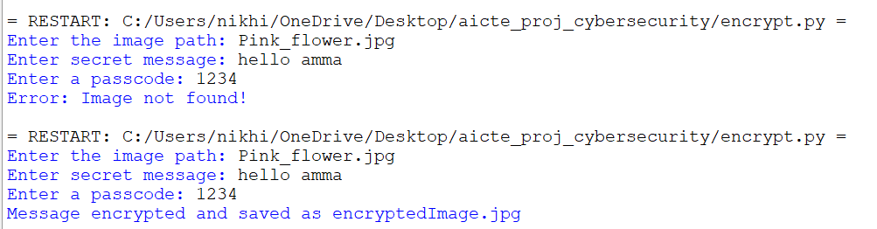
Results

Slide 10
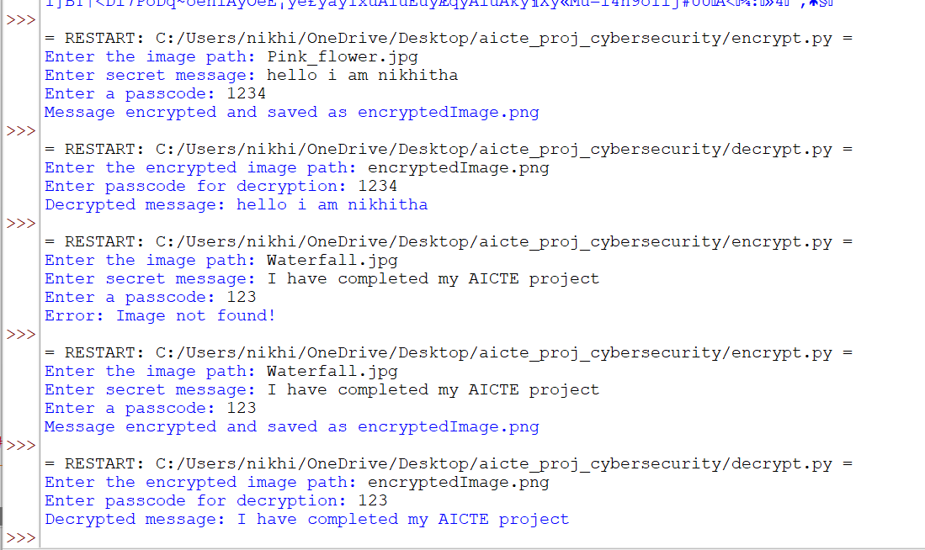

Slide 11
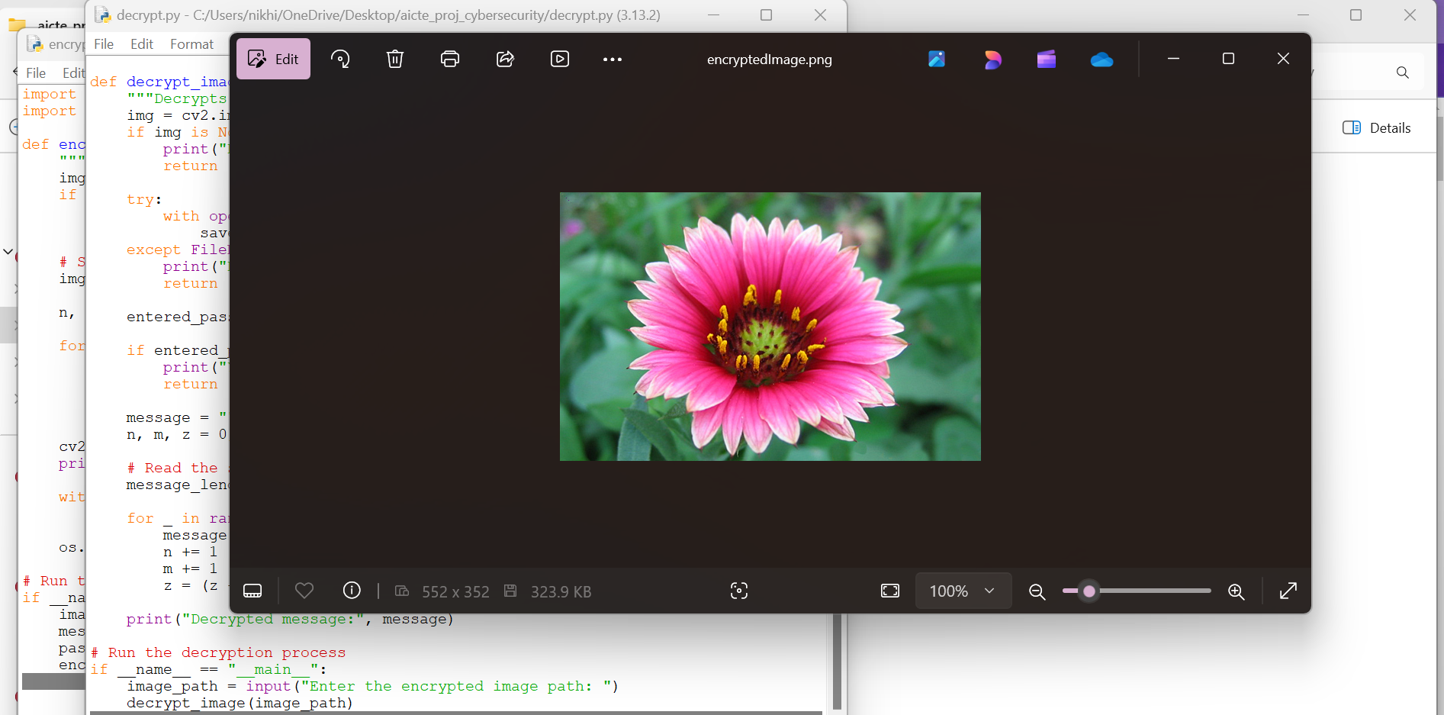

Slide 12
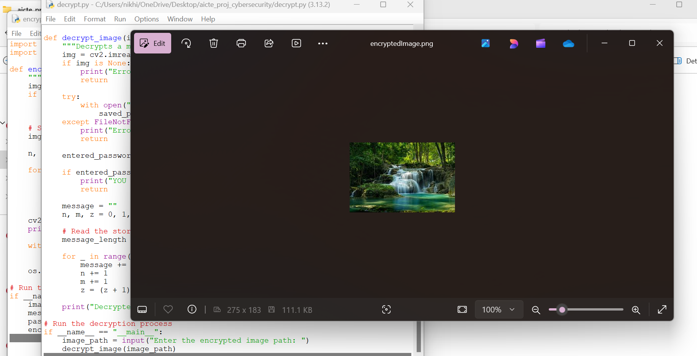

Slide 13
Conclusion
In modern cybersecurity, securing sensitive information is crucial, as traditional encryption methods can attract attention.
This project implements image steganography using Python and OpenCV to conceal secret messages within images, ensuring covert and password-protected communication. It enables undetectable data transmission, making it useful for military, intelligence, and cybersecurity applications. The approach preserves image integrity while restricting access to authorized users. Future improvements could include stronger encryption, AI-based detection resistance, and a user-friendly GUI for broader applications.

Slide 14
GitHub Link
https://github.com/NikhithaChandran1/Aicte_cybersecurity_project/tree/main
OR
https://github.com/NikhithaChandran1/Aicte_cybersecurity_project.git (Clone using the web URL)

Slide 15
Future scope(optional)
Use better encryption techniques for increased security. Implement advanced encryption techniques like AES or RSA to further secure the hidden message.
Implement GUI-based message hiding and retrieval.
Mobile & Web Integration – Adapt the project for mobile and web platforms for broader accessibility.

Slide 16
THANK YOU

