Slide 1
Cyber Risk Assessment & Threat Intelligence Platform
Intelligent automation
for enterprise security monitoring

Slide 2
The Challenge of Network Security Monitoring
Traditional security practices present significant operational challenges that hinder effective threat detection and response.
Time-Consuming Manual Processes
Undetected Threats Lurking
Traditional network analysis relies on manual tools and command-line interfaces, requiring significant time investment and technical expertise for each scan and assessment.
Without continuous threat intelligence integration, vulnerabilities and malicious IP addresses may remain undetected, exposing networks to exploitation and data breaches.
Fragmented Data Sources
Delayed Critical Notifications
Scan results scattered across multiple tools lack centralized visualization, making it difficult to interpret security posture and identify critical issues quickly.
Absence of real-time alerting mechanisms means security teams miss immediate notification for critical vulnerabilities, delaying incident response and remediation.

Slide 3




Project Objectives
Our goal is to develop an intelligent system that transforms cybersecurity monitoring from reactive to proactive through automation and threat intelligence integration.
Automate Network Scanning
Integrate Threat Intelligence
Deploy Nmap to systematically detect open ports, running services, and network topology across target systems.
Connect to VirusTotal API for comprehensive analysis of IP addresses, domains, and files against global threat databases.
Provide Risk-Based Insights
Enable Interactive Visualisation
Calculate dynamic risk scores and assign severity levels based on service exposure and threat intelligence findings.
Present security data through intuitive charts, KPIs, heatmaps, and colour-coded dashboards for rapid decision-making.

Slide 4
Proposed Solution
A comprehensive platform combining automated scanning, threat intelligence, and real-time visualisation to empower security teams with actionable insights.
01
02
03
Automated Network Scanning
Threat Intelligence Integration
Risk Scoring System
Systematically identifies open ports, services, and network configurations across target systems.
Detects malicious IP behaviour, malware signatures, and threat actor patterns using external APIs.
Calculates composite risk scores based on service criticality, exposure level, and threat indicators.
04
05
Interactive Dashboard
Real-Time Alerts & Reports
Displays security insights through dynamic charts, KPIs, heatmaps, and colour-coded severity indicators.
Sends email notifications for critical findings and generates comprehensive PDF reports for audit and compliance.

Slide 5
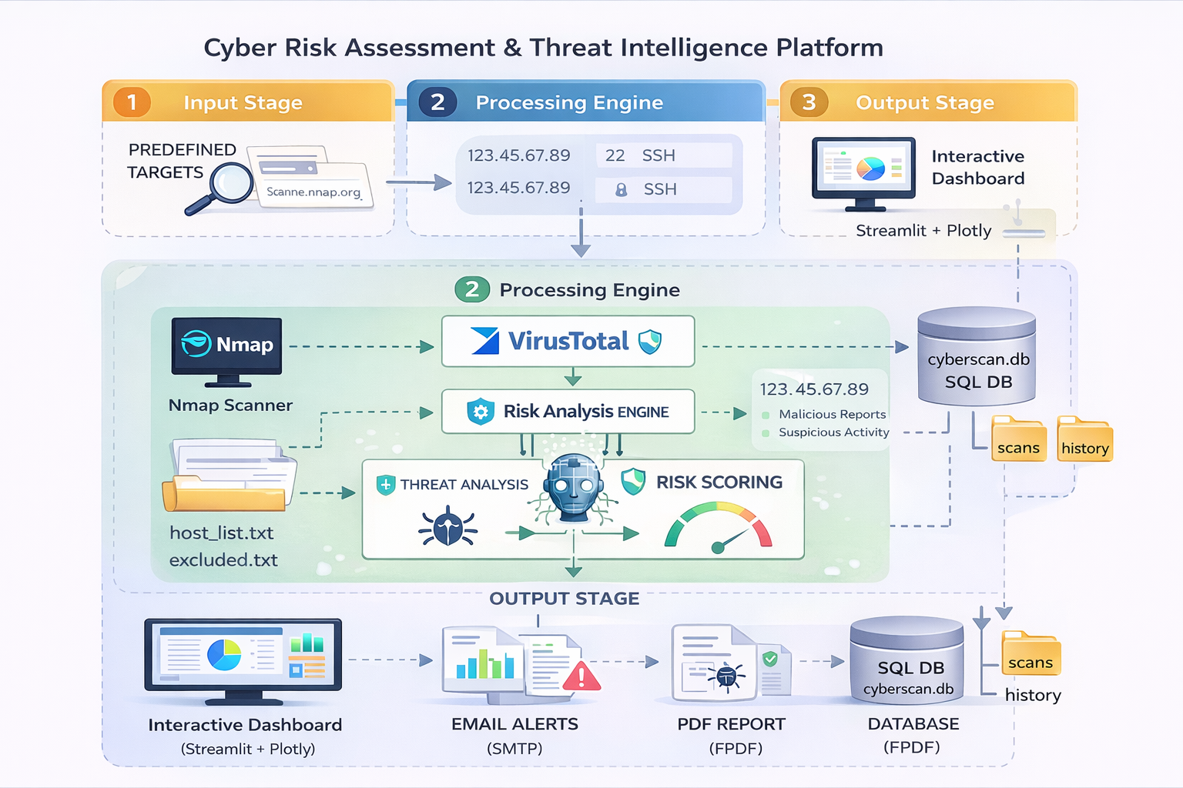




System Architecture
Input Layer
Target systems specified by IP address or domain name for security assessment.
Processing Layer
Nmap scanner identifies network services. VirusTotal API provides threat intelligence. Risk Analysis Engine computes security scores.
Output Layer
Streamlit dashboard displays insights. Email system sends alerts. PDF generator creates reports. Database stores historical data.
The system follows a streamlined workflow:
Scan → Analyse → Visualise → Alert

Slide 6
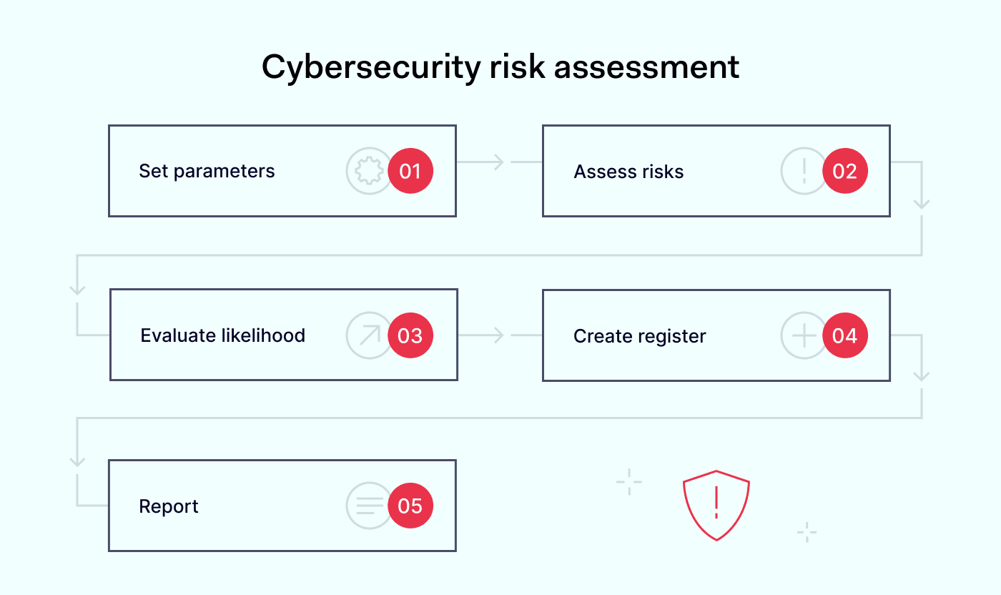
Implementation Details
Scanning & Analysis Module
Dashboard Module
Renders interactive KPIs showing security metrics. Generates dynamic charts including pie charts for threat distribution, bar charts for service exposure, and heatmaps for risk visualization using Plotly.
Executes Nmap scans, extracts IP addresses, open ports, and running services. Fetches threat intelligence data via VirusTotal API and computes comprehensive risk scores based on multiple factors.
Alert & Reporting Module
Sends email notifications with critical vulnerability details. Generates downloadable PDF reports containing scan results, risk analysis, and remediation recommendations for compliance and audit purposes.

Slide 7
Challenges & Learnings
Challenges Encountered
Key Learnings
API integration complexities with VirusTotal rate limits and authentication
Debugging inconsistent scanning results across different network configurations
Email configuration errors requiring SMTP troubleshooting
Real-time data processing latency issues
Mastered API integration techniques for third-party security services
Developed expertise in cybersecurity risk analysis methodologies
Built proficiency in data visualization using Plotly libraries
Applied modular system design principles for maintainability

Slide 8





Future Scope
Next-generation enhancements that will expand the platform's capabilities and enterprise integration potential.
Geo-Location Threat Mapping
AI-Based Anomaly Detection
Continuous Monitoring
Visualise threat origins on interactive maps, identifying geographic patterns in attack sources and malicious infrastructure.
Deploy machine learning models to identify unusual network behaviour, zero-day exploits, and sophisticated persistent threats.
Implement 24/7 surveillance with automated recurring scans and real-time threat intelligence updates for proactive defence.
Enterprise Integration
Advanced Analytics Dashboard
Connect with SIEM systems, SOAR platforms, and enterprise security infrastructure for unified incident response workflows.
Develop predictive analytics, trend analysis, and compliance reporting features for executive security reporting.

Slide 9
Conclusion
Automated Threat Detection
Actionable Intelligence
Transforms manual scanning into automated, continuous security monitoring with comprehensive network analysis.
Provides real-time visualisations, risk scores, and threat intelligence insights that drive informed security decisions.
Enhanced Response
Operational Efficiency
Enables rapid incident response through immediate email alerts and comprehensive reporting for audit compliance.
Reduces manual effort, accelerates vulnerability assessment, and improves security team productivity significantly.
The Cyber Risk Assessment Platform transforms traditional security analysis into a smart, automated system that empowers security teams to stay ahead of emerging threats.

Slide 10
Thank You

