Slide 1

DSCI-6670 AI–Term Project
Ashwini Joshi and Nikhitha Nagirimadugu
-Fall 2020

Slide 2
Project Details
Project Topic :
Implementation of Multiple Tic-Tac-Toe Agents in a Tournament Setting
We are developing Tic-Tac-Toe game using Artificial Intelligence techniques. It has fully observable and deterministic environment .
The Game Environment is 3x3 Grid and it is played between any two AI Agents at a time.
Objective of the agent is to win the game by achieving either a horizontal or vertical or diagonal line of all X OR all O in a grid where each agent gets to play one after the other.
Another objective is to make sure your opponent is not able to make such pattern of X OR O as it is a zero-sum game.
The game ends as soon as any agent completes such a pattern or agents fill up the grid without reaching any pattern(tie between agents).

Slide 3
STATEMENT OF Project Objectives
All AI agents involved in the game are designed by different adversarial search algorithms or Reinforcement learning algorithm of AI.
We are designing 4 AI agents which acts as players of the game.
The user can select which 2 agents to play in a Tic-Tac-Toe tournament against each other.
Game will be based on the logic implemented for agents and the result of the game will be either of the following:
Agent 1 wins against agent 2
Agent 2 wins against agent 1
Tie between 2 agents

Slide 4
Approach
Agents in the Tic-Tac-Toe game are designed using following algorithms:
Adversarial search Algorithms
1. Minimax algorithm using traditional approach
2. Minimax algorithm using alpha-beta pruning approach
3. Expectimax algorithm
Reinforcement Learning Algorithm
1. Q-learning
Technology details :
1. Programming Language - Python3 (Version 3.8)
2. IDE - PyCharm

Slide 5
Deliverables
User documentation manual which gives details about the Tic-Tac-Toe game implementation and execution(README.md)
Algorithms developed for AI agent using python programming language(.py files)
GitHub repository link for project code and related files.
YouTube video demonstrating project implementation and slides.

Slide 6
Evaluation Methodology
Project is evaluated based on the correct implementation of 4 algorithms for AI agents.
None of the agent should freeze or fail while making the next move.
Agent’s next move should always try to sabotage the opponent's chances of winning the game.
Agents should be trained in such a way that output of the game is proper as if two human brains are playing the game.

Slide 7
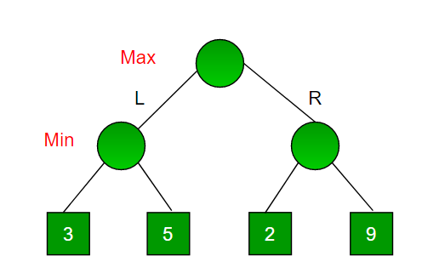
Minimax -Graph

Slide 8
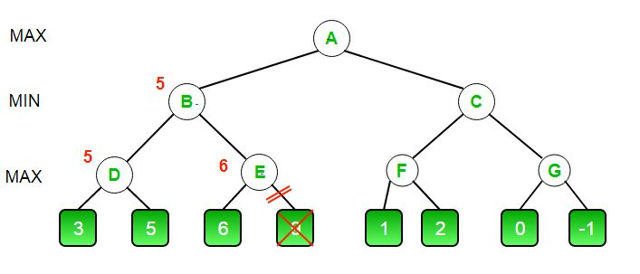
Alpha-Beta Minimax Graph

Slide 9
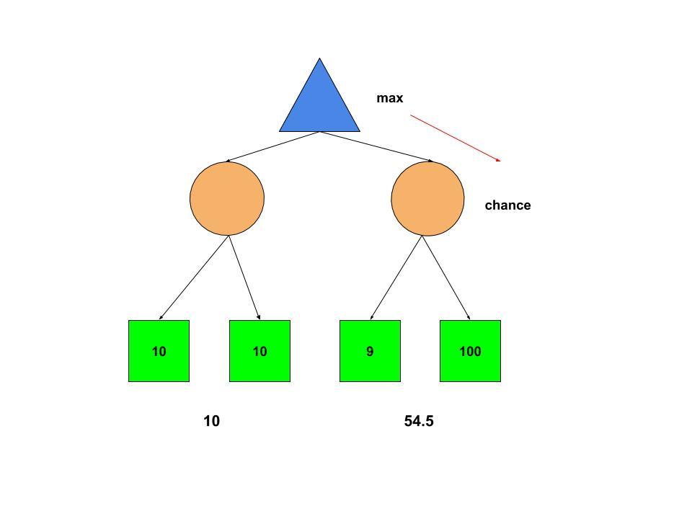
Expectimax graph

Slide 10
Code Demonstration

Slide 11
THANK YOU..!

