Slide 1
E-bay website
Under Guidance of Mrs. Vaishali Sonanis Mam.
Presented By: nikhitha

Slide 2
Introduction: :
eBay is a global online shopping platform.
Ebay started in 1995, it has grown into one of the biggest e-commerce platforms in the world.
It's a place where millions of people can buy, sell, and manage their online business.
This means that a single glitch, bug, or error can affect a lot of users and cause big problems.
In this presentation, I'll take you through my journey of testing the eBay website.

Slide 3
Responsibilities
Doing the project independently
Writing the test plan
Writing the test cases
Execute all the test cases.
Create defect report.
Presentation and final reporting

Slide 4
Overview
.
What is ebay?
eBay website testing is the process of checking the functionality, performance, and user experience of the eBay platform.
Ensures smooth buying and selling experience for users.
Validates key features like search, filters, cart, checkout, and payments.
Checks performance, speed, and reliability across devices and browsers.
Focuses on security to protect user data and transactions.
Improves user experience (UI/UX) with easy navigation and responsiveness.

Slide 5
Modules:
Module 1 : login page
Verify successful login with correct credentials and appropriate error messages for incorrect credentials like username , password.
Module 2 : searchbar
The Search Bar Module is a core component that allows users to find multiple products by entering keywords.
Module 3 : add to cart
Select a product from a listing and place it into their cart. This action should reflect the correct item quantity and price.
Module 3 :delete from cart
Remove a product from their cart if they change their mind or they find better option than
this product.
Notes:
Module 1: Signn in page
Checked all the functionalities on Sign in page which included personal info as email
address, password
Module 2: Women page
Checked all the functionalities on Women page which included item details, Quantity, Filters,compare button,Add to cart button,product info,grid,list button
Module 3: Tshirt page
Checked all the functionalities on T-Shirt page which included item details, Quantity, Filters,compare button,Add to cart button,product info,grid,list button
Module 4: All Buttons and Drop Down Arrow :
team checked if all the buttons and drop down arrows of different fields are functioning properly or not

Slide 6
Module 5 : change login name
It allows a user to modify their public-facing username, which is their unique identifier on the platform.
Module 6 : change address
The "Change Address" module provides a user with the ability to manage all addresses associated with their account.
Module 7 : shop by catagory
The "Shop by Category" module provides a clear, organized menu of links that lead users from broad categories (e.g., "Electronics") to more specific subcategories (e.g., "Cell Phones & Accessories")
Module 8 : product right click
"right-click" refers to the simulation of a user performing a right-mouse click on a specific web element or at a particular location on a web page and displaying the description about the product.
Module 9: language change
The Change Language Module (or system) on eBay gives users the ability to switch the website's interface language.

Slide 7
Defects
In the ebay website if im searching for bangles it is showing watches ,this is not working as it is expected which is nothing but a defect, so I have created a Defect report on those defect.
In the ebay website if im searching for hair Accessories which is in blue, but it is showing black hair clip also ,this is not working as it is expected which is nothing but a defect, so I have created a Defect report on those defect.

Slide 8
Defect identifier :- B_001
Defect summary :- searching for bangles but displaying the watches
Test Id :- TC_01
Test case name :- TC_ebay displaying wrong results
Module name :- searching of a product
Reproducible :- 1.click on the ebay website url 2.login 3.search the product
Severity :- medium
Priority :- medium
Raised by :- nikhitha
Assigned to :- developer Team lead
Date of assignment :- 18-08-2025
Status :- open
Snap shots :-
Fixed by :- developer
Date of fixing :-

Slide 9
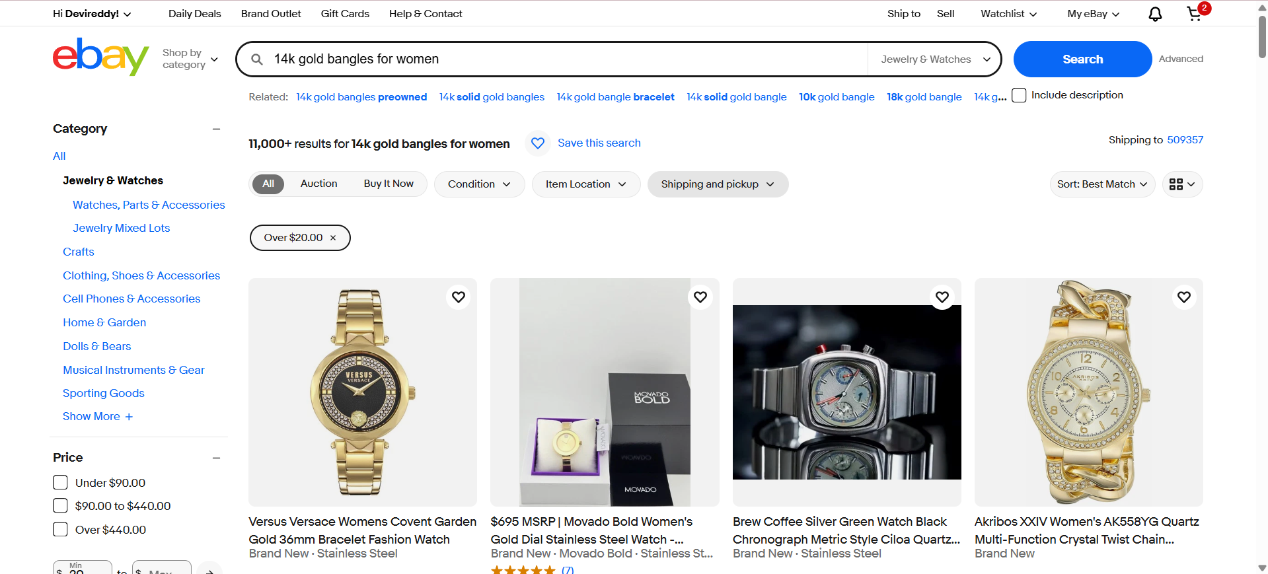

Slide 10
Defect identifier :- B_002
Defect summary :- searching for blue hair accessories but displaying the black accessories
Test Id :- TC_02
Test case name :- TC_ebay displaying wrong results
Module name :- searching of a product
Reproducible :- 1.click on the ebay website url 2.login 3.search the product
Severity :- low
Priority :- low
Raised by :- Nikhitha
Assigned to :- developer Team lead
Date of assignment :- 18-08-2025
Status :- open
Snap shots :-
Fixed by :- developer
Date of fixing :-

Slide 11
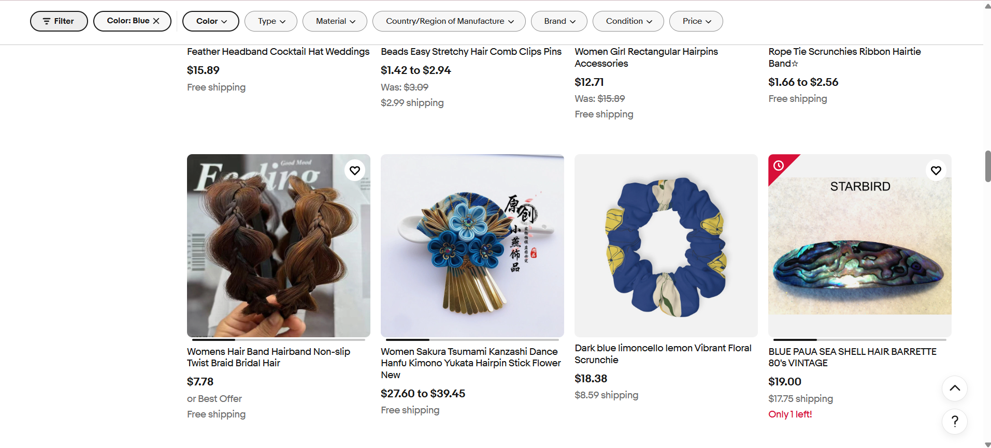

Slide 12
Challenges:
While testing ebay website we faced some challenges about:
1.I have no knowledge on testing side, firstly faced issue of understanding , but after mams explanation ang giving projects to us ,then now im able to do projects.
2. There is comes difference in writing a test case and while running it.
3 . finding out the defects in the ebay website.
4. I personally faced challenge in add to card and delete from cart testcase in automation.
5. sometimes I have tested the both invalid credentials first and after that valid in automation testing ,then its not working ,and later mam said that enter valid credentails first and invalid last ,it is working.

Slide 13
Experience:
I have learned how to write test plan ,test cases , test reports.
I have learned how to find out bugs or defects.
I have gained hands on experience on manual and automation testing
Have improved my communication skills because discussing how to write projects with mam and friends.

Slide 14
Thank You!!!
Vaishali Mam For Guiding Us through out the Project.

