Slide 1
Browser stack demo website
under guidance of mrs.vishali sonasis mam
Presented By: Devi reddy nikhitha

Slide 2
Introduction: :
BStack Demo is an online e-commerce demo website for practicing automation testing.
Provides various products like electronics, apparel, and accessories for search and purchase simulations.
Enables adding, deleting, and managing items in a shopping cart.
Supports a checkout process including shipping and order placement.
Designed for learning and testing automation frameworks such as Selenium, Cucumber, and Java.

Slide 3
Responsibilities
Doing the project independently
Writing the test plan
Writing the test cases
Execute all the test cases.
Create defect report.
Doing Automation testing by using cucumber bdd
Presentation and final reporting

Slide 4
Overview
.
What is broserstack demo?
BrowserStack Demo website is a sample e-commerce platform for testing and automation practice.
Users can browse products across various categories like cell phones.
It has a search functionality to quickly find products, useful for automation testing.
Supports cart management, including adding, updating, and removing products.
Includes a checkout process with sign-in, shipping details, and order placement.
Designed as a safe environment for practicing Selenium, Java, TestNG, and Cucumber automation.
Helps testers gain hands-on experience with real-world web application workflows.
Serves as an interactive learning platform for developing, testing, and validating automation scripts.

Slide 5
Modules:
Module 1 : login page
Verify successful login with default usernames and one default password ,if we login with fifth default username and default password.
EX:VALID USERNAME:DEMOUSER PASSWORD:TESTINGISFUN99
INVALID USERNAME:LOCK_USER PASSWORD:TESTINGISFUN99
Module 2 : searchbar
The Search Bar Module is a core component that allows users to find multiple products by entering keywords.
EX:IPHONE12
Module 3 : add to cart
Select a product from a listing and place it into their cart. This action should reflect the correct item quantity and price.
EX:ADD IPHONE 12 TO CART
Module 3 :delete from cart
Remove a product from their cart if they change their mind or they find better option than
this product.
EX:REMOVE IPHONE12 FROM CART
Notes:
Module 1: Signn in page
Checked all the functionalities on Sign in page which included personal info as email
address, password
Module 2: Women page
Checked all the functionalities on Women page which included item details, Quantity, Filters,compare button,Add to cart button,product info,grid,list button
Module 3: Tshirt page
Checked all the functionalities on T-Shirt page which included item details, Quantity, Filters,compare button,Add to cart button,product info,grid,list button
Module 4: All Buttons and Drop Down Arrow :
team checked if all the buttons and drop down arrows of different fields are functioning properly or not

Slide 6
Module 5 : checkout(shipping details)
Checkout is the final step to purchase products, where users enter shipping details,
review the cart, and place the order.
EX: DETAILS FIRSTNAME=JDHK
LASTNAME=HDID
ADDRESS=897 HSYSD
STATE=HSYUD
POSTAL CODE=809765
Module 6 : orders
orders are records of products purchased by a user on the website.they track details like product name,quantity ,price and order status for management and reference.
EX:IT SHOWS ORDERS WHICH I HAVE ORDERED PREVIOUSLY
Module 7 : favourites
favourites are products that a user marks or saves for quick accesss later.they allow users to easily view and purchase preferred items without searching again
EX:IPHONE12 ADDING TO FAVOURITE

Slide 7
MODULES
Module 8 : offers
offers are special discounts or deals provided on products to attract customers.they help users save money and encourage more purchases on the platform.
EX:$799 25%DISCOUNT ON THAT PRODUCT
Module 9: logout
logout is the process of securely existing a user account from the website .it ensures that no unauthorized person can access your account after you finish your session

Slide 8
Defects
In the BSTACK DEMO WEBSITE IF IM LOGIN WITH FIFTH DEFAULT USERNAME THEN IT IS SHOWING LIKE “ACCOUNT HAS BEEN LOCKED”,this is not working as it is expected which is nothing but a defect, so I have created a Defect report on those defect.
In the BSTACK DEMO WEBSITE IF IM SEARCHING FOR ANY PRODUCT IT IS NOT SHOWING RELEVENT PRODUCTS, but it is showing ALL PRODUCTS,this is not working as it is expected which is nothing but a defect, so I have created a Defect report on those defect.
In the BSTACK DEMO WEBSITE IF I’M GOING TO OFFERS PAGE IT IS SHOWING LIKE “THERE IS NO PROMOTIONAL OFFERS IN YOUR CITY”,this is not working as it is expected which is nothing but a defect, so I have created a Defect report on those defect.

Slide 9
DEFECT REPORT1
ØDefect identifier | Def_login with default fifth username and first default password_001
ØDefect summary | Expected result= It should navigate to homepage and displays product images and product information ,but Actual result=It is not navigating to the homepage,it is showing like"Your account has been locked" .
ØTest Id | TC-006
ØTest case name | TC_ default_login5
ØModule name | Login to the website
Øreproducible | 1.click on URL 2.navigates to home page 3.click on sign in button 4.signin page will be opened 5. select second default username and default password
Øseverity | Medium
Øpriority | Medium
ØRaised by | Nikhitha
ØAssigned to | (TL Name)
ØDate of assignment | 03-09-2025
Østatus | open
ØSnap shots
ØFixed by | (Developer name)
ØDate of fixing= | 03-09-2025
ØApprovals=manager name | (manager name)

Slide 10
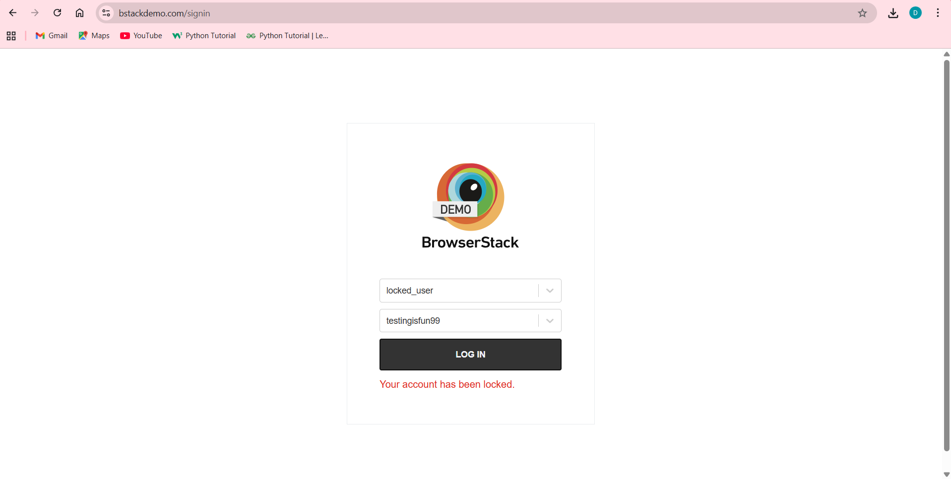

Slide 11
ØDefect identifier | Def_searchbar_002
ØDefect summary | Expected result= checking for searchbar,it should give correct results based on our search ,but Actual result=the correct product is not displaying,only 25 default products is displaying,irrespective of searech
ØTest Id | TC_011,TC_012,TC_013,TC_014,TC_015
ØTest case name | TC_BrowserStack Demo_searchbar_valid
ØModule name | Searchbar
Øreproducible | 1.click on URL 2.navigates to home page 3.click on sign in button 4.signin page will be opened 5.search the product
Øseverity | Medium
Øpriority | Medium
ØRaised by | Nikhitha
ØAssigned to | (TL Name)
ØDate of assignment | 03-09-2025
Østatus | open
ØSnap shots
ØFixed by | (Developer name)
ØDate of fixing= | 03-09-2025
ØApprovals=manager name | (manager name)

Slide 12
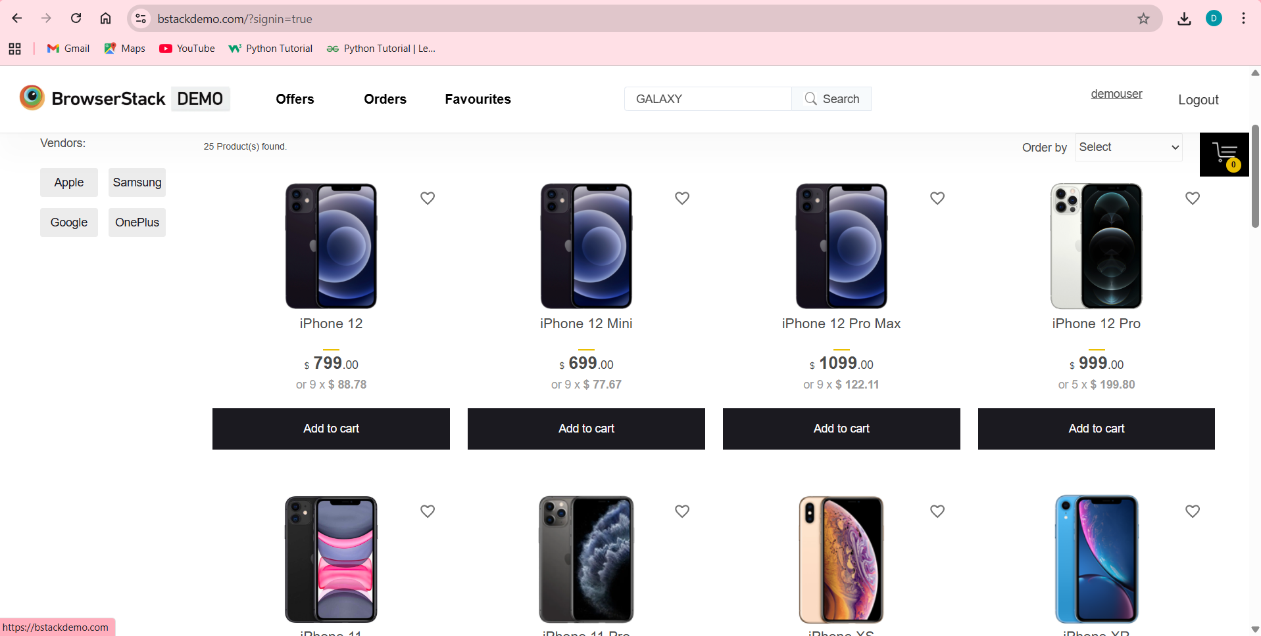

Slide 13
ØDefect identifier | Def_offers_003
ØDefect summary | Expected result= It should filter the offers and display on the offers page ,but Actual result=It is not showing the offer details for any product ,it is showing "Sorry we do not have any promotional offers in your city."
ØTest Id | TC_038,TC_039,TC_040
ØTest case name | TC_BrowserStack Demo _offers_valid
ØModule name | offers
Øreproducible | 1.click on URL 2.navigates to home page 3.click on sign in button 4.signin page will be opened 5.search the product
Øseverity | Medium
Øpriority | Medium
ØRaised by | Nikhitha
ØAssigned to | (TL NAME)
ØDate of assignment | 03-09-2025
Østatus | open
ØSnap shots
ØFixed by | (Developer name)
ØDate of fixing= | 03-09-2025
ØApprovals=manager name | (manager name)

Slide 14
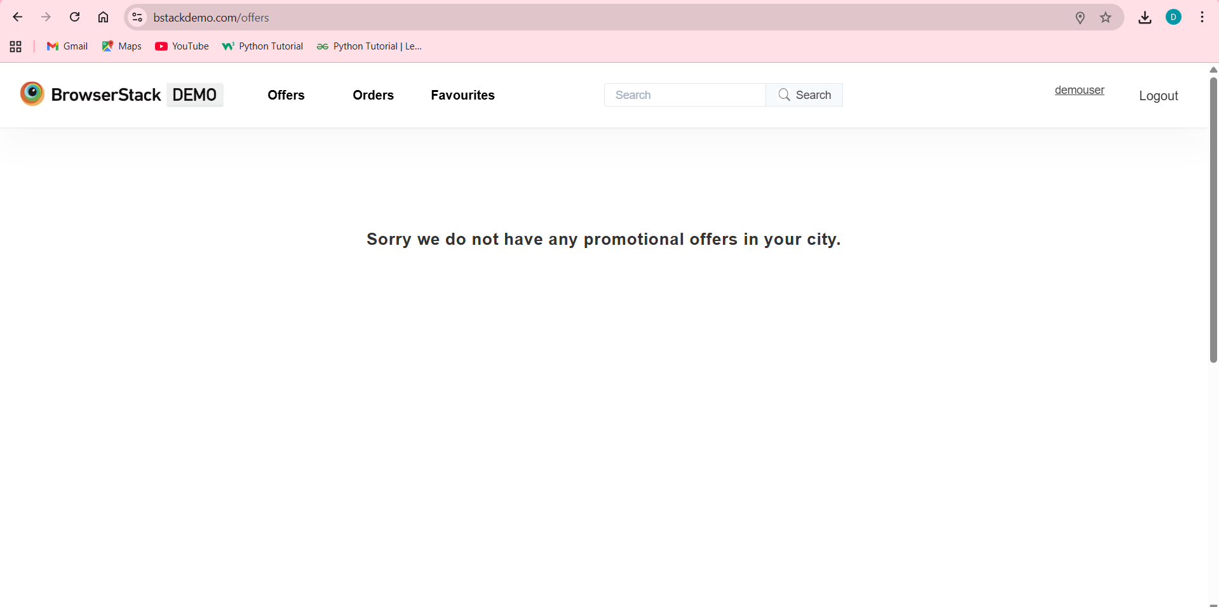

Slide 15
Challenges:
While testing BSTACK DEMO website we faced some challenges about:
1.I have no knowledge on testing side, firstly faced issue of understanding , but after mams explanation ang giving projects to us ,then now im able to do projects.
2. There is comes difference in writing a test case and while running it.
3 . finding out the defects in the Bstack demo website.
4. I personally faced challenge in add to card and delete from cart testcase in automation.

Slide 16
Experience:
I have learned how to write test plan ,test cases , test reports.
I have learned how to find out bugs or defects.
I have gained hands on experience on manual and automation testing
Have improved my communication skills because discussing how to write projects with mam and friends.

Slide 17
Thank You!!!
Vaishali Mam For Guiding Us through out the Project.

