Slide 1
DATABASE PROJECT · MYSQL · SQL
Library Management System
A relational database that manages books, authors, publishers, students, staff, memberships, issues, returns, reservations, fines, payments and purchasing, with SQL reporting on top.
15 tables · 5 views · 5 procedures · 3 triggers · 30 queries
Team:
Koduri Nikhitha

Slide 2
INTRODUCTION
Project overview
What it is
A MySQL database that organizes everything a library does: catalogue, members, staff, circulation, reservations, fines, payments and book purchasing.
The problem it solves
Registers and loose spreadsheets lead to duplicate records, lost issue history, missed due dates and unclear fine balances. Nobody can quickly see what is available or overdue.
How the project answers it
A normalized schema of 15 related tables, validation rules inside the database, sample data, five reporting views, five stored procedures, three triggers and 30 analytical queries.
15
Tables
10
Modules
30
SQL queries
2

Slide 3
GOALS
Project objectives
1
Maintain books
2
Manage people
3
Track availability
Keep title, ISBN, author, publisher, category, language and price in one place.
Store student and staff details such as department, designation and joining date.
Know which physical copy is Available, Issued, Reserved, Lost or Damaged.
4
Record circulation
5
Run memberships
6
Handle reservations
Log every issue and return with dates, condition and the staff member involved.
Control who may borrow using start date, expiry date and Active or Suspended status.
Let students reserve a book and follow it from Pending to Fulfilled or Expired.
7
Collect fines
8
Buy new stock
9
Report with SQL
Record fines per issue and the payments that settle them by cash, UPI, card or online.
Track suppliers and purchase orders with quantity, unit price and delivery date.
Answer real questions through joins, subqueries, views and window functions.
3

Slide 4
TOOLS
Technologies and project structure
MySQL
Relational database engine that stores the data and enforces keys, checks, views, procedures and triggers.
Project files
database.sql creates the library_management database
tables.sql 15 CREATE TABLE statements
insert_data.sql sample records for every table
queries.sql 30 queries in 5 sections
views.sql 5 reporting views
stored_procedures.sql 5 reusable procedures
triggers.sql 3 automatic updates
window_functions.sql 6 analytic queries
Documentation/ requirements, design notes, ER diagram
MySQL Workbench
Visual tool used to design the schema and draw the EER model, saved as Library_Management_System.mwb.
SQL
Standard query language used for table creation (DDL), data entry (DML) and all reporting queries.
4

Slide 5
SKILLS
SQL concepts demonstrated
DDL and DML: CREATE TABLE statements and INSERT sample data
Subqueries: Books above average price, never-issued books
Keys: Primary keys with AUTO_INCREMENT and foreign keys on every link
Views: Saved joins for frequently needed reports
Constraints: NOT NULL, UNIQUE, CHECK, DEFAULT and ENUM
Stored procedures: Parameterised, reusable operations
SELECT and WHERE: Filtering by price, name pattern and status
Triggers: Automatic updates after issue, return and payment
Aggregates: COUNT, AVG and SUM over books, fines and issues
Window functions: ROW_NUMBER, RANK, DENSE_RANK, SUM OVER, LAG and LEAD
GROUP BY and HAVING: Books per category, departments with over two students
CASE statements: Labelling an issue as Completed, Overdue or Within Due Date
Joins: INNER and LEFT JOIN across up to five tables
5

Slide 6
SCOPE
Ten main modules
Book: catalogue with authors, publishers, categories and copies
Student: student details, department and admission date
1
2
Staff: librarian records with designation and joining date
Membership: membership number, validity period and status
3
4
Book Issue: who borrowed which copy, when, and the due date
Book Return: return date, book condition and receiving staff
5
6
Reservation: student requests for a book with expiry and status
Fine and Payment: late or damage fines and how they are paid
7
8
Supplier: vendor contact details for new stock
Purchase Order: orders with quantity, price and delivery date
9
10
6

Slide 7
SCHEMA
Database design: 15 tables
Catalogue
People
Authors name and country
Publishers name, email, phone, address
Categories unique name and description
Books title, ISBN, year, language, price
Book_Copies accession number, shelf, status
Students name, email, department, admission date
Staff name, email, designation, joining date
Memberships number, validity dates, status
Circulation
Finance and supply
Book_Issues copy, member, staff, issue and due dates
Book_Returns return date, condition, remarks
Reservations student, book, dates, status
Fines amount, reason, date, status
Payments amount and method (Cash, UPI, Card, Online)
Suppliers contact person and address
Purchase_Orders quantity, unit price, delivery, status
7

Slide 8
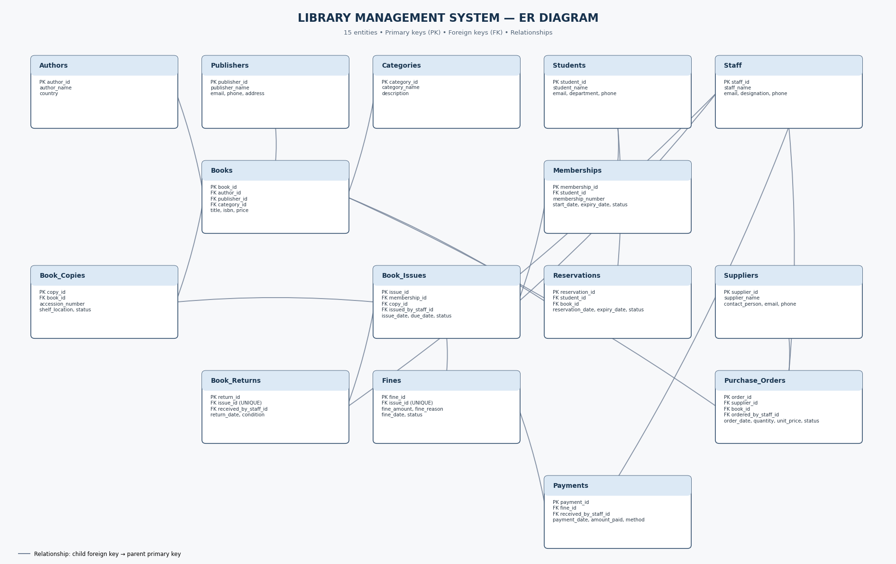
SCHEMA
Entity-relationship diagram
How to read it
Each box is a table showing its PK and FK columns.
Lines run from a child foreign key to its parent primary key.
Books connects to Authors, Publishers, Categories and Book_Copies.
Book_Issues is the hub: it joins Memberships, Book_Copies and Staff.
Fines and Book_Returns each hang off one issue; Payments hang off Fines.
Built in MySQL Workbench.
8

Slide 9
SCHEMA
Inside the core tables
Books
Book_Issues
book_id: primary key
title: VARCHAR(200)
isbn: UNIQUE
author_id: FK, required
category_id: FK, required
publisher_id: FK, optional
year, language (English)
price: DECIMAL, ≥ 0
issue_id: primary key
membership_id: FK
copy_id: FK to a copy
issued_by_staff_id: FK
issue_date, due_date
status: default Issued
CHECK due ≥ issue date
Fines
Purchase_Orders
fine_id: primary key
issue_id: FK, UNIQUE
fine_amount: DECIMAL, ≥ 0
fine_reason: VARCHAR(150)
fine_date: DATE
status: default Unpaid
order_id: primary key
supplier_id: FK
book_id: FK
ordered_by_staff_id: FK
order_date, delivery date
quantity > 0, price ≥ 0
status: default Pending
9

Slide 10
RELATIONSHIPS
How the data connects
Student
→
Membership
→
Book Issue
→
Book Copy
→
Book
A student borrows through a membership; each issue points to one physical copy of a book.
Books reference Authors, Publishers and Categories, and own many Book_Copies.
Book_Issues link to exactly one Book_Return and at most one Fine, enforced with UNIQUE issue_id.
Fines are settled by one or more Payments, each received by a staff member.
Reservations connect Students to the Books they want, independent of any copy.
Purchase_Orders tie a Supplier, a Book and the ordering Staff member together.
Staff appear on issues, returns, payments and purchase orders for accountability.
10

Slide 11
WORKFLOW
A book's journey through the system
1
Issue
2
Return
3
Fine
4
Payment
A Book_Issues row stores the member, copy, issuing staff, issue date and due date. The copy changes to Issued.
A Book_Returns row stores the return date, condition (Good, Damaged, Lost) and receiving staff. The copy becomes Available.
Late, damaged or lost books create one Fine per issue with an amount and a reason.
Each Payment records the amount, date, method and staff member, and moves the fine toward Paid.
Status: Issued
Status: Returned
Unpaid, Partially_Paid, Paid or Waived
Cash, UPI, Card or Online
11

Slide 12
CONSTRAINTS
Data integrity and validation
PK / FK
UNIQUE
Every table has an AUTO_INCREMENT primary key. Foreign keys stop orphan records, such as an issue for a copy that does not exist.
ISBN, accession number, membership number, category name and emails cannot repeat. One return and one fine per issue.
CHECK
Date rules
Price and fine are never negative, a payment is above zero and an order quantity is above zero.
Due date cannot precede issue date, membership expiry cannot precede start, delivery cannot precede order date.
ENUM
NOT NULL and DEFAULT
Status columns accept only listed values such as Available, Issued, Overdue, Paid or Received.
Mandatory fields must be filled; statuses start at Available, Active, Issued or Unpaid automatically.
12

Slide 13
DATA MODEL
Business states stored as ENUMs
Fixed value lists keep the data consistent and make filters such as WHERE status = 'Available' reliable.
Book_Copies.status
Available, Issued, Reserved, Lost, Damaged
Memberships.status
Active, Expired, Suspended
Book_Issues.status
Issued, Returned, Overdue, Lost
Book_Returns.book_condition
Good, Damaged, Lost
Reservations.status
Pending, Fulfilled, Cancelled, Expired
Fines.status
Unpaid, Partially_Paid, Paid, Waived
Payments.payment_method
Cash, UPI, Card, Online
Purchase_Orders.status
Pending, Ordered, Received, Cancelled
13

Slide 14
QUERYING
30 SQL queries in five sections
Basic SQL: Show all books and students, books over 300, names starting with A, five most expensive books.
Aggregates: Total and average book price, books per category, departments with over two students, fines by status.
Joins: Books with authors and categories, students with memberships, fines with student names, purchase orders with suppliers.
Subqueries: Books above average price, the most expensive book, books never issued, students who never borrowed.
Practical: Overdue books, available copies, returns, payments, issues per staff member, order totals and CASE labels.
14

Slide 15
QUERYING
Query spotlight
Q22: overdue books
Q30: status with CASE
SELECT b.title, s.student_name,
i.due_date
FROM Book_Issues i
JOIN Book_Copies bc
ON i.copy_id=bc.copy_id
JOIN Books b
ON bc.book_id=b.book_id
JOIN Memberships m
ON i.membership_id=m.membership_id
JOIN Students s
ON m.student_id=s.student_id
WHERE i.due_date < CURDATE()
AND i.status = 'Issued';
SELECT issue_id, due_date, status,
CASE
WHEN status='Returned'
THEN 'Completed'
WHEN due_date < CURDATE()
AND status='Issued'
THEN 'Overdue'
ELSE 'Within Due Date'
END AS issue_condition
FROM Book_Issues;
Joins four tables to show who still holds a book past its due date, so staff know whom to contact.
Turns raw status and dates into a readable label for every issue, ready for a report or dashboard.
15

Slide 16
VIEWS
Five views for common reports
1
view_book_details
Title, author, publisher, category and price in one row.
Joins: Books, Authors, Publishers, Categories
2
view_available_books
Copies that can be issued now, with accession number and shelf.
Joins: Books, Book_Copies
3
view_active_memberships
Students holding an Active membership with start and expiry.
Joins: Students, Memberships
4
view_issued_books
Who borrowed which title, with issue date, due date and status.
Joins: Issues, Memberships, Students, Copies, Books
5
view_unpaid_fines
Unpaid or partially paid fines per student and book.
Joins: Fines, Issues, Students, Books
16

Slide 17
AUTOMATION
Stored procedures and triggers
5 stored procedures
3 triggers
GetAllBooks()
lists every book
GetBooksByCategory(id)
titles and prices in one category
GetStudentDetails(id)
full record of one student
GetStudentIssuedBooks(id)
each book a student borrowed, with dates
GetUnpaidFines()
fines that are Unpaid or Partially_Paid
after_book_issue
Fires after a row is added to Book_Issues and sets the issued copy to Issued.
after_book_return
Fires after a row is added to Book_Returns and sets the copy back to Available.
after_fine_payment
Fires after a row is added to Payments and marks the fine as Paid.
17

Slide 18
ANALYTICS
Window functions for analysis
ROW_NUMBER
RANK
DENSE_RANK
Gives each book a unique position by price, highest first.
Ranks books by price; equal prices share a rank and leave a gap.
Ranks books by price inside each category, with no gaps.
OVER (ORDER BY price DESC)
OVER (ORDER BY price DESC)
OVER (PARTITION BY category_id ...)
SUM OVER
LAG
LEAD
Running total of fine payments in date order.
Shows each member's previous issue date next to the current one.
Shows each member's next issue date to study borrowing gaps.
OVER (ORDER BY payment_date ...)
OVER (PARTITION BY membership_id ...)
OVER (PARTITION BY membership_id ...)
18

Slide 19
CONCLUSION
Outcomes and future scope
What the project delivers
Future scope
A structured database for all library records
Rules enforced by the database, not by people
Quick answers on overdue books, availability and unpaid fines
Reusable views and procedures for daily work
Hands-on use of joins, subqueries, triggers and window functions
A web or desktop front end for librarians and students
Automatic fine calculation from the due date
Email or SMS reminders for due and overdue books
Dashboards on borrowing trends and popular categories
Roles and permissions for staff and student logins
19

Slide 20
Thank you
Library Management System: 15 tables, 5 views, 5 stored procedures, 3 triggers and 30 queries, built with MySQL and MySQL Workbench.

