Slide 1
HiLabsTM
APM Case Study 2025

Slide 2
Problem Statement
Problem Statement:
Payers face opaque, inconsitent pricing and lack a unified view to benchmark provider rates, understand risk-adjusted cost trends, and identify network adequacy gaps. Even with CMS TiC/MRF and Hospital Price Transparency data, the files are massive and heterogeneous, and analysis requires complex normalization and linkage with claims and provider directories—creating integration and operational friction.
Current Process Shortcomings & Effects
Platform’s Transformative Impact
Siloed datasets (MRFs, claims, directories not linked)
Weak negotiation leverage; savings left on the table.
Schema & scale issues in MRFs (volume/standardization problems)
Manual/Excel workflows miss outliers and delay decisions.
No geographic adequacy analytics (county/specialty view missing)
Hidden access risk and compliance exposure
Static reporting (point-in-time extracts, not interactive)
Slow cycles; decisions based on partial snapshots.
Strategic Impact : Shift from reactive to proactive strategy executives can identify cost, adequacy, and risk trends before they become financial or regulatory issues.
Assumptions

Slide 3
User Personas & Needs
Network Executives
Network Manager
Contracting Team
“Are we paying more than others in the market, & how can we reduce the cost?”
“Which areas or specialties don’t have enough doctors or are costing us too much?”
“What are the fair market rates I should use to negotiate better contracts?”
A clear, data-backed view of market rates, risks, and gaps easy to share and act on.
A local insights tool showing benchmarks, gaps, and savings opportunities.
A smart benchmarking engine that simplifies data and strengthens negotiations.

Slide 4
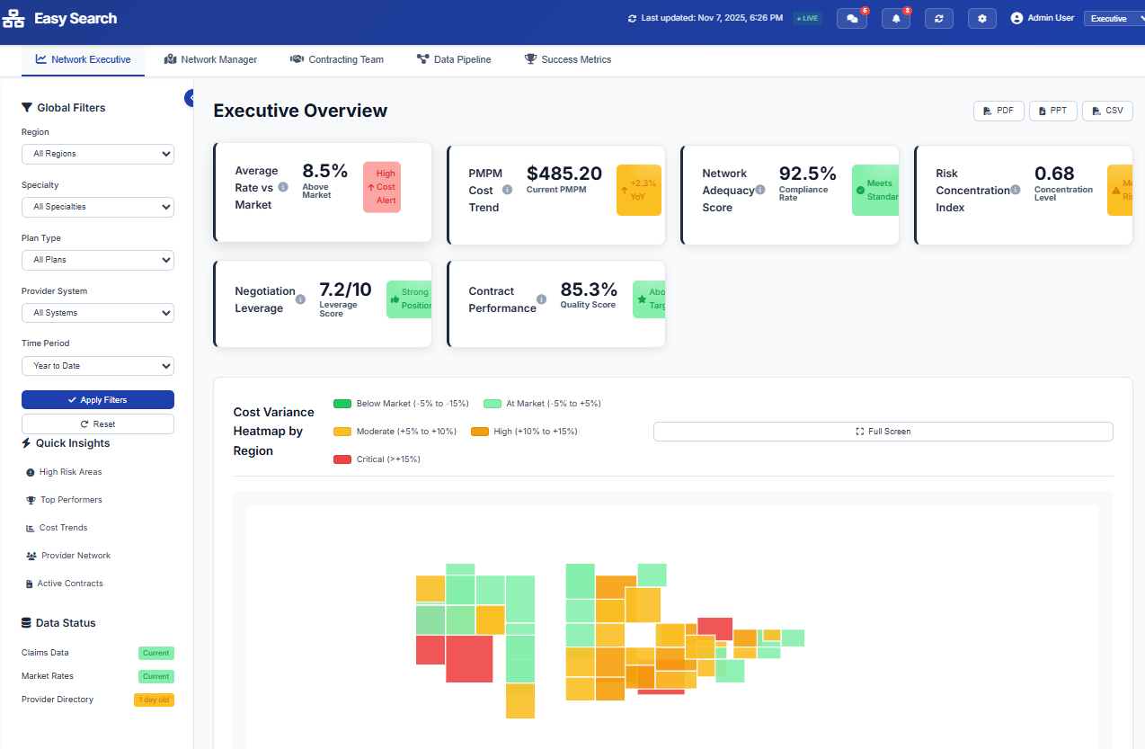
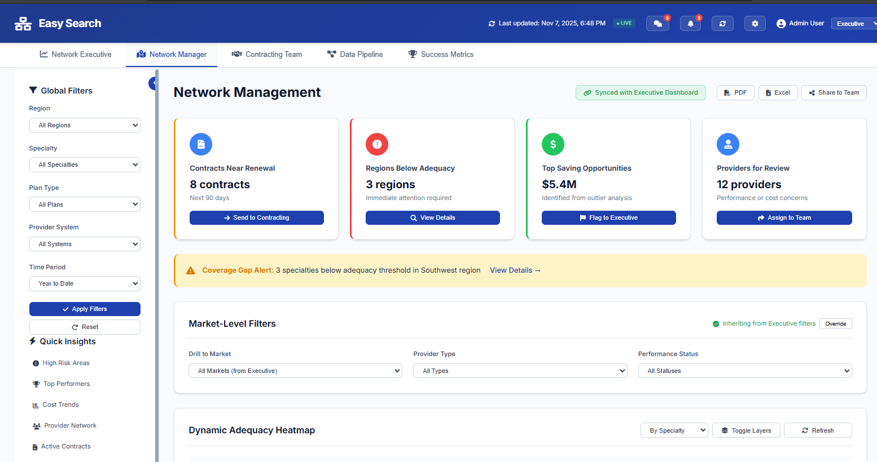
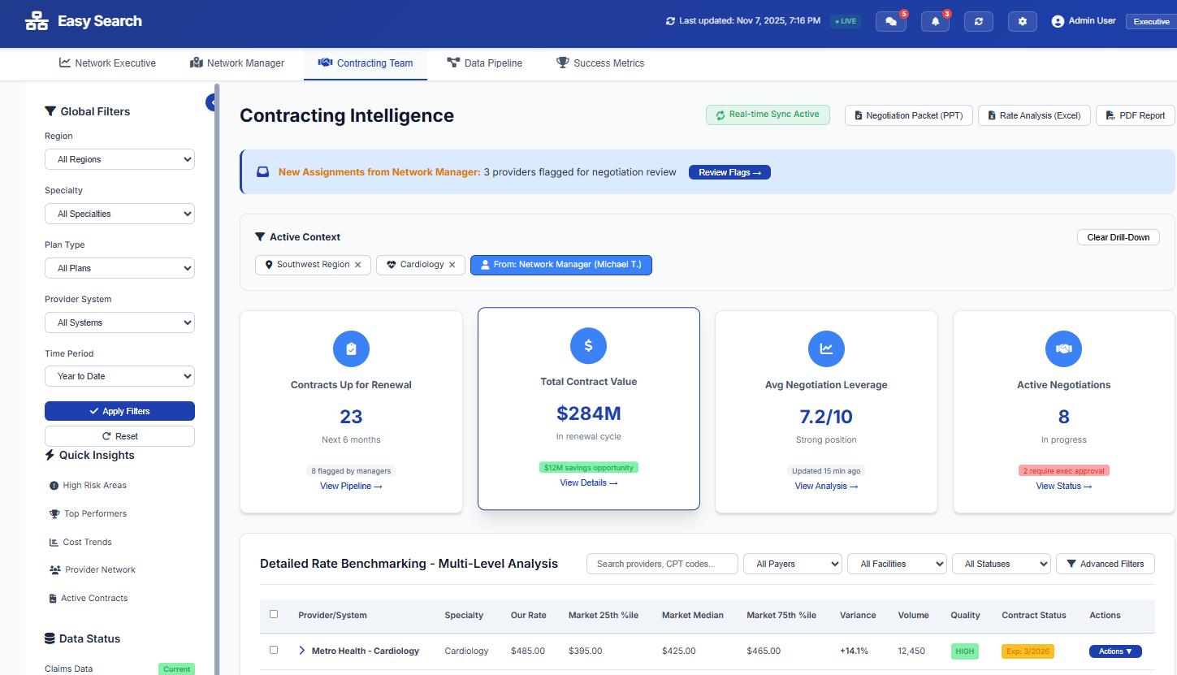
Solution Overview
Platform - Easy search
Easy Search Transparency in Coverage (TiC), Machine-Readable Files (MRF), claims, and provider directories into a single analytics ecosystem. It delivers real-time rate benchmarking, risk scoring, and network adequacy insights to reduce costs, enhance efficiency, strengthen coverage, and ensure full CMS compliance-empowering payers to make faster, data-driven, and transparent decisions.
Executive KPI Summary Cards : Average Rate vs Market, PMPM Cost, etc.
Global Filters Panel :
analytics by Region, Specialty, Plan Type
Cost Variance Heatmap : identify regional overspend and target negotiation zones.
Rate Comparison by Specialty (Main Histogram): provide good intuition
Key Operational Cards : Contracts Near Renewal, Regions Below adequacy
Coverage Gap Alert : real-time adequacy gap notifications
Dynamic Adequacy Heatmap : help managers pinpoint weak zones quickly.
Executive Sync & Reporting Tools : alignment between strategic (executive) and operational (manager) views.
Network Executive Dashboard
Network Manager Dashboard
Contracting Intelligence Overview:
Displays Contracts up for renewal,
average negotiation leverage.
Real-Time Sync & aligned flow:
New Assignments from Network
manager
Rate Benchmarking Table : multi-level contract benchmarking by provider, specialty, and CPT code.
Export & Reporting Tools : Negotiation Packet (PPT), Rate Analysis (Excel), and PDF Report
Contracting Team Dashboard

Slide 5
Problem Statement
Framework
Data source - TiC, MRF & other directories
Ingestion - Auto-fetch & validate files
Parsing - Flatten JSON/CSV
Stage | Purpose | Core Tech/Tool Examples
1. Ingestion | Fetch all source files & APIs automatically | Airflow, AWS Lambda, Google Cloud Functions
2. Parsing | Flatten massive JSON/CSV data efficiently | Spark, Dask, Snowflake External Tables
3. Cleaning | Remove bad data, duplicates, wrong formats | Pandera, Great Expectations
4. Identity Graph | Create unique provider mapping | Neo4j, NetworkX, SQL Graph Tables
5. Normalization | Make data consistent across payers | Python ETL, dbt, Pandas pipelines
6. Integration | Join datasets for benchmarking | Snowflake SQL, BigQuery, Delta Lake
7. Modeling | Compute risk, cost, adequacy analytics | Python (scikit-learn, GeoPandas)
8. Curated Store | Central, query-ready data warehouse | Snowflake / BigQuery / Databricks
9. API Layer | Serve processed data securely | FastAPI, GraphQL, Flask
10. Dashboards | Visualize & interact | React.js, Tailwind, Plotly, Power BI
Normalization - Standardize codes, POS
Identity Graph - Link NPI-TIN-Location for unique IDs
Cleaning - Remove errors, outliers
Analytics & Modeling - Risk, cost, adequacy
Curated Data Store - Clean, query-ready DB
API Layer - role-based security → Dashboard

Slide 6
Problem Statement

Slide 7
Problem Statement

Slide 8
Problem Statement

Slide 9
Problem Statement

